Slide 1
Film Studies A Level – coursework intro 2021 - 2022

Slide 2
Quick task
What is the purpose of coursework?
What do you like / dislike about doing coursework?
What do you think you will be doing for A Level Film Studies coursework?
2 minutes, discuss with the people around you, ready to feedback to the class.

Slide 3
Overview
Coursework (also known as Non-exam assessment- NEA) entails making something and then evaluating the completed piece.
We have always received positive feedback from the exam board regarding our coursework submissions. I do hope that record is maintained, it is really important to take the coursework unit seriously as it accounts for 30% of your final grade.

Slide 4
Coursework Options – A Level
Either
a short MOVING IMAGE film highlighting narrative construction
(4 – 5 minutes).
Or
a SCREENPLAY for a short film highlighting narrative construction of between 1600 – 1800 words.
Plus, a digitally photographed storyboard of a key section from the screenplay (approximately 2 minutes' screen time, corresponding to approximately 18 - 22 storyboard photos).
40marks

Slide 5
Options (Cont.)
Once you have completed your practical piece you will then have to write an EVALUATION (know as an Evaluative Analysis).
An evaluative analysis of your production, in comparison with other professionally produced films or screenplays. 1800 words.
20marks

Slide 6
Schedule
We will spend 1 lesson a week, across 13 weeks to complete your coursework submission. That is more than enough time to create something submit-able, but you will need to be proactive in between lessons too.
You have 7 weeks (timetabled) to complete the first draft of your practical piece. You will have a mandatory draft deadline to meet and will then receive feedback a week or so later.
If you miss the draft deadline you will miss out on feedback.

Slide 7
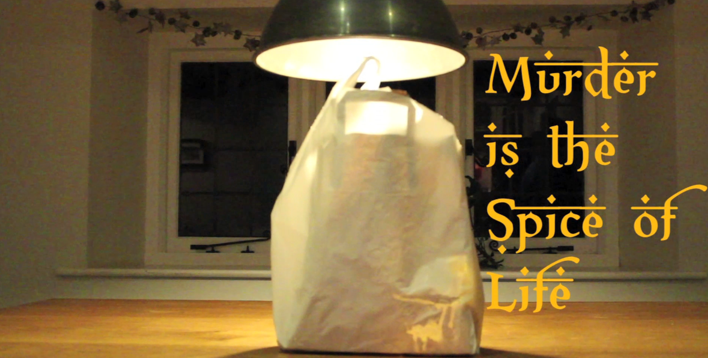
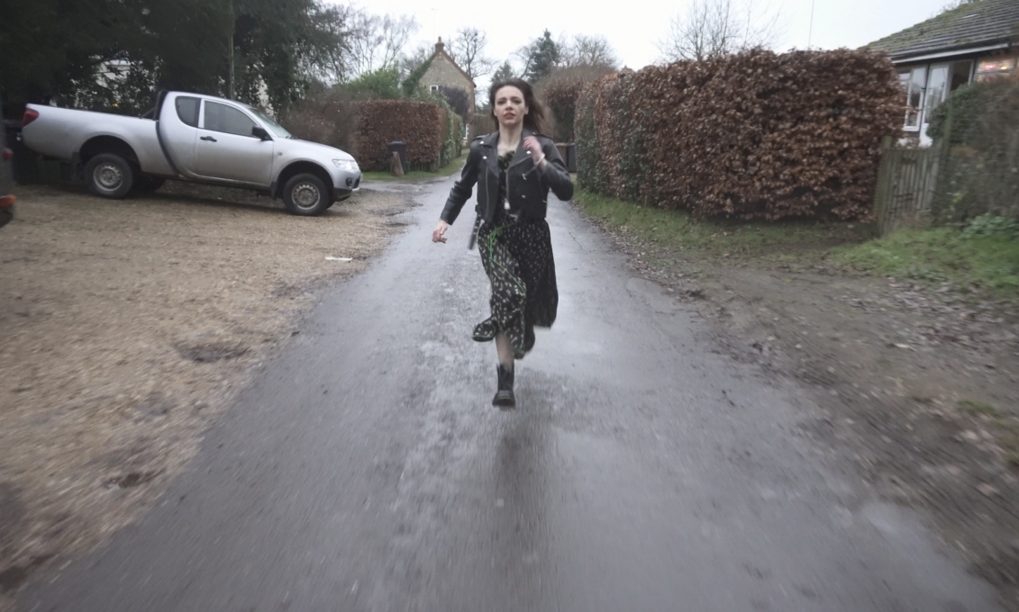
Moving image examples
Short films

Slide 8
Screenplay and storyboard example

Slide 9
Screenplay and storyboard example cont.

Slide 11
A Level Film Studies - Moving Image

Slide 12
PRODUCTION BRIEF – Moving Image A Level
Learners are required to create an individual production consisting of:
a short film of between 4 and 5 minutes which includes one of the following:
a narrative which has a distinct genre
a narrative which has parallel stories
a non-linear narrative
a narrator.

Slide 13
Learners are encouraged to put into practice an appropriate range of camera shots and editing techniques in their production, applying their knowledge and understanding of cinematography, mise-en-scène, editing and sound.

Slide 14
Notes from WJEC / Eduqas
All production work, whether filmmaking or screenwriting, must be individual and demonstrably the candidate's own, unaided work.
For the film option, the individual learner must be responsible for the camerawork and editing of the short film. Unassessed participants may act in, or appear in, the film. Performance skills will not, however, be assessed. Although there is no explicit requirement for independent lighting or independent sound, unassessed assistants may operate lighting and/or sound equipment, provided this is under the direction of the learner being assessed.

Slide 15
Notes from WJEC / Eduqas (Cont.)
Learners may also make use of material which is not the learner's own under the following conditions:
a soundtrack from existing sources (music or music from a film) may be used provided it is appropriately acknowledged on the relevant form and used for education purposes only
if use outside education purposes is envisaged (e.g. uploading to YouTube or similar), normal copyright restrictions must be followed
up to ten seconds (maximum) of found visual material may be used if its use is integral to the genre-based film extract (which could either be a shot or shots which would be impossible to film or found footage such as a news extract)
if found footage is used, it must be excluded from the specified length of the production.
It is recommended that learners:
use copyright-free material where possible
plan genre-based extracts which do not rely on shots impossible to film or other examples of found footage

Slide 16
A Level Film Studies - Screenplay

Slide 17
PRODUCTION BRIEF – Screenplay A Level
Learners are required to create an individual production consisting of:
(ii) a screenplay for a short film of between 1600 and 1800 words which includes one of the following:
a narrative which has a distinct genre
a narrator
a narrative which has parallel stories
a non-linear narrative

Slide 18
Learners are encouraged to put into practice an appropriate range of camera shots and editing techniques in their production, applying their knowledge and understanding of cinematography, mise-en-scène, editing and sound.
No camera references in your screenplay, only in the storyboard.

