Slide 1
WEEK 7

Slide 2
45

Slide 3
RWS17: Wage Determination
An Introduction to the Labour Market
Worksheet: Intro to Labour Markets
  Comparing product and labour markets and the concept of “derived demand”
  Labour Demand and Supply Curves
  Wage Determination – why does a doctor get paid MORE than a teacher?
Introduction to PREP Homework
  Issues in the Labour Market TODAY - ROBOT VID

Slide 4
The Labour Demand Curve
(1) Draw the demand curve to the left for your notes
(2) Explain why the Labour demand curve is downward sloping?
(3) Draw a second demand curve and show it shifting to the left and the right at a given wage rate….Provide reasons as to why might the curve shift to the left or the right?
Wages
W2
W1
Ld
Qd2
Qd1
Quantity Demanded

Slide 5
10 Weirdest Jobs in the World
Using MRP theory, explain which of these jobs would pay the most and which would pay the least….make sure you explain your answer using the theory!!!!
1: Professional Sleeper
2: Vomit Collector
3: Virtual Gold Farmer
4: Cow Inseminator
5: Worm Picker
6: Fortune Cookie Writer
7: Chicken Sexer
8: Roadkill Cleaner
9: Gum Buster
10: Grave Digger
POINT: Hmmmmm….perhaps there is something else that also determines the wage of a worker……… LABOUR SUPPLY!!

Slide 6
Labour Supply
(using whiteboards!!)
Who’s supplying?
What does the supply curve look like for:
  The industry?
  The firm?
Why might there be a movement along the supply curve?
  Wages
Why might there be a shift in the supply curve?
  Expertise
  Job Welfare/Preference
Different types of supply curve
  Market (upward sloping)
  Individual (backward bending), the opportunity cost of working and substitution and income effects
Notes:
Substitution – substituting leisure for work at higher wage rates
Income – choosing to work less as higher wages = higher incomes

Slide 7
Labour Supply for the Market
(1) Draw the supply curve to the left for your notes
(2) Explain why the Labour supply curve is upwards sloping?
(3) Draw a second supply curve and show it shifting to the left and the right….Provide reasons as to why might the curve shift to the left or the right?
Wages
Ls
W2
W1
Quantity Supplied
Qs1
Qs2

Slide 8
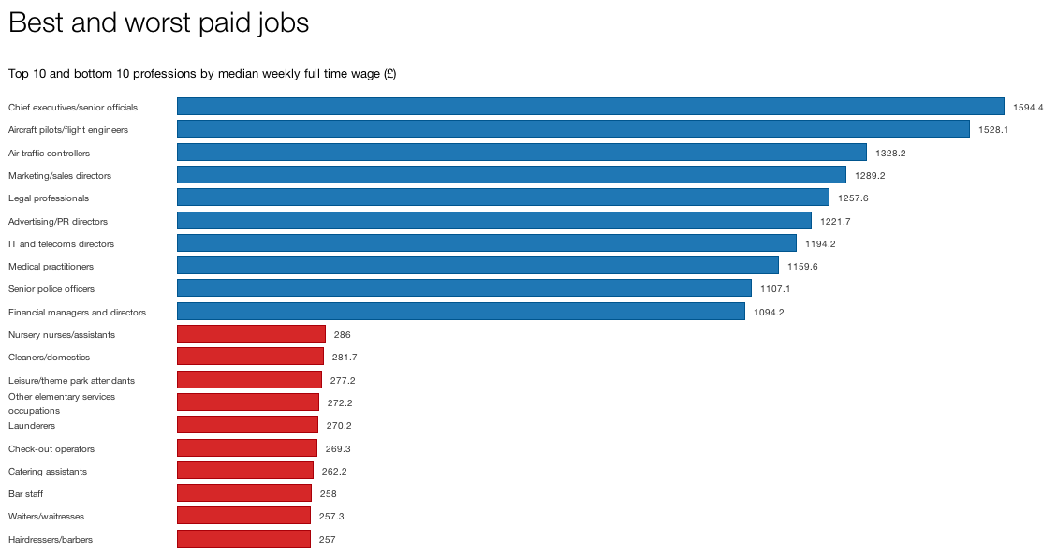
Wage Determination:
Labour Market Equilbrium

Slide 9
Exercise: Wage Determination
SCRIBBLE AND MAKE MISTAKES!!!!
Using a labour supply and demand diagram, show what would happen to the wage for coffee Barista’s if coffee became more popular?
What impact might greater immigration have on the wages for Barista’s - demonstrate on a labour demand and supply diagram.
Using a Ls curve, explain what might happen to the supply of Investment Bankers if bonuses (wages) increase further?
The ‘Brain Drain’ of surgeons from India to the USA and UK has been a problem for the Indian Government. Using an Ls and Ld curve, explain what might happen to the wage rates of surgeons in India.
How could you draw two supply and demand diagrams side by side to determine the difference between a doctors equilibrium wage and a coffee barista’s wage
EXTENSION (no diagram but discussion): Should a doctor (£2500 per week) get paid more than a Barista (£350 per week) to this extent? Arguments for and against?

Slide 10
RWS17: Wage Determination
An Introduction to the Labour Market
Worksheet: Intro to Labour Markets
  Comparing product and labour markets and the concept of “derived demand”
  Labour Demand and Supply Curves
  Wage Determination – why does a doctor get paid MORE than a teacher?
Introduction to PREP Homework
  Issues in the Labour Market TODAY - ROBOT VID

Slide 11
4 CATEGORIES OF ISSUES IN THE UK TODAY TO DO WITH THE LABOUR MARKET
‘THE GREAT RECESSION, DELAYED RECOVERY AND PRODUCTIVITY PUZZLE 2008-2017
  Spike in unemployment, delayed recovery and increase in poverty. Real wages falling due to low productivity gains.
“POOR QUALITY” EMPLOYMENT:
  Zero contract hours, forced part-time work, ‘McJobs’ and longer hours for self-employed?
LONG TERM UNEMPLOYMENT:
  STRUCTURAL: impact of Globalisation and increase in technology (computers and AI?)
  IMMIGRATION: some argue this caused ‘BREXIT’, increased numbers from Eastern Europe for low paid and ‘trade jobs’.
  WELFARE DEPENDENCY: Are more people are switching from unemployment benefits to incapacity benefits
  NEET: Unemployment among the youth of the country is very worrying
DECREASING WORKFORCE:
  A fall in the economically active in the future due to an ageing population
  BREXIT - leading to less economic immigration?

Slide 12
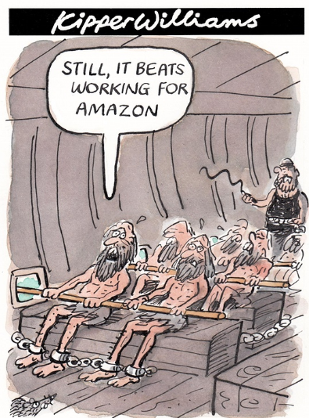
KEY ISSUES in the UK Labour Market over the past 30 years
Globalisation
  Decline in manufacturing industry since 1980’s leading to structural unemployment and exacerbation of North/South divide
  Immigration fears
  Greater competition
Neo-liberal agenda promoted (free market ideology)
  Greater flexibility with labour markets with removal of trade union power and advent of ‘zero contract hours’
Role of women and minorities
  Increase in the role of women and minorities in the workforce which has increased supply
  Discrimination for women and minorities still an issue when it comes to pay gaps and opportunity

Slide 13
WEEK 1

Slide 14
HWK

Slide 15
PREP HWK
Microeconomic Issues
  Source articles on the ‘4 categories’ of labour market issues (either left wing or right wing)

Slide 16
WEEK 2

Slide 17
HWK

Slide 18
PREP HOMEWORK
Due w/b 15th January (2.25 to 3 Hours)
Complete Worksheet on Labour Supply
LABOUR SUPPLY CURVE: Read pp 98-101 in your textbooks (available on GOL) and answer questions on pg1 of worksheet on GOL
IMPERFECT COMPETITION IN THE LABOUR MARKET INTRODUCTION: Complete pg2 of worksheet on GOL on ‘Trade Unions’ and ‘Monopsony Employers’.

Slide 19
30

Slide 20
RWS17: Wage Determination
Issues in the Labour Market
STARTER ACTIVITY (First 10 minutes):
Using your Micro PREP Homework, you need to complete the worksheet grid by 0900 on issues in the labour market!

Slide 21
90

Slide 22
RWS17: Wage Determination (MICRO)
TODAY: Deriving the Labour Demand Curve using MRP Theory
STARTER QUESTION (and the answer to this lesson!!): What three things affect the firms’ demand for labour?
Concept of Derived Demand: Product Market .v. Labour Market
Questions to check your understanding so far on derived demand
  Q: Why do Godalming College have a demand for Economic teachers and Waitrose have a demand for workers to control the checkouts??
    A: Because there is a demand for students taking A-level Economics and there is a demand for the selling of groceries to people in our society. Waitrose need therefore someone to work the tills and help with this process
  Q: Explain why Labour is considered to be a ‘derived demand’
    A: it is only demanded because it is needed to help produce goods and services which are demanded.

Slide 23
RWS17: Wage Determination
Labour Demand and MRP Theory in a ‘Perfect World’!
Wages
W2
W1
Marginal Revenue Product
Ld = MRP
Qd2
Qd1
Quantity Demanded

Slide 24




Diminishing Marginal Returns
“Too many cooks spoil the broth”
4 KEY TERMS
Derived Demand
Diminishing Marginal Returns
Marginal Physical Product
Marginal Revenue Product
What is the market we are looking at?
How do restaurants make money?
Simplifying the categories of resources/assets into Labour and Capital
What is a resource/asset in the context of the restaurant business?
What is the difference between a fixed and variable resource/asset?
Under what circumstances might a fixed asset become variable?
What would happen to the productivity of each chef as they were added to the ‘fixed’ kitchen in the short run?

Slide 25


4 KEY TERMS
Derived Demand
Diminishing Marginal Returns
Marginal Physical Product
Marginal Revenue Product
PHYSICAL PRODUCT .V. REVENUE PRODUCT
MARGINAL PHYSICAL PRODUCT
MARGINAL REVENUE PRODUCT

Slide 26
How much do I know?
EXERCISE:
THINK (INDIVIDUALLY): Define these four terms using one sentence for each
PAIRS (Compare with the person on your table): What have they written…would you alter your sentence?
SHARE (Four lucky people to be picked on to share their sentence)
4 KEY TERMS
Derived Demand
Diminishing Marginal Returns of Labour
Marginal Physical Product (MPP) of Labour
Marginal Revenue Product (MRP) of Labour
Derived demand - Demand for a good/service is directly attributed to the demand for another good
Diminishing marginal returns - the decrease in the additional output of a production process as the amount of labour is incrementally increased, while the amounts of capital stay constant.
MPP of Labour - An additional good or service that is produced
MRP of Labour - An additional amount of income that is earned from the production of an additional good or service

Slide 27

Pedro and his Wheelbarrow Business
Calculating MPP and MRP
1 | 2 | 3 | 4
Size of Labour Force | Total Physical Product of Labour (wheel barrow per week) | Marginal Physical Product | Marginal Revenue Product if wheelbarrows were £20 each
0 | 0 | 0 | 0
1 | 5
2 | 12
3 | 21
4 | 31
5 | 40
6 | 46
7 | 50
8 | 51
9 | 51
PEDRO

Slide 28
Pedro and his Wheelbarrow Business
Calculating MPP and MRP
TASKS (INDIVIDUALLY):
Complete columns 3 and 4 above
On a separate piece of paper, plot a graph for MPP (MPP on the Y-axis and labour quantity on the X-axis) and then join up the plotted points
Plot a second graph for MRP (£ on Y-axis and Quantity of Labour on X-axis) and then join up the plotted points
What comments, explanations can you make about the shape of the MPP and MRP curves? Why do these curves rise and then fall?
For the MRP diagram, assume the wage of wheelbarrow workers is £80 for a week of work. How many workers would the firm employ and why?
The workers band together and decided to force a wage rise otherwise they will go on strike. Wages rise to £120. How many workers will now be employed by Pedro?
PEDRO

Slide 29
Pedro and his Wheelbarrow Business
Calculating MPP and MRP
1 | 2 | 3 | 4
Size of Labour Force | Total Physical Product of Labour (wheel barrow per week) | Marginal Physical Product | Marginal Revenue Product if wheelbarrows were £20 each
0 | 0 | 0 | 0
1 | 5 | 5 | 100
2 | 12 | 7 | 140
3 | 21 | 9 | 180
4 | 31 | 10 | 200
5 | 40 | 9 | 180
6 | 46 | 6 | 120
7 | 50 | 4 | 80
8 | 51 | 1 | 20
9 | 51 | 0 | 0
PEDRO

Slide 30
Why the MRP Curve is the Demand Curve
Labour will be demanded up to the point where the MRP of the next worker is equal to the going wage rate
SHORT RUN - this is because of the law of diminishing marginal returns
LONG RUN - this is because firms can substitute labour for more capital
Wages
W2
W1
Ld. = MRP
Qd2
Qd1
Quantity Demanded

Slide 31
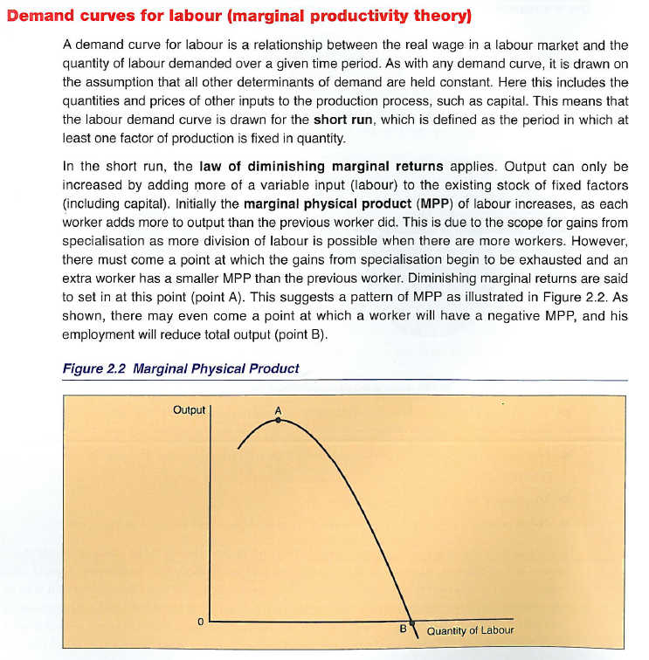

Slide 32
Pedro and his Wheelbarrow Business
Calculating MPP and MRP
1 | 2 | 3 | 4 | 5 | 6
Size of Labour Force | Total Physical Product of Labour (wheel barrow per week) | Marginal Physical Product | Marginal Revenue Product if wheelbarrows were £20 each | Marginal Revenue Product if wheelbarrows were now £10 | Marginal Revenue Product at £10 (because of whipping the workers)
0 | 0 | 0 | 0 | 0 | 0
1 | 5 | 5 | £100
2 | 12 | 7 | £140
3 | 21 | 9 | £180
4 | 31 | 10 | £200
5 | 40 | 9 | £180
6 | 46 | 6 | £120
7 | 50 | 4 | £80
8 | 51 | 1 | £20
9 | 51 | 0 | 0
PEDRO

Slide 33
Pedro and his Wheelbarrow Business
Calculating MPP and MRP
TASKS:
The wages fall back to £80 due to immigration but wheelbarrows aren’t what they used to be. The Welsh have flooded the market with their wheelbarrows and the price has plummeted. Calculate the MRP for each worker at the new price in the table above - column 5 - and draw a new MRP diagram to plot the old and new points). What has happened to the MRP curve?
In a desperate bid to save his cabbage farm, Pedro employs some dubious techniques to get his workers productivity to rise and employs a “whipping” strategy. If the workers are not considered to be doing enough work then they will be publicly flogged. Amazingly labour productivity triples for each worker. Referring to the table above, you will need to alter one of the columns (which one!?) and then with the new information fill in column 6.
Summary: Which two factors have affected the firms labour demand and therefore caused the labour demand curve to shift?
The Commission for Working Conditions and Practices catches up with Pedro and he is closed down. After his prison spell, Pedro decides to start a business of his second love, accounting! PPN Accounting is born! His first task is to try and improve his labour productivity again. However this time public humiliation is not on the menu….he implements a longer holidays programme for his workers. Productivity increases by 25%! Using MRP theory and a labour demand curve, explain what would happen to labour demand if this happened using a ‘sketched’ diagram to help (do not bother plotting it from the numbers).
APPLICATION TASKS:
Using MRP theory explain why an experienced carpenter might earn more money than a farm worker making cabbages
Using MRP theory, explain why Investment Bankers in the City of London might earn more money than an Economics teacher at Godalming College
PEDRO

Slide 34
Pedro and his Wheelbarrow Business
Calculating MPP and MRP: ANSWERS
1 | 2 | 3 | 3a | 4 | 5 | 6
Size of Labour Force | Total Physical Product of Labour (wheel barrow per week) | Marginal Physical Product | Marginal Physical Product (Productivity triples!) | Marginal Revenue Product if wheelbarrows were £20 each | Marginal Revenue Product if wheelbarrows were now £10 | Marginal Revenue Product at £10 with the addition of whipping the workers
0 | 0 | 0 | 0 | £0 | £0 | £0
1 | 5 | 5 | 15 | £100 | £50 | £150
2 | 12 | 7 | 21 | £140 | £70 | £210
3 | 21 | 9 | 27 | £180 | £90 | £280
4 | 31 | 10 | 30 | £200 | £100 | £300
5 | 40 | 9 | 27 | £180 | £90 | £280
6 | 46 | 6 | 18 | £120 | £60 | £180
7 | 50 | 4 | 12 | £80 | £40 | £120
8 | 51 | 1 | 3 | £20 | £10 | £30
9 | 51 | 0 | 0 | £0 | £0 | £0
PEDRO

Slide 35
APPLICATION TASK ANSWERS
Using MRP theory explain why an experienced carpenter might earn more money than a farm worker making cabbages
Furniture maker builds hand-made items
Farm worker contributes to cabbage production (production in tonnes)
What is the price of an individual hand made piece of furniture compared to a cabbage?
Therefore how might the demand curve for hand-made products differ from cabbages?
Therefore how might the labour demand curve for carpenters compare to cabbage workers?
What role does labour productivity have, if any in the example?

Slide 36
APPLICATION TASK ANSWERS
Using MRP theory, explain why Investment Bankers in the City of London might earn more money than an Economics teacher at Godalming College
Investment banker works for an Investment Bank (Goldman Sachs for example) and will invest their clients money for a fee.
Economics teacher works for College (which is funded by the Government) and gives information to students to help them get the grade they deserve in their Economics A-level. The benefit is a society full of educated Economists!
What is the price of the fee given to the investment banker and therefore their company compared to the price or value to society of more A-level Economists?!
Therefore how does the demand curve for both these services compare and how does the labour demand curve for workers in these markets compare?
Does labour productivity have any relevance to this question in your view? ☺

Slide 37
What shifts the demand curve?
(NOT THE PRICE of Labour i.e. the Wage)
Labour demand will shift to the left or right dependent on changes in two factors:
Price of the product: If the price rises, then the MRP of each worker will increase as well and Ld shifts to the right
Productivity of the Worker: if workers become more productive (for whatever reason), they will increase their MPP and therefore MRP will increase regardless of the price.
Wages
W2
W1
Ld. = MRP
Qd2
Qd1
Quantity Demanded

Slide 38
WEEK 3

Slide 39
HWK

Slide 40


RWS HOMEWORK
Due w/b 22nd January (2.25 to 3 hours)

Slide 41
45

Slide 42
RWS17: Wage Determination
Labour Demand and MRP Theory in a ‘Perfect World’!
STARTER CHECKPOINT
What three factors affect the demand for labour in a market?
How does each factor affect the labour demand curve?
What about the supply curve - what factors affect a movement along and a shift?
Wages
W1
Ld = MRP
Qd1
Quantity Demanded

Slide 43
EXTRA TASKS ON MRP THEORY
  Using MRP theory, draw a diagram for each one and explain why the curve is affected in the way it is. Demonstrate on a Labour demand curve, what would happen to the demand for builders if:
    A new foreman was employed to make sure the amount of tea breaks in a day was reduced from 50 to only 3.
    Interest rates rise
    Financial deregulation, making it easier to borrow money
    A rise in immigration leads to a fall in the real wage of an unskilled labourer
b) Using MRP theory, draw a diagram for each one and explain why the curve is affected in the way it is. Demonstrate on a Labour demand curve, what would happen to the demand for Car workers if:
  A report came out to say that the new Mercedes XL and BMW 5 series were unsafe. The Mercedes XL topples over at high speeds and the BMW 5 series spontaneously combusts.
  There is an influx of Turkish workers into Germany (where the VW factories are)
  Justin Bieber is seen driving around in a VW
EXTENSION: Can you think of why MRP theory might be a controversial ?

Slide 44
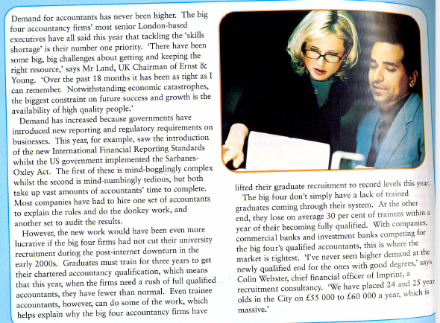
Accountant Task
TASK: Read the following article and explain using MRP theory why demand for accountants increased
An accountant monitors accounts for individuals and firms to ensure they are complying with the laws of the land. Accountants get paid an annual salary and their work consists of signing off accounts for the accounting firm’s clients to ensure they have met all regulations.
Notes:
MRP curve shifts to the right:
New regulatory and reporting requirements introduced = greater demand for accountancy services in the ‘product market’ pushes up the price of accountancy services.
The increase in price will increase the MRP of accountants at a given wage and the labour demand curve will increase.
If wages remain constant, Accountancy firms can take on more accountants because each accountant is now earning a higher price per contract that they complete.
Shortage of accountants is not part of the answer as it does not account for an increase in demand for accountants. See me if unsure.

Slide 45
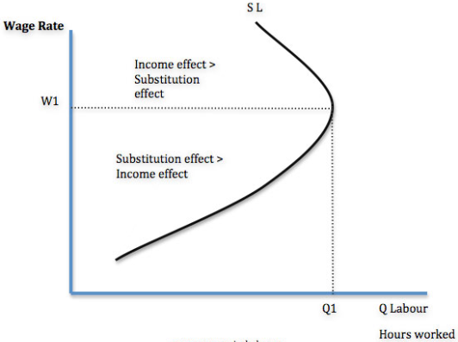
The Labour Supply Curve facing…
…an INDIVIDUAL
an INDUSTRY
Wage
Wage
Ls
Ls
QL
QL

Slide 46
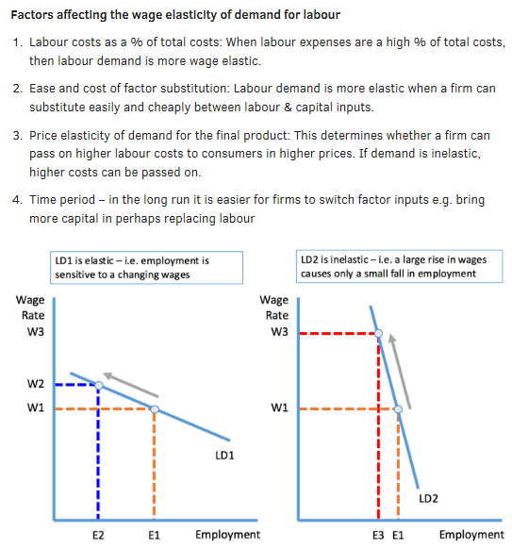
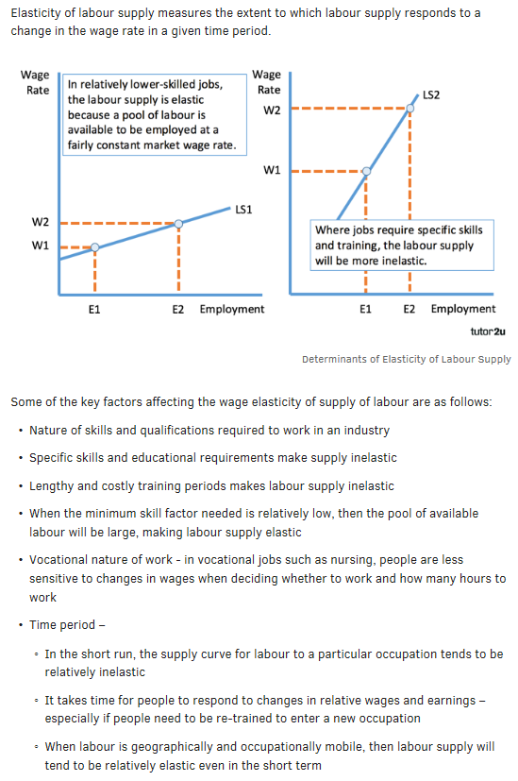
Elasticity of Labour Supply and Demand
Notes:
Elasticity of labour demand measures the responsiveness of demand for labour when there is a change in the ruling market wage rate. The elasticity of demand for labour depends on these factors:
Labour costs as a % of total costs: When labour expenses are a high proportion of total costs, then labour demand is more elastic than a business where fixed costs of capital are the dominant business expense. In many service jobs such as customer service centres or gas boiler repairs, labour costs are a high proportion of the total costs of a business.
The ease and cost of factor substitution: Labour demand will be more elastic when a firm can substitute quickly and easily between labour and capital inputs. When specialised labour or capital is needed, then the demand for labour will be more inelastic with respect to the wage rate. For example it might be fairly easy and cheap to replace security guards with cameras but a hotel would find it almost impossible to replace hotel cleaning staff with machinery!
The price elasticity of demand for the final output produced by a business: If a firm is operating in a highly competitive market where final demand for the product is price elastic, they may have little market power to pass on higher wage costs to consumers through a higher price. The demand for labour may therefore be more elastic as a consequence. In contrast, a firm that sells a product where final demand is inelastic will be better placed to pass on higher costs to consumers.

Slide 47
Elasticity in the Labour Market
Wage
Labour Market
TASK: Complete these questions by writing notes in the space below
Identify, why the Ld curves are shaped like they are?
What would the supply curve for these professions look like do you think?
Ld Premier League Footballer
Ld Doctor
Ld Coffee Barista
Quantity

Slide 48
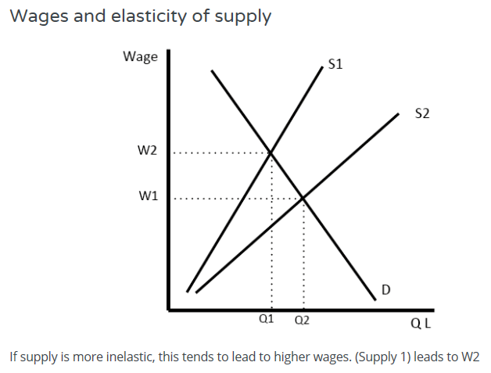

Slide 49
90

Slide 50
RWS17: Wage Determination
Wage Determination Exercises (Perfectly Competitive Labour Market)

Slide 51
Ls
Wages
Questions:
Explain why the Ls curves are in these positions?
Explain why the Ld curves are in these positions using MRP theory?
I have not taken into account elasticity. Explain how each Ls and Ld curve for each job might be steeper or flatter (i.e. more inelasitc or elastic)?
Using economic theory, explain why executive managers get paid more than leek pickers
Key:
CEO – Executive Manager
SW – Sewer Worker
LP – Leek Picker
WCEO
Ld = MRP
Ls
WSW
Ld = MRP
Ls
WLP
Ld = MRP
QCEO
QSW
QLP
Quantity of Labour

Slide 52
Wage Determination
Extra Questions - please answer all of these questions by using economic analysis and a diagram for your explanation
In the 1980’s the Steel Industry in the UK started to decline. Using economic theory, explain why the wage of steel workers would fall.
Using economic theory, explain what might happen to the wage rate of the unskilled if the UK relaxed its border controls and made it easier for foreign nationals to obtain work visas?
Malawi currently suffers from “Brain Drain” where a large proportion of educated people are leaving the country to find work elsewhere. What would happen to the wages of a brain surgeon in Malawi as a result of this? Use economic theory to explain.
New information technology means workers in an office are able to complete more tasks in a given period of time. Explain what might happen to their wages as a result?
New robotic, artificial intelligence technology would result in there being no need for human teachers by 2072. Explain what would happen to teachers wages from now until then.

Slide 53
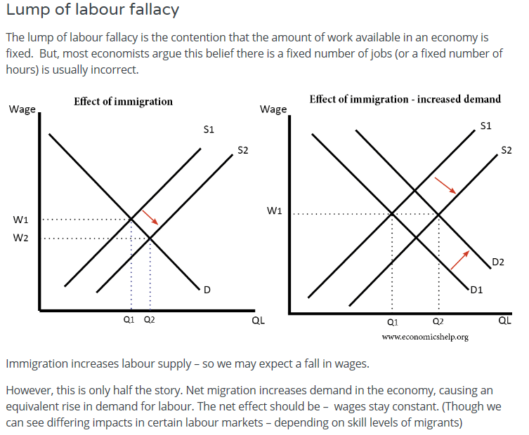

Slide 54


CLASS DEBATE:
Should David De Gea (Manchester United Goalkeeper) be paid more than a doctor?
EXERCISE: Think of some opinions and be prepared to back them up with your ideas and Economic Theory!
£200,000 per week
£2500 per week

Slide 55
What determines wages
Wage determination: Why do some people get paid more than others? (Market Success - Free Market Theory)
Demand changes = MRP Theory (Wage, Price of product and Productivity of Labour
Supply changes (Wage and Non-Monetary Considerations)
If supply of labour becomes more inelastic, the wages are likely to be higher
Other possible reasons (Examples of market failure):
Discrimination against certain social groups
Lack of competition (Monopsony Employers and Monopoly)
Government intervention (minimum wage etc.)

Slide 56
END

Slide 57
Perfect Competition .v. Imperfect Competition
  Q: Is the labour market for Godalming College teachers and Sainsbury’s checkout workers perfectly competitive? Explain your answer.
    A: NO! Economics teachers face an employer with some ‘monopsony power’. Over the past 2 years, we have increased our number of Economics students and this year significantly and so why have Economics teachers not had their pay increased? Lots of Economics teachers are also affiliated with Trade Unions. Equally, you might argue that Waitrose checkout staff are not able to transfer into any other job (you might say that about Economics teachers as well!). Also, do Waitrose staff have limited substitutes in terms of supplying their labour like Economics teachers?
  Perfectly Competitive .v. Imperfectly Competitive
  Concept of Monopoly and Monopsony

Slide 58
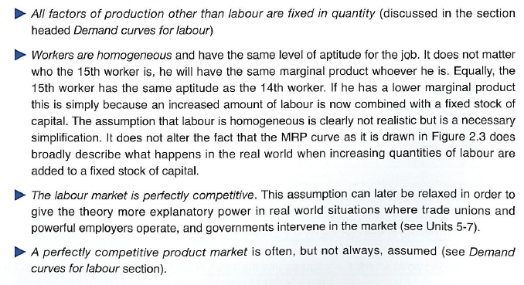
Perfectly Competitive Labour Markets
Key Assumptions of MRP Theory

Slide 59
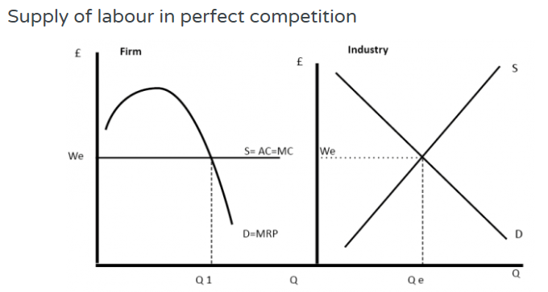
RWS17: Wage Determination
Labour Demand and Labour Supply for a Perfectly Competitive Firm and Market

