Slide 2
RWS 17 (MACRO): Philips Curve Analysis Causes of Unemployment
STARTER ACTIVITY (10 minutes):
“The current UK unemployment rate is currently 4.2% of the workforce (16-65), the lowest rate since the early 1970’s.”
Using your prep homework on unemployment to help, answer the following questions:
How would a ‘Classical Economist’ (like Hayek) and a ‘Keynesian Economist’ (like Keynes!) claim is the cause(s) of this unemployment?
(HINT 1: Their views would differ!)
(HINT 2: Drawing macro and micro diagrams for your analysis might help?
Explain what policies (if any) these two economists would advise Theresa May to reduce unemployment further

Slide 3
Unemployment TODAY in the UK HOW might a Classical and Keynesian economist argue about the causes of unemployment (4.2% of workforce) in todays economy?
Classical:
Disequilibrium Unemployment
Wages expectations are too high due to imperfections in the labour market. The jobs are there but workers are not willing to lower their wages to get the jobs. They are choosing to stay unemployed.
Equilibrium Unemployment
2-3% of frictional and structural unemployment
Better today than it was back in 1979 due to more flexible labour markets but more to be done? Minimum wage for example to be eradicated?
SOLUTIONS:
Encourage labour market flexibility to remove imperfections (rigidities) in the labour market.
Wait for wages to fall
Keynesian:
Disequilibrium Unemployment
Mainly disequilibrium unemployment due to a lack of AD in the economy. Workers are unable to access jobs due to a lack of overall demand from firms.
Equilibrium Unemployment
Technically, in the 1930’s it was considered to be 0% (but this was changed later to accept some frictional and structural)
SOLUTIONS:
Boost AD through monetary and fiscal policy

Slide 4
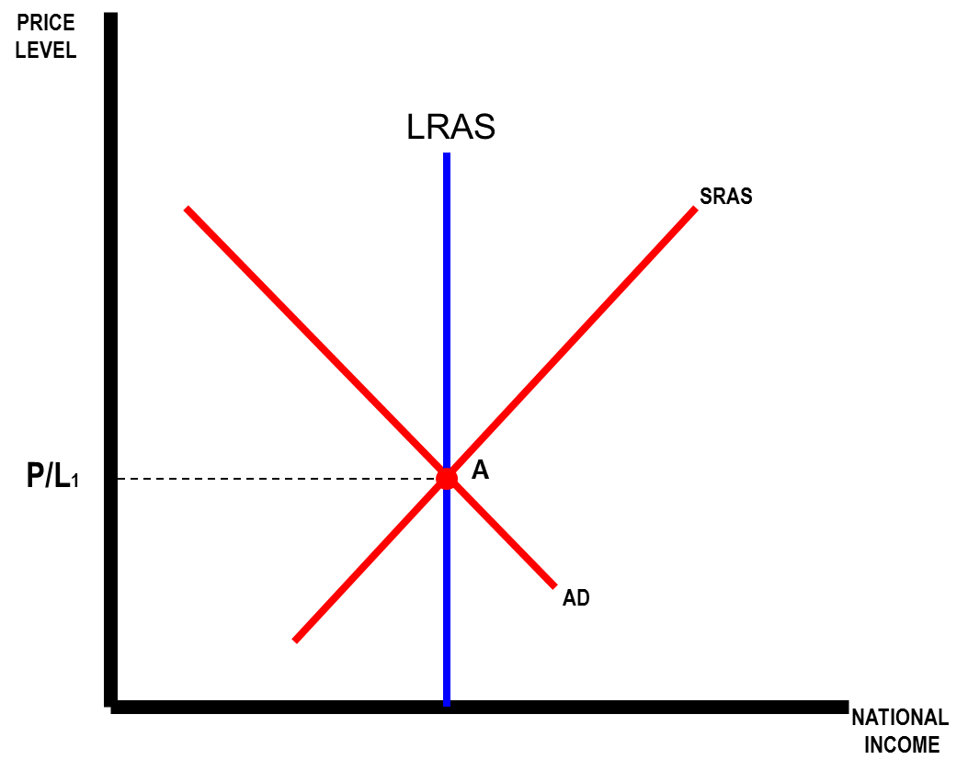
SOLVING UNEMPLOYMENT Demonstrating Disequilibrium Unemployment
MICRO ANALYSIS
MACRO ANALYSIS
Wage/Price
Ls
W0
W1
P/L2
Ld
AD2
Ld
QL
Ls
QL: Labour Output
Y2
Y
Excess Supply of Labour = Unemployment
Negative Output Gap = Unemployment

Slide 5
SOLVING UNEMPLOYMENT MICRO ANALYSIS: Disequilibrium Unemployment
TASK: explain how Keynes and Hayek would differ in terms of their explanation of unemployment here and what their policy recommendations might be and draw the possible result on the diagrams
Wage/Price
Keynes
Wage/Price
Hayek
Ls
Ls
W0
W0
W1
W1
Ld
Ld
Ld
QL
Ls
QL: Labour Output
Ld
QL
Ls
QL: Labour Output
Excess Supply of Labour = Unemployment
Excess Supply of Labour = Unemployment

Slide 6
SOLVING UNEMPLOYMENT MICRO ANALYSIS: Disequilibrium Unemployment
TASK: explain how Keynes and Hayek would differ in terms of their explanation of unemployment here and what their policy recommendations might be and draw the possible result on the diagrams
Wage/Price
Classical Explanations:
W0 is artificially too high and unemployed workers expectations are therefore too high and they are refusing to work at the lower W1 market rate.
Wages will return to the original level at W1 if the market is free from interventions and is functioning properly.
SOLUTION: Therefore leave the market to it’s own devices or remove regulations and restrictions.
Keynesian Explanations:
There is not enough demand for labour in the economy.
There is not enough demand in the economy as not enough people are consuming goods and therefore firms can not afford to pay the higher wages
SOLUTION: Therefore Ld needs to shift to the right to A, thus boosting employment
Ls
W0
A
W1
Ld
Ld
QL
Ls
QL: Labour Output
Excess Supply of Labour = Unemployment

Slide 7
SOLVING UNEMPLOYMENT MACRO ANALYSIS: Demonstrating Disequilibrium Unemployment
TASK: explain how Keynes and Hayek would differ in terms of their explanation of unemployment here and what their policy recommendations might be and draw the possible result on the diagrams
P/L2
P/L2
AD2
AD2
Y2
Y
Y2
Y
Negative Output Gap = Unemployment
Negative Output Gap = Unemployment

Slide 8
SOLVING UNEMPLOYMENT MACRO ANALYSIS: Demonstrating Disequilibrium Unemployment
Classical Explanations:
A shift to the left in the SRAS
Wages are sticky and too high. They refuse to move to the equilibrium because of labour market imperfections – trade unions etc. Therefore firms cannot afford to employ as many people and the SRAS shifts to the left due to the higher costs.
SOLUTION: Eventually if the markets are working properly, the SRAS will shift back to the right and we will be back on full capacity
Keynesian Explanations:
A shift to the left with AD
There is not enough demand in the economy as not enough people are consuming. Therefore AD shifts to the left and the overall demand for labour declines as well.
SOLUTION: Stimulate the economy through demand side policies to shift the AD curve back to A
MACRO ANALYSIS
P/L2
AD2
Y2
Y
Negative Output Gap = Unemployment

Slide 9
SOLVING UNEMPLOYMENT Demonstrating Equilibrium Unemployment
MICRO ANALYSIS
MACRO ANALYSIS
Wage/Price
Ls
W1
Ld
QL
QL: Labour Output

Slide 10
SOLVING UNEMPLOYMENT Equilibrium Unemployment: is this FULL EMPLOYMENT?
MICRO ANALYSIS
MACRO ANALYSIS
Wage/Price
Ls
Labour Force
W1
Ld
QL
QLF
QL: Labour Output
Y
Voluntary Unemployment - consisting of frictional and structural unemployment (Classicals)

Slide 11
EQUILIBRIUM UNEMPLOYMENT The Natural Rate of Unemployment Theory (NRU)
PRICE
LEVEL
The NRU:
CLASSICAL INTERPRETATION
4.2% Unemployment - perhaps made up of…
1% Disequilbirum (or Cyclical/Demand Deficient) [C to B]
3.2% Equilibrium [B]
KEYNESIAN INTERPRETATION
4.2% Unemployment - perhaps made up of….
4.2% Disequilibrium (Real Wage/Classical [C to A]
0% Equilibrium [A]
THEREFORE with 4.2% unemployment Keynesians and Classicals are differing with their view of where we are on this AD/AS Model
LRAS
SRAS1
SRAS2
P/L2
A
P/L1
C
B
AD2
AD1
NATIONAL
INCOME
Yd
Ye
Equilibrium Unemployment: Frictional and Structural for Classical Economists

Slide 12
SOLVING UNEMPLOYMENT FULL EMPLOYMENT = Equilibrium Unemployment The Natural Rate of Unemployment
Classical Economists
2-3% of people are always voluntarily choosing not to work because:
Frictional: Choosing not to work so they can get a better job
Structural: Choosing not to work as they are wanting to work in the same sector or are not willing to move or retrain
Keynesian Economists
0%??? - absence of involuntary unemployment
Frictional due to a lack of demand for workers; frictional time would be close to zero if enough demand.
Structural unemployment is a lack of demand for labour and is involuntary. It should not be considered voluntary.

Slide 13
EQUILIBRIUM UNEMPLOYMENT The Natural Rate of Unemployment Theory
PRICE
LEVEL
The NRU:
Point A is where everyone who wants a job has a job at the going wage rate.
This does not mean 100% of the workforce is employed. Classical economists would argue that there will still be elements of the workforce unemployed but they are choosing to be unemployed.
Therefore, if we are in equilibrium anywhere on the LRAS, the economy is at full employment
LRAS
SRAS
P/L1
A
AD
NATIONAL
INCOME
Y
Equilibrium Unemployment: Frictional and Structural

Slide 14
Natural Rate of Unemployment Some questions…variations in the size of the NRU
The current UK employment rate is .
How many of these workers are voluntary unemployed do you think?
Why might Classical economists argue the NRU is larger than Keynesian economists?
Why might our NRU have arguably have fallen since 1979 in the UK?
Margaret Thatcher introduced supply side reforms to remove rigidities in the labour market and discourage voluntary unemployment (Examples?)
Why might some argue that the NRU of the EU in countries such as is larger than the NRU of the UK
Flexible labour markets?
What are problems with the NRU as a concept?
How do you measure it? Subjective! Who is voluntary and who is involuntary?

Slide 15
EXTRA QUESTIONS Without notes…
Using macro analysis, explain how a Classical economist would theorise about why there is prolonged unemployment in a recession? What would they advise the Government to do?
Using macro analysis, explain how a Keynesian economist would theorise about why there is prolonged unemployment in a recession? What would they advise the Government to do?
Define the Natural Rate of Unemployment Theory?

