Slide 1
WEEK 7

Slide 2
45

Slide 3
AD/AS RECAP and Unemployment
1930’s Recession and the Birth of Macro
What is unemployment?
Causes of Unemployment
  Disequilibrium Unemployment debate
  Equilibrium Unemployment debate

Slide 4
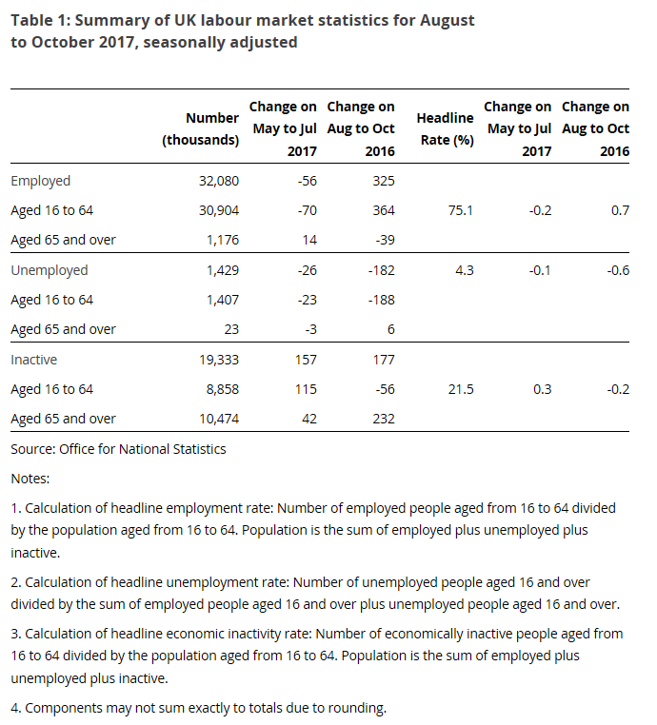

Slide 5
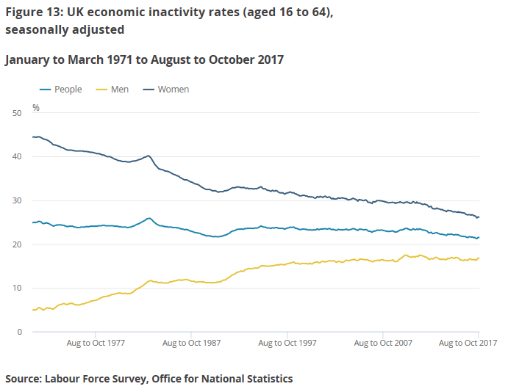

Slide 6
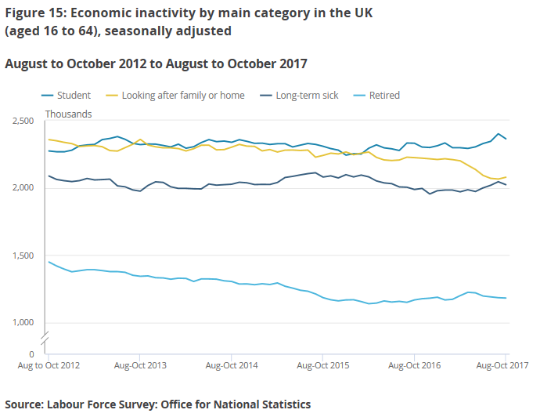

Slide 7
Key Issues to do with the Labour Market?
‘THE GREAT RECESSION, DELAYED RECOVERY AND PRODUCTIVITY PUZZLE 2008-2017
  Spike in unemployment, delayed recovery and increase in poverty. Real wages falling due to low productivity gains.
“POOR QUALITY” EMPLOYMENT:
  Zero contract hours, forced part-time work, ‘McJobs’ and longer hours for self-employed?
LONG TERM UNEMPLOYMENT:
  STRUCTURAL: impact of Globalisation and increase in technology (computers and AI?)
  IMMIGRATION: some argue this caused ‘BREXIT’, increased numbers from Eastern Europe for low paid and ‘trade jobs’.
  WELFARE DEPENDENCY: Are more people are switching from unemployment benefits to incapacity benefits
  NEET: Unemployment among the youth of the country is very worrying
DECREASING WORKFORCE:
  A fall in the economically active in the future due to an ageing population
  BREXIT - leading to less economic immigration?

Slide 8
WEEK 1

Slide 9
HWK

Slide 10
PREP HOMEWORK
Due for w/b 8th January 2018
MACRO (4.5 to 6 hours): Complete the booklet on unemployment and inflation basics
MICRO (4.5 to 6 hours): Complete the worksheet on Labour Markets and Current Issues

Slide 11
WEEK 2

Slide 12
HWK

Slide 13
PREP2 HOMEWORK
Due w/b 15th January 2018 (2.25 to 3 Hours)
History Learning! 1930 to 2017…history of Unemployment and Inflation in the UK

Slide 14
60

Slide 15
RWS 17 (MACRO): Philips Curve Analysis
Causes of Unemployment
STARTER ACTIVITY (10 minutes):
“The current UK unemployment rate is currently 4.2% of the workforce (16-65), the lowest rate since the early 1970’s.”
Using your prep homework on unemployment to help, answer the following questions:
How would a ‘Classical Economist’ (like Hayek) and a ‘Keynesian Economist’ (like Keynes!) claim is the cause(s) of this unemployment?
  (HINT 1: Their views would differ!)
  (HINT 2: Drawing macro and micro diagrams for your analysis might help?
Explain what policies (if any) these two economists would advise Theresa May to reduce unemployment further

Slide 16
Unemployment TODAY in the UK
HOW might a Classical and Keynesian economist argue about the causes of unemployment (4.2% of workforce) in todays economy?
Classical:
  Disequilibrium Unemployment
    Wages expectations are too high due to imperfections in the labour market. The jobs are there but workers are not willing to lower their wages to get the jobs. They are choosing to stay unemployed.
  Equilibrium Unemployment
    2-3% of frictional and structural unemployment
    Better today than it was back in 1979 due to more flexible labour markets but more to be done? Minimum wage for example to be eradicated?
  SOLUTIONS:
    Encourage labour market flexibility to remove imperfections (rigidities) in the labour market.
    Wait for wages to fall
Keynesian:
  Disequilibrium Unemployment
    Mainly disequilibrium unemployment due to a lack of AD in the economy. Workers are unable to access jobs due to a lack of overall demand from firms.
  Equilibrium Unemployment
    Technically, in the 1930’s it was considered to be 0% (but this was changed later to accept some frictional and structural)
  SOLUTIONS:
    Boost AD through monetary and fiscal policy

Slide 17
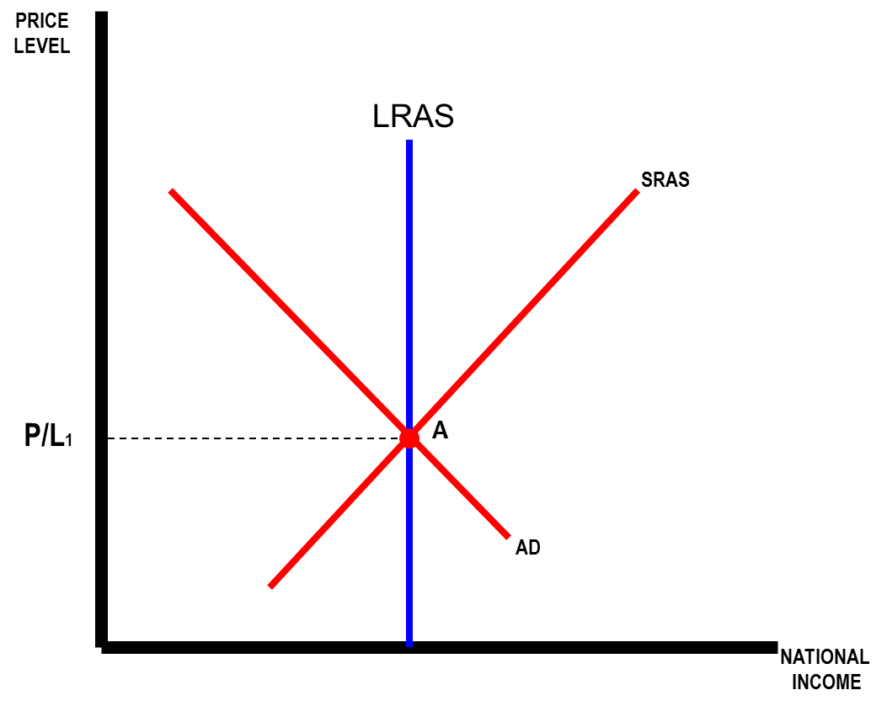
SOLVING UNEMPLOYMENT
Demonstrating Disequilibrium Unemployment
MICRO ANALYSIS
MACRO ANALYSIS
Wage/Price
Ls
W0
W1
P/L2
Ld
AD2
Ld
QL
Ls
QL: Labour Output
Y2
Y
Excess Supply of Labour = Unemployment
Negative Output Gap = Unemployment

Slide 18
SOLVING UNEMPLOYMENT
MICRO ANALYSIS: Disequilibrium Unemployment
TASK: explain how Keynes and Hayek would differ in terms of their explanation of unemployment here and what their policy recommendations might be and draw the possible result on the diagrams
Wage/Price
Keynes
Wage/Price
Hayek
Ls
Ls
W0
W0
W1
W1
Ld
Ld
Ld
QL
Ls
QL: Labour Output
Ld
QL
Ls
QL: Labour Output
Excess Supply of Labour = Unemployment
Excess Supply of Labour = Unemployment

Slide 19
SOLVING UNEMPLOYMENT
MICRO ANALYSIS: Disequilibrium Unemployment
TASK: explain how Keynes and Hayek would differ in terms of their explanation of unemployment here and what their policy recommendations might be and draw the possible result on the diagrams
Wage/Price
Classical Explanations:
W0 is artificially too high and unemployed workers expectations are therefore too high and they are refusing to work at the lower W1 market rate.
Wages will return to the original level at W1 if the market is free from interventions and is functioning properly.
SOLUTION: Therefore leave the market to it’s own devices or remove regulations and restrictions.
Keynesian Explanations:
There is not enough demand for labour in the economy.
There is not enough demand in the economy as not enough people are consuming goods and therefore firms can not afford to pay the higher wages
SOLUTION: Therefore Ld needs to shift to the right to A, thus boosting employment
Ls
W0
A
W1
Ld
Ld
QL
Ls
QL: Labour Output
Excess Supply of Labour = Unemployment

Slide 20
SOLVING UNEMPLOYMENT
MACRO ANALYSIS: Demonstrating Disequilibrium Unemployment
TASK: explain how Keynes and Hayek would differ in terms of their explanation of unemployment here and what their policy recommendations might be and draw the possible result on the diagrams
P/L2
P/L2
AD2
AD2
Y2
Y
Y2
Y
Negative Output Gap = Unemployment
Negative Output Gap = Unemployment

Slide 21
SOLVING UNEMPLOYMENT
MACRO ANALYSIS: Demonstrating Disequilibrium Unemployment
Classical Explanations:
A shift to the left in the SRAS
Wages are sticky and too high. They refuse to move to the equilibrium because of labour market imperfections – trade unions etc. Therefore firms cannot afford to employ as many people and the SRAS shifts to the left due to the higher costs.
SOLUTION: Eventually if the markets are working properly, the SRAS will shift back to the right and we will be back on full capacity
Keynesian Explanations:
A shift to the left with AD
There is not enough demand in the economy as not enough people are consuming. Therefore AD shifts to the left and the overall demand for labour declines as well.
SOLUTION: Stimulate the economy through demand side policies to shift the AD curve back to A
MACRO ANALYSIS
P/L2
AD2
Y2
Y
Negative Output Gap = Unemployment

Slide 22
SOLVING UNEMPLOYMENT
Demonstrating Equilibrium Unemployment
MICRO ANALYSIS
MACRO ANALYSIS
Wage/Price
Ls
W1
Ld
QL
QL: Labour Output

Slide 23
SOLVING UNEMPLOYMENT
Equilibrium Unemployment: is this FULL EMPLOYMENT?
MICRO ANALYSIS
MACRO ANALYSIS
Wage/Price
Ls
Labour Force
W1
Ld
QL
QLF
QL: Labour Output
Y
Voluntary Unemployment - consisting of frictional and structural unemployment (Classicals)

Slide 24
EQUILIBRIUM UNEMPLOYMENT
The Natural Rate of Unemployment Theory (NRU)
PRICE
LEVEL
The NRU:
CLASSICAL INTERPRETATION
4.2% Unemployment - perhaps made up of…
1% Disequilbirum (or Cyclical/Demand Deficient) [C to B]
3.2% Equilibrium [B]
KEYNESIAN INTERPRETATION
4.2% Unemployment - perhaps made up of….
4.2% Disequilibrium (Real Wage/Classical [C to A]
0% Equilibrium [A]
THEREFORE with 4.2% unemployment Keynesians and Classicals are differing with their view of where we are on this AD/AS Model
LRAS
SRAS1
SRAS2
P/L2
A
P/L1
C
B
AD2
AD1
NATIONAL
INCOME
Yd
Ye
Equilibrium Unemployment: Frictional and Structural for Classical Economists

Slide 25
SOLVING UNEMPLOYMENT
FULL EMPLOYMENT = Equilibrium Unemployment
The Natural Rate of Unemployment
Classical Economists
2-3% of people are always voluntarily choosing not to work because:
Frictional: Choosing not to work so they can get a better job
Structural: Choosing not to work as they are wanting to work in the same sector or are not willing to move or retrain
Keynesian Economists
0%??? - absence of involuntary unemployment
Frictional due to a lack of demand for workers; frictional time would be close to zero if enough demand.
Structural unemployment is a lack of demand for labour and is involuntary. It should not be considered voluntary.

Slide 26
EQUILIBRIUM UNEMPLOYMENT
The Natural Rate of Unemployment Theory
PRICE
LEVEL
The NRU:
Point A is where everyone who wants a job has a job at the going wage rate.
This does not mean 100% of the workforce is employed. Classical economists would argue that there will still be elements of the workforce unemployed but they are choosing to be unemployed.
Therefore, if we are in equilibrium anywhere on the LRAS, the economy is at full employment
LRAS
SRAS
P/L1
A
AD
NATIONAL
INCOME
Y
Equilibrium Unemployment: Frictional and Structural

Slide 27
EQUILIBRIUM UNEMPLOYMENT
The Natural Rate of Unemployment Theory
PRICE
LEVEL
The NRU:
Point A is where everyone who wants a job has a job at the going wage rate.
This does not mean 100% of the workforce is employed. Classical economists would argue that there will still be elements of the workforce unemployed but they are choosing to be unemployed.
Therefore, if we are in equilibrium anywhere on the LRAS, the economy is at full employment
LRAS
SRAS
P/L2
B
P/L1
A
AD2
AD1
NATIONAL
INCOME
Y
Equilibrium Unemployment: Frictional and Structural

Slide 28
Natural Rate of Unemployment
Some questions…variations in the size of the NRU
The current UK employment rate is .
  How many of these workers are voluntary unemployed do you think?
  Why might Classical economists argue the NRU is larger than Keynesian economists?
Why might our NRU have arguably have fallen since 1979 in the UK?
  Margaret Thatcher introduced supply side reforms to remove rigidities in the labour market and discourage voluntary unemployment (Examples?)
Why might some argue that the NRU of the EU in countries such as is larger than the NRU of the UK
  Flexible labour markets?
What are problems with the NRU as a concept?
    How do you measure it? Subjective! Who is voluntary and who is involuntary?

Slide 29
EXTRA QUESTIONS
Without notes…
Using macro analysis, explain how a Classical economist would theorise about why there is prolonged unemployment in a recession? What would they advise the Government to do?
Using macro analysis, explain how a Keynesian economist would theorise about why there is prolonged unemployment in a recession? What would they advise the Government to do?
Define the Natural Rate of Unemployment Theory?

Slide 30
90

Slide 31
TODAY
Causes of Inflation
  Keynesian Theory: Cost Push .v. Demand Pull
  Wage Spiral: Downfall of Keynesianism Theory of Unemployment?
  New Classical Theories: Monetarism and Expectations
Summary of AD/AS Analysis with Unemployment and Inflation
  1930’s: Prolonged Unemployment (solutions?)
  1940’s-60’s: Full Employment (solutions?)
  1970’s: Excessive Inflation (solutions?)

Slide 32
RWS 17 (MACRO): Philips Curve Analysis
Causes of inflation, solving unemployment and policy conflicts: The Wage Spiral
TASK1 – Analysis Basics of the Causes of Inflation: Assess each others answers in threes on the PREP homework for demand pull and cost push inflation. Have you all got the same answer and do you understand the definitions and analysis of these two concepts? If not, try and work out which is the correct answer. If you are have the same answer, make sure you can each explain it fully if asked
TASK 2 – Applying the analysis of Causes of inflation to questions: For each question, draw a diagram and explain why the scenario has led to inflation (remember this explanation is ‘analysis’ and you will get marked on your ‘chains of logic’)
  In 1973 and 1981, inflation was at some of the highest is it has been in the UK for 100 years (in 1973 it approached 26%. At the time, OPEC (an organisation of petroleum exporting countries like Venezuela and Saudi Arabia) all agreed to raise the price of crude oil by restricting supply. Why would this cause inflation to rise?
  Donald Trump has instigated tax cuts in January 2018, explain why inflation may rise in the UK as a result?
  Inflation in the UK from the latest data suggested it was at 3.1% which is above the inflation target set by the Bank of England. Using your current affairs knowledge, explain why inflation is risen in the UK in the past year.
TASK 3 – Policy conflict analysis: As we have seen, Keynesians advocate increasing Government spending in a recession to stimulate AD and reduce unemployment. Classical economists argue this will just lead to inflation and that in the end all a Government will do by stimulating AD is to not increase GDP and just increase inflation? Draw a diagram to help explain this.
TASK 4: Look at the two macroeconomic diagrams below (on next PP slide). Which do you think is the ‘Keynesian model’ and which do you think is the ‘Classical model’? Explain why you think this.

Slide 33
MODEL 1
MODEL 2
LRAS
Price Level
Price Level
LRAS
SRAS
P/L1
A
P/L1
A
AD1
AD1
Y1
Y
Real GDP
Y1
Y
Real GDP

Slide 34
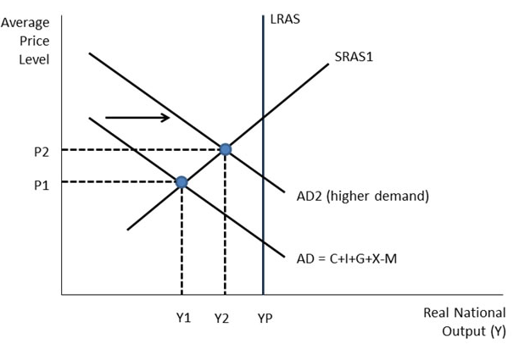
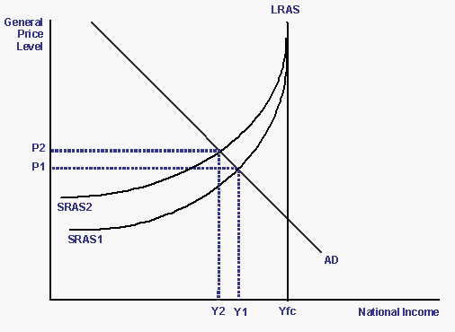
Causes of Inflation
Demand Pull Theory of Inflation
Cost Push Theory of Inflation

Slide 35
THE WAGE SPIRAL
Proving why demand side policies can be ineffective in reducing unemployment
PRICE
LEVEL
SRAS 2
(1) There is “demand-pull” inflation, causing the AD curve to shift to the right.
What might have caused this?
LRAS
SRAS 1
P/L3
C
(2) The increase in demand and subsequent “overproduction” leads to the costs of firms increasing (e.g. overtime workers being paid more) and the SRAS shifts to the left as workers inflationary expectations increase.
Why does the SRAS shift to the left?
P/L2
B
P/L1
A
AD2
AD1
NATIONAL
INCOME
Y1
y2
y3
y2

Slide 37
RWS 17 (MACRO): Philips Curve Analysis
The Classicals fight back! Causes of inflation
HISTORY OF MACROECONOMICS – How do we deal with Unemployment?
1930’s: PROLONGED UNEMPLOYMENT - Keynes takes on the Classicals with their ‘AD is lacking’ theory!
1940’s-1970’s: ‘COMMITMENT TO FULL EMPLOYMENT’ - Keynesianism model adopted by Governments. Spend in times of scarcity and save in times of plenty.
1970’s: ‘HIGH INFLATION’ - Birth of Monetarism and ‘New-Classicals’: Inflationary problems hint at limitations with the Keynesian model? Should the focus be on inflation AND NOT unemployment?
  Keynes manipulation of AD helps with ‘demand-pull’ but what about ‘cost-push’ pressures from external factors (i.e. oil prices)
  Hard to know how far to stimulate AD to reduce unemployment without causing an inflationary problem?
  Perhaps something else is causing inflationary pressures other than cost push and demand pull? Monetarism and research on ‘inflationary expectations’ begins.

Slide 38
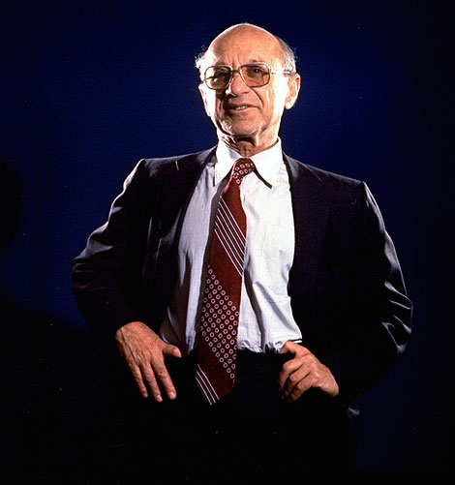
INFLATIONARY THINKING: 1970’s and 1980’s
Monetarism, Expectations and Freidman
Milton Freidman
(1912-2006)
Reinvented the idea of monetarism from the 1700’s as a way to explain inflation
Challenged the Keynesian orthodoxy in the 1960’s
Against Government regulation in ANY forms
Margaret Thatcher loved Freidman’s ideas and when she came to power, to combat inflation she adopted his ideas on combatting inflation by drastically reducing the money supply.
Contributed to the debate concerning the relationship with inflation and unemployment through his “expectations” hypothesis
  If people think the inflation rate will be higher, they will ask for higher wages and it will be a self-fulfilling prophecy

Slide 39

INFLATIONARY THINKING: 1970’s and 1980’s
The Quantity Theory of Money (Monetarism)
According to Freidman:
“Inflation is always and everywhere a monetary phenomenon, in the sense that it cannot occur without a more rapid increase in the quantity of money”
According to Wikipedia:
“Monetarism is the study of the money supply in determining inflation”
“Too much money chasing too few goods?”

Slide 40
INFLATIONARY THINKING: 1970’s and 1980’s
Monetarism and the Fischer Equation
Assume £100 of money in circulation in the economy. On average, each £1 changed hands 4 times during the year. So we know that £400 must have been spent during the year. If the average price of each transaction £2, there must have been 200 goods/services bought.
TASK: How much is M, V, P and Y?
MV=PY
M=Stock of Money (includes notes, deposits etc.)
V=Circulation of Money (the speed at which money circulates)
P=Price Level (average price of a basket of goods)
Y=Total Output
M is £200, V is 10 and Y is 100.
What is the value of P
The money supply now doubles. If V and T remains constant, what is the new value of P?
At the new money supply level, T now increases from 100 to 150. What will happen to the price level if there is no change in the money supply and V remains constant.
Notes:
M = total amount of money
V = Velocity of ciiculation: V is the number of times the money supply changes hands over a period of time, such as a year.
Assume £100 of money (M) in circulation in the economy. On average, each £1 changed hands 4 times (V) during the year. So we know that £400 must have been spent during the year (MxV). If the average price of each transaction £2 (P), there must have been 200 goods/services bought.
Similarly if 100 goods/services are exchanged over a year and each good/service was an average of £5 (P), then the total amount spent was £500. If there was only £50 of money in circulation (M), that money must have changed hands on average 10 times during the year. So the velocity of circulation of money must be 10.

Slide 41
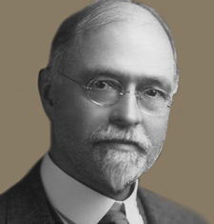
INFLATIONARY THINKING: 1970’s and 1980’s
Monetarism and the Fischer Equation
MV=PY
M=Stock of Money (includes notes, deposits etc.)
V=Circulation of Money (the speed at which money circulates)
P=Price Level (average price of a basket of goods)
Y=Total Output
Assumptions:
V=Fixed/Constant (money circulates quickly and similarly)
Y=Fixed/Constant (at the maximum capacity each year)
What is the CONCLUSION?
Inflation is caused by…increases in the money supply lead to increases in the price level
Notes:
M = total amount of money
V = Velocity of ciiculation: V is the number of times the money supply changes hands over a period of time, such as a year.
Assume £100 of money (M) in circulation in the economy. On average, each £1 changed hands 4 times (V) during the year. So we know that £400 must have been spent during the year (MxV). If the average price of each transaction £2 (P), there must have been 200 goods/services bought.
Similarly if 100 goods/services are exchanged over a year and each good/service was an average of £5 (P), then the total amount spent was £500. If there was only £50 of money in circulation (M), that money must have changed hands on average 10 times during the year. So the velocity of circulation of money must be 10.

Slide 42
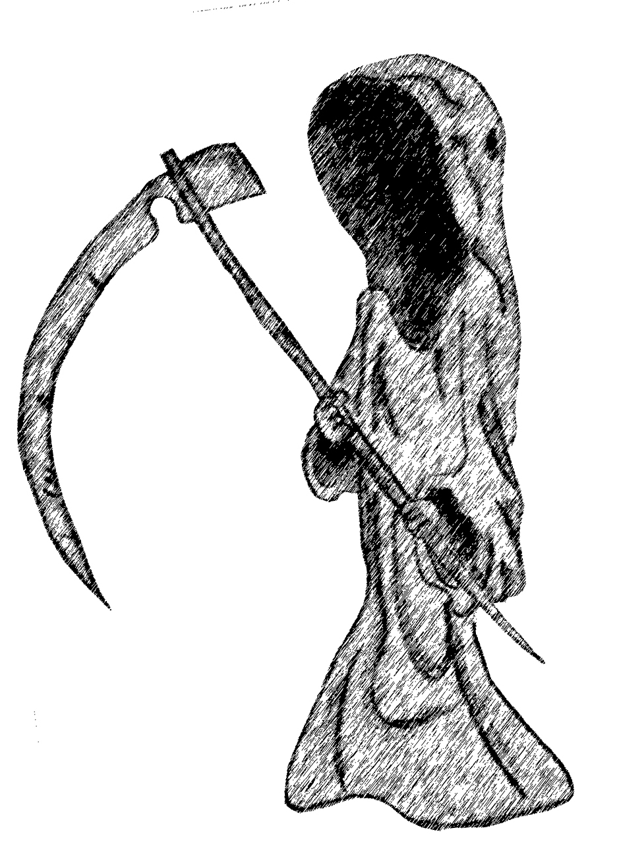
INFLATIONARY THINKING: 1970’s and 1980’s
Is Monetarism Dead Today?
What are the criticisms of monetarism today?
Velocity is not necessarily constant and changes frequently especially if it becomes easier to make transactions
Output not at maximum productive capacity and therefore can change?
The growth of the money supply is notoriously hard to identify (credit money etc.)
Other factors (e.g. Keynesian causes more real?)

Slide 43
INFLATIONARY THINKING: 1970’s and 1980’s
Psychology of Inflation
KEY TERMS:
Inflationary Expectations
  1960’s and 70’s: Adaptive Expectations
  1980’s: Rational Expectations
Horse Race Analogy – What would you look for when betting on a horse?
Form of the horse?
Jockey?
Other?
Inflation Analogy – people judge their expectations on:
Last years inflation (Adaptive)
Current situation and whole history of inflation: Oil prices? Cycle of economy? (Rational)
FINAL KEY TERM:
MONEY ILLUSION (when agents confuse nominal and real values when making decisions). Money illusion is most likely to occur when inflation is unanticipated.
Year 1: 5%
Year 2: 5%
Year 3: 7%
What is the illusion?
Abraham Lincoln famously asserted:
“You can fool some of the people all of the time, and all of the people some of the time, but you cannot fool all of the people all of the time.”

Slide 44
Theories of Inflation
TASK: Note taking and clarification of learning….
Keynesians
  Demand Pull – inflating prices through increases in ‘real output’ through behavioural factors (‘people’ just have confidence to ‘buy’ more)
  Cost Push - caused by higher wage demands (as well as import price increases).
New Classicals
  Monetarism (Quantity Theory of Money) - a form of ‘demand pull’ but based on ‘excess money’ not ‘real income’ like Keynesian demand-pull. So
  Psychology of Inflation (Adaptive and later Rational Expectations)

Slide 46
WEEK 3

Slide 47
HWK

Slide 48
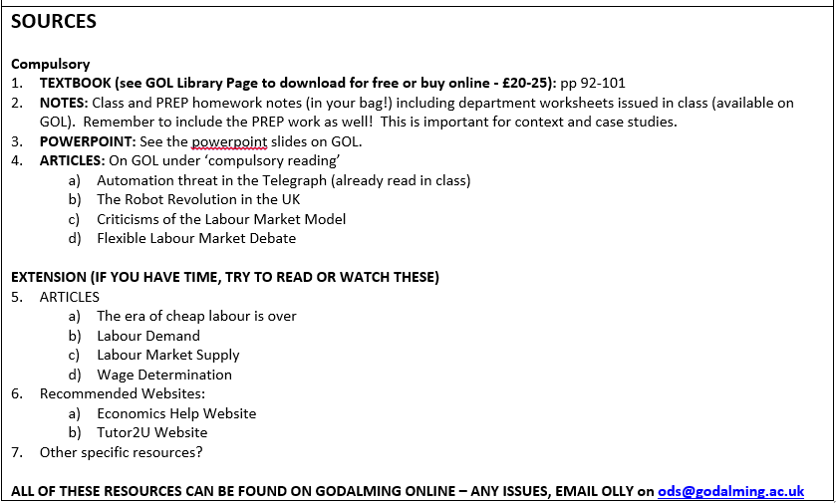
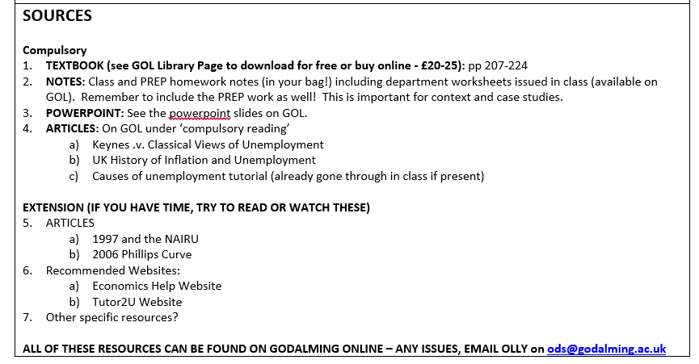
RWS HOMEWORK
Due w/b 22nd January (2.25 to 3 hours)

Slide 49
45

Slide 50
RWS 17 (MACRO): Philips Curve Analysis
The Classicals fight back! Causes of inflation
HISTORY OF MACROECONOMICS – How do we deal with Unemployment?
1930’s: PROLONGED UNEMPLOYMENT - Keynes takes on the Classicals with their ‘AD is lacking’ theory!
1940’s-1970’s: ‘COMMITMENT TO FULL EMPLOYMENT’ - Keynesianism model adopted by Governments. Spend in times of scarcity and save in times of plenty.
1970’s: ‘HIGH INFLATION’ - Birth of Monetarism and ‘New-Classicals’: Inflationary problems hint at limitations with the Keynesian model? Should the focus be on inflation AND NOT unemployment?
  Keynes manipulation of AD helps with ‘demand-pull’ but what about ‘cost-push’ pressures from external factors (i.e. oil prices)
  Hard to know how far to stimulate AD to reduce unemployment without causing an inflationary problem?
  Perhaps something else is causing inflationary pressures other than cost push and demand pull? Monetarism and research on ‘inflationary expectations’ begins.
1980’s: ‘INFLATION TAMED’ - Margaret Thatcher in 1980 adopted Friedman’s targeting of inflation and monetarism but ‘boom and bust’ still remain
1993-2007: ‘THE GREAT MODERATION’ - Low inflation and steady growth as inflation still targeted (Central Bank made independent in 1997) but monetarism abandoned.

Slide 51
LONG RUN EQUILIBRIUM DEBATES
Where is equilibrium on the AD/AS Model?
Can equilibrium stay behind the LRAS for ever?
Keynesian and Classical Controversy
  CLASSICAL VIEW: Short run equilibrium will ultimately move back to the long run equilibrium (so be on the LRAS) through changes in SRAS. This is because market forces will ensure that costs of production will change to return to the LRAS as workers will accept lower real wages.
  KEYNESIAN VIEW: Short run equilibrium will not necessarily move back towards the LRAS. Therefore long run equilibrium does not need to be on the LRAS but can be behind it for long periods of time at “A”. Perhaps it would move back to the LRAS eventually but this could take an awfully long time and we may have all died by then! He even suggested that due to a lack of consumer confidence (‘animal spirits) caused by the persistent unemployment the AD curve might shift more to the left as consumers chose to save. Therefore he invented his own LRAS curve called the ‘Keynesian LRAS’ - see Diagram 2. This states that increasing aggregate demand to achieve growth would not lead to price increases (a criticism of Hayek’s towards Keynes’ ideas).
  SOLVING UNEMPLOYMENT: Classical economists think the Government should not intervene (unless it is to remove ‘rigidities’ in the labour market like Trade Unions). The market mechanism will return the long run equilibrium to the LRAS. Keynesian economists however feel the Government must intervene in the short run to grow the economy and generate unemployment because in the long run we are all dead and cannot wait for the ‘market’ to kick into action.
LRAS
Classical
Price Level
Price Level
LRAS Keynesian
SRAS
P/L1
A
P/L1
A
AD1
AD1
AD2
Y1
Y
Real GDP
Y1
Y
Real GDP

Slide 52

LONG RUN EQUILIBRIUM DEBATES
Can equilibrium stay behind the LRAS for ever?
Keynesian and Classical Controversy
1. CLASSICAL SOLUTION TO UNEMPLOYMENT
TASK: Draw an economy using an ADAS diagram in short run equilibrium with a negative output gap (representing unemployment). What would a classical economist argue would eventually happen to this short run equilibrium in the long run to return to full employment?
2. KEYNESIAN CRITICISM TO CLASSICAL SOLUTION OF UNEMPLOYMENT
TASK: Draw an economy using an ADAS diagram in short run equilibrium with a negative output gap (representing unemployment). What would a Keynesian economist say would eventually happen if there was no intervention?
EXTRA QUESTION TO CONSIDER: Because of ‘animal spirits’ (in other words consumer confidence), why did Keynes say that not only would we stay at the equilibrium but that the AD curve might start to fall back (shift to the left) making the output gap even worse?
3. KEYNESIAN SOLUTION TO UNEMPLOYMENT
TASK: Draw an economy using an ADAS Diagram in short run equilibrium with a negative output gap. Demonstrate what Keynes said Government’s should do intervene to close the output gap back to long run equilibrium?
Why might Hayek criticize this approach? (think about why Keynes’ approach may be unsustainable).

Slide 53
LONG RUN EQUILIBRIUM DEBATES
Can equilibrium stay ahead of the LRAS forever?
Classical and Keynesian CONSENSUS: The Wage Spiral Theory
QUESTION:
Assume the UK economy is in equilibrium on the productive capacity of the economy. If consumer confidence increases because of a football world cup, using a AD/AS diagram, explain what would happen to output and prices in the short run AND the long run.
Shift in the AD curve due to an increase in consumer confidence
(e.g. the World Cup is on and people are more inclined to spend)
Price Level
LRAS
SRAS2
P/L 3
SRAS1
An increase in the price level has occurred. As more consumers wish to spend,
Output in the economy has risen from Y1 to Y2. However, the economy is using resources beyond it’s means (outside the PPF or LRAS).
Workers will be expected to work overtime for a while to produce the extra output. Eventually after higher wage demands (as inflationary expectations increase), the SRAS will start to shift to the left as the costs of production for companies increases due to increase in wage demands.
Output will fall from Y2 to Y3
The price level will continue to rise and ultimately, the increase in AD has not increased output in the long run but has only increased price levels (P/L1 to P/L3)
P/L 2
P/L 1
AD2
AD1
Y1
Y2
Real GDP
Y3
Y2

Slide 54
ASSESSMENT QUESTIONS
Why did Keynes argue that stimulating AD through fiscal policy was an effective policy to reduce unemployment
  Free market faces rigidities and wages will not naturally fall to correct unemployment = ‘we are are all dead in the long run
  Monetary policy is less effective when there is a ‘liquidity trap’
Why did Classical economists argue against the Keynesian hypothesis?
  Danger of inflationary pressures – especially wage spiral
  Crowding out of private sector investment
  Excessive debt is not sustainable
Why was Keynesianism so successful from 1940’s to 1970’s
  Targeting ‘full employment’
  LRAS L-shaped so increases in AD do not lead to inflation up to productive capacity
  Managing AD – not just borrowing but also paying off debt during good times
Why did New Classical theories take over in the 1970’s?
  High inflation in the 1970’s due to wage pressures from trade unions etc.
  New theories of why inflation is caused – monetarism and expectations

Slide 55
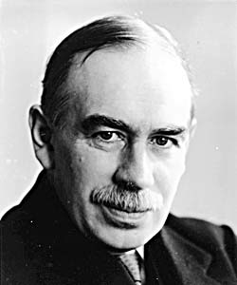
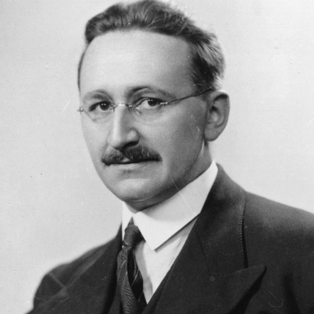
Government Policy
Classical .v. Keynesian Approaches to dealing with Unemployment
Demand Side Policy
  Fiscal Policy
    Running a budget deficit (so lower taxes and increased spending)
  Monetary Policy
    Lowering interest rates
Supply Side Policy
  Interventionist
    Minimum Wage
    Education
    Job Centres
  Free Market (Do nothing or move away from Government intervention)
    Cutting benefits
    Increasing the flexibility of the labour market by cutting labour regulations and cutting Trade Union Power

Slide 56
Evaluate policies to reduce unemployment
INTRO
MAIN
  Point 1: Demand side policies reduce unemployment
    As: Disequilibrium Keynesian unemployment argument (AD curve to the right - give examples of possible policies)
    Ae: Disequilibrium Classical unemployment argument (the market will reduce wages)
    Ae: Equilibrium argument against Keynesianism = e.g. the ‘Wage Spiral’ effect at the NRU?
  Point 2: Supply side policies reduce unemployment
    As: Examples of policies and explain how SRAS could shift to the right to solve disequilibrium
    As: Helps to eradicate dis-equilibrium classical unemployment if restrictions are preventing the wage from dropping and the market from operating efficiently
    Ae: Long time to implement supply side policies, could lead to lower wages and greater poverty etc.
CONC

Slide 57
‘Full Employment’?
NRU?
NAIRU?
N = Non
A = Accelerating
I = Inflation
R = Rate of
U = Unemployment
N = Natural
R = Rate of
U = Unemployment
Voluntarily Unemployed
Workers who are choosing not to work - frictional and structural
It is an equilibrium or steady state of unemployment.
RIGHT WING VIEW

Slide 58
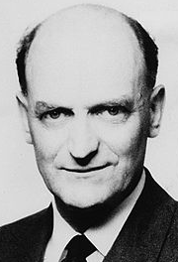
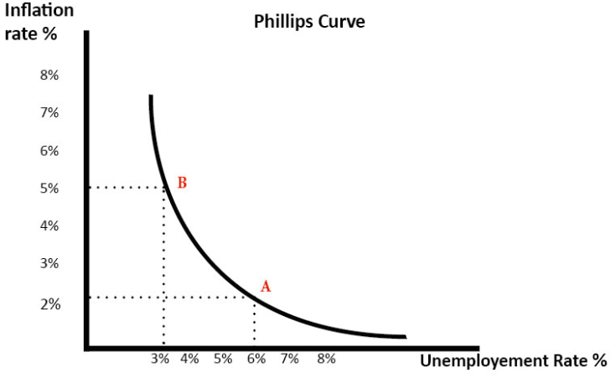
The Phillips Curve!
Relationship between Unemployment and Inflation
Based on data from 1861 to 1957 by Bill Phillips
Suggests:
  Inverse relationship between unemployment and inflation
  Policy makers have a choice between focusing on unemployment OR inflation not both
  Keynesians suggest that reducing unemployment leads to a cost of inflation but this is worthwhile

Slide 59
The Phillips Curve!
Relationship between Unemployment and Inflation
TASK 1: Explain why is there a trade off between unemployment and inflation?
TASK 2: Draw an AD/AS diagram below to show the same effect?

Slide 60
The Phillips Curve!
Relationship between Unemployment and Inflation
TASK 1: Explain why is there a trade off between unemployment and inflation?
An increase in aggregate demand (AD to AD2) causes higher real GDP (Y1 to Y2 on an AD/AS diagram). Therefore firms employ more workers and unemployment falls.
However, as the economy gets closer to full capacity, we see an increase in inflationary pressures. With lower unemployment, workers can demand higher money wages, which causes wage inflation. Also, firms can put up prices due to rising demand.
Therefore, in this situation, we see falling unemployment, but higher inflation.

Slide 61
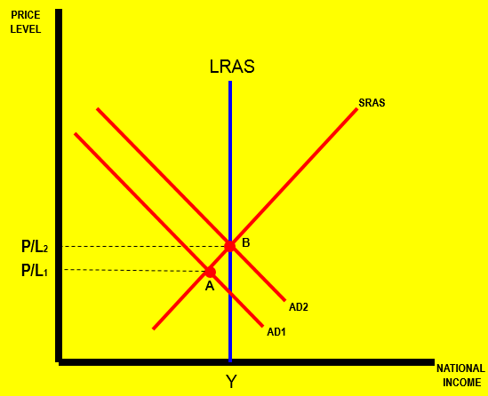
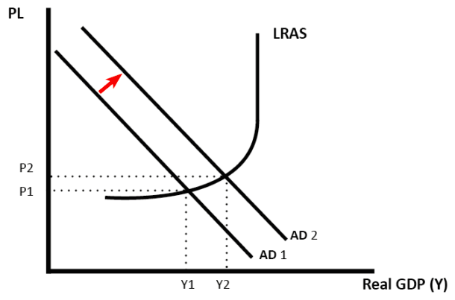
The Phillips Curve!
Relationship between Unemployment and Inflation
TASK 2: Draw an AD/AS diagram below to show the same effect?

Slide 62
90

Slide 63





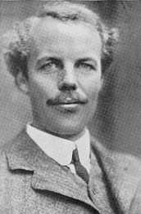



FIGURING OUT UNEMPLOYMENT AND INFLATION: What’s a Govt. to do?
The Macroeconomic Timeline: An Economic History 1930-2018
Keynesians
Monetarists
Consensus?
Classicals
Philips Curve
New Classicals
What Now?

Slide 64
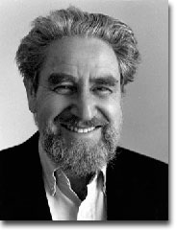
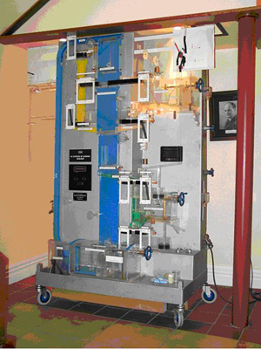

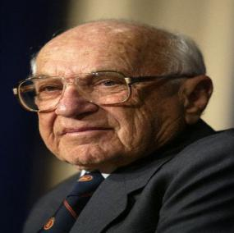
The Sixties 1960-1969
Bill Philips and The Original Philips Curve
Background
Born in New Zealand in 1914 and died in 1975
(b) Career
Originally an Engineer but changed to become an Economist, after trying Sociology
(c) Developed MONIAC
Monetary National Income Automatic Computer – modelled the UK economy – an engineering feat to demonstrate the circular flow of income model
Theoretical Criticisms of the Philips Curve from Milton Freidman
(a) The distinction between the short run and the long run
He accepted that the Philips curve in the short run but claimed there was no trade-off in the long run. Attempts to reduce unemployment would be unsuccessful and just generate inflation (sound familiar?) in the long run.
(b) Expectations theory, Money Illusion and the Wage Spiral
Freidman developed his idea of expectations in the late 1960’s by saying that peoples expectations of inflation would change WITH inflation after a time as they would ‘adapt’ to the previous year. Workers may suffer from ‘money illusion’ in the short-run but because of adaptive expectations, they would not in the long run. Bill Philips simply assumed there was only a given expectation of inflation.

Slide 65
The Sixties 1960-1969
Criticisms of the Philips Curve from Milton Freidman
Adaptive Expectations theory, Money Illusion and the Wage Spiral
Bill Philips simply assumed there was only a given expectation of inflation.
Freidman disputed this. He developed his idea of adaptive expectations in the late 1960’s by saying that peoples expectations of inflation would change because of their knowledge of previous inflation after a period of time.
Money Illusion and Expectations:
People think they have more money then they actually do. For example, you might expect inflation to be 1% because that is what it has been like for the past few years. When inflation changes to 3%, it will take you sometime to realise this and if your wages rise by 3% as well, you think you have more money then you actually do. Although your nominal income has increased, your REAL income has fallen. However money illusion does not last for ever as people’s EXPECTATIONS change based on what happened before.

Slide 66
The Sixties 1960-1969
NOTE TAKING Summary
What is the relationship between unemployment and inflation according to Bill Philips?
Why did Freidman criticise the Philips curve?
What is money illusion and why did Freidman say it would not last forever?

Slide 67

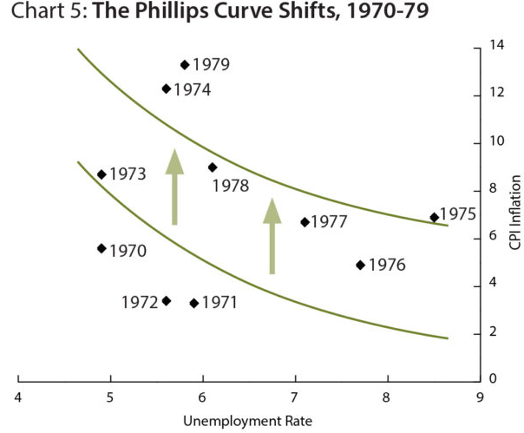
The Seventies 1970-1979: Freidman is right!
Milton Freidman suggested workers (organised by trade unions) were realising inflation was higher from last year (adaptive expectations) and were pushing for higher wages
SRPC can shift due to inflaitonary expectations

Slide 68
The Seventies 1970-1979
The Monetarists’ Long Run Phillips Curve and the NAIRU plus the birth of the ‘New Classicals’ and Rational Expectations
The NRU (Natural Rate of Unemployment) or NAIRU (Non-Accelerating Inflation Rate of Unemployment)
So Freidman developed the idea of a point where demand side policies would no longer work and rather than reducing unemployment, they would just cause inflation in the long run. All unemployment at this point was considered to be voluntary – i.e. people are choosing not to work.
There needed to be a combination of:
(i) supply side policies to remove Government interventions (and therefore reduce the NAIRU)
(ii) controlling the money supply to keep inflationary expectations under control
(b) The New Classicals, Money Illusion and Rational Expectations:
How quickly do you think people will realise they are suffering from money illusion?? Freidman took the analysis further therefore by saying People will never think they have more money then they actually do. This is because they not only take into account historical data but other information around them (the state of the economy etc.). They have perfect information! HOW realistic is this?

Slide 69
Clockwise Phillips loops
.
P (%)
c
b
a
Year 2
U_{n}
U (%)
Year 0, 1

Slide 70
Clockwise Phillips loops
.
P (%)
f
e
d
Year 5
c
Year 4
Year 3
b
a
Year 2
U_{n}
U (%)
Year 0, 1

Slide 71
The Phillips Curve
To counter the rise in unemployment, government once again injects resources into the economy – the result is a short-term fall in unemployment but higher inflation. This higher inflation fuels further expectation of higher inflation and so the process continues. The long run Phillips Curve is vertical at the natural rate of unemployment. This is how economists have explained the movements in the Phillips Curve and it is termed the Expectations Augmented Phillips Curve.
Inflation
Long Run PC
Assume the economy starts with an inflation rate of 1% but very high unemployment at 7%. Government takes measures to reduce unemployment by an expansionary fiscal policy that pushes AD to the right (see the AD/AS diagram on slide 15)
There is a short term fall in unemployment but at a cost of higher inflation. Individuals now base their wage negotiations on expectations of higher inflation in the next period. If higher wages are granted then firms costs rise – they start to shed labour and unemployment creeps back up to 7% again.
3.0%
2.0%
1.0%
PC1
5%
7%
PC2
Unemployment
PC3
The NRU (also called the NAIRU)

Slide 72
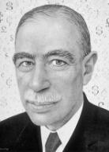


The Seventies 1970-1979
The New Philips Curve and the NAIRU: A new approach - The Death of Keynesianism?
The NAIRU and New Classicals
So Freidman developed the idea of a point where demand side policies would no longer work and rather than reducing unemployment, they would just cause inflation. New Classicals then claimed that because of rational expectations, money illusion would not exist and any demand side policy would lead to instant inflation.
Therefore there needed to be a combination of:
(i) supply side policies (to reduce the NAIRU)
(ii) controlling the money supply to keep inflationary expectations under control
PROBLEM: Stagflation – How did Freidman explain this?
Defintion: Where unemployment is rising, but SO is inflation!
Inflationary expectations and the NAIRU? Inflation got up to 25% in the mid 70’s and unemployment reached 10%)
Is the Long Run Philips curve redundant OR is it moving?

Slide 73
The Seventies 1970-1979
NOTE TAKING SUMMARY
What shape is the LRPC and why?
What is stagflation
Why was large inflation the death of Keynesianism?
Why were there increasing inflationary expectations in the 1970s?
What are the differences between adaptive and rational expectations and what are the implications for the LRPC if demand management is used to reduce unemployment?
Why did Stagflation question Freidman’s LRPC theory?

Slide 74

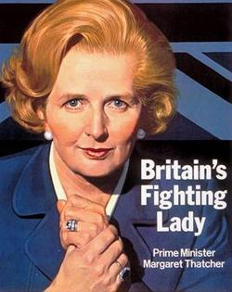
The Eighties 1979-93: Thatcher’s Legacy
Thatcher adopted Freidman’s policies
Policy #1: Target the money supply
Policy #2: Implement free market supply side policies
Consequences?

Slide 75
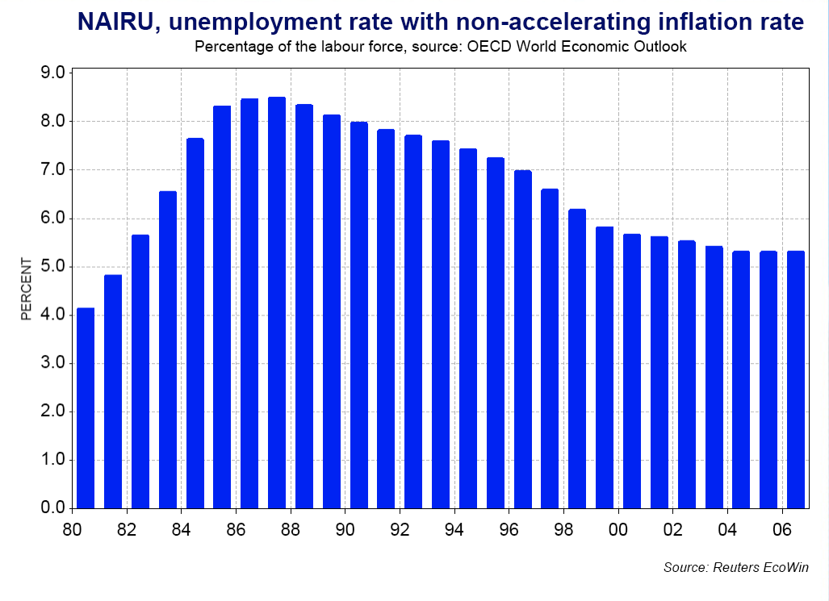
The New Classicals .v. The New Keynesians: The BIG FIGHT
NAIRU does MOVE but WHY?
Hysterisis (New Keynesians) .v. Labour Market Inflexibility (New Classicals)

Slide 76
The Eighties 1979-93: Note Taking Summary
What did Thatcher prioritise when she came to power?
What were the New Classicals and New Keynesians arguing about and why did their solutions differ??

Slide 77

The Nineties and Naughties 1993 - 2007
The Great Moderation (The Death of Inflation) and an Academic Consensus!
Great Moderation (Death of Inflation
Government policy in the 1980’s helped to subdue inflationary expectations compared to 1970’s (although still ‘Boom and Bust’ cycle)
Globalisation – cheaper imports and cheaper labour (immigration)
Technological advances – shipping, computers and internet increase productivity and lower costs
Academic Consensus
Agreement that combination of free market and interventionist supply side policy important to reducing unemployment
Agreement inflation targeting since the early 1990’s by the Bank of England has given ‘credibility’ and controlled inflationary expectations

Slide 78
History of Short Run Philips Curve 1970-2007
Inflationary Expectations

Slide 79
Inflation (%)
The breakdown of the Phillips curve?
65
66
62
61
64
67
63
60
Unemployment (%)

Slide 80

Inflation (%)
The breakdown of the Phillips curve?
Original Phillips curve
65
66
62
61
64
67
63
60
Unemployment (%)

Slide 81
Inflation (%)
The breakdown of the Phillips curve?
74
73
71
72
70
65
69
66
62
68
61
64
67
63
60
Unemployment (%)

Slide 82
Inflation (%)
The breakdown of the Phillips curve?
75
76
74
77
79
73
71
72
78
70
65
69
66
62
68
61
64
67
63
60
Unemployment (%)

Slide 83
Inflation (%)
The breakdown of the Phillips curve?
75
80
76
74
77
79
81
73
71
78
82
72
70
85
65
69
84
62
68
83
66
61
64
67
63
60
Unemployment (%)

Slide 84
Inflation (%)
The breakdown of the Phillips curve?
75
80
76
74
77
79
81
71
90
73
78
89
82
72
70
91
85
65
69
88
84
62
68
87
83
66
95
92
86
61
64
67
94
63
93
60
Unemployment (%)

Slide 85
Inflation (%)
The breakdown of the Phillips curve?
75
80
76
74
77
79
81
71
90
73
78
89
82
72
70
91
85
65
69
88
84
62
68
98
87
83
66
03
00
97
95
92
86
61
64
67
96
94
63
01
02
99
93
60
Unemployment (%)

Slide 86
HISTORY OF SHORT RUN PHILIPS CURVE
Inflationary Expectations: 1971 to 2007

Slide 87
The Nineties and Naughties 1993 - 2007
Note Taking Summary
Why has the great moderation been associated with ‘the death of inflation’?
What was the academic consensus about reducing unemplyoment and inflation during this period?

Slide 88
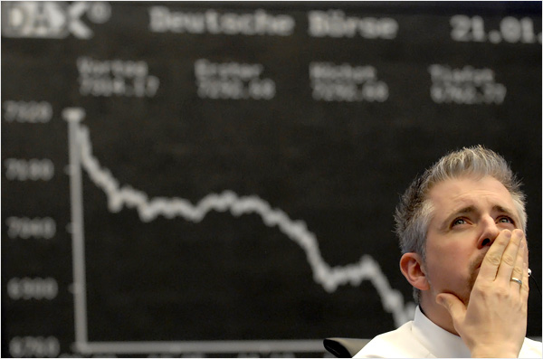

The Naughties and Global Recession 2007 – 2013
‘The Great Recession’
2007-2010: New Labour
Old Keyneisan Policy of AD Management
2010-2015: Austerity
Balance the Budget and reduce the National Debt
Unemployment falling
Danger of deflationary spiral
Stagflation REVISITED?
POLICY RESPONSE?
TASK: Sketch what might have happened to the SRPC and LRPC in this period?

Slide 89

‘The Great Backlash?’ 2013 – 2018??
Threat today?
Abandon austerity?
Rise of populist politics – backlash against globalisation
Lowest unemployment
But low real wages = lower living standards?
Productivity puzzle?
TASK: What might have happened to the SRPC and LRPC in this period?

Slide 90
FIGURING OUT UNEMPLOYMENT AND INFLATION: What’s a Govt. to do?
The Macroeconomic Timeline: An Economic History 1930-2018
Keynesians
Monetarists
Consensus?
Classicals
Philips Curve
New Classicals
What Now?

Slide 91
SUMMARY of Unemployment and Inflation Relationship
1930’s-1940’s: Classicals .v. Keynesians (The First BIG FIGHT) – Classicals claimed unemployment is because firms cannot employ people because real wages and wage expectations are too high. Workers are choosing not to work at the lower market wage rate. Keynesians wondered how long this would last for and suggested it was a lack of AD.
1940’s-1970’s: Keynesianism – unemployment due to lack of AD so boost AD to reduce it. Philips identified a trade off between unemployment and inflation. Governments target full employment.
1970’s: Monetarists (Freidman) – Short Run and Long Run relationship between unemployment and inflation. Inflationary expectations are not fixed but change (shifts in SRPC) through adaptive expectations. In the long run there is a fixed natural rate of unemployment (voluntary unemployment) represented by a LRPC. Therefore deducing unemployment through Keynesian AD boosts will just lead to inflation.
1975-1979: New Classicals – Suggests that because of rational expectations, the effect of AD management would be instant because rational workers would predict any possible inflation increases.
1979-1993: New Keynesians .v. New Classicals – the SECOND BIG FIGHT: Why is the NAIRU (LRPC) moving and how do we reduce it? New Keynesians (hysterisis and interventionist supply side) and New Classicals (inflexible labour markets the problem so need to have rigidities removed) are in CONFLICT
1993-2007: CONSENSUS – perhaps a combination of ‘Interventionist’ and ‘Free Market’ Supply Side Policies are useful? Death of inflation supposedly occurs; caused by Government policies or Globalisation.
2007-2013: Great Recession - return to Traditional Keynesian economics!! Boost AD
2010+: What now….deflationary threats? How do we stop deflation? A ‘lost decade’? OR ‘a recovery thanks to Austerity Economics’?

Slide 92
Summary Questions
Unemployment and Inflation
How can Philips Curve analysis help us demonstrate both equilibrium and disequilibrium unemployment? Draw a graph to demonstrate.
Using Phillips Curve analysis, explain why demand management policies might be ‘useful’ and ‘not useful’ in reducing unemployment.
Using Phillips Curve analysis, explain the role of supply side policies play in reducing unemployment?
What might the problems be with supply side policies for reducing unemployment?
What policies should the Government be using currently with the UK economy?

Slide 93
“The only way to reduce unemployment from ‘The Great Recession’ is to use demand side policies”. To what extent do you agree with this statement? (25 Marks)

Slide 94
Summary of Theories
Economic Theories | How do Government’s reduce unemployment? | Managing the price level
Classical | Wages can be sticky but only in the short run. Workers are volunteering not to work at a lower wage rate. This will only go on for so long as the free market will correct itself eventually | Free market will take care of itself.
Keynesian | Wages are sticky and will not revert to the new equilibrium price – we are all dead in the long run. This is because firms cannot afford to pay workers the ‘right’ wage. Stimulate aggregate demand with fiscal policy to allow further demand to stimulate activity in the economy so firms can afford to pay wages. | Inflation may occur but target of full employment more important to achieve. Trade off recognised however via Phillips Curve.
Monetarists and New Classicals | Free Market supply side polices to reduce the NAIRU (the natural rate of unemployment – frictional and structural unemployment or “voluntary unemployment”). The NAIRU reduces due to the inflexibilities of the labour market such as too much Government welfare support, power of trade unions etc.. | Do not use demand management policies as it creates more inflation. Manage expectations through control of the money supply (Monetarism) Recognition that economic agents have ‘inflationary expectations’ and therefore will make more informed decisions and are less likely to suffer from money illusion.
New Keynesian | Interventionist supply side policies to reduce the NAIRU (the natural rate of unemployment – frictional unemployment which is not necessarily “voluntary”). The increasing NAIRU is caused by Hysterisis and therefore policies such as education and training or the minimum wage will encourage the unemployed back into the workforce. | Recognition that inflationary expectations can play a part. Rejects the monetarist ‘quantity theory of money’ and the Fisher equation.
New Keynesian/Classical consensus | Use both free market and interventionist supply side policies to reduce overall NAIRU | Target inflation using interest rates and make Bank of England independent from political influence to provide more inflationary credibility and bring down expectations
The Future | Do not move the LRAS too far to the right – can create undercapacity and deflationary pressures. Unemployment caused by the ‘great recession’ of 2008; how should it be dealt with? Is Austerity just making the problems worse? | Liquidity trap problems in Japan? A return to Keynesianism to reverse deflationary pressures 2007-2010? A return to Classical economics in balancing the budgets from 2010 onwards

Slide 95
END

Slide 96
LABOUR MARKET FLEXIBILITY
EUROPEAN SOCIAL MODEL
ANGLO-SAXON MODEL
High unemployment benefits
Rules which make it difficult to fire workers
Protection for trade unions
Worker consultation regarding company policy -in Germany worker representation on the board of directors
Early retirement on generous state funded pensions
Maximum working time – 48 hours and 35 hour week in France and Germany
High rates of taxation to pay for benefits
National champions – domestic firms - powerful internationally
Protected from take over by “foreigners” who might shut down domestic plants and transfer production elsewhere (think about Sarkozy’s recent comments about French car manufacturers in the Czech Republic)
Reluctance to privatise and remove government interference from key industries
Relatively low unemployment benefits to deter frictional or search unemployment
If the redundancy regulations are met firms can hire and fire at will
Trade union powers reduced in the 80’s and not restored by current government
Increasing worker consultation - usually only when firms have decided an outcome
Policy to increase retirement age in all the public services
Private pensions encouraged –abandonment of defined benefit schemes
High rates of income tax seen as a disincentive effect
No limitations on ownership of firms – takeovers left to shareholder/firms discretion
Privatise everything that can be sold to increase economic efficiency
VIDEO – 0930-20:25
Advantages and Disadvantages of the Two Models?

Slide 97
Problems with the models
EUROPEAN SOCIAL MODEL
ANGLO-SAXON MODEL
10% unemployment in France and Germany – firms do not hire unless they are able to fire when economic circumstances change - in a recession
Rates of economic growth too low to reduce unemployment
Problems of firms being uncompetitive due to high corporate taxation
Ageing of the population will mean that pensions/ welfare state support will have to be reduced or taxes will need to increase
Increasing gap between rich and poor in US and UK
Workers forced to be flexible – will have a poor standard of living if work is avoided
Increasing hours of work and stress levels
Quality of work may be low? You may only be working 15 hours a week part-time but need to work 40. You would not be classed as unemployed

Slide 98
­Discuss the view that as an economy approaches full employment, inflation will inevitably accelerate (25 marks)
Introduction
Define full employment – does it mean 0% unemployment or unemployment at the NAIRU?
Define inflation
Conclusion
Point of view
Justify
PTS |  | Economic Analysis | Real Life Examples
As an economy approaches full employment (0%) then inflation will inevitably increase | Support | Full employment is defined as 0% and there is a trade off between unemployment and inflation. Short run Philips curve analysis ONLY, explaining why as unemployment falls, inflation starts to rise – demand pull inflation. AD/AS Analysis can be used here as well/instead of…perhaps approaching the LRAS? | 1970’s – Barber boom and attempt to lower unemployment and approach full employment led to significant inflation in the mid-70’s (25%) 1980’s - Lawson Boom - similar fall in unemployment leads to sharp rises of inflation
 | Evaluate | This relationship is maybe not inevitable because of the death of inflation. Death of inflation led to flatter SRPC curves so the trade off was less. As the economy approaches roughly 0% unemployment (full employment), maybe inflation will not be inevitable? Also Implementation of supply side policies will lead to LRPC shifting to the left and approaching full employment at 0% but not necessarily causing inflation (SRPC shifts with LRPC to keep price level the same). Again inflation not inevitable | 1997-2007: The Goldilocks Era? Control of inflation with an independent central bank; the impact of globalisation on cheaper imports; more competitive labour markets through the lack of power from trade unions, more labour market flexibility and greater immigration from EU enlargement all keep wages and inflationary expectations down.
As an economy approaches full employment (NAIRU), inflation is not inevitable | Support | If full employment is at the NAIRU, then approaching full employment will not necessarily lead to inflation. Define NAIRU and voluntary unemployment. NAIRU analysis and points moving up to this point. Should show a flatter SRPC up until the NAIRU point to demonstrate argument. | 1997-2007: Did this happen in the Goldilocks Era? Policies of the 1980’s shifted NAIRU to the left, so demand management policies more viable to reduce disequilibrium unemployment as equilibrium unemployment had been reduced by supply side policies
 | Evaluate | But where is the NAIRU or ‘full capacity’ (LRAS) of the economy? It is very hard to estimate. What if as we approach full employment with demand side policies, we overshoot the mark? NAIRU, LRPC, expectations theory and the wage spiral. Also bring in the concept of money illusion. AD/AS Analysis of the ‘wage spiral’ would be acceptable here. | 1970’s – arguably greater inflation as a result of demand side policies to approach full employment kicked off higher inflationary expectations

Slide 99
Assess the impact on the UK macroeconomic performance of a prolonged period of deflation (25 marks)
Introduction Define macroeconomic performance Define deflation Current UK situation at the moment?
Main Points | ARGUMENTS | Economic Analysis | Real-life Examples
Deflation can lead to a deflationary spiral and reduction in economic growth (and the standard of living) | Support | Deflationary spiral can lead to reduction in economic growth Explain what deflationary spiral is and how it can delay consumption and how this could affect the UK economy. Use AD/AS analysis to demonstrate too | Japan in the 1990’s
 | Evaluate | Increased standard of living because of lower prices Explain how lower prices might stimulate AD and therefore be self-correcting. Use AD/AS analysis | N/A
Deflation can lead to reductions in unemployment | AGREE: | Refer to greater AD in argument above SRPC (movement along) | N/A
 | DISAGREE: | Unemployment will not fall and may rise Incentive to work may fall = increase in voluntary unemployment Slope of SRPC might effect degree of unemployment reduction. Slope determined by inflationary expectations. | House prices? Negative wealth effect might occur – very important in the UK as it is the culture to own a house.
Trade deficit might reduce | AGREE: | Imports would reduce and exports increase (why?) – talk about effect on macroeconomic indicators using AD/AS diagram – i.e. growth, inflation (recorrecting) and employment | N/A
 | DISAGREE: | This would not happen as other factors affect trade deficits Explain other factors – e.g. exchange rates, quality of goods in other countries, recessions in other countries and our own country, productivity rates between countries etc. | Talk about global economy currently – possible collapse of Euro imminent !?
Conclusion: Deflation has the potential to have mixed effects on UK macroeconomic performance. The degree to which it corrects itself rather than spiralling into a deflationary spiral depends on economic circumstances of the time especially inflationary expectations. Currently in the UK inflationary expectations are actually rising and therefore a short period of deflation might just lead to stimulated AD rather than delayed consumption. This would have a positive impact on unemployment. The trade deficit is hard to ascertain as many other factors influence the trade deficit of which domestic prices are just one small part. However in the longer run maybe a prolonged period of deflation could well have very damaging consequences for the UK economy, especially one on the brink of another recession.

