Slide 1
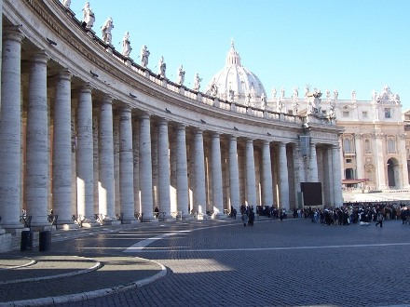
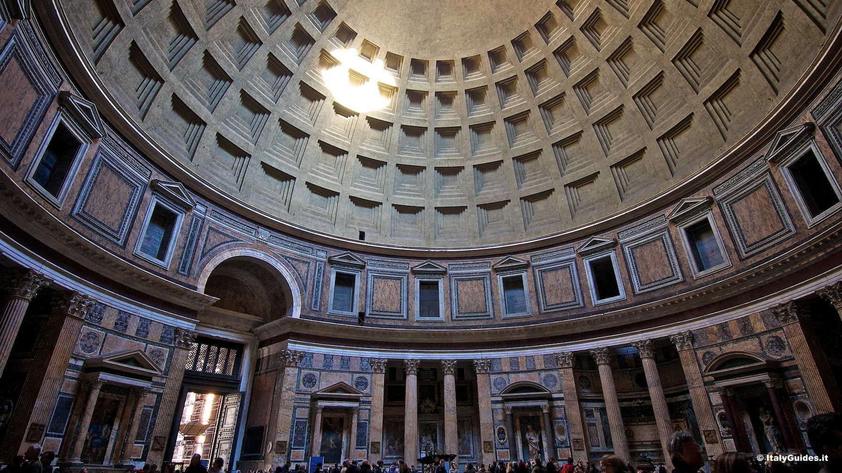
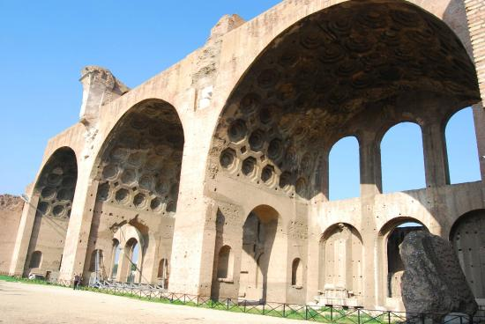
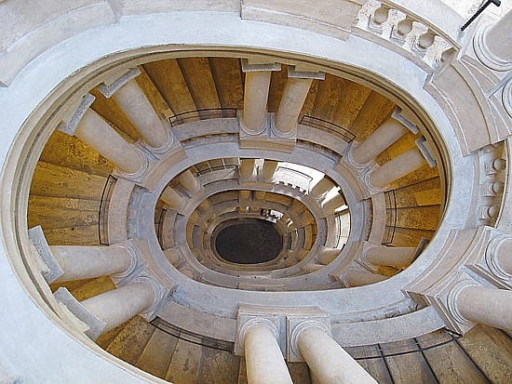
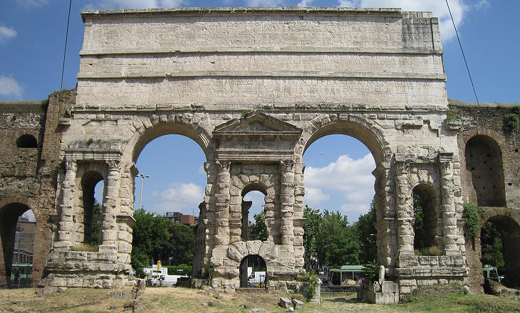
Pantheon
Basilica of Maxentius
Piazza San Pietro
Use of Columns/pilotis
Coffering/concrete
Coffering/curves/arches
Staircase
Military importance/ Grandeur and height
Francesco Borromini
Porta Maggiore

Slide 2
Explore how identity is expressed in one building.

