Slide 2
MS 1.10
Understand measures of dispersion, including standard deviation and range
Students may be tested on their ability to:
calculate the standard deviation
understand why standard deviation might be a more useful measure of dispersion for a given set of data, eg where there is an outlying result

Slide 3
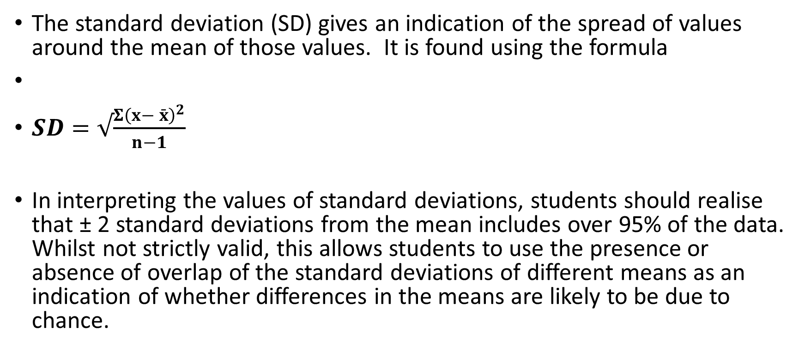
Standard Deviation
The standard deviation (SD) gives an indication of the spread of values around the mean of those values. It is found using the formula
$SD=√\frac{{Σ\left(x− \bar{x}\right)}^{2}}{n−1}$
In interpreting the values of standard deviations, students should realise that ± 2 standard deviations from the mean includes over 95% of the data. Whilst not strictly valid, this allows students to use the presence or absence of overlap of the standard deviations of different means as an indication of whether differences in the means are likely to be due to chance.

Slide 4
http://standard-deviation.appspot.com/

