Slide 1
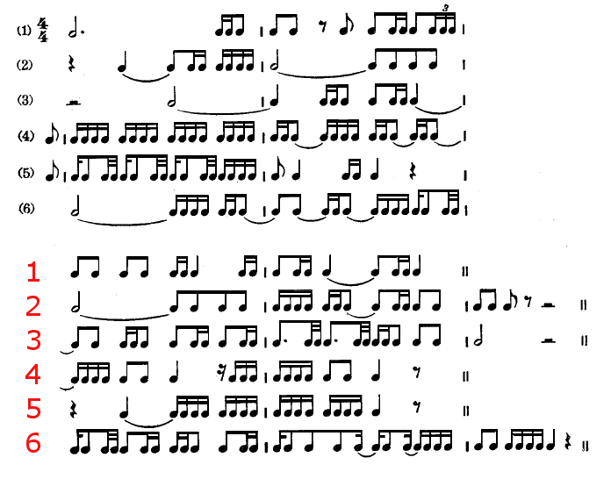
A2 MUSIC – RHYTHM TECHNIQUES

Slide 2
A2 MUSIC – RHYTHM TECHNIQUES
Don’t be scared!

Slide 3
Do you understand the following?
Simple Time
Compound Time
Complex Time
Triplets
Duplets
Other tuplets
Hemiola
Crossrhythm / Polyrhythm

Slide 4
Simple Time
Usually where ‘4’ is found as the lower number (i.e. measured in crotchets and with groupings of 2
2/4, 3/4 and 4/4
3/8 is also a simple time, but measured in quavers
2/2 or 3/2 are also simple times / meters

Slide 5
Compound time
Usually where ‘8’ is found as the lower number (i.e. measured in quavers)
Counted in groups of 3 (triplets)
E.g. 6/8, 9/8, 12/8
Can also be 6/4, 9/4 etc.
Or 6/16, 9/16… !

Slide 6
Complex time
Irregular meter or assymetric time
Does not fit usual duple or triple measures
5/4 ,7/8, 11/8 etc.

Slide 7
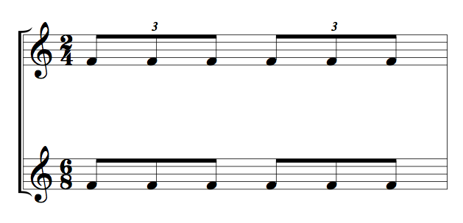
Triplets
A subdivision of three beats fitting into two
E.g. Two groups of three quavers in a 2/4 bar

Slide 8
Duplets
A subdivision of two beats fitting into three
E.g. Two groups of two quavers in a 6/8 bar

Slide 9
Tuplets
Any equal subdivision of beats within a given space
Written/beamed as the closest beat division
E.g. Below we see septuplets!

Slide 10
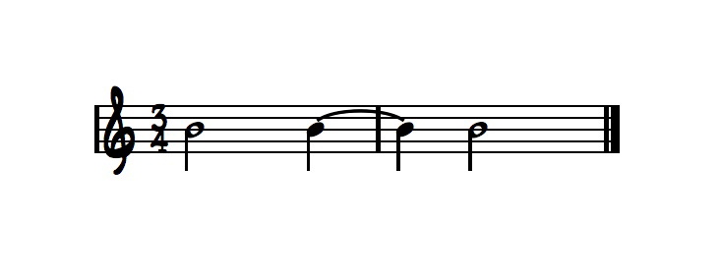
Hemiola
An effect often created with tied notes, to give the impression / feel of a different time signature to the one given e.g.

Slide 11
Hemiola continued…

Slide 12
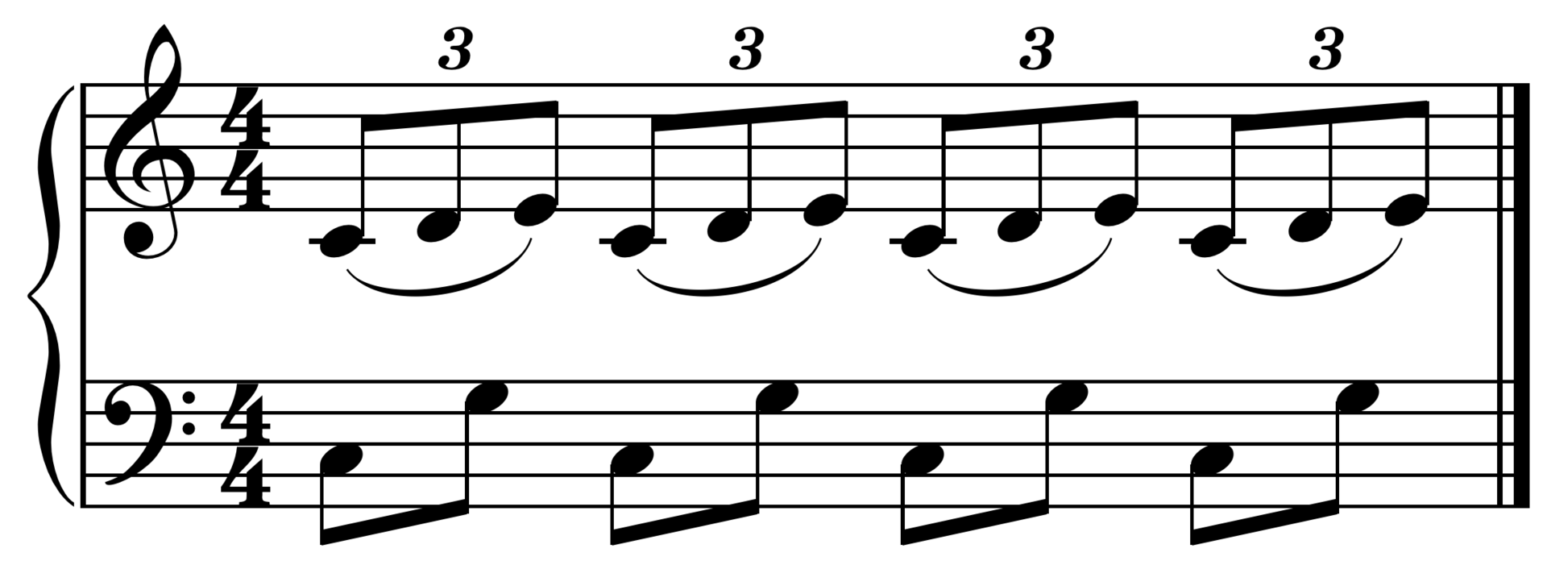
Crossrhythm / Polyrhythm
Two conflicting rhythms / meters being heard at the same time
Usually using triplet patterns over duplet patterns

Slide 13
Exercise one
Please transform the following 4/4 melody to fit into these time signatures. Write for piano and include chords -
6/8
5/4
7/8
https://www.youtube.com/watch?v=WjEdTfVDOl0

Slide 14
Exercise Two
Please now write a 4/4 version of ‘Auld Lang Syne’ with one example of a hemiola, and one example of crossrhythms/polyrhythms in the accompaniment / L.H.
Write for piano or melody instrument and simple accompaniment
For example you might use regular quavers in the L.H. to start with, before moving to triplet crotchets against the regular R.H. crotchets

