Slide 1
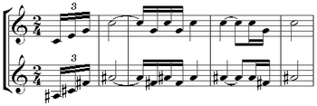
A2 Composition Extended Harmony

Slide 2
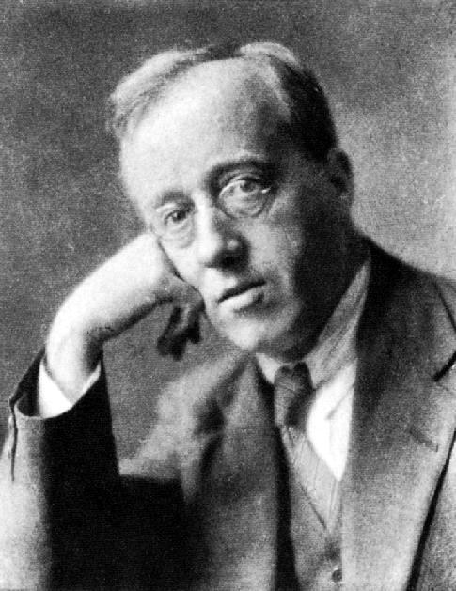
Gustav Holst – Planet Suite
When was it composed?
What genre is this musical work?
How could we describe the style?

Slide 3
Gustav Holst – Planet Suite
When was it composed?
1914 - 1916
What genre is this musical work?
Seven Movement Orchestral Suite / Programme Music
How could we describe the style?
Very much 20th Century! Quite eclectic and a key influence on modern day film score. We can even hear links to jazz!

Slide 4
Gustav Holst - Venus
The second movement in the suite -
II. Venus - ‘The Bringer Of Peace’
https://www.youtube.com/watch?v=EE6_PacCnRw

Slide 5
Gustav Holst - Venus
Are there any harmonic features which stand out purely from listening?

Slide 6
Activity (pairs) – Using Score
The music begins in Eb major (as per key sig). What is the basic harmonic movement in bars 3 – 4? Ignore chord extensions for now. Label on score as roman numerals
Now work out the extensions that have been added to / resulted in these chords and what names these chords would have i.e. a major triad plus major seventh = maj7 chord. Label on score or separate paper
What is the name of the chord in bar 5? How could we describe its relationship with the opening chord of F minor?

Slide 7
Continued analysis
The music then implies a modulation to Cb major(!!) has happened (Db minor being chord ii) and essentially transposes the opening material in bars 6 – 10
Another tertiary move is implied in bar 10, and indeed we seem to settle in Ab major from bar 11 onwards (notice all the D flats!)… at least for a bit!

Slide 8
Continued analysis
What harmonic feature (left hand) is used from bars 14 – 18?
Bars 26 – 27 (first half) suggest an approaching cadence in which key?
Bar 30 subverts all harmonic expectations! But how might we label the chord in this bar? The new key is F# major. Describe the chord in its full name (not roman numeral)

Slide 9
Composition Time
Today you should continue working on either your composition, or theme and variations for your practice technical study
Look at your use of harmony and consider from this Holst analysis whether you could enrich the harmony in your piece with extended chords and unexpected modulations

