Slide 1
WEEK 4
Notes:
Per student (16)
Print off 30 and 31

Slide 2
90

Slide 3

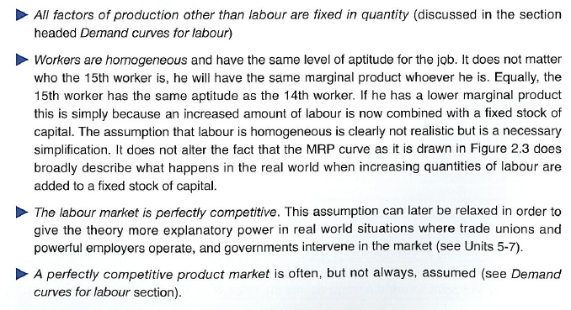
Perfect Competition .v. Imperfect Competition in the Labour Market
  STARTER TASK 1: Read this extract. Then answer this question: Is the labour market for Godalming College teachers and Sainsbury’s checkout workers perfectly competitive? Explain your answer.
EXTRACT A: Perfect Competition in the Labour Market assumes that….
There are many buyers of labour (firms) and many sellers of labour (workers) in the market
There are no barriers to entry or exit into the labour market for workers. Workers can come and go as they please.
STARTER TASK 2: If we assume that labour markets are perfectly competitive (and therefore firms are ‘wage takers’), what might the labour market for one firm in that market look like? Draw some ideas below?

Slide 4
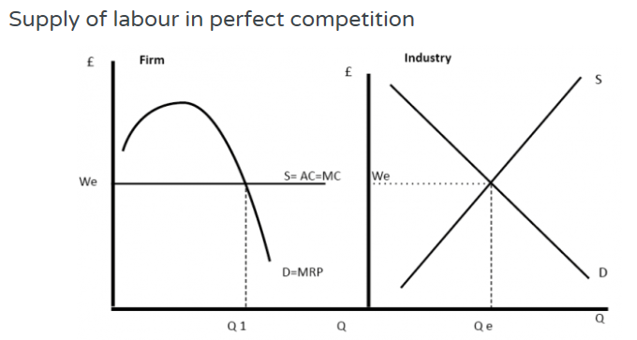
RWS17: Wage Determination
Labour Demand and Labour Supply for a Perfectly Competitive Firm and Market
Ls
Ld
STARTER TASK 2: The firm has to accept the prevailing wage in the labour market and cannot influence it anyway (otherwise, competing firms will respond in a similar way). Therefore the perfectly competitive firm will employ up to the point at where the MRP=MC or Q1. If firms were to employ more than the Q1, they would make a loss on the marginal workers. If they were to employ less than Q1, there is still the potential to make more profit.

Slide 5
Perfect Competition .v. Imperfect Competition in the Labour Market
  STARTER ACTIVITY: Read this extract. Then answer this question: Is the labour market for Godalming College teachers and Sainsbury’s checkout workers perfectly competitive? Explain your answer.
  A: NO! Economics teachers face an employer with some ‘monopsony power’. Over the past 2 years, we have increased our number of Economics students and this year significantly and so why have Economics teachers not had their pay increased? Lots of Economics teachers are also affiliated with Trade Unions. Equally, you might argue that Waitrose checkout staff are not able to transfer into any other job (you might say that about Economics teachers as well!). Also, do Waitrose staff have limited substitutes in terms of supplying their labour like Economics teachers?
EXTRACT A: Perfect Competition in the Labour Market assumes that….
There are many buyers of labour (firms) and many sellers of labour (workers) in the market
There are no barriers to entry or exit into the labour market for workers. Workers can come and go as they please.

Slide 6
Perfect Competition .v. Imperfect Competition in the Labour Market
Wage Determination…
In the real world, labour markets are rarely perfectly competitive. This is because workers or firms usually have the power to set and influence wages and therefore wages may be set to levels different than anticipated by Marginal Revenue Product (MRP) theory.
Imperfections in the labour market cause wages to differ from a competitive equilibrium.
Different Imperfections in the Labour Market (why MRP theory may fall down….)
TODAY: Imperfect Competition: Monopsony, Trade unions and Bi-lateral monopoly
PREP HOMEWORK: Discrimination
Poor Information: Difficult to measure productivity etc.
Firms, not profit maximisers
Immobilities: Geographical and Occupational

Slide 7


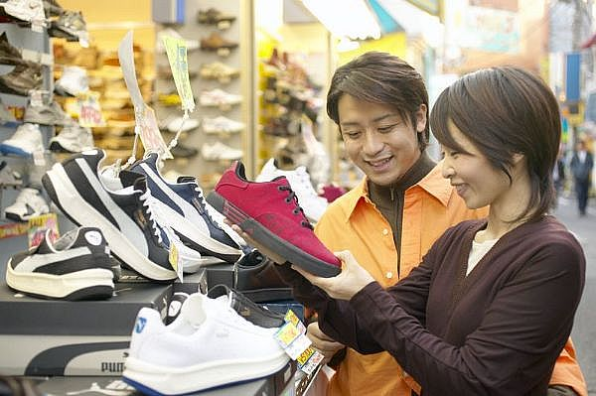



Imperfect Competition
Economic Theory - Concept
Perfect Competition in the Product Market
Imperfect Competition in the Product Market
Demand
Supply
Demand
Supply
Perfect Competition in the Labour Market
Imperfect Competition in the Labour Market
Labour Demand
Labour Supply
Labour Demand
Labour Supply

Slide 8


TRADE UNIONS – MONOPOLY SELLER OF LABOUR
WHAT ARE THEY?
Organisation of workers that seek to:
(i) improve the real incomes of members
(ii) provide job security
(iii) protect workers against their employer – e.g. unfair dismissal
HOW?
“COLLECTIVE BARGAINING”
“INDUSTRIAL ACTION”
EXAMPLES:
(1) RMT
(Royal Maritime and Transport Workers Union)
  MEMBERSHIP: 73,000 members
(2) AMICUS
  (Represents workers in almost every industry, mainly in the private sector
  MEMBERSHIP: 1.2 million workers
  AND MANY MORE!!

Slide 9


MONOPSONY EMPLOYERS
EXAMPLES?

Slide 10
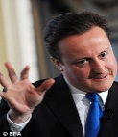

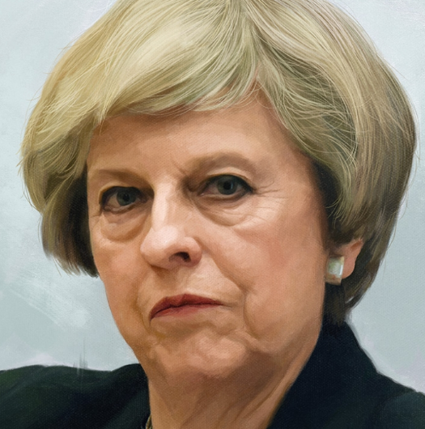




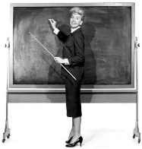
Less competitive markets
TRADE UNION ONLY
MONOPSONY EMPLOYER ONLY
BI-LATERAL MONOPOLY

Slide 11
Less Competitive Labour Markets
Assumptions about the Labour Market Model?
Workers are competing
Employers are competing
(1) Trade Unions
(MONOPOLY)
(2) Dominant Employers
(MONOPOSONY)
(3) The two together
(BI-LATERAL MONOPOLY)
TASK: On scrap paper/whiteboards, draw three labour market diagrams representing the market failure (distortion) potentially caused by a trade union, a monopsony and a bi-lateral monopoly
CALL ME OVER IF YOU THINK YOU HAVE IT!

Slide 12
Less Competitive Labour Markets
TRADE UNIONS
MONOPSONY
BI-LATERAL MONOPOLY

Slide 13
Monopsony Summary
Monopsony in the real world
Even if a firm is not a pure monopsony, it may have a degree of monopsony power, due to geographical and occupational immobilities, which make it difficult for workers to switch jobs and find alternative employment.
For example, there are several employers who might employ supermarket checkout workers. However, in practice, it is difficult for workers to switch jobs to take advantage of slightly higher wages in other supermarkets. There is a lack of information and barriers to moving jobs. Therefore, although there are several buyers of labour, in practice the big supermarkets have a degree of monopsony power in employing workers
Problems of monopsony in labour markets
Monopsony can lead to lower wages for workers. This increases inequality in society.
Workers are paid less than their marginal revenue product.
Firms with monopsony power often have a degree of monopoly selling power. This enables them to make high profits at the expense of consumers and workers.
Firms with monopsony power may also care less about working conditions because workers don’t have many alternatives to the main firm.

Slide 14
Government Intervention and Failure?
Trade Unions History and Today
1800’s: Birth of Unions - legalised in 1871
1900’s: Birth of Labour Party (heavily affiliated with the Unions)
1926: General Strike
1970’s: Trade Unions became unpopular with the bringing down of a Conservative Government and ‘The Winter of Discontent’
1980’s: Margaret Thatcher drastically reduced the power of Trade Unions through legislation
2000’s: Tony Blair criticised as Labour leader for not reversing this
2012: decline from 13 million 1979 to below 6 million
Government Intervention: Remove Trade Union Power through Legislation
Higher wages creating cost push inflation and real wage unemployment
Powerful unions of the 1970’s “anti-democratic”
Government Failure: Why might this not be a good idea?
The Efficiency Wages Argument - The TU may create improved productivity because higher wages improve motivation or because the TU successfully presses for improved personnel practices, or because in negotiating increased wages the TU agrees to productivity improvements — e.g. more flexible working practices.
The Monopsony Power Argument - The trade union may be faced with a powerful employer with MONOPSONY power (see below) — in its pure form this means that the employer is the sole buyer of that type of labour. The monopsony employer may be exploiting the workforce by paying less than the market equilibrium wage. Workers must accept this because there is no one else who will employ them. The trade union could force wages up above this level towards the equilibrium wage, depending on its strength.

Slide 15
Government Intervention and Failure?
Trade Unions History and Today
Other Interventions to combat poverty and inequality?
  Minimum Wage
  Increased benefits
  Universal Basic Income

Slide 16
WEEK 5
Notes:
Per student (16)
Print off 30 and 31

Slide 17
90

Slide 18
STARTER ACTIVITY
Complete the following tasks - 1 and 2 you should be able to do. 3-5 are HARD but the next step…have a go.
Draw 2 diagrams representing how a TU can influence wages in a market AND how a monopsony employer can influence wages in a market. Why are both situations undesirable?
Draw a labour supply and demand curve for a perfectly competitive firm.
Then draw a labour supply and demand curve for a perfectly competitive industry. On this diagram, where do you think the MC curve is if to attract more workers, if the firms in the industry have to raise the wages of not only the ‘marginal worker’ but the rest of the workforce too? Remember your ‘theory of the firm’ work on the relationships between ‘marginal’ and ‘average’ variables
On the diagram from question 3, where would a perfectly competitive industry be producing? Why?
Diagram 3 is actually the diagram for the Monopsony firm AND the Monopsony industry? Why?
Where on diagram 3 would the monopsonist be employing and why?

Slide 19
STARTER ACTIVITY
Complete the following tasks - 1 and 2 you should be able to do. 3-5 are HARD but the next step…have a go.
Draw 2 diagrams representing how a TU can influence wages in a market AND how a monopsony employer can influence wages in a market. Why are both situations undesirable?
Draw a labour supply and demand curve for a perfectly competitive firm.
Then draw a labour supply and demand curve for a perfectly competitive industry. On this diagram, where do you think the MC curve is if to attract more workers, if the firms in the industry have to raise the wages of not only the ‘marginal worker’ but the rest of the workforce too? Remember your ‘theory of the firm’ work on the relationships between ‘marginal’ and ‘average’ variables
On the diagram from question 3, where would a perfectly competitive industry be producing? Why?
Diagram 3 is actually the diagram for the Monopsony firm AND the Monopsony industry? Why?
Where on diagram 3 would the monopsonist be employing and why?
TODAYs LESSON (MICRO)
RWS 18 Labour Market Failure
Alternative monopsony analysis
Why TU’s might not always destroy employment?
Discrimination - The Gender Pay Gap: Is it because of discrimination? What can the Government do about it?

Slide 20
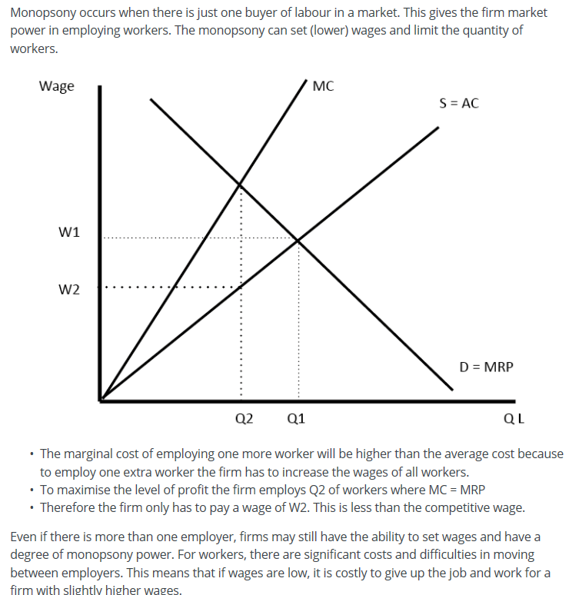
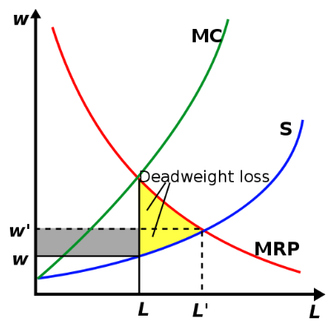
Advanced Monopsony Diagram
The AC shows the different wage rates that the monopsony employer must pay to attract labour forces of different wages
Diagram for the Monopsony Firm AND the Industry
NOTE TAKING: Draw the advanced monopsony diagram, and explain why the monopsonist is able to pay lower wages than in a perfectly competitive market?
Notes:
“Readers Question – A microeconomics question. In you labour market section you discuss a monopsonist.You say that “in order to employ one extra worker the firm has to increase the wages of all workers”- why? You give a coal mine as a possible example of a monopsonist, do you really think that a coal mine owner hired an extra worker(the marginal cost) and then increased the “wages of all workers”? Can you clarify this.
Just think of an upwardly sloping supply curve of labour.
If the firm offers a wage of £100, it can employ 10 workers.
To employ 11 workers, it would have to increase the wage rate to £110.
Therefore, according to this supply curve, if the firm needs to employ 11 workers the firm has to pay every worker £110. Therefore the marginal cost of employing an 11th worker is £210 (11*110 = £1,210 – 10*100). The marginal cost of the 11th worker is greater than the average cost
Theory and in practice
1. Wage discrimination. One exception would be if a monopsonist could wage discriminate – i.e. pay £110 to the extra worker, but continue to pay £100 to the existing mine workers. In reality this could be possible. For example, the firm could introduce a special post or job title which pays £110, whilst the existing workers get stuck on £100. If the monopsony can get away with this, then it will not have to pay every worker £110.
2. Elastic supply. Also, another possibility is that the supply curve is very elastic, therefore there may be infinite (or at least a very large) supply of labour at £100. For example, in a period of high unemployment, there are probably many workers willing to supply there labour at £100. Many coal mine owners may find, even at low wages, a large pool of unemployed workers willing to take a job at £100.
However, the theory of an upward sloping supply curve suggests that the marginal cost of employing an extra worker will increase faster than average cost.
Readers Question: My confusion gets worse as on the same page you say that one of the problems with a monopsonist is it can “lead to lower wages for workers”. Doesn’t this contradict your above point about a monopsonists increasing all workers’ wages as it employs one extra worker?
The key thing is that a monopsonist is reluctant to hire extra workers, precisely because it would have to increase wages of all workers (high marginal cost). Because of this prospect the monopsonist prefers to employ less workers and pay lower wages. To profit maximise, it avoids the extra marginal cost of paying all workers more.
This diagram shows a theoretical monopsony. It’s profit maximising decision is to employ only Q2 workers at a wage of W2. (where MRP = MC). This is a lower wage and lower quantity of workers than in a perfectly competitive market.
See: Monopsony for more explanation
Is Tesco a monopsony?
Readers Question Or, is it all just theory? You talk of supermarkets behaving like monopsonists but I’m pretty sure my local Tescos doesn’t increase the wages of all its workers when it hires an extra worker.
I think it is true to some extent that Tesco will not increase the wages of all workers when hiring more workers. Though, in a period of full employment and labour shortages, it may have to increase wages, if it is short of staff.
Also, Tesco is not the best example of a monopsony. It may exhibit some monopsony behaviour – Workers have degrees of labour immobility e.t.c. But, Tesco workers could go and work at similar retail jobs elsewhere. A better example, is the government employing firemen. There is only one employer (government of firemen) If the government found there was a shortage of firemen, it may have to put up wages to attract more people into the profession.
Also, in the case of firemen, I don’t think the government could get away with paying just the new workers a higher wage.
Another way of thinking about it. Suppose Tesco cut wages by 20% (or freezed wages for several years), how many workers would leave and get a job elsewhere? Some would be able and willing to move, but many workers would feel tied to staying at Tesco.
I remember working for a tutorial college and the boss was a real profit maximising capitalist For three years he freezed nominal wages. I could have left and gone and worked somewhere else for a higher wage, but I felt it wasn’t worth the hassle. The diverse group of tutors at the college had little bargaining power. Therefore, I felt he had a degree of monopsony power – even if we could in theory work elsewhere

Slide 21

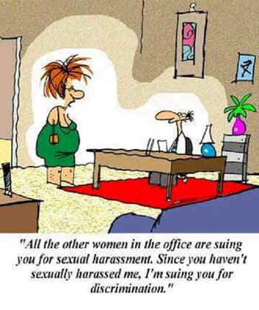
Discrimination
A Market Failure
“To treat one particular group of people less favourably than others because of their gender, colour, nationality, or ethnic group etc…”
“A valuation in the market place of personal characteristics of the worker that are unrelated to worker productivity”
Discrimination in terms of:
Higher unemployment rate and unequal chances in certain professions
Differences in earnings

Slide 22
Discrimination
Economic Theory – Graphs!
“A valuation in the market place of personal characteristics of the worker that are unrelated to worker productivity”
Theory #1:
Wage Discrimination Effect
Theory #2 and 3:
The Prejudice and Crowding Effect
Wages
Wages
Wages
Ls
Ls
Ls1
Ls2
W1
W1
W1
W2
W2
W2
Ld
Ld2
Ld1
Ld
Q1
Quantity of Labour
Q2
Q1
Quantity of Labour
Q1
Q2
Quantity of Labour

Slide 23
Debate: Is the Gender Pay Gap Discrimination in the Market?
Does gender discrimination affect wage differences between men and women in the UK?
The gender pay gap and equal pay are two different things. The former is the difference in average earnings between men and woman. Equal pay, or paying men and woman the same amount to do the same job, has been a legal requirement for more than 40 years.
The UK gender pay gap is estimated at 18.1% for all workers, or 9.4% for full-time staff.
SOURCE: BBC NEWS April 2017
TASK in THREES/4’s: To what extent does gender discrimination affect wage differences between men and women in the UK?
NEW NOTES: Create a table of ‘for and against’ this idea. List the arguments for and against whether gender discrimination exists in the UK using your PREP homework
Watch this video, and add to your table
  Tutor2U (6 Minutes)
  Channel 4 News (3 Minutes)
Conclusion - do you feel that gender discrimination takes place in the UK today? Come to a conclusion as a group and justify your reasoning.

Slide 24
Debate: Is the Gender Pay Gap Discrimination in the Market?
Does gender discrimination affect wage differences between men and women in the UK?
YES
MRP theory of prejudice
Crowding out theory valid in 1960’s? Less so now? Shouldn’t all wages be falling?
Evidence of a gender pay gap. Perhaps opportunities for women denied - glass ceiling, differences in pay for the same job etc.
NO
Free market would lead to equality
Crowding out theory: discrimination reducing = more women in the market place leads to lower wages.
Gender pay gap figures mis-leading. Females tend to be more prone to part-time work and child care?

Slide 25
Govt Intervention to Combat Gender Discrimination Inequality
Government Legislation (A History):
  Equal Pay Act 1970
  Sex Discrimination Act 1975
  Race Relations Act 1976
  Disability Discrimination Act 1995
  Employment Equality (Religion, Belief and Sexual Orientation) Regulations 2003
  Employment Equality (Age) Regulations 2006
  Equality Act (Sexual Orientation) 2007
  Equality Act 2010 – bringing all the previous acts together in one law and adding a few more clauses
Notes:
Useful to go through the Government legislation to challenge a few pre-conceptions the students might have…for example before 2003 it was technically legal to discriminate against someone who you perceived to be homosexual. Before the 1960’s it was illegal to have homosexual relations. Compare it to the Uganda case-study from before…we were not putting them to death but not so long ago we were discriminating.
Other examples - no Irish in the 1970’s in B+B’s….more recently Brighton homosexual couple denied a room at a B+B (owner prosecuted but would this have happened before 2010 as the 2003 act is just for eomployment.
Any other anecdotes you can find??

Slide 26
Government Intervention to combat discrimination
Regulation 1: The Equality Act 2010: Effective?
Social Groups which might face discrimination: Gender, Age, Ethnicity, Disability, Sexuality, Maternity
Protected Characteristic: gender, age, ethnicity / skin colour, disability, sexuality
PREVENTS DISCRIMINATION: Protects their status under the law of the land and prevents discrimination leading to less disparities in economic, social and political inequality. The new streamlined bill enables more clarity with the Law - helps women to protect themselves
NO MAGIC BULLET????: Might not change things instantly but is a “catalyst for change”…sets a marker down in our society about what we should and shouldn’t accept. Look at the progress of people of a different skin colour or gender differences over the past 40 years?
PREVENTS DISCRIMINATION???: Does it really - how effective can the law courts be in preventing discrimination? Also, in cases of supposed harrassment, how is this proved?
NO MAGIC BULLET: More needs to be done alongside. The Bill will take ages before anything starts to happen.
Notes:
Emphasise the Equality Act of 2010 and the concept of “protected characteristics” and the fact it has brought together all the previous acts from 1970
What are the protected characteristics of Travellers?
Maybe split the class into 5 groups and each group has to come up with a story involving Travellers in the UK and how each of the discriminations above might be played out? You could use “direct discrimination” as an example to the class. Might be hard for them to do but will get them thinking…
Associative discrimination: direct discrimination against someone because they are associated with another person with a protected characteristic. e.g. Jack has a friend who is a traveller and because of this, he is refused entry to his local pub
Indirect discrimination: when you have a rule or policy that applies to everyone but disadvantages a person with a protected characteristic. - e.g. a new Government initiative provides benefits as a safety net but only to those in a fixed address (obviously rules out Traveller’s benefitting from it
Harassment: behaviour deemed offensive by the recipient. Employees can claim they find something offensive even when it's not directed at them. - e.g. A traveller has a job in Sainsbury’s and overhears co-workers discussing how Travellers are “dirty pikeys”. Maybe you could get into a whole discussion about social media and Twitter????
Victimisation: discrimination against someone because they made or supported a complaint under Equality Act legislation. - Jack is shunned at Sainsbury’s because he overheard the conversation above as well and made a complaint even though he himself is not a Traveller
Discrimination by perception: direct discrimination against someone because others think they have a protected characteristic (even if they don't). Jack owns a caravan and decides to go on holiday but is refused entry to pub car parks because they associate him with being a Traveller.
DEVIL’s ADVOCATE? It is important to point out to those who maybe dismiss some of these discrimination aspects as petty that as white, middle class Surry-ites, students may never have experienced discrimination for prolonged periods and understand the stress and anxiety it may cause. What may be a throw away comment to one person, could cause great offence to another.
Maybe a discussion about the comedic merits of Ricky Gervais and his “mong” twitter scandel when he was eventually forced to back down and apologise. Do we live in a world now where we are not allowed to make jokes at anyone’s expense and people are too sensitive or should we be living in a world where we respect others views and differences….where is the line drawn!?

Slide 27
Government Intervention to combat discrimination
Regulation 2: Firms over 250 Employers must reveal pay details of employers
IN A NUTSHELL
UK companies with 250 or more employees (public, private, voluntary) will have to publish their gender pay gaps (including bonuses) within the next year under a new legal requirement. The move is part of attempts to fight workplace discrimination.
About half of the UK workforce will be affected by the new reporting rules, which encompass 9,000 employers and more than 15 million employees.
April 2018 is the final deadline. Until then, it may take weeks or months for the UK's largest companies to publish the differences between what they pay men and women.
If employers fail to comply by the April 2018 deadline, they will be contacted by the Equalities and Human Rights Commission.
Companies that discover they do have a gender pay gap will be encouraged to publish an action plan alongside the figures detailing the steps they plan to take to address the problem.
CASE STUDY!
Some have already volunteered the information - with Schroders fund managers taking the plunge as the first FTSE100 company to go public.
The group revealed that fixed pay for its female staff was 33% lower on average than for their male staff, while there was a bonus gap of 66%.

Slide 28
END

Slide 29
Trade Unions
Government Intervention and Failure:
Thatcher and Blair
To what extent should Thatcher have curbed the power of the Unions in the 1980’s?
In other words - Thatcher reduced the power of the Unions in the 1980’s. Therefore what useful role do Trade Unions have in our society?
See Anderton pp 496 to 497
Notes:
Curbing Trade Union Power?
It has happened
Yes - Thatcher should have curbed the power of the Unions:
Too much power - bringing down the Govt in the 1970’s / Winter of Discontent
Badly set up…bullying? Poor voting?
Bob Crow - pay for tube drivers and disruption
Too close to the Labour Party
No - Thatchers should not have curbed the power of the Unions
Correct market failure - Increasing income inequality in the UK - trade unions help address this
Decline of various areas of the UK under Margaret Thatcher
Current coalition’s deficit cuts - need organisations to stand up to Govt.

Slide 30
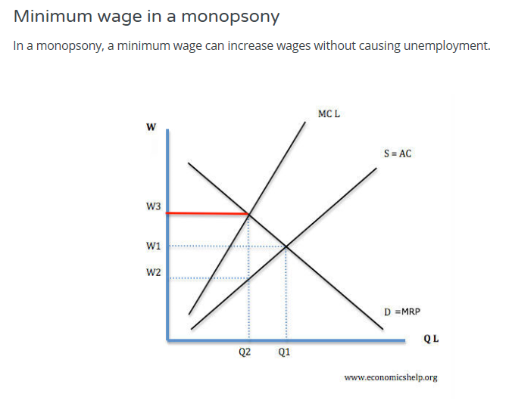
Minimum Wage in a Monopsony

