Slide 1
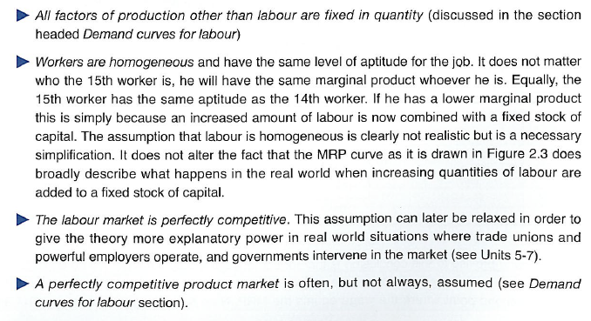
Perfect Competition .v. Imperfect Competition in the Labour Market
STARTER TASK 1: Read this extract. Then answer this question: Is the labour market for Godalming College teachers and Sainsbury’s checkout workers perfectly competitive? Explain your answer.
EXTRACT A: Perfect Competition in the Labour Market assumes that….
There are many buyers of labour (firms) and many sellers of labour (workers) in the market
There are no barriers to entry or exit into the labour market for workers. Workers can come and go as they please.
STARTER TASK 2: If we assume that labour markets are perfectly competitive (and therefore firms are ‘wage takers’), what might the labour market for one firm in that market look like? Draw some ideas below?

Slide 2
RWS17: Wage Determination Labour Demand and Labour Supply for a Perfectly Competitive Firm and Market
Ls
Ld
STARTER TASK 2: The firm has to accept the prevailing wage in the labour market and cannot influence it anyway (otherwise, competing firms will respond in a similar way). Therefore the perfectly competitive firm will employ up to the point at where the MRP=MC or Q1. If firms were to employ more than the Q1, they would make a loss on the marginal workers. If they were to employ less than Q1, there is still the potential to make more profit.

