Slide 1
Unit 3 – Digital Media Skills
BTEC – Creative Digital Media (Dip.) – Film & Television

Slide 2
The remainder of your course will consist of…
UNIT 3 – Digital Media Skills (externally assessed) Steve
UNIT 7 – Media Enterprise Matt
or
UNIT 3 – Digital Media Skills (externally assessed) Mark
UNIT 7 – Media Enterprise Matt
These remaining units will complete your portfolio and allow you to finish in May. However, you will have to use your organisation skills to manage both.

Slide 3
UNIT 3 – what’s it about?
It is a synoptic unit that provides you with an opportunity to demonstrate your ability to construct a media product for a specified brief and within the moving image medium.
The unit will allow you to demonstrate all of the skills you have learnt throughout the course.
The tasks within the unit are to be completed individually; therefore you will each be producing your own film product. However, you are allowed to enlist the help of others to create the material, such as actors, presenters and models.

Slide 4
Period of assessment
Today you will receive the vocational brief from Pearson and from that point on you will be given a period of six weeks (5 weeks up to Easter, 1 week post Easter) to complete a practical task in response to it.
The assessment period includes the preparatory stage undertaken under informal supervision – i.e. I will be helping you, advising and checking your progress for the planning stages of the project. This will consist of 5 hours.
After the preparatory stage you will have a period of 20 supervised hours in which you will edit the product and produce documents which justify your decisions, processes, and assets.

Slide 5
Synoptic =
“Learners are expected to draw on their understanding of media production processes and skills from across the qualification and apply transferable and specialist knowledge and skills to complete the externally assessed practical task.”

Slide 6
The Brief
Learners need to understand;
How to read a brief to extract key information about the intentions of the client.
Who the target audience is.
What the purpose of the required media product is.
This should be very familiar to you with regards to the work you have completed for UNIT 8
Watch this clip:
https://www.youtube.com/watch?v=l-LtVBKs39w

Slide 7
The Project
You must effectively demonstrate your ability to be able to;
Create
Source
Organise
Prepare
Edit and manipulate assets and/or material during the preparatory period
You will need to be the creative force behind the project and in control of the use of equipment and software tools.

Slide 8
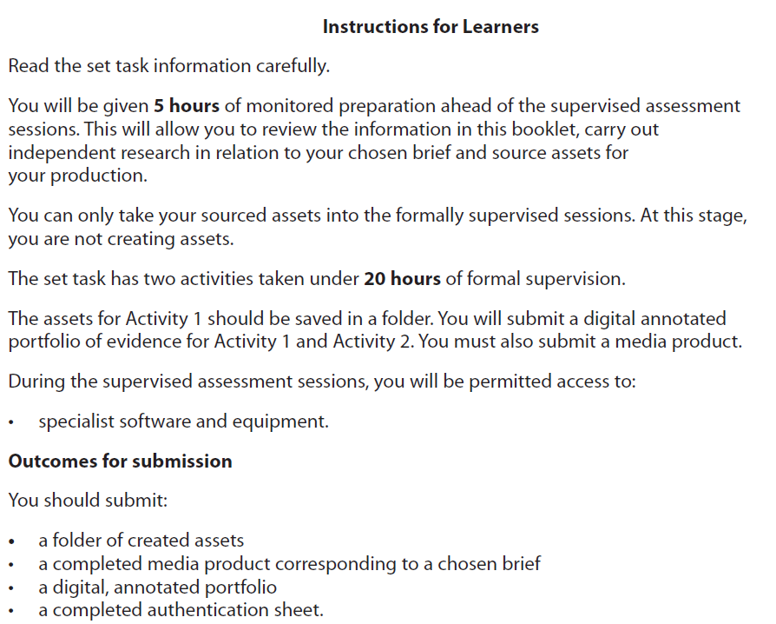

Slide 10
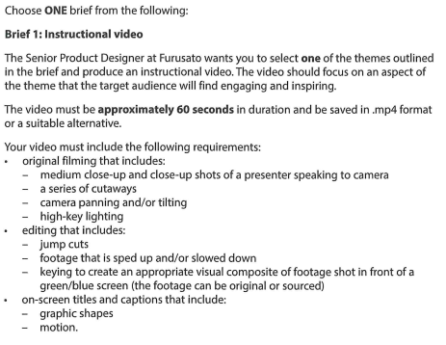

Slide 11
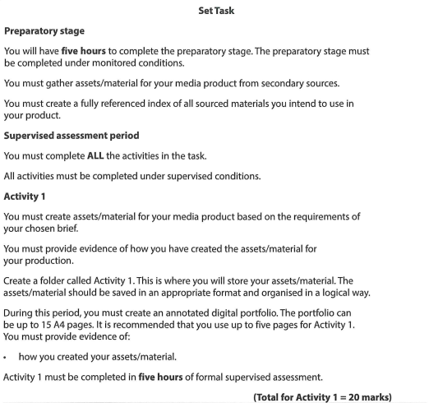

Slide 12
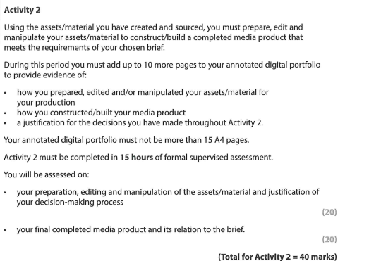

Slide 13
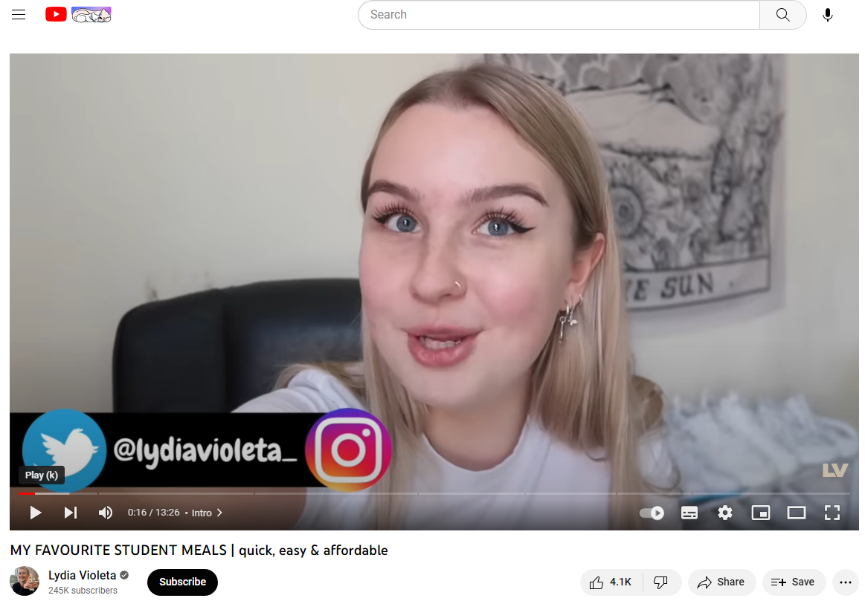
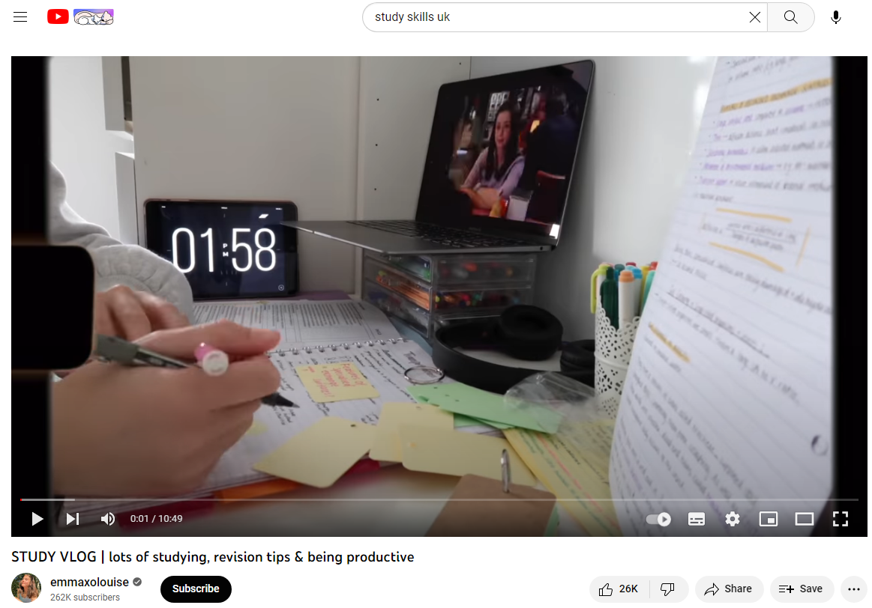
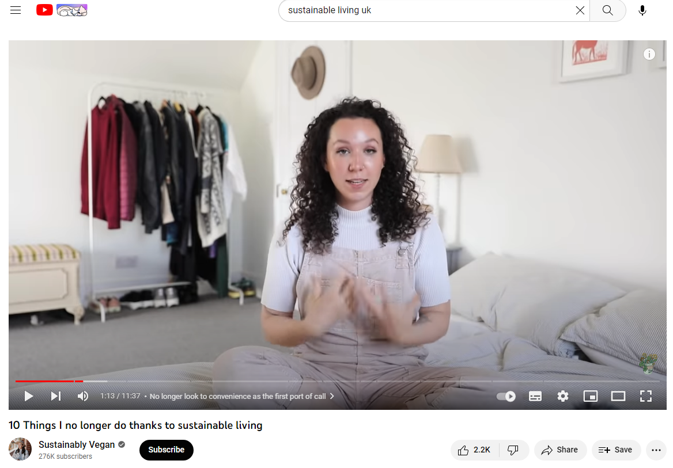
Examples
https://www.youtube.com/watch?v=AmGjCgCmJKE
https://www.youtube.com/watch?v=etkAtfM-0NE
https://www.youtube.com/watch?v=jcBp52BITbw

Slide 14
Now what…?
Have a look through the printed handout of the brief. This is your copy so you can scribble, annotate, underline etc.
Start working through the initial tasks on GOL.

Slide 15
Week
1 – 27th February | PLANNING A1. The brief – pre-production research – scripting / storyboard / proposal
2 – 6th March | PLANNING – preparing to film; locations, props, costumes, actors etc. CAMERA & EDITING WORKSHOPS
3 –13th March | FILMING
4 – 20th March | FILMING/ PRACTICE EDIT
5 – 27th March | FILMING/ PRACTICE EDIT
EASTER HOLIDAYS
6- 17th April | PLANNING Indexing and storing Preparing e-portfolio
7 – 24th April | Exam – finished 28th APRIL (FRIDAY)
 | EDITING EXAM – SEND OFF 4th May

Slide 16
Period of assessment
The assessment period includes the preparatory stage undertaken under informal supervision – i.e. I will be helping you, advising and checking your progress for the planning stages of the project. This will consist of 5 hours.
After the preparatory stage you will have a period of 20 supervised hours in which you will edit the product and produce documents which justify your decisions, processes, and assets.

Slide 17
Activity 1 Folder – should include
An index / contents page
Annotated screen shots of how the assets/material were organised into a logical folder structure.
Annotated photographs of camera, lighting and audio recording set ups from a video shoot
screen shots of the production skills and techniques used (i.e. you doing them)
an explanation of how the assets/material created relate to the requirements of the client brief

Slide 18
Activity 1
“In the Activity 1 folder learners should submit a selection of their self-generated assets/material, which demonstrate the quality of the assets/material and the skills used to create them.”
“The annotated digital portfolio is where learners should provide evidence of the skills and techniques they applied when creating their assets/material.”
2022 Examiners Report

Slide 19
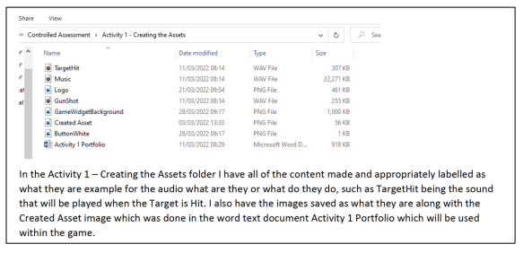
Annotated screen shots of how the assets/material were organised into a logical folder structure.
“Learners must provide appropriate evidence of the logical storage of assets/material, which included logging or naming assets/material with appropriate file names and saving them in an appropriate file format into an organised folder structure.”

Slide 20
Screen shots of the production skills and techniques used (i.e. you doing them) and an explanation of how the assets/material created relate to the requirements of the client brief
Reference to brief requirements
Screenshots of you completing tasks
Explanation

Slide 21
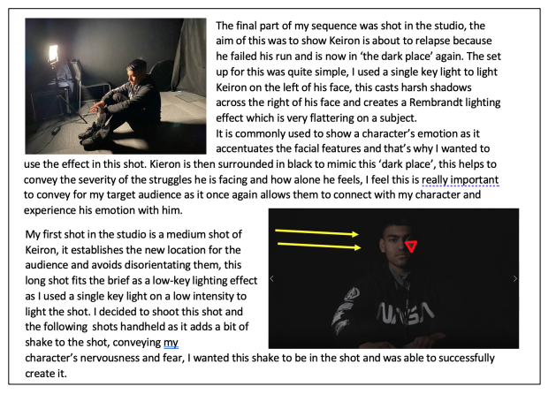

Slide 22
Activity 2 folder – should include
The Activity 2 folder should only include the final working version of the video (MP4) and the final annotated digital portfolio (covering Activity 2).
Duplicate files and earlier versions of media product should be removed from the final submission by learners.

Slide 23
“During the 15 hours for Activity 2, learners must edit together their assets/material to create a final media product in response to the brief.
The highest achieving learners provided evidence of the following in the 10 A4 pages of their annotated digital portfolio dedicated to Activity 2:
the preparation, editing and/or manipulation of the assets/material during the production
how the media product was constructed/built
a justification for the decisions made throughout Activity 2.”

Slide 24
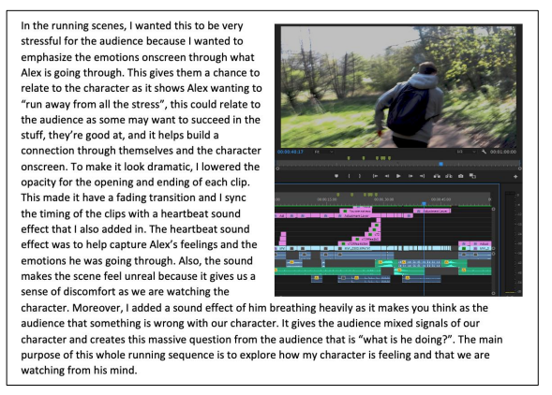
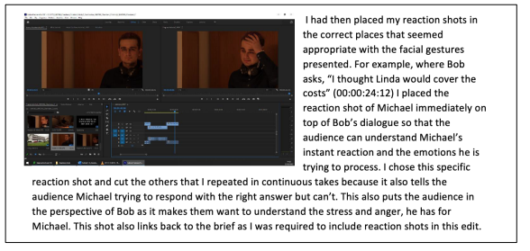
References to audio requirements
References to specific requirements of the brief
Screengrabs as evidence
References to specific requirements of the brief

Slide 25
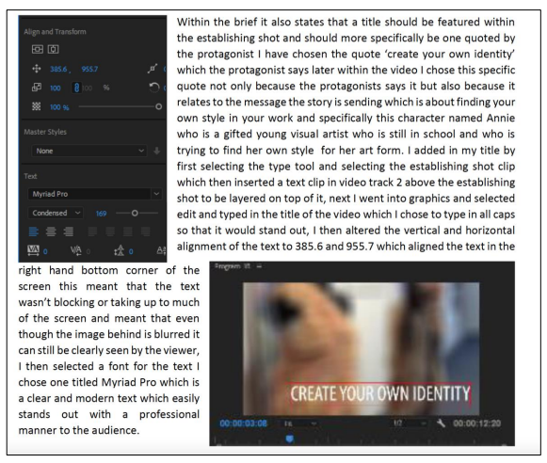
Reference to brief requirements
Justification
Explanation of process
Evidence
Effect on audience

Slide 26
Q&A
What should I be doing now?
Now is the time to plan and when you feel ready, film. You may need more than one or two attempts to get it right. Remember to keep referring to the brief throughout.
For Activity 1 do I need scripts, storyboards etc.?
No, but you may find them useful in planning your production
How many pages of notes can I take into the assessment?
4x sides of A4 – handwritten or pt12 font. These should be a memory jogger and not include full sentences.
What do I need on my USB when I enter the exam?
All of the footage you need for the final edit, any secondary sources (archive footage) and audio tracks.
Screengrabs of your filling system and photos from the shoot. You will be creating screengrabs of your final edit in the exam.
What are the timings of the exam?
5 hours – activity 1
15 hours – activity 2 (combination of writing and editing)
Can I use the internet to help with my edit?
No

