Slide 1
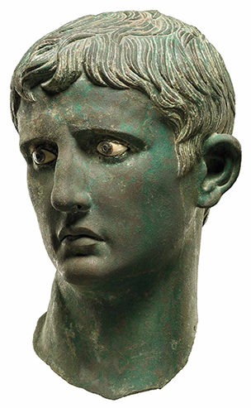
Ancient History Component 2: Rome Period Study: The Julio-Claudian Emperors 31 BC – 68 AD

Slide 2
Period Study: The Julio-Claudian Emperors 31 BC – 68 AD
This is a ‘Period Study’ meaning that it is meant to cover a broad timespan
The Roman period study carries as much weight as the Greek period study – 25% for A level / 50% for AS
The Roman period study is assessed in exactly the same way as the Greek period study:
A Level =a 20 mark interpretation question and a 30 mark essay question
AS Level = a 10 mark O.K. question, a 20 mark mini-essay, a 30 mark essay question
The Basics

Slide 3
Period Study: The Julio-Claudian Emperors 31 BC – 68 AD
AS exam dates
Greek Topic – 18th May (pm) 1 hour 30 minutes
Roman Topic – 25th May (pm) 1 hour 30 minutes
The Basics

Slide 4
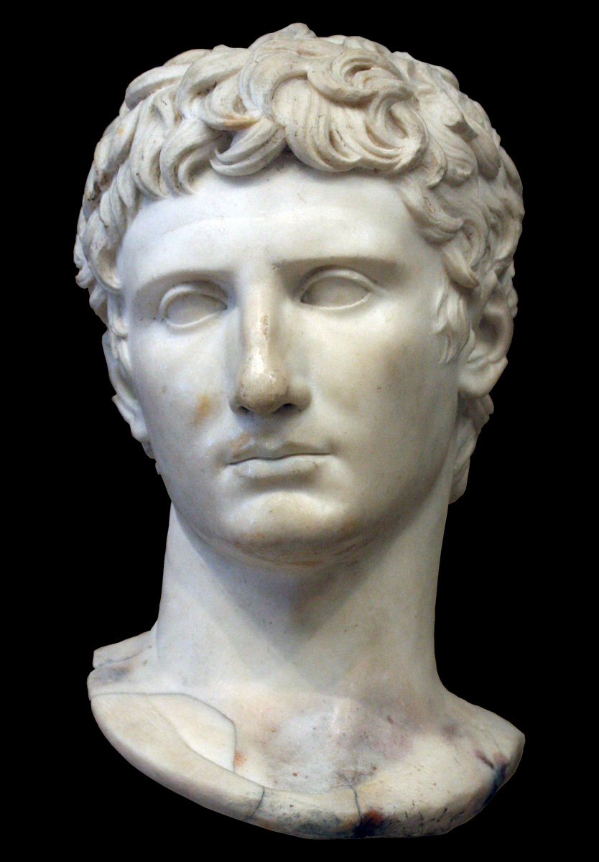
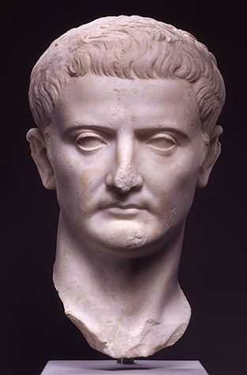
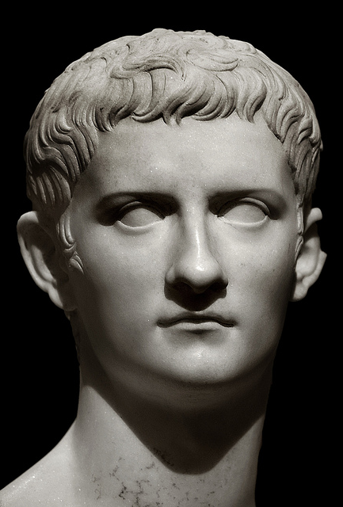
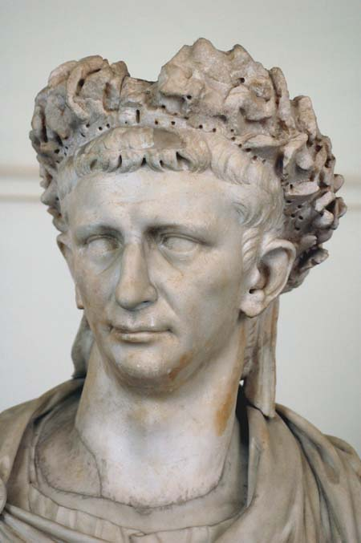
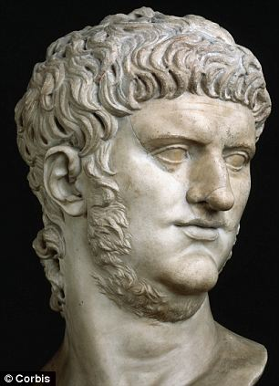
Period Study: The Julio-Claudian Emperors 31 BC – 68 AD
The Roman Period study looks at the first dynasty of Roman Emperors, known as the Julio-Claudians:
Augustus
27 BC – 14 AD
Tiberius
14-37 AD
Gaius
37-41 AD
The Basics
Claudius
41 -54 AD
Nero
54-68 AD

Slide 5
Period Study: The Julio-Claudian Emperors 31 BC – 68 AD
The Roman Period study starts with the reign of the first emperor Augustus
Under his rule Rome was transformed from a system of government known as the Republic in which the people (or some of them) held power, to an empire in which the emperor held absolute power, known as the Principate
To some, Augustan Rome would be a ‘golden age’ and he would be a model for future emperors
To begin with, however, Augustus, then known as Octavian, had to win a bloody civil war putting an end to almost a century of conflict within Rome
The Basics
Augustus
27 BC – 14 AD

