Slide 1
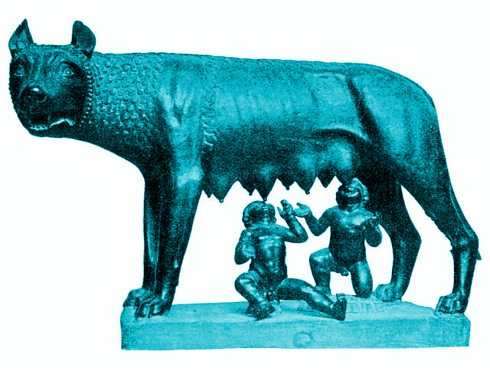
Rome

Slide 2
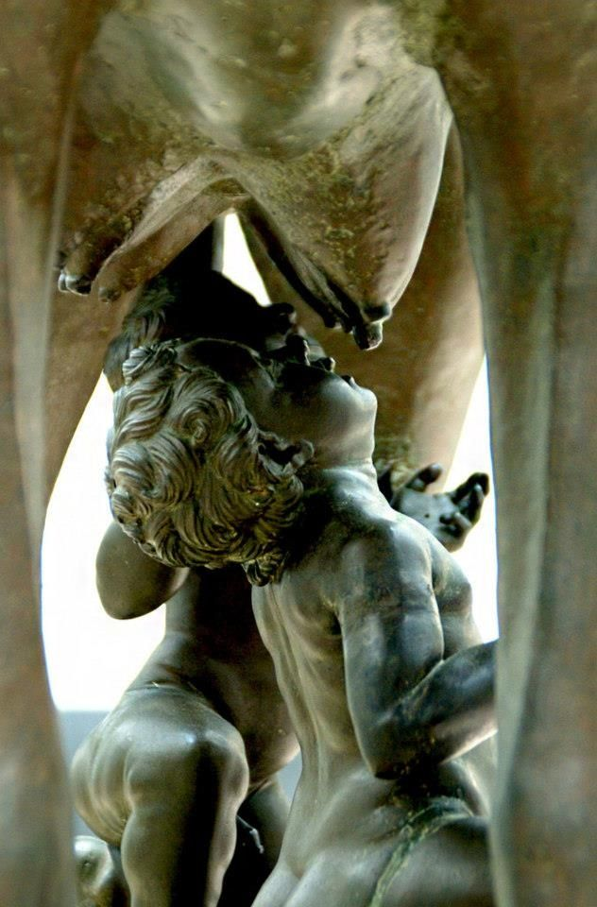
Foundation myth
Romulus and Remus:
They were twin brothers who were abandoned by their parents as babies. They were put in a basket that was then placed and floated down the river tiber. They were later discovered and raised by a wolf. The wolf fed them with her own milk and a woodpecker brought them food. They were later discovered and brought up by a shepherd. When they became adults, they decided to found a city where the wolf had found them. They argued over where the site should be and Remus was killed by Romulus. He was left as the sole founder of the city and named it Rome in 753 BCE
Aeneas:
He was the son of the goddess Venus, born from the nut, who was the leader of the Trojan survivors after Troy was taken by the Greeks. He and the survivors journeyed around the mediterranean and eventually landed in Italy. After a conflict with the local king Latinus the Trojans won the right to assimilate the local people and found the city.
The details of the story were written by Virgil in “The Aeneid” under the Emperor Augustus. This can be viewed as propaganda as Caesar claimed to be related to be a descendant of Venus and consequently Aeneas cementing his lineage as the founders and rightful rulers of Rome

Slide 3
Actual Foundation
It started off as a small town on the banks of the river Tiber in central Italy founded in 753.The name Rome is said to derive from the word “Rumon” which was the ancient name of the river Tiber. The location was ideal for merchants by land and sea thus the settlement grew in size and strength through trade.
Greek culture came to Rome through colonies in southern Italy such as Naples providing Rome with literacy religion and architecture.
They traded with the Etruscans who were a major mediterranean trading power. They provided a model for trade and urban luxury

Slide 4
The City of Rome
The Forum was the most important part of the city. It was where politicians met, where law was administered, and where the shops and temples were, the market was eventually moved to reduce congestion.
By the 1st century AD the population of Rome had grown to 1,000,000 people. They were forced to build upwards, most of the Romans lived in blocks of flats called insulas. The streets were also very narrow.
The city of Rome was built upon 7 hills, Aventine Hill, Caelian Hill, Capitoline Hill, Esquiline Hill, Palatine Hill, Quirinal Hill, Viminal Hill. Before, each hill had its own community and they were brought together to form one city.
Entertainment included the colosseum and many smaller amphitheatres where gladiatorial fights may have taken place. Also, chariot racing and the feeding of christians to lions were shown for the people’s delight.

Slide 5
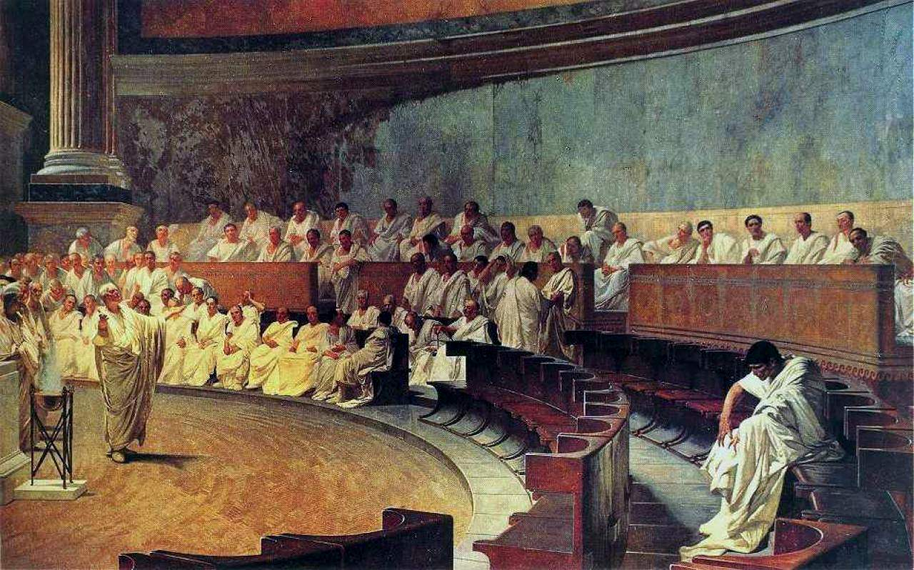
Roman Society - The Patricians
At the top of the Roman hierarchy was the emperor - the absolute ruler of Rome and its entire empire, holding legal and military power but also leading a lavish life of luxury.
Ranked below the emperor were the patricians who were wealthy landowners from old influential families along with a chosen few that were promoted by the emperor. They essentially monopolised political power as they were the only ones that could hold political office.
Patricians also had privileges, like the emperor, but on a much smaller scale: they were excused of some military duties and were the only ones eligible to become emperor.
Senators were part of an advisory council for the emperor and were a selected from the Patrician class by the emperor. They alone could hold the highest official offices and judgeships in courts and had special reservations for ceremonies and games.

Slide 6
The Equestrians
The Plebeians
Ranking immediately below senators were the equestrians who originally were composed of the Roman cavalry. But later on they took more of a commercial role as Senators were moved away from being involved in trade and business
They then became a class of wealthy businessmen, consisting of tax collectors, bankers, and traders and other important jobs
Anyone could become an equestrian as long as they had a good reputation, health and wealth
Equestrians could also become senators because they were finding it difficult to recruit people from the patrician class
The difference between the plebeians and patricians was based only on birth - they weren’t born into as wealthy and influential families as the patricians were
They were the average working class of Rome, employed as farmers, bakers, builders and craftsmen
It was extremely difficult for the plebeians to move up to the equestrian class as it was a struggle to save enough money to be eligible
They had little individual power but in bad times they could mob together and attempt to rebel

Slide 7
The Slaves and Freemen
All slaves were property of their owners and could be sold and rented out at any time
They were treated very harshly - being whipped, branded and cruelly mistreated
Slavery was accepted as the norm but some people argued against, saying that they should be treated fairly
They worked everywhere - private households, mines, factories and farms
Slaves could however be freed, but they technically weren’t citizens and any property they owned became their former owners’
Once freed they would work in the same jobs as plebeians and could even become wealthy, however there was still a stigma attached to them so were still discriminated against even after being free

Slide 8
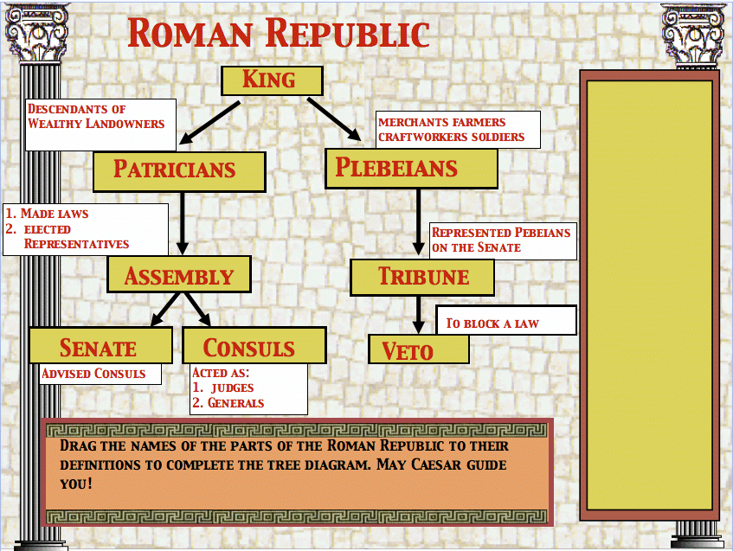
The Roman Republic
509-27BC
The Roman Government was led by two CONSULS
Consuls were the highest elected position in office
There would be two each year
They could propose laws, and were military commanders
Each consul could veto the other and were accountable for their actions even after leaving the office - consuls were subject to provocatio meaning the people could vote them out
After the year 27 BC consuls held very little power - as the Emperor held supreme authority
Consuls were advised by a SENATE
The senate initially had an advisory role
They could pass decrees however these were not legally binding and could be overruled by assemblies
During times of war the senate took on new authority and role in foreign policy
Senators were appointed by consuls and censors and the position was often elitist
Below the consuls were the roman magistrates known as the PRAETOR
They only spent one year in office
The praetor was given imperium which meant power in courts and the ability to order the trials
There were 6 praetors after the year 197 BC
The direct representatives of the people were called the TRIBUNE OF THE PLEBS
They only spent one year in office
They were elected by the Plebeian Assembly
Their position was sacrosanct meaning interference with the tribune could be punished by death

Slide 9
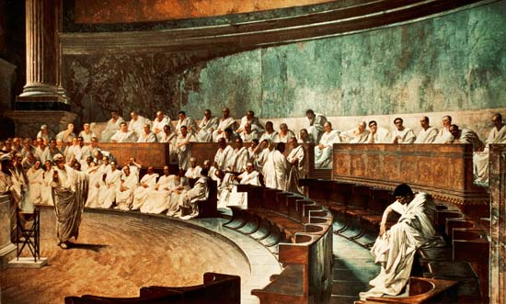
The Roman Republic
There was one DICTATOR and one master of the horse (Dictator’s assistant)
They spent a maximum of six months in office
A dictator could be nominated by the two consuls
Had chief executive and military powers, including the power to kill any Roman citizen
Dictators were supposed to return their power after the emergency in which they were dealing with was resolved
AEDILE
Spent one year in office
They supervised public works, temples, markets and games
There were four of the Aediles and two of them were commonly plebeians
QUAESTOR was the assistant to the consuls
Spent one year in office
There was four after 421 BC, this was doubled in 267 BC and finally there were twenty after 80 BC
They controlled the military or civic treasury and kept the records

Slide 10
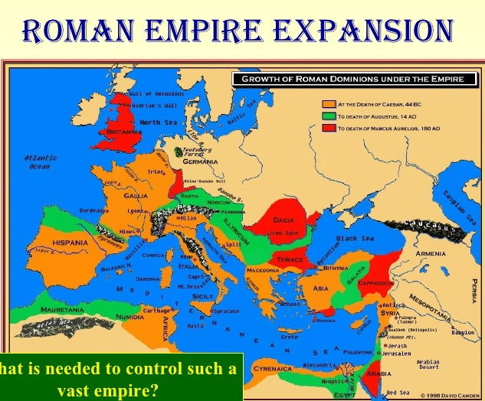
The Empire
It is unfortunately difficult to obtain precise figures on the number of people living at any one time in the Roman Empire. Any calculation of the population would be garnered from the census, but the Roman census may or may not have included women and children below a certain age. Also, slaves were probably not included but according to one estimate there were between 1,500,000 and 2,000,000 slaves in Italy in the 1st century BCE. In the beginning before the republic, the population of Rome was only a few thousand people. By the 6th century BCE this population had grown to between 20,000 and 30,000 people which then began the start and growth of the empire which caused the cities population to grow close to 1,000,000 people while the population of the empire was around 4,063,000. In 14 years this number grew to 4,937,000
The expansion of rome begins after the overthrowing of King Tarquin Superbus in 510 BCE. After this the empire kept expanding and by the death of Julius Caesar in 44 BCE much of the mediterranean had been conquered as well as Spain, France and parts of North Africa. The empire continued expanding after this though as after the death of Augustus much of eastern Europe, more of North Africa and most importantly Egypt.

