Slide 1
Ensuring you cover all the criteria for Learning Aim B

Slide 2
Task B1
Be specific with your detailing- wattage (watts), Tungsten, kelvins etc.
Try to use confident language
Avoid copying and pasting from websites.

Slide 3
2. For the section of the PowerPoint template on Lighting for factual programming, please collate any relevant images (screengrabs and production stills) and diagrams (floorplans, sketches etc.) from your recent multicamera production and evidence accordingly.
Make sure you refence the type of lights you used- DOFs, Floods etc.
Discuss pros and cons of the lighting set up- illuminated the set well, threw shadows on the greenscreen wall etc.
Ensure you evidence a chrome keyed ‘final image’.

Slide 4
3. You don’t need to be an expert to complete the slide on Stage Lights. You need to:
Give a brief definition for Stage Lighting
Find some relevant images related to Stage Lighting (see next slide)
Refer to considerations regarding- design, time spent setting up (rigging) and desk control
Refer to possible light utilised by theatre practitioners- Flood, Gels, Spot, Gobos etc.

Slide 5
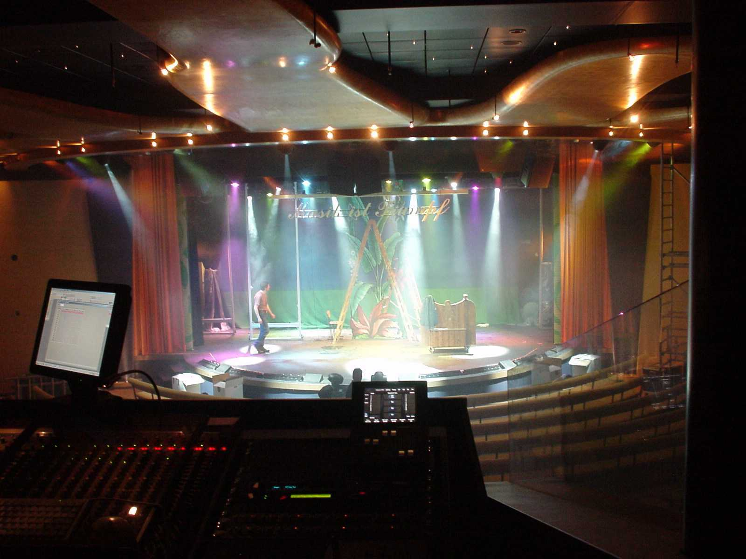
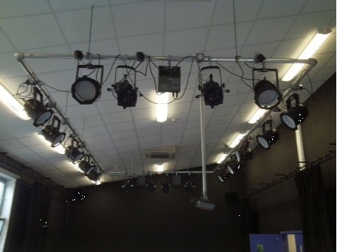
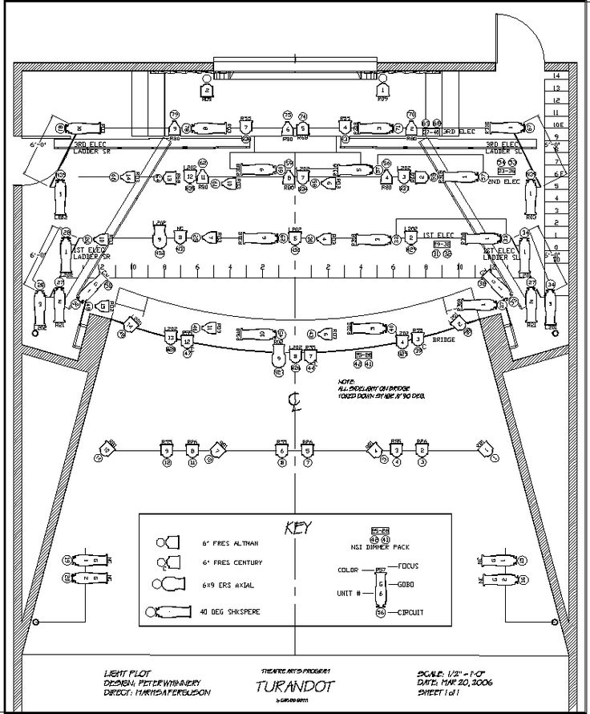
Stage lights – example images

Slide 6
Deadline
Learning Aim B
Friday 3rd Feb 2023

