Slide 1
WEEK 6

Slide 2
MIND MAP - Started it but you should refer to your revision worksheets to create your own. It may take a few drafts remember to perfect your mind map. Mind maps are crucially important in giving your brain the bigger picture. The process of creating ‘the perfect mind map’ through several drafts is a handy way of familiarising yourself with the material. Always try and handwrite the mind maps and avoid using the computer.
Wage spiral
Hysterisis
Flexible labour markets
SRPC and LRPC
Inflationary expectations
Equilibrium, Disequilibrium Unemployment and the Natural Rate (including the NAIRU)
RWS 17
Phillips Curve Analysis
RWS 17
Phillips Curve Analysis
Economic History of Thought: Classicals v Keynesians
B8
MICRO
MACRO
RWS 18
Labour Market Failures
RWS 18
Fiscal and Supply Side Policies
Fiscal Policy
Supply Side Policy

Slide 3
15 MARKS
MICRO
Explain what is meant by the term ‘wage differentials’ and analyse why wage differentials occur.
Explain what has been the cause of greater flexibility in the UK labour markets
Explain why a ‘doctor’ would be paid more than a ‘road sweeper’
Using MRP theory, the concept of derived demand and a labour demand curve only, explain what might happen to the demand for footballers in the labour market for the Premiership from 1992 until today
Explain the demand side consequences of an increase in taxation
Explain the supply side consequences of a fall in taxation
Explain the consequences to the labour market of increased flexibility
Explain the factors which may determine the elasticity for labour demand and supply
Explain what perfect competition in the labour markets and explain how the wage rate in labour market may be affected by imperfect competition
Explain why there might be a gender pay gap
Explain how discrimination might affect the wage determination within a market
Explain the key assumptions of a perfectly competitive labour market
Explain the possible impacts of Globalisation on the labour markets of the UK

Slide 4
25 MARKS
MACRO
Discuss the view that as an economy approaches full employment, inflation inevitably increases
Evaluate the view that reducing unemployment inevitably has trade-offs with other macroeconomic objectives.
To what extent do you agree, if at all, that the implementation of a budget deficit reduction programme will improve the UK’s long-term economic prospects? Justify your answer.
Assess the possible effects on macroeconomic performance of a sustained rise in UK productivity
To what extent do you agree that cuts to direct taxation would benefit growth and living standards in the UK? Justify your answer.
Assess the view that a reduction in income tax is the best way to improve the performance of the UK economy in both the short run and the long run.
Discuss the view that the measures taken to reduce the size of the budget deficit will inevitably result in a rise in unemployment in the UK.
To what extent do you agree that a further reduction in the UK’s unemployment rate is most likely to be achieved by improvements in the supply-side rather than the demand-side of the economy?
Evaluate different policies that could be used to reduce the rate of unemployment in the UK
Evaluate the use of demand management and supply side policies to promote economic recovery
Assess how effective fiscal policy might be in fostering a recovery in aggregate demand
Discuss the importance of fiscal policy in trying to avoid a major recession
“The only way to reduce unemployment from ‘The Great Recession’ is to use demand side policies”. To what extent do you agree with this statement? (25 Marks)

Slide 5
90

Slide 6
Benchmark 8! RWS 17 and 18
STARTER ACTIVITY:
Draw your first ‘draft’ mind map for the micro and macro side of this upcoming benchmark. Try to recall the material off the top of your head, liaising in your 3’s/4’s before looking at notes etc.
BENCHMARK 8:
Monday 19th February at 0845 (so two weeks of revision - up to 12 hours)
1 Hour Long (1 hour 15 Minutes with extra time)
A 15 marker and a 25 marker (you are not sure whether it will be a micro and/or macro question)
Material = RWS 17 and 18 on the micro and macro

Slide 7
Analysis Questions You should be able to answer these now but might need a bit of help
Using AD/AS diagram AND a Phillips Curve diagram for each question below:
Explain how demand side policies would be effective in reducing unemployment in the short run
Explain how demand side policies would NOT be effective in reducing unemployment in the long run
Explain how supply side policies might reduce unemployment?
Explain why supply side policies might NOT be effective in reducing unemployment?
Using labour market diagrams:
Explain how a firm operates in a perfectly competitive labour market
Why is a monopsony firm have a negative effect on a labour market?
Why are trade unions a positive force in the labour market?
Why are trade unions considered not to be a positive force in the labour market?
Answer question 2 using the advanced diagram if you have not already done so
EXTENSION: What is going on in the USA at the moment and why is this proof of the SRPC?!

Slide 8
90

Slide 9
15 Mark Questions - Go through
Notes:
11 - 3 Points
Overall AD effect from direct taxation - shift in the curve: C hit / G hit / I hit
SRAS effect from indirect taxation - costs of production - movement along the curve due to rise in inflationary pressures
Demerit good effect - reduce demand for goods with negative consumption externalities
12 - 3 Points: austerity is unneccesary and undesirable
YES - Austerity delayed the recovery
YES - Austerity led to a fall in living standards and greater poverty
NO - The state is inefficient and leads to crowding out
MORE DETAIL BELOW
FOR AUSTERITY in 2010
Reassure Markets:
As: UK Government (New Labour) increased national debt from 37% of GDP to 86% of GDP (doubled it) to bail out the banks and recover from the financial crash of 2008. Also, New Labour managed to leave office with a structural deficit (New Labour minister who left a note saying there was no money left to incoming conservative ministers). Markets may start to become jittery and bond prices will fall, meaning the interest rates (or cost of borrowing for the UK) will be very high in the short-term and future. This can have knock on effects to the private sector who might be less willing to invest, preventing economic growth. Greece, Ireland and Italy are examples of where bond yields increased hugely in a short space of time because a loss of confidence by the Bond Markets in their Governments in the wake of the financial crisis.
Ae: New Labour’s structural deficit was actually quite small and there was a desperate need to bail out the banks. 86% of GDP is still manageable especially when you look at USA (120%) and Japan (over 200%). UK’s 86% is also historically low and we tend to have a long maturity on bonds so any short-term effects would be minimal. Greece, Ireland and Italy arguably faced problems because of a lack of a central bank in the Eurozone rather than issues with their Government debt? Borrowing costs are at their lowest for a while so it made more sense to increase national debt?
Strong Fiscal Rules
As: A general sense that we needed to tighten our belts after the financial crash which was caused by excessive debt; therefore having strong rules to manage Government debt was the prudent thing to do. The increase in borrowing has fallen since 2010, suggesting the policy has been working. Although the deficit hasn’t been erased, it is hard to do that as a budget deficit naturally forms in a period of downturn or recession.
Ae: Osborne (and all Conservative chancellor’s) have failed to meet fiscal rules and borrowing has still increased. Also debt is vital to how our economies work and to compare household budgets to Government budgets is irresponsible by the Government (David Cameron famously said we should all pay off our credit cards but trouble with that is everyone would save and no one would spend! Firms lose profits, start laying off workers etc. This is called the ‘Paradox of Thrift’). Perhaps if more fiscal stimulus had occurred, the cyclical deficit would have been much less and boosted the overall economy?
Inefficiencies with the State and ‘Crowding Out’
As: Better to shrink the size of the state to prevent crowding out. Also, danger of X-inefficiency because of a lack of the profit motive. Became too big under New Labour from 97 to 10. In particular welfare payments deemed to be too excessive.
Ae: Welfare cuts and pursuit of ‘Universal Credit’ by the Coalition and Conservative Governments have led to vulnerable people (disabled, low incomes etc.) being at even greater risk. These are not inefficiencies in the state but necessities for a decent society. Private sector strangely not offering to help the most vulnerable so state must step in. Also no danger of crowding out as economy had a large negative output gap and there was more likelihood of ‘crowding in’ where the private sector is stimulated by a boost to the public sector. Lastly, whether the state was too big or not is almost a mute point because in a recession, your first priority is to get out of that recession, not try and reform for the long-term.
AGAINST AUSTERITY in 2010
Austerity is Self-Defeating and destroyed the recovery of 2009-10:
As: George Osborne caused a double dip recession after he came to power and austerity has prolonged the effects of recession. Austerity just damaged already weak consumer and business confidence further and led to further fall in AD creating an even bigger negative output gap because of a de-multiplier effect. Further AD stimulus needed via fiscal policy to prevent a double dip recession. Slowest recovery on record.
Ae: Examples of other countries recovering after austerity and although it took time, it means we have stronger foundations with which to build in the future. Short term pain for long term gain. Also, fiscal policy in a recession is not necessarily the right way forward if it stores up lots of debt laater. Better to pursue monetary quantitative easing etc. to get the economy going.
Fall in Living Standards and Longer Term damage to the economy:
As: Since 2010, poverty has been on the rise as Healthcare cut in real terms and education cut in nominal and real terms. Failure of public serivces as well (police, local authorities etc.). Real wages are stagnating and we have a productivity puzzle.
Ae: Unemployment is now at it’s lowest since the 1970’s and so we have recovered from the financial crash.
Alternatives to Austerity were available
As: Allowing the pound to devalue would have caused exports to rise and boosted AD. Fiscal stimulus also important as we are in a liquidity trap.
Ae: Global recessions mean that other economies are reducing their imports which means we might not have sold more exports. Fiscal stimulus would lead to greater debt which would cause bond yields to increase and possibly cause another period of excess debt similar to before the financial crisis of 2008!

Slide 10
15 Mark Questions
(Question 03):
“The Great moderation was a period of time straddling two Governments, Conservatives from 1993 to 1997 and New Labour from 1997 to 2007. It is characterised with falling unemployment and low inflation leading to some commentators at the time calling it ‘The Death of Inflation’
(a) Explain how the ‘Great Moderation’ occurred from 1993 to 2007 (15 Marks)
(b) “The only way to reduce unemployment from ‘The Great Recession’ is to use demand side policies”. To what extent do you agree with this statement? (25 Marks)
Notes:
3a) 3 Points:
(1) LRPC to left = Supply Side Policies (Free Market and Interventionist)
(2) SRPC - shift to the left: Lower expectations because of Bank of England independence
(3) SRPC - movement along: INTERNAL - Flatter SRPC because of Globalisation

Slide 11
15 Mark Questions
Explain why doctors get paid more than nurses (15 Marks)

Slide 12
90

Slide 13
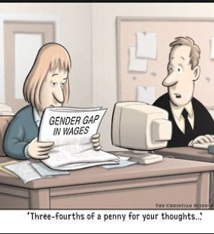
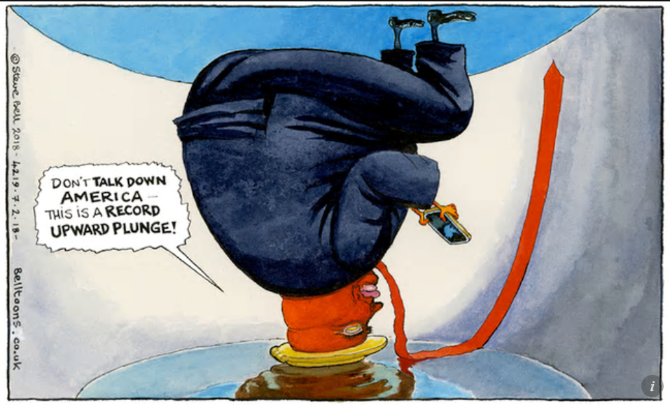
FEB 2018: Global Stock Market Turmoil! STARTER: Check your RWS’s and A3 Sheets - what do you need to concentrate on for the benchmark after half-term? Also - please use your phones to answer these questions below; useful application for possible questions in the benchmamark!
MICRO
MACRO
What is happening with the gender pay gap in supermarkets this week? Who is in the right; female workers or the supermarkets?
What has been happening to global stock markets and why? Why is this proof that people still believe in Phillips curve analysis?

Slide 14
25 Marks - ESSAYS!
14 “The only way to reduce unemployment from ‘The Great Recession’ is to use demand side policies”. To what extent do you agree with this statement? (25 Marks)
16 ­Discuss the view that as an economy approaches full employment, inflation will inevitably accelerate (25 marks)

Slide 15
25 Mark Essays - Wording can be complicated but….
Evaluate whether austerity in 2010 has been beneficial to the UK economy
‘Austerity has been an unmitigated disaster’. Discuss this view with reference to the UK experience.
Evaluate the view that austerity measures post 2010 were vital to the recovery from the Great Recession
Evaluate the view that the UK Government’s Policy of deficit reduction through lower Government spending is unnecessary and undesirable
George Osborne is an economic twat. Discuss.

Slide 16
12
YES UNDESIRABLE: Self-defeating and delayed recovery
As: Double dip recession (reduction in AD). Slowest recovery in recent years. De multiplier effect etc. Poverty on the rise and failure of public services (NHS crisis, problems in schools, terrorist attacks etc.). Productivity issue in the UK and falling real wages. Need boost to AD not reduction! Also in a liquidity trap so fiscal policy needed.
Ae: Great Recession was worst since 1930’s so recovery always going to be hard but now have lowest unemployment since 1970s. No pain no gain. Monetary policy (quantitative easing) helped with the recovery; no need for fiscal policy.
NOT UNNESSECARY: Need strong fiscal rules because of pre 2010 Government’s reckless spending
As: Success with reducing deficit since 2010 thanks to strong rules of reducing deficit over 5 years. Enabled calming of markets because of large debts inherited from previous 2010 Government. Look at Greece, Italy and Ireland and their bond yields
Ae: Didn’t need strong rules = Debt due to financial crisis and was needed and we are not Greece as have a sovereign currency (i.e. not the Euro). Actual inherited structural deficit small and our national debt is much lower than USA and Japan. Also chancellors since 2010 have only reduced deficit and NOT met their fiscal rules (which was to eradicate the deficit).
NOT UNNECESSARY OR UNDESIRABLE: Inefficiencies with State and ‘Crowding Out’
As: Prevent crowding out by reducing state as it is X-inefficient. Too big under New Labour; needs to be reduced
Ae: Vulnerable in society now more at risk. Private sector investment has not stepped up….almost the case that we needed more public expenditure for private sector to ‘crowd in’.

Slide 17
14
14 “The only way to reduce unemployment from ‘The Great Recession’ is to use demand side policies”. To what extent do you agree with this statement? (25 Marks)
Demand side policies: Monetary
Demand side policies: Fiscal
Supply Side policies
Demand side policies: Monetary and Fiscal
Supply Side Policies: Interventionist
Supply Side policies: Free Market

Slide 18
­Discuss the view that as an economy approaches full employment, inflation will inevitably accelerate (25 marks)
16
Introduction
Define full employment – it means 0% and inflation
Context - Phillips Curve Analysis suggests a short run trade off but is there one in the long run? History shows that SRPC and LRPC shift and SRPC can change shape
Route through the essay -
YES INTEVITABLE: Short run Phillips Curve shows a trade off | Support | Full employment is defined as 0% and there is a trade-off between unemployment and inflation. Short run Philips curve analysis: Explaining why as unemployment falls, inflation starts to rise with a movement along the line – demand pull inflation. Greater jobs = more inflation etc. AD/AS Analysis can be used here as well/instead of…perhaps approaching the LRAS? | 1970’s – Barber boom and attempt to lower unemployment and approach full employment led to significant inflation in the mid-70’s (25%) 1980’s - Lawson Boom - similar fall in unemployment leads to sharp rises of inflation
 | Evaluate | This relationship is maybe not inevitable because of the death of inflation. Death of inflation led to flatter SRPC curves so the trade off was less. As the economy approaches roughly 0% unemployment (full employment), maybe inflation will not be inevitable? Also Implementation of supply side policies to make labour markets more flexible will lead to LRPC shifting to the left and approaching full employment at 0% but not necessarily causing inflation (SRPC shifts left with LRPC to keep price level the same and due to dampening of inflationary expectations). Again inflation not inevitable | 1993-2007: The Great Moderation or ‘The Goldilocks Economy? Control of inflation with an independent central bank targeting inflation; the impact of globalisation on cheaper imports; more competitive labour markets through the lack of power from trade unions, more labour market flexibility and greater immigration from EU enlargement all keep wages and inflationary expectations down.
YES INEVITABLE: Overshoot NAIRU and get Wage Spiral | Support | Even if SRPC is flatter, in long run no trade off between unemployment and inflation (LRPC Analysis). Wage spiral and inflationary expectations as Government tries to push towards 0% full employment | 2018 – US Economy
 | Evaluate | Where is the NAIRU? Hard to say what is ‘equilibrium unemployment’? So whether the economy would go into a wage spiral is debatable. Draw Keynesian AS curve to show how perhaps we are behind the LRAS | Classical economists might argue that someone in South Wales who has not moved or retrained is voluntarily and structurally unemployed whereas a Keynesian might argue that this is demand deficient unemployment?
NO NOT INEVITABLE: Supply side policies might shift NAIRU | Support | The NAIRU might be able to be reduced by supply side policies which might dampen inflationary expectations as output increases? AD/AS analysis (LRAS shifting to right) and LRPC Analysis (LRPC moving to left) | 1993-2007: Did this happen in the Goldilocks Era? Policies of the 1980’s shifted NAIRU to the left, so demand management policies more viable to reduce disequilibrium unemployment as equilibrium unemployment had been reduced by supply side policies
 | Evaluate | Are targeting inflaiton, an independent central bank and globalisation going to dampen down inflationary expectations (i.e. SRPC shift to the left). Perhaps SRPC shifts to the right as inflationary expectations rise because everyone has a job. | Decline of globalisation 2013-today (BREXIT, Trump etc.) Bank of England failures?

Slide 19
END

