Slide 1
Vogue (1965)
Audience

Slide 2
Starter
Remember this table?: Has anything changed since studying Vogue?
Under each heading place the following statement based on your reading habits.
Absolutely Not | Somewhat True | True
I regularly read magazines
I read magazines for information/ to keep up to date on specific topics (e.g. fashion/ music/ sport)
I buy whichever magazine has a special offer or free gift
I always buy (or subscribe to) my favourite magazine
I follow my favourite magazine on social media
I read magazines for pleasure/ entertainment
I regularly visit magazine websites (even if I don’t buy the magazine)
Print magazines are preferable to digital magazines on a phone/ tablet
I enjoy the additional content that magazines post online e.g. videos
Magazines are a luxury
Magazines are aspirational
I have bought a product after seeing an advertisement in a magazine
Print magazines have too much advertising

Slide 3
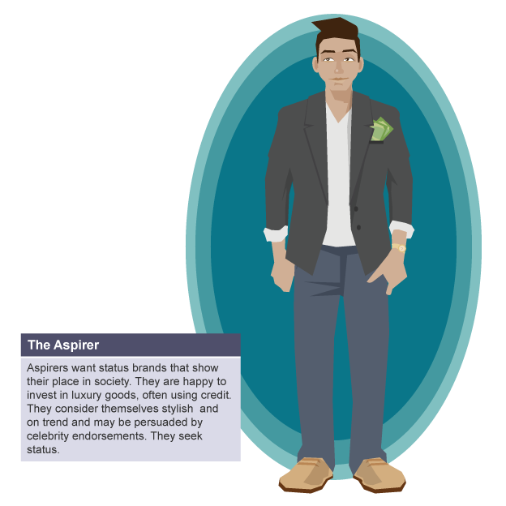
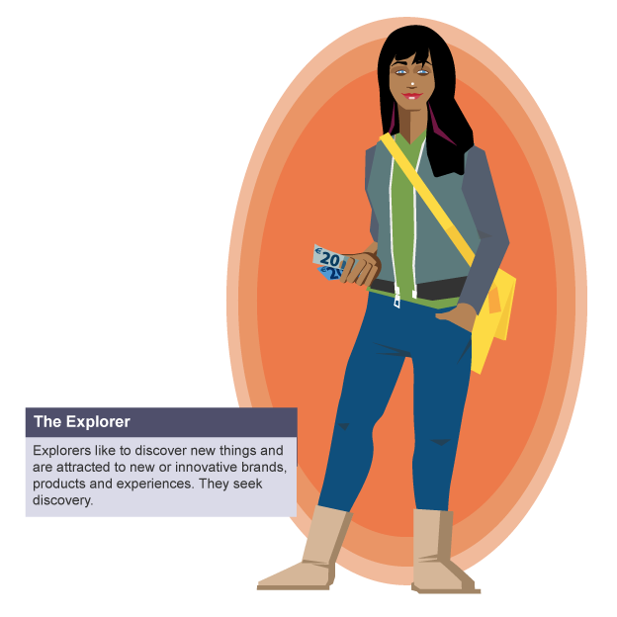
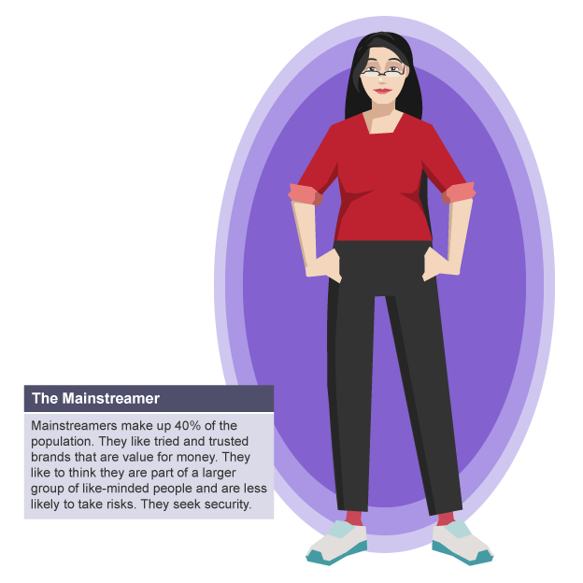
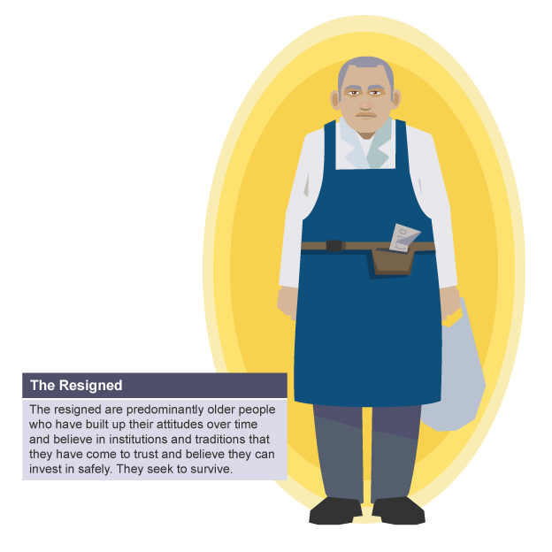
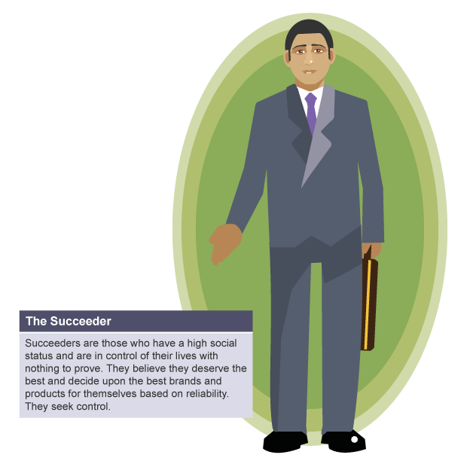
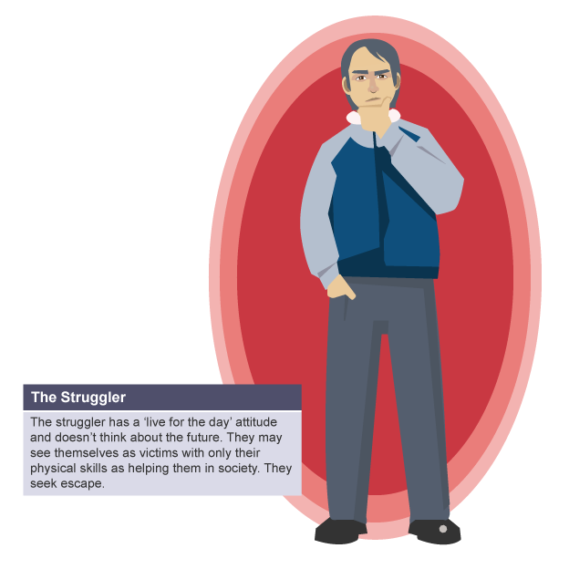
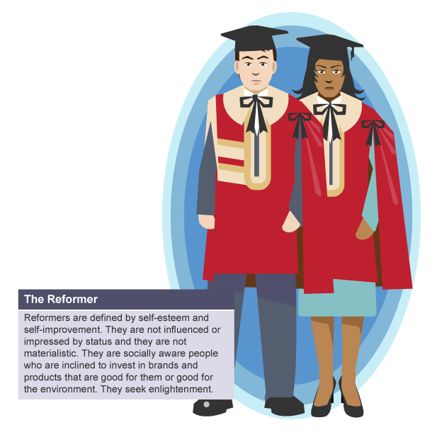

Slide 9
What are the specific appeals to audiences of Vogue? Give examples from the magazine to support your points.
Information/advice e.g. fashion/health
Familiar conventions
Luxury – ‘glossy’ magazines
Entertainment
Diversion/escapism
Mode of address – e.g. ‘friend’ or ‘big sister’
‘Lean back’ experience, pleasure of relaxing with the magazine
Personal identity – reflection of ‘actual’ or ‘desired’ self
Aspiration
Interaction

Slide 10
Theory:
Apply Stuart Hall’s reception theory. You should give specific examples from the magazine (front cover, contents, articles, advertising) when completing this exercise.
The target audience of the time was potentially more likely to take a preferred reading of the text.
Remember, the social and cultural context will have had an impact on how readers responded to the magazine.
Contemporary readers are potentially more likely to have a negotiated or oppositional reading due to the changes that have occurred in society since the 1960s, especially in relation to gender.
Preferred Reading (dominant-hegemonic position – the intended meaning is accepted)
Negotiated Reading (the intended meaning is generally acknowledged but adapted to fit the reader’s experience or context)
Oppositional Reading (the intended message is understood but the reader disagrees with it)

Slide 11
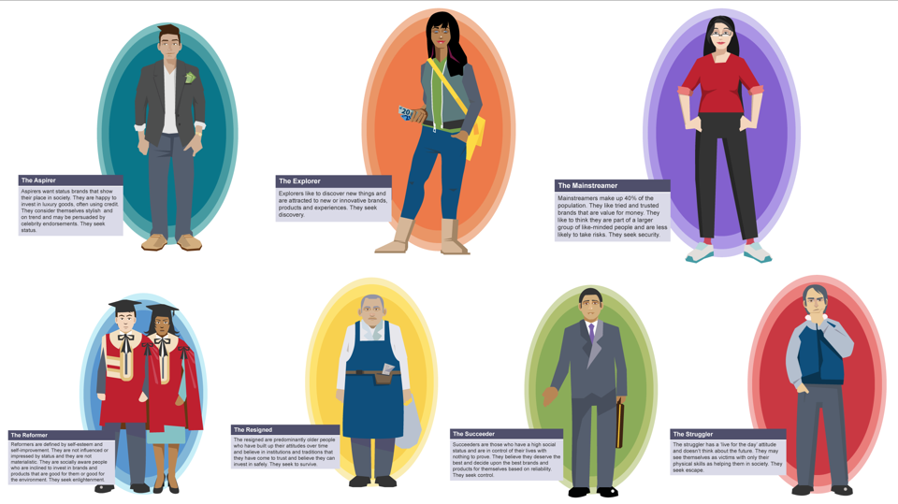
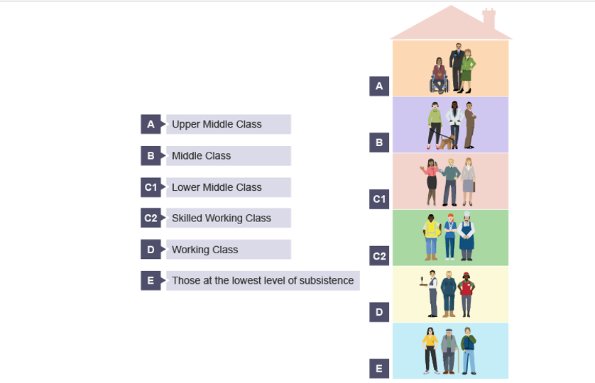
Target Audience Task
Demographic/ Psychographic element | ‘Ideal Reader’ | Evidence from Magazine or Industry Research
Age
Gender
Socio-economic group
Interests E.g. fashion, sport, culture
Lifestyle Occupation, family etc.
Values Consider the ‘Four Cs’

Slide 12
NEW MAGAZINE IDEA
Pitch an idea for a new, non-mainstream magazine. This should be for a niche/specialised audience. This needs to be produced as a PowerPoint – with a slide for each of the following (look at example for guidance).
Decide:
What genre of magazine
What content will you include? Number of pages?
Masthead? What name will you choose?
Who is your target audience? (Define by demographic and psychographic factors and/or interests).
Style. How will you appeal to them?
How will your magazine be produced – print and/or digital format?
What online and social media presence will your magazine have?
What will make your magazine unique?
Produce a digital mood-board which sums up your target audience/the look – ‘house style’ of your proposed magazine

