Slide 1
Writing a Brief

Slide 2
Lesson Plan:
Finish The Apprentice task
Read through and annotate past examples of briefs.
Practise writing a brief for the creation of a new digital media product
Start to write the context for your own brief
H/W: Conduct Primary Research (Focus groups, 1-2-1s to determine or confirm your final idea)

Slide 3
Task:
Look at the different example briefs on GoL.
Annotate, trying to identify key content features.
What are they saying and when are they saying it?
REMEMBER: You will need to write a brief that sounds like these examples so it is important to recognise the key features.

Slide 4
Features and Content:
1: Background/Overview
2: Objective, what is the goal?
3: Target Audience, -
- Who are they?
- Where are they?
- How will we communicate with them?
What else do we need to know about them?
4: Focus, what will the product do? Entertain, educate inform?

Slide 5
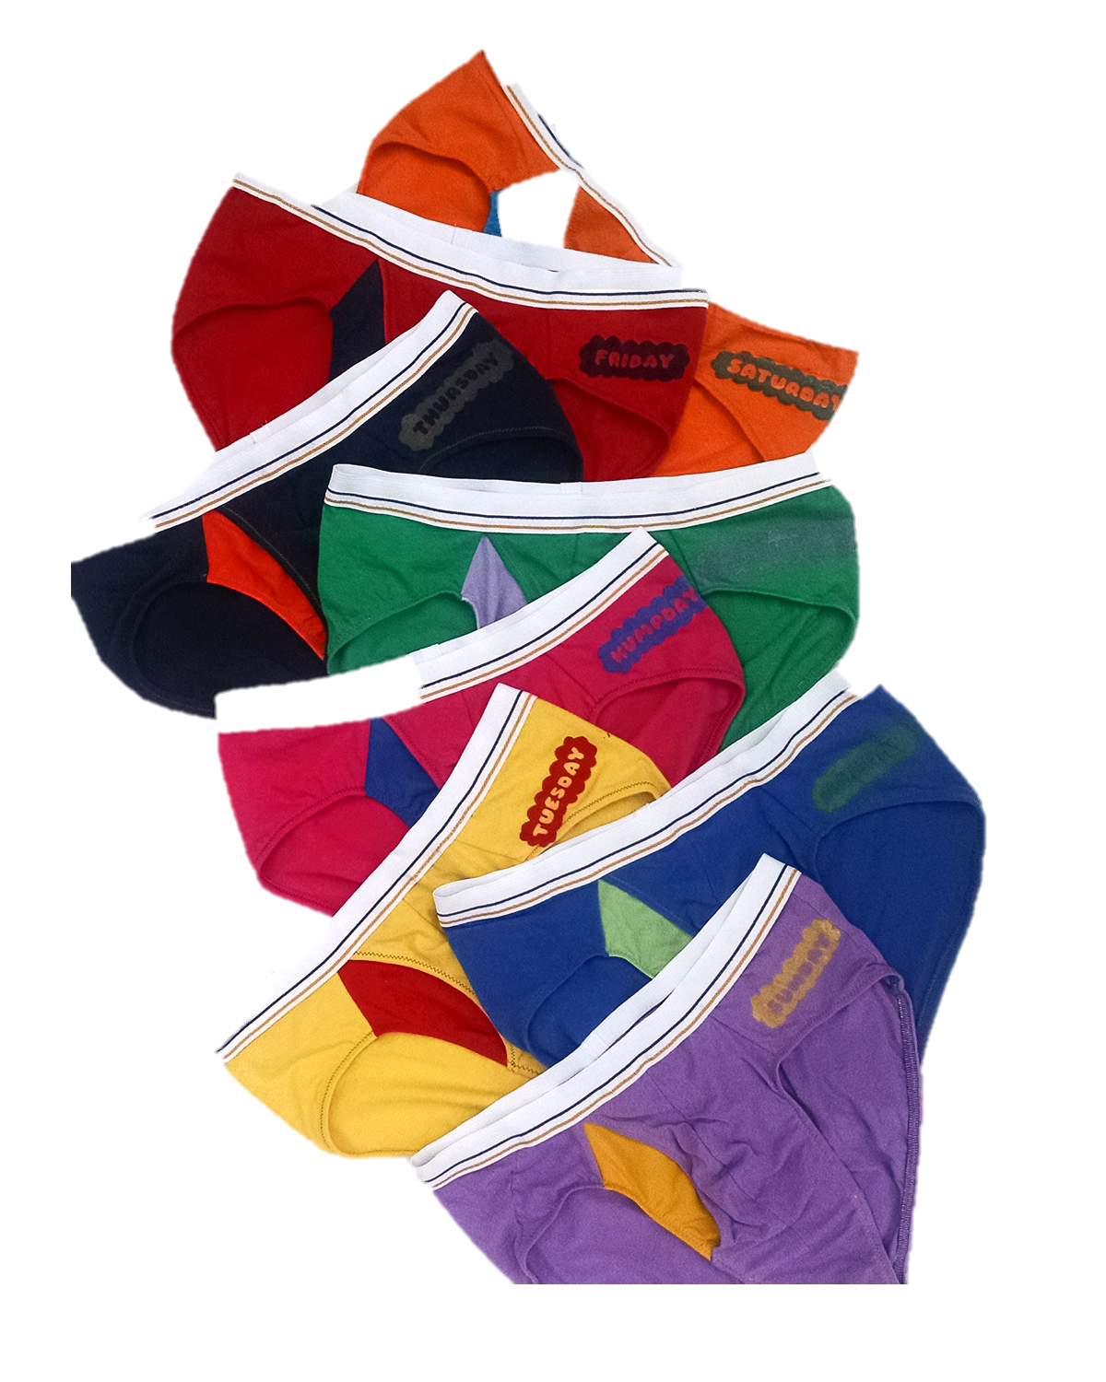
Steps to create your Creative Brief
Intro –Describe your business in 1 short paragraph
Feelings – What feelings do you want your brand to evoke?
Look / Feel – What aesthetic are you looking for?
Likes / Dislikes – What brand do you like / dislike? Why?
Competitors – Who are your closest competitors? What makes your idea unique?
Needs – What exactly do you need at the end of the project?
Budget – How much will it cost?
Timeline – When do you need the project to be completed by?

Slide 6
Enterprise Skills Diary Entry:
Remember to title this diary entry as Research and Ideas Portfolio.
- evidence for the selection and rejection of ideas
- evidence of the use of enterprise skills (e.g. self motivation, creative skills, conducting research) to generate ideas
- an evaluation of how your media enterprise skills contributed to the generation and development of ideas.

