Slide 1
SKILLS & ATTRIBUTES
Unit 21 P4

Slide 2
You will need to identify the key job roles that will be needed to organise your proposed event.
Use the list on page 1 of your class notes to help you.

Slide 3
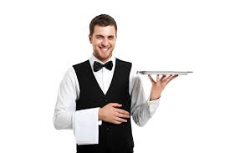
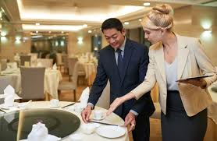
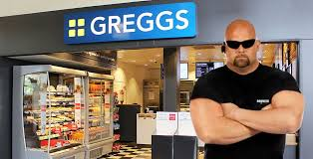
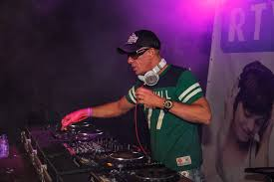

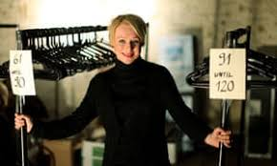
Then for each job role, complete the following information
JOB ROLE:
TASKS INVOLVED | SKILLS REQUIRED | ATTRIBUTES
 | Essential:
 | Desirable:
QUALIFICATIONS REQUIRED

Slide 4

What are skills?
Skills are the expertise or talent needed in order to do a job or task.
Skills are things you learn which help you to do certain tasks.
Job specific skills are those abilities that allow someone to excel in a particular job.
EXAMPLES OF JOB SKILLS?
HOSPITALITY SKILLS?
Some skills are attained by attending school or training programs. Others can be acquired through experience learning on the job. The skills that are needed for a specific job are also known as a skill set.

Slide 5
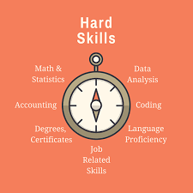
Hard skills are specific, teachable abilities that can be defined and measured.

Slide 6
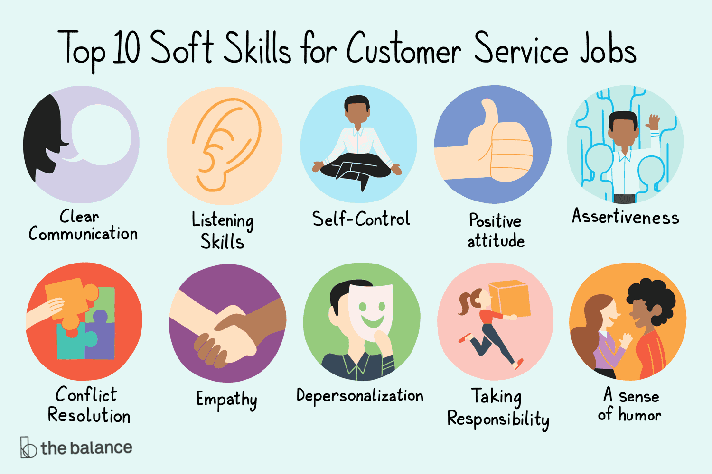
Soft skills are less tangible and harder to quantify, such as etiquette, getting along with others, listening and engaging in small talk.

Slide 7
TOP EMPLOYABILITY SKILLS
Communication skills — Listening, speaking and writing.
Teamwork —Many jobs involve working in one or more groups. Employers want someone who can bring out the best in others.
Analytical and problem-solving skills — Employers want people who can use creativity, reasoning and past experiences to identify and solve problems effectively.
Organisational skills — The ability to plan and manage multiple assignments and tasks, set priorities and adapt to changing conditions and work assignments.
Interpersonal skills — Employers usually note whether an employee can relate to co-workers and build relationships with others in the organization.
Computer/technical literacy (IT skills) — Although employers expect to provide training on job-specific software, they also expect employees to be proficient with basic computer skills.
Leadership/management skills — The ability to take charge and manage your co-workers, if required, is a welcome trait. Most employers look for signs of leadership qualities.
Learning skills — Jobs are constantly changing and evolving, and employers want people who can grow and learn as changes come.
Academic competence in reading and maths — Although most jobs don’t require calculus, almost all jobs require the ability to read and comprehend instructions and perform basic math.

Slide 8


Using online job sites/job descriptions, research the skills required to be able to do the following Hospitality jobs:
Chef
Hotel Receptionist

Slide 9
Identify the skills that you think would be needed by someone employed as a “Door Supervisor”:
Duties/Responsibilities | Skills Required
1. Managing crowds and queues.
2. Making sure people keep to the dress code.
3. Checking tickets.
4. Patrolling inside and outside the venue.
5. Watching people's behaviour and dealing with conflict.
6. Restraining and escorting people out of the venue, if necessary.
7. Dealing with emergencies.
8. Co-operating with police, first aiders and management.

Slide 10
What is meant by “Attributes”?
Attributes (Personal skills OR Qualities) are not hard skills that you can quantify and measure. Many of these cannot be taught (people are born with them).
Instead, they are qualities or attitudes that a person demonstrates that still have an impact on a worker’s job performance. These are often the things which stand successful staff out from the rest.
EXAMPLES OF ATTRIBUTES?
HOSPITALITY ATTRIBUTES?

Slide 11
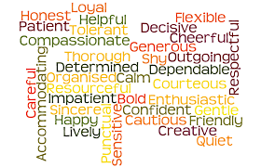

Slide 12
Top “Attributes”
Critical Thinking
Employers want employees who are able to solve problems on their own using creative thinking, initiative and thoughtful analysis
Dependability
Dependability is a very important quality in an employee. Employers want someone who is reliable and responsible. These kinds of employees can be trusted with more responsibilities, and might become strong leaders and managers.
Flexibility
Flexibility is important in many jobs. Many jobs require employees to juggle multiple tasks at the same time. Flexible employees are able to perform more than one task at the same time.
Being flexible might also be useful for shift work, which requires employees to work at various times. A flexible person would be able to work when needed, on whatever project is assigned.
Motivation
Employers look for employees who are positive and passionate about their jobs, and are motivated. Motivated employees tend to put the most effort into their work.

Slide 13


Using online job sites/job descriptions, research the attributes required to be successful in the following Hospitality jobs:
Chef
Hotel Receptionist

Slide 14
Identify the attributes that you think would be needed by someone employed as a “Door Supervisor”:
Duties/Responsibilities | Attributes Required
1. Managing crowds and queues.
2. Making sure people keep to the dress code.
3. Checking tickets.
4. Patrolling inside and outside the venue.
5. Watching people's behaviour and dealing with conflict.
6. Restraining and escorting people out of the venue, if necessary.
7. Dealing with emergencies.
8. Co-operating with police, first aiders and management.

Slide 15

QUALIFICATIONS
Academic: http://www.accreditedqualifications.org.uk/qualifications-and-credit-framework-qcf.html
Vocational: https://www.nidirect.gov.uk/articles/nvqs
Professional Qualifications:
https://www.prospects.ac.uk/postgraduate-study/professional-courses
https://rlss.org.uk/professional-qualifications/national-pool-lifeguard-qualification/
Other Qualifications?
Driving Licence
First Aid

Slide 16
Useful Sources:
https://nationalcareersservice.direct.gov.uk/job-profiles
https://www.prospects.ac.uk/job-profiles
https://www.caterer.com/
Google “job descriptions” for specific job titles.

Slide 17

To help plan your P4 work:
List in the table (at the end of your class notes) all of the job roles that you will need to research/write up for your 2 event proposals.
Aim for at least 8-10 to cover both proposals…there will be some common jobs required for both proposals.
Remember - You will need to complete one table for EACH job role.
There is a table template on teams/GOL.

