Slide 1
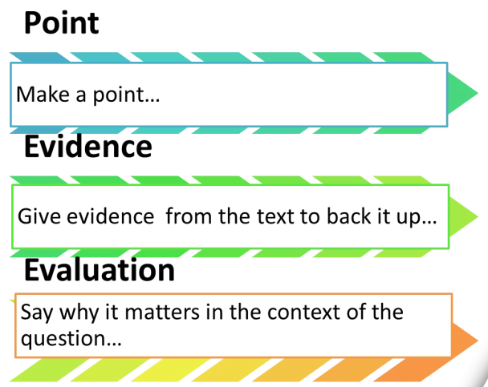
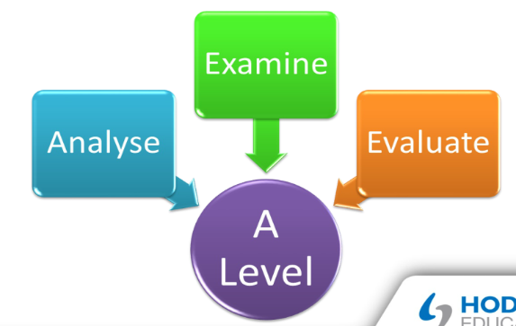
Analysez l’importance des épisodes et les évènements les plus importants de l’histoire.
Utilisez les points suivants:
les épisodes les plus importants et leur impact
l’attitude des personnages envers ces évènements
le lien entre les épisodes les plus importants et le titre du film
comment ils font avancer l’histoire

Slide 2
Introduction
Important: The introduction needs to be short but show your understanding of the question.
It should explain to the reader what you understand the question to mean, identify the issues it raises and how you are going to tackle them.
1. La première phrase présente le film que vous avez étudié et donne une brève indication de l’histoire en relation avec la question.
2. La deuxième phrase identifie la question, ses enjeux et est une phrase de transition qui permet de lier la première phrase au plan de votre dissertation.
3. La troisième phrase donne le plan de votre dissertation.

Slide 3
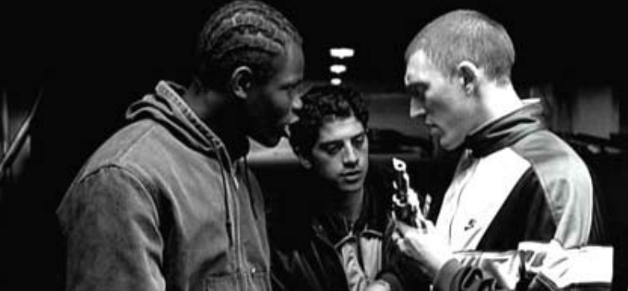
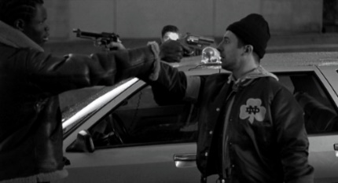
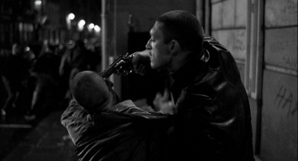
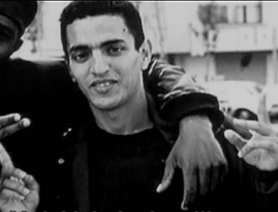

Slide 5
Quality of language
Mark | Quality of Language (A03)
13-15 | Generally accurate with some minor errors. Generally good grasp of grammar and often able to manipulate complex structures accurately. Good range of vocab
10-12 | Reasonably accurate with a few serious errors. Reasonable grasp of grammar and sometimes manipulates complex structures accurately. Reasonable range of V
7-9 | Many errors, some grasp of grammar and occasional accurate manipulation of complex structures. Sufficient range of vocab appropriate to the context & task.
4-6 | Many errors, some of a basic nature. Little grasp of grammar and rare accurate manipulation of complex structures. Limited range of appropriate vocabulary.
1-3 | Many errors, most of a basic nature. Very little grasp of grammar and very rare accurate manipulation of complex structures. Very limited appropriate vocab.

Slide 6
Mark | Skills / Content (A04)
17 – 20 | VERY GOOD critical response to the question with knowledge of the film is consistently accurate and detailed. Consistent use of appropriate evidence to justify points of view, develop arguments and draw conclusions based on understanding of the film.
13 – 16 | GOOD critical response to the question with knowledge of the film is usually accurate and detailed. Appropriate evidence usually used to justify points of view, develop arguments and draw conclusions based on their understanding of the film.
9 – 12 | REASONABLE critical response to the question with knowledge of the film sometimes accurate and detailed. Appropriate evidence is sometimes used to justify their points of view, develop arguments and draw, conclusions based on their understanding of the film.
5 – 8 | LIMITED critical response to the question with some knowledge of the film demonstrated. Occasional use of appropriate evidence to justify points of view, develop arguments and draw conclusions based on understanding of the film.
1- 4 | VERY LIMITED critical response to the task, with little knowledge of the film demonstrated. Very occasional use of appropriate evidence to justify points of view, develop arguments and draw conclusions based on their understanding of the film.

Slide 7
Exemple de paragraphe

Slide 8
