Slide 1
WEEK 1

Slide 2
90:

Slide 3
Benchmark 8

Slide 4
90:

Slide 5
Lead up to the Exam
PHASE 1: Paper 3 PREP
WK 1 = Benchmark and Intro to Paper 3 and Quantitative Skills
WK 2 = RWS 19
WK 3 = RWS 19
WK 4 = RWS 20
WK 5 = RWS 20
WK 6 = Revision
EAS = Revise whole course (RWS 1-20)
EAS = Revise whole course (RWS 1-20)
WK1 = Mock Exam 2 Hours Paper 3
PHASE 2: Paper 1 and 2 Data Response
WK 2 = DR – India and Development
WK 3 = Mock Exam Back
WK 4 = DR – Environmental Economics
WK 5 = DR – Health Economics
WK 6 = DR – Balance of Payments and Exchange Rates
MAY HALF-TERM
Paper 1 and 2
Paper 3

Slide 6
AQA A-LEVEL ECONOMICS
PAPER 1: MICRO
2HOURS
Section A: Data Response
2 Mark - Calculation
4 Mark – Data (2 points backed up with data)
9 Mark – Analysis and Application (Define and 1-2 Points)
25 Mark - Essay
Section B: Extended Writing (‘Essay’)
15 Marks – Analysis and Application (Define and 3 points)
25 Marks - Essay
PAPER 2: MACRO
2HOURS
Section A: Data Response
2 Mark - Calculation
4 Mark – Data (2 points backed up with data)
9 Mark – Analysis and Application (Define and 1-2 Points)
25 Mark - Essay
Section B: Extended Writing (‘Essay’)
15 Marks – Analysis and Application (Define and 3 points)
25 Marks - Essay
PAPER 3: SYNOPTIC
2HOURS
Section A: Data Response
30 Multiple Choice Questions (Micro and Macro Economics)
Section B: Investigation
10 Marks – Data Evaluation
15 Marks – Analysis and Application (Define and 3 points)
25 Marks - Essay

Slide 7
Exam Techniques
2 Mark – Calculation Data (Units!)
4 Mark – Descriptive Data (2 Points backed with data)
9 Mark – Analysis and Application (Brief definition and 2 Points of Analysis; no conclusion)
10 Mark – Evaluative Data (3 Points and Conclusion)
15 Mark – Analysis and Application (Definition and 3 Points; no conclusion)
25 Mark – Evaluative Analysis and Application (Intro, 3 Points Evaluated, Conclusion)
Knowledge
Ability to define key terms and draw diagrams
Apply quantitative methods to economic theory
Application
Real life examples (extracts and own knowledge)
Analysis
Chains of reasoning – explanations of economic theory
Using diagrams to enhance the above
Evaluation
‘Superficial’: On the other hand
Conclusion: weighing up the strengths and weaknesses of points and arguments

Slide 8
Timings
TASK: Look at Papers 1 to 3. How would you approach your timings on this?

Slide 9
Timings
Paper 1 and 2
5 Mins: ‘Skim and Plan’ – Skim Read Extracts and all Questions (Can you make a Choice? If time, can you start to plan your answers?
55-60 Mins: Section A Data Response
5 Mins: Read extracts and then plan rough answers to 2,4,9 mark questions (draw on question paper)
10-15 Mins: 2,4,9 Marker Writing
40 Mins (including up to 5 mins planning): 25 Marker
55-60 Mins: Section B Extended Writing
15-20 Mins: 15 marker writing
40 Mins (including up to 5 mins planning): 25 Marker
Paper 3
30 (40 max) Minutes: Section A - Multiple Choice. Mark a minute – some questions will take longer than a minute and some will be very quick.
80-90 Minutes: Section B – Investigation
5-10 Minutes Skim and Plan
20 Minutes (10 Marker)
20 Minutes (15 Marker incl. reading relevant extracts)
40 Minutes (25 Marker)

Slide 10
Quantitative Skills in A-level
In order to develop their skills, knowledge and understanding in economics, students need to have acquired competence in the quantitative skills that are relevant to the subject content and which are applied in the context of an economics A-level, including:
calculate, use and understand ratios and fractions
calculate, use and understand percentages and percentage changes
understand and use the terms mean, median and relevant quantiles
construct and interpret a range of standard graphical forms
calculate and interpret index numbers
calculate cost, revenue and profit (marginal, average, totals)
make calculations to convert from money to real terms
make calculations of elasticity and interpret the result
interpret, apply and analyse information in written, graphical and numerical forms.
The assessment of quantitative skills will include at least Level 2 mathematical skills as a minimum of 20% of the overall A-level marks. These skills may be assessed across the assessment objectives.

Slide 11
Quantitative Skills in A-level
TASK 1: The average price index of CPI in 2005 was 103 (2004=100).
Calculate the percentage increase in inflation between 2004 and 2005
In 2003 the index was 97. Calculate the percentage increase from 2003 to 2005
If in 2007 the index was 110, calculate the percentage increase from 2005 to 2007
TASK 2: The average basket of goods according to consumer prices in 2005 was £4.56. In 2006, it was £4.80 and 2007 it was £4.95.
Convert the average price of goods into an index from 2005 to 2007 with 2006 as the base year (i.e. 100)
Calculate the percentage increase from 2005 to 2006 using index numbers
Calculate the percentage increase from 2006 to 2007 using index numbers
TASK 3: An SME has a revenue in one year of £1,000,000. It sold 200,000 units. The average cost per unit is £3.
What is it’s total revenue?
What is the average revenue?
What is the price of the good it is selling?
What is the price of the total cost?
How could we calculate the total variable cost (algebra only)?
How could we calculate the marginal revenue (algebra only)?
TASK 4: Nominal (current) to real (constant) terms
Wages increase by 5% in an economy. At the same time, inflation increases by 5% as well. What is the nominal wage increase and what is the real wage increase?
Wages increase by 2.2% but inflation increases by 3.7%. What is the real wage increase?
If UK GDP Rose from £1,242 bn to £1,442bn and the price level rose by 13% then what would the real GDP increase be?
In 1987, UK average house prices were just over £40,000. By 2008, average house prices had increased to £180,000. However a £40,000 house in 1987 was actually worth £90,000 in 2008 at constant prices. Therefore what is the real house price increase?
TASK 5: It is 2018. Income increases in the UK have fallen in real terms by 3% since 2010. The demand for golf clubs has fallen in the same period from 700,000 units to 500,000 units. The price of bowling has also decreased in this period from £10 a session to £9 a session.
Calculate the income elasticity of demand for golf clubs
Using the statistic, explain whether golf clubs are a normal or inferior good AND whether they are elastic or inelastic
Calculate the cross elasticity of demand for golf clubs (compared to bowling)
Is bowling a substitute or complement to golfing according to your statistic?
How strong is the relationship between golf clubs and bowling?
TASK 6: Mean and Median
If there are 756 consumers paying a total of £20,000 for tickets on the black market, what is the mean cost per consumer

Slide 12
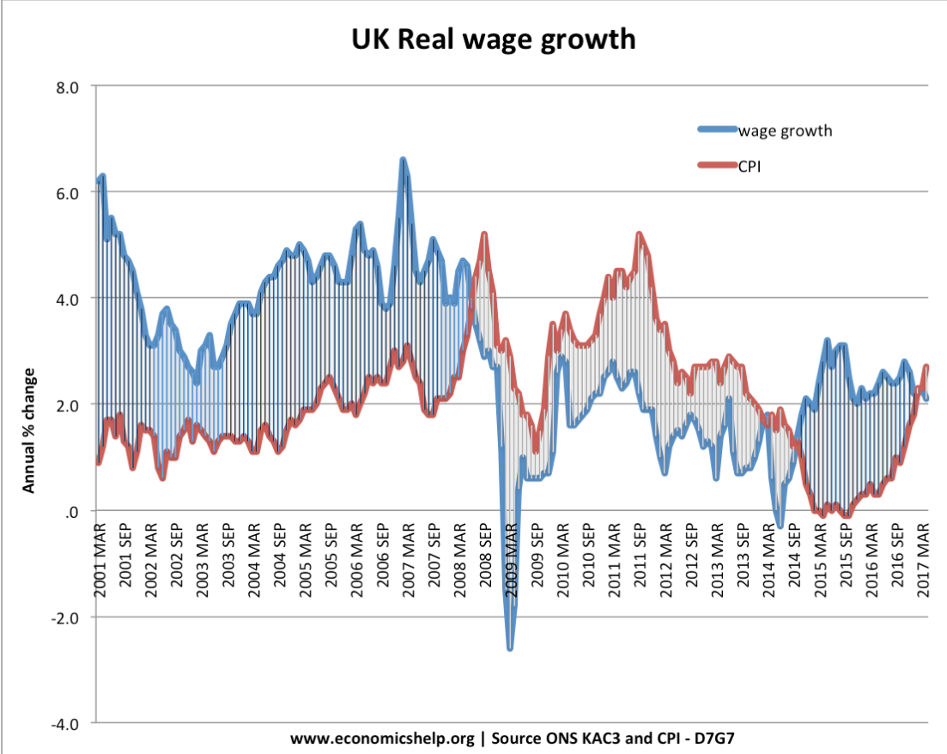
Using Index Numbers: ‘Nominal’ and ‘Real’ Wages
READ THIS
Real wages show the value of wages adjusted for inflation. Real wages are a guide to how living standards have changed.
For example, if nominal (actual) wages increased 5%, but inflation was 5%. This would mean the purchasing power of your wages had stayed the same. The net effect would be the same as a wage freeze (0% real increase)
However, if wages increase by 2%, and we have an inflation rate of 3%, your real wages is -1%. Prices have risen faster than wages, meaning you are worse off.
ANSWER THE FOLLOWING QUESTIONS
Describe what this graph tells us about real wages in the UK?
Is ‘wage growth’ nominal or real wages?
Explain why the graph might follow these trends? (HINT: think back to what happened before 2008 and the financial crisis - Goldilocks economy - and what has happened since)
Notes:
Q1: What would the index be in 1985 and 1994? 100 in 1985 and 150 in 1994
Q2: Calculate the real GDP for 1994
Therefore real GDP = $300bn * 100/ 150 =$200 bn
Q3: Calculate the real growth rate from 1985 to 1994
50 (200-150) / 150 *100 = 33.3%

Slide 13
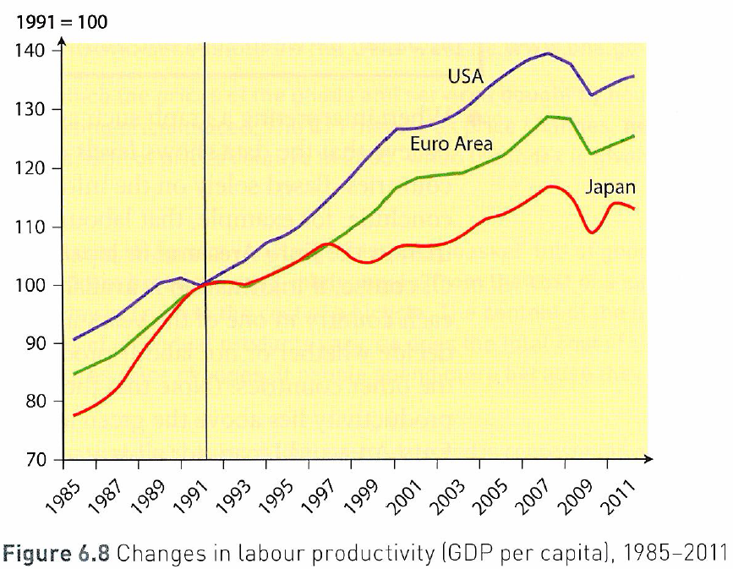
Understanding INDEX NUMBERS: How much do you know?
Index numbers are used to compare ‘relative’ numbers not ‘absolute’ numbers. They measure the rate of change over a period of time. They are usually calculated from a ‘base year’ which is given the value of 100 for ease of computation. Therefore if the base value is 100 and this increases to 105 in the following year, then this is a 5% increase. Equally if the rate of change falls from 100 in the first year to 93 in the second year, it is very easy to say there has been a 7% decrease.
TASKS TO COMPLETE:
Calculate the percentage increase in labour productivity from 1992 to 2011 in the USA just by looking at the graph.
Calculate the rough percentage increase from 2001 to 2008 for the USA.
Why might it be incorrect to say that the USA has had higher levels of labour productivity than Japan?
Is it true to say that it is at least possible that Japan could have higher levels of labour productivity than the USA?
Identify two significant points of comparison in the labour productivity of countries shown in Figure 6.8
Notes:
(1)
(2)
(3) INDEX numbers do not measure ‘absolute’ numbers but ‘relative numbers’. Therefore, USA line measures productivity against it’s 1992 100 base which could be higher or lower than Euro Area and Japan. What we can say is that the ‘relative’ growth in productivity was higher in the USA than the Euro Area and Japan from their base line of 1992

Slide 14
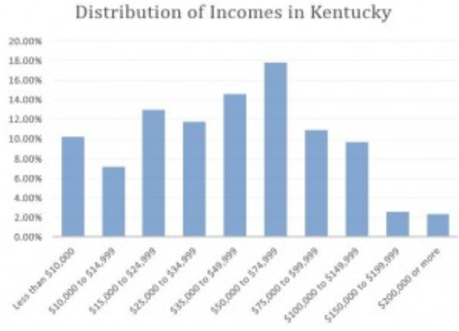
Mean vs. Median Income: Which One to Use and What it Means for South Central Kentucky
When it comes to economic indicators as litmus tests on the state of the economy, the measurement of mean or median income is often discussed. What has happened to the “typical” person’s income over time? What does the “typical” income tell us about the state of income distribution? Are people better off today than they were yesterday? A lot of questions can be discussed about this topic, but it is important to be able to understand some of the basic statistical differences between the measurement of mean and median income so that a more accurate representation can be drawn from what is actually being discussed.
The technical distinction between these two measurements may seem inconsequential, but it really can matter. The short answer of which measurement is more important is rather vague: it depends. In order to answer that question more effectively you would need to know how your data is distributed.
Using Kentucky income as an example, the mean income is calculated by dividing the total combined income of all Kentuckians by the number of incomes that you combined. This measurement would be fine for an economic indicator if the income data you were using was evenly distributed where 50% of Kentuckians made income higher than the mean and 50% made less. However, that is not the case with Kentucky income data.
If you look at the data published by The United State Census Bureau (illustrated in FIGURE 1), you can see that significantly more people make lower incomes which means that the data is not evenly distributed. Instead it is skewed to the left – meaning that a larger proportion of people have incomes lower than the mean. Using the mean, or the average, in this case could be misleading because a few wealthy millionaires in an otherwise poor county could substantially raise the mean income making it look like people have higher incomes on average than they actually do. Bureau of Labor Statistics data on annual wages of Kentucky illustrates this. The mean wage is $39,520, but the median wage is $31,220 – a difference of $8,300.
In this case, the median, the middle-most value, would be a more accurate representation of the typical Kentuckian income because less than 50% of people are making more than mean income. Knowing that, we can look at a breakdown of median incomes.
FIGURE 1
Explain why the median has an advantage over the mean average when calculating average income for an economy?

Slide 15
90:

Slide 16
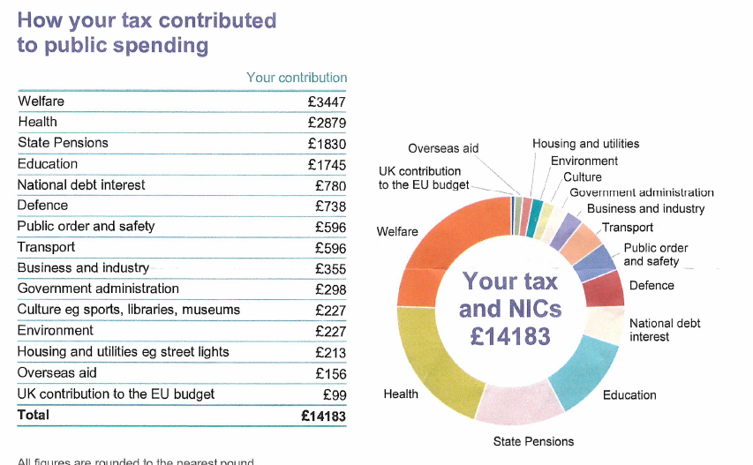
Calculate the percentage that ‘welfare’ and ‘pensions’ take up as a % of total spending by the Government.
Calculate the amount that health and education take up
Name one surprising and one unsurprising fact from the data below to you personally

Slide 17
TODAY 10 Mark Question and Intro to Topic
Just over one side of A4?
Definitions
A few sentences max
3 Points (Paragraphs) - Each point must:
Explicitly refer to the data (use units etc.)
Have a sentence or two of evaluation at the end of the paragraph (evaluation: bias of article, missing data, is it only a forecast, is their contradictory data in another figure, short-term v long-term impacts etc.
Overall Conclusion
A few sentences MAX
Bringing together the central thread of your arguments above.
RWS 19: Inequality (wealth and income) and Poverty (relative) in the UK
Defining, measuring and effects
Causes and Strategies
Redistribute income (taxes and benefits)
Government Legislation (equality act, minimum wage, trade union legislation)
Government Initiatives (supply side labour market policies, poverty targets etc.)

Slide 18
RWS 19: Inequality and Poverty in the UK Introduction in the UK
What does this mean in the UK today? Life of Kurt (10 minutes) and discussions about effects and causes of poverty for Kurt.
Knowledge you should already know from year 1:
What is poverty and inequality?
What is the distinction between absolute and relative poverty?
What is the distinction between income and wealth inequality?
What is the distinction between income (or wealth) equality and equity?
How is poverty measured in the UK?
How is income inequality measured in the UK?
What do you think are the two biggest causes of why some people may be at risk from poverty?
Are your two causes, ‘structural’ (i.e. to do with the system surrounding those at risk of poverty) or ‘agency’ (i.e. to do with the fault of the individual who is at risk)

Slide 19
WEEK 2

Slide 20
90:

Slide 21
TODAY 10 Mark Question and Intro to Topic
Just over one side of A4?
Definitions
A few sentences max
3 Points (Paragraphs) - Each point must:
Explicitly refer to the data (use units etc.)
Have a sentence or two of evaluation at the end of the paragraph (evaluation: bias of article, missing data, is it only a forecast, is their contradictory data in another figure, short-term v long-term impacts etc.
Overall Conclusion
A few sentences MAX
Bringing together the central thread of your arguments above.
RWS 19: Inequality (wealth and income) and Poverty (relative) in the UK
Defining, measuring and effects
Causes and Strategies
Redistribute income (taxes and benefits)
Government Legislation (equality act, minimum wage, trade union legislation)
Government Initiatives (supply side labour market policies, poverty targets etc.)

Slide 22
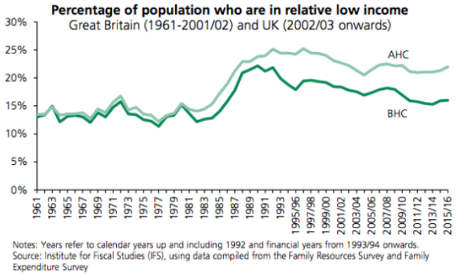
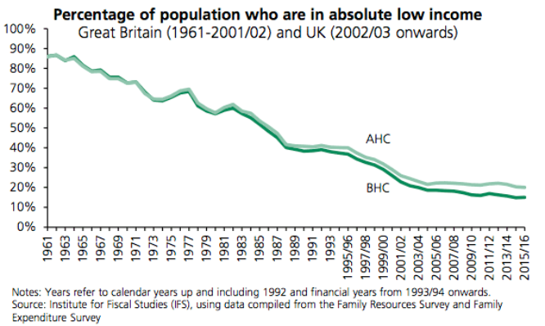
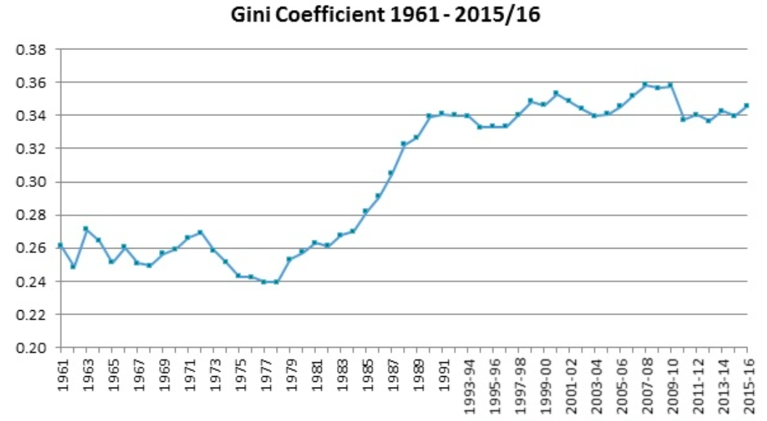
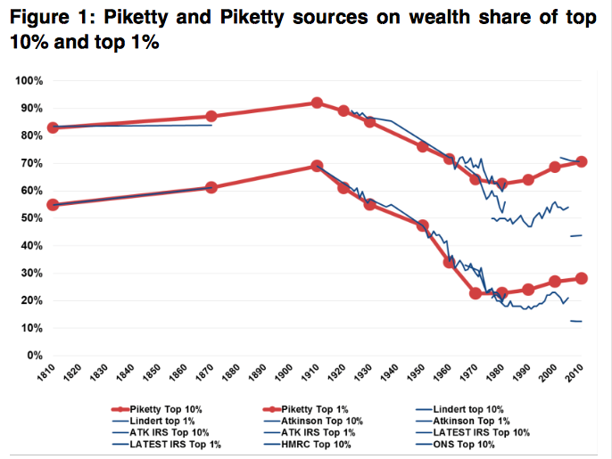
RWS 19: Inequality and Poverty in the UK Data in the UK Today – 10 Marker
The UK
The World
Notes:
EVALUATION POINTS
Poverty is not just about income
Issues with absolute income measures over a large period due to fixed level of income to define poverty
Issues with relative income measures over a shorter period due to average falling more quickly than those at the bottom then it looks like poverty falling when it is not
Stats from a Labour Think Tank who would want to portray Conservatives in a bad light
NOTES FOR ANALYSIS
Absolute Income Measures used for short-term comparisons – 1961 85% lived in absolute poverty compared to 2010/11 stats. So £138 per week in 2010/11 would have been a lot more in 1961 hence why 85% seem to be in absolute poverty. Therefore it is not a useful comparison in the long run. Over a shorter time period of say 5-10 years, it might be useful to see how basic living standards have changed using this measure – a fall in absolute poverty might occur because those on lower incomes have rising real wages however the relative income would not account for this necessarily as those on higher incomes might push up what it means to be 60% of the median. One of the perceived drawbacks of the relative measure is that if median incomes fall more quickly than incomes at the bottom it can appear as if poverty rates are falling even though the incomes of those at the bottom are not going up. The latter is what happened in the years after the financial crisis of 2008. In such instances it is important to look at poverty rates against fixed thresholds. This is also why policymakers need to understand what is being measured and, the way in which existing measures complement each other.
Relative income measures are therefore used for long term comparisons as it is calculated in a given year. So I 1961, it measures how many were below the median income of 1961 (not 2010 as absolute comparisons are inappropriate) and so is based on the current year.
While the current poverty lines are similar, absolute and relative poverty are very different concepts, and they can provide importantly different information about changes in the living standards of low-income households. For example, absolute poverty rises when the incomes of low-income people are falling in real terms, meaning that more people are living in households below the fixed poverty line. In contrast, relative poverty can rise even if there is no change in the real incomes of low-income households, if median income rises.
We think it is useful to track both absolute and relative measures of poverty. Because society’s view about what is an acceptable standard of living evolves over time, it is particularly appropriate to use a relative poverty measure when looking at long-run trends. In the short run, however, there is also interest in whether people are getting better or worse off in absolute terms and therefore changes in the absolute poverty rate are important when focusing on trends over recent years. For these reasons, we focus on absolute poverty when looking at short-run trends and relative poverty when examining how poverty has changed over several decades. Official income poverty rates are calculated using incomes measured both before housing costs are deducted (BHC) and after housing costs are deducted (AHC). Our analysis focuses on poverty measured AHC as, for a number of reasons, we believe changes in AHC poverty provide a more accurate indication of recent changes in the prevalence of those facing very low living standards.24
As well as the different definitions mentioned above, measures of poverty can also vary depending on the length of period that is considered. The vast majority of analysis of income poverty is based on ‘snapshot’ poverty rates – the incomes of households are recorded at one point in time, and that information is used to determine whether the household is in poverty. However, it is also interesting to consider the ‘persistence’ of low income, for two reasons. First, one might expect low income to be less likely to lead to low living standards – which is closer to what ‘poverty’ is normally intended to mean – if it is temporary. For example, if I had a high income last year, I may have put some of that income aside, which I can draw on this year when my income is lower. Second, lower living standards may be a greater cause for concern if they are experienced on a long-term basis than just temporarily. Assessing ‘persistent’ poverty involves measuring the incomes of the same households at multiple times, and assessing how much of the time they have a low income. Comparing snapshot and persistent poverty measures allows us to highlight how poverty is more likely to be temporary for groups that experience greater variability in their incomes, with potentially important implications for policy.

Slide 23
RWS 19: Inequality and Poverty in the UK Strategies in the UK Today
Redistribute income and wealth (taxes and benefits)
Progressive .v. regressive taxation?
Inheritance tax?
Benefit Claimants: Vulnerable or Scroungers?
Conservative Universal Credit Scheme
Government legislation (living wage, discrimination and trade union laws)
National Minimum Wage and Living Wage
Maximum Wage / Wage Ratios
Discrimination Laws and other Measures
Trade Union Reform
Government Initiatives
Reducing unemployment
Removing barriers to work
Macro stimulation of the economy
Targeting poverty
What is in place today (under each category)?
What more could be done?

Slide 24
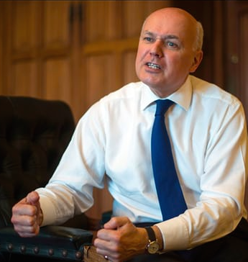
RWS 19: Inequality and Poverty in the UK Benefits Discussion
Stats about welfare in the UK
Universal Credit: Reducing benefits
Universal Basic Income: Increasing benefits
Overall Conclusion?

Slide 25
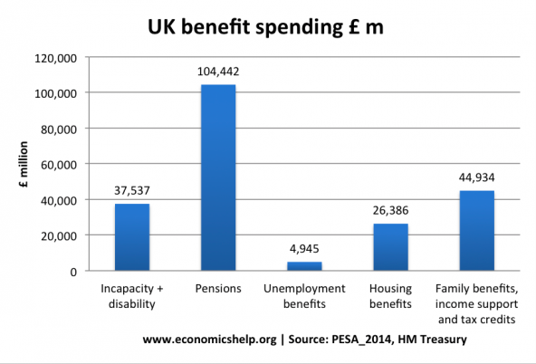
RWS 19: Inequality and Poverty in the UK UK WELFARE STATS

Slide 26
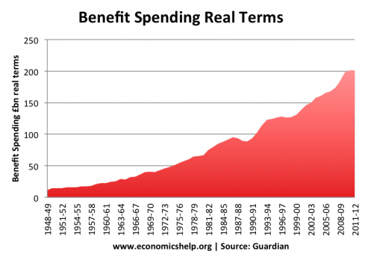
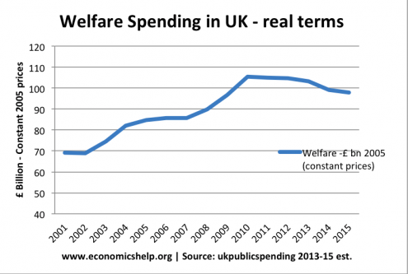
RWS 19: Inequality and Poverty in the UK UK WELFARE STATS – Universal Credit
Newcastle - Video (8 Mins)

Slide 27
RWS 19: Inequality and Poverty in the UK UNIVERSAL CREDIT
Government Intervention
Streamlined – rolling together 6 key benefits (unemployment, tax credits, housing benefit, employment and support allowance or ‘incapacity benefit’…). Reduce long term admin burdens. Cheaper to administer as all online
Reduce the ‘poverty gap’: Create incentives to work rather than stay on benefits and the current ‘disincentive problem’. A benefits cap will prevent people from earning more benefits than the average wage in the UK. People on universal credit are finding work faster than those on the old system, staying in it for longer, and keeping more of what they earn according to the DWP. The new system means that in-work benefits mean there is a greater incentive to work longer hours. Also means that the need to look for a job affects all possible benefit incomes not just JSA as in the old system.
Reduces the ‘unemployment trap’ by reducing benefits. Also helps to reduce structural budget deficit - £11bn in savings – dependency costs UK ‘uncounted billions’ according to Daily Telegraph editorial
Monthly payments – similar to work pay to help better manage money
No delay – DWP spokesman said he had known for “a number of months” that the timetable would change and this happened because “the scope of the programme has been increased by the desire of the government to do more welfare reform.” He explained: “It’s a bit like you asked me to build a house with three bedrooms in it and while I was laying the bricks you asked for five rooms, which is why it feels like a delay.” Also The media’s portrayal of the mess the system is has just focused on the six-week gap between applying for the benefit and receiving money, which has pushed SOME into debt and food poverty. Once it is up and running then it works very well.
Government Failure
Not universal – disability living allowance, maternirty pay, child benefit, council tax benefit, carers allowance still extra
Due to be rolled out in 2017 after announcement in 2011 but manaagement failures etc. mean delayed by 5 years to 2022/23 to 7 million recipients at cost of £63 billion. 7th announcement in 2018 about scheme being delayed since 2013.
Experience of pilot schemes so far has been very poor with accusations of overly complex and a heavy reliance on using the internet.
Cuts by the back door. Food banks report an increase in their use when universal credit is introduced in their areas. the Resolution Foundation thinktank, universal credit will leave about 2.5 million low-income working households more than £1,000 a year worse off.
Landlords worried by the rise in tenants in ‘arrears’ and a spike in eviction and homelessness. Private landlords will no longer rent to universal credit claimants. Housing benefit equialent now paid to tenants not directly to landlords as it was.
Too big to fail – lots of money and political cpaital invested….but affecting 50% of children in the UK (ie those who live in households with benefit incomes)
Only due to reduce overall spending by 2% - £8.5 bn to implement so far!

Slide 28
RWS 19: Inequality and Poverty in the UK BENEFITS AS A GOVERNMENT INTERVENTION?
VIDEO (5 Mins): Benefits Tourism - https://www.youtube.com/watch?v=P2AER5IKNwE
Government Intervention
Reducing absolute/relative poverty. For families without work, welfare benefits help maintain a minimum standard of living. Without a minimum income, it will cause low living standards. For example, children in low-income families may suffer inadequate diet and poorer health. Benefits can ensure everyone is able to afford important aspects of what we consider to be basic living standards. And it can also provide opportunities for all – external benefits for society in the longer run and improved labour productivity.
The diminishing marginal utility of money. Progressive taxation which takes money from high earners and redistributes to low-income earners can increase economic welfare because of the diminishing marginal utility of extra money. A millionaire will not be affected significantly by losing £1,000 in extra tax. However, if someone on very low income gains an extra £100, this can make a big difference to their quality of life. (e.g. people on low income can now afford a better diet). Plus, pensions take up the majority of increase in welfare not to the most vulnerable.
Lower inequality reduces social problems. If people perceive there is vast inequality in society, it may increase resentment and increase the prevalence of crime, vandalism and general dissatisfaction. If welfare benefits provide basic living standards, it could contribute to greater social cohesion as those living in disadvantaged areas can see improvements in their living standards.
Higher consumption = stronger economy. If there is income redistribution from high earners to low earners then overall consumption in the economy may rise. High earners have a high marginal propensity to save. Low-income earners have a much higher marginal propensity to consume. In a recession, increasing welfare benefits could play a role in increasing the level of aggregate demand.
Government Failure
Disincentive effects; creates a dependency culture
‘unemployment trap’ (JSA too high etc)
‘poverty trap’ (WTC too high etc.)
Costs the taxpayer ‘significant’ money – leading to further disincentive effects for higher earners
Sharp rise since 1945
Administrative burden – too complicated
Potential for fraud
Encourages benefit tourism – accelerates the incentive for immigrants to come to the UK and creates more unemployment problems.
Alternatives like minimum wage more effective and encourage work
TASK:
What are the two strongest arguments on each side and why?
Write a conclusion about whether increasing benefits is a good policy to reduce poverty

Slide 29
90:

Slide 30
RWS 19: Inequality and Poverty in the UK UNIVERSAL BASIC INCOME
VIDEO (5 Minutes): Research on the impact of benefits and the ‘unemployment’ and ‘poverty’ trap
Government Intervention
Means tested benefits are becoming increasingly complex and cumbersome. There are costs – both financial and time – for people to apply and receive benefits. Efficiency savings from abolishing the bureaucracy behind means tested benefits would enable more to be spent on actual benefits.
Increasingly flexible labour markets make conventional benefits more limited. Modern labour markets have seen a rise in self-employment, flexible hours and zero hour contracts. This means that people can end up receiving very low income in certain months, but not be eligible for any work related or unemployment benefits because they are not classed as unemployed or normal employment.
Supports people who fulfil socially beneficial tasks. A universal citizens income would offer support to mothers bring up children or people acting as care assistants.
Health benefits. A universal basic income could have positive impact on reducing medical costs associated with types of poverty and homelessness, e.g. high blood pressure, type II diabetes.
Supports entrepreneurship (and therefore productivity?). Somebody who wishes to work on new business ideas could use a citizen’s income to support their initiative. Conventional benefits would not be given to people working on self-employment start ups. Alternatively, it may give people more time to find the most suitable long-term job – rather than rushing into the first job which comes along. This could increase the long-term efficiency of labour market.
Government Failure
Money for nothing. The concern about a citizens income is that people will get money without doing anything. It may encourage people to be lazy and live off benefits.
Disincentive to work. Some fear that if universal income is given, some will work less. Studies are mixed, but one study from Canada found that as universal credit is relatively low, the main groups who worked less were young mothers and teenagers in education.
Less flexible labour markets. The universal credit may mean part-time workers, such as working mothers and students don’t need to supplement income by working part-time, reducing flow of temporary part-time workers. Others argue this is not a problem as we should try to avoid a part-time, zero hour contract labour market.
Short-term inflaitonary costs. Sudden increase in Government spending may push AD to the right significantly and if it gets past full employment, perhaps there couldbe a further wage spiral?
https://archive.intereconomics.eu/year/2017/2/on-the-economics-of-a-universal-basic-income/

Slide 31
90:

Slide 32
Macro Government Policy to reduce Poverty? Evaluate how the Government might use Macroeconomic Policy to reduce poverty in the UK TASK: Think of 3 possible points you might make (remember each one has to be evaluated)
Improve employment prospects and the ‘quality of labour’
DEMAND SIDE POLICIES: Expansionary fiscal policy (budget deficit)
As: Boost AD (and multiplier effect) – create jobs especially in a recession to combat ‘cyclical unemployment’. In ‘Liquidity Trap’ with very low interest rates and failed QE experiment.
Ae: Debt problems (structural deficit and increase in national debt affects bond yields and therefore longer term borrowing costs especially with uncertainties of BREXIT). Inflationary pressures causes boom (wage spiral). Extra income might just suck in imports and worsen the current account deficit further.
SUPPLY SIDE POLICIES 1: Free Market Policies
As: Flexible labour markets (encourage zero contract hours by removing regulations), reduction in benefits, minimum wage, trade union power etc. – LRAS shifts to the left and reduces structural, real-wage and frictional unemployment. Levels of inequality are good (‘trickle down effect’ etc.).
Ae: Working and living conditions possibly poor – uncertain income leads to increases in poverty in the short run. May just be a lack of jobs in certain regions and poor labour mobility means structural and frictional not solved. Rising income inequality is damaging to the UK economy (marginal propensity to save for higher earners,
SUPPLY SIDE POLICIES 2: Interventionist Policies
As: Increase spending on education, healthcare and infrastructure – LRAS shifts to the right as quality of labour increases and possiblities for greater quantity of capital (attract FDI etc.)
Ae: Crowding out. Deflationary pressures potentially? Long-term solution – effects not felt for a while.

Slide 33
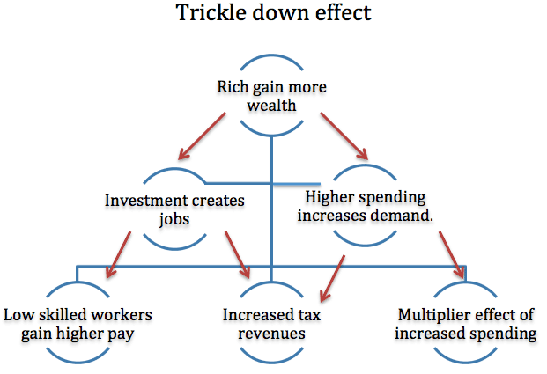
Government Policy to reduce Poverty and Inequality? TASK: Think of 3 possible points you might make (remember each one has to be evaluated)
Pros of Inequality: Perhaps the Government does not need to intervene; surely a bit of inequality in the economy is positive. Perhaps poverty can be sorted out without the need for drastic intervention?

Slide 34
Macro Government Policy to reduce Poverty and Inequality? TASK: Think of 3 possible points you might make (remember each one has to be evaluated)
Pros of Inequality: Perhaps the Government does not need to intervene; surely a bit of inequality in the economy is positive. Perhaps poverty can be sorted out without the need for drastic intervention?
Incentive effect.
As: Incentive - If someone works harder and as a consequence receives a higher wage then this is not market failure. The promise of a higher wage is essential to encourage extra effort. By rewarding hard work, there will be a boost to productivity leading to a higher national output – so everyone can benefit. Entrepreneurs also require rewards. Inequality is necessary to encourage entrepreneurs to take risks and set up new business. Without the prospect of substantial rewards, there would be little incentive to take risks and invest in new business opportunities.
Ae: Equity, Danger of Poverty and the Evolution of Monopoly? Gaps between rich and poor can get out of control – as gap between CEO’s and rising footballers wages demonstrate. This can lead to social unrest and high levels of poverty where households cannot meet their relative needs. These inequalities can perpetuate as well - inequality being solidified through educational opportunities, wealth accumulation and the growth of monopoly/monopsony power if left unchecked).
Trickle down effect.
As: Trickle down effect: If some people gain extra income, then this can ‘trickle down’ to other people, e.g. if an entrepreneur sets up a business he may become a millionaire, but also will create jobs and provide incomes for other workers. There may be a gap between highest and lowest earners. But, the lowest earners are still better off than without the entrepreneur.
Ae: Marginal utility of income theory and marginal propensity to save: (1) Income has a diminishing marginal utility. The first £1,000 of income you earn gives substantial benefits because you can buy food to eat and contribute towards your rent and other basic necessities. If you gain another £1,000 income this also increases your utility (satisfaction) because you can now buy better quality food and have improved shelter. But, the increase in utility is less than first £1,000. If you are a millionaire and gain an extra £1,000. The extra (marginal) utility is very limited. You can maybe buy a slightly more expensive car; you can buy a yacht that is 3ft bigger. But, the increase in utility/satisfaction is fairly limited. Therefore too much inequality does not lead to higher welfare gains for society as a whole. (2) Some also criticise this belief in ‘the trickle-down effect. In particular, the wealthy have a higher marginal propensity to save. In recent years, wealth has been saved in off-shore accounts to avoid paying tax rather than being used productively in the economy and therefore lead to lower rates of economic growth.
Fairness.
As: FAIRNESS -It can be argued that people deserve to keep higher incomes if their skills merit it. If a top footballer gets paid £100,000 a week, this is a reflection that people are willing to pay that kind of money to watch him because of the revenue he generates for the firm. Equally supply constraints for footballers skills mean they can demand higher wages.
Ae: MRP theory could be flawed – the value of a footballer to the firm is much easier to calculate than the impact of a nurse? The value of a nurse to society is arguably higher than the contribution of a footballer suggesting that there is market failure. Equally, discrimination and gender pay gap mean that the functioning of the labour market is distorted suggesting a lack of fairness between wage differences in some cases.

Slide 35
Macro Government Policy to reduce Poverty and Inequality? TASK: Think of 3 possible points you might make (remember each one has to be evaluated)
Pros of Inequality: Perhaps the Government does not need to intervene; surely a bit of inequality in the economy is positive. Perhaps poverty can be sorted out without the need for drastic intervention?
Incentive effect.
As: Incentive - If someone works harder and as a consequence receives a higher wage then this is not market failure. The promise of a higher wage is essential to encourage extra effort. By rewarding hard work, there will be a boost to productivity leading to a higher national output – so everyone can benefit. Entrepreneurs also require rewards. Inequality is necessary to encourage entrepreneurs to take risks and set up new business. Without the prospect of substantial rewards, there would be little incentive to take risks and invest in new business opportunities.
Ae: Equity, Danger of Poverty and the Evolution of Monopoly? Gaps between rich and poor can get out of control – as gap between CEO’s and rising footballers wages demonstrate. This can lead to social unrest and high levels of poverty where households cannot meet their relative needs. These inequalities can perpetuate as well - inequality being solidified through enhanced educational opportunities, wealth accumulation and the growth of monopoly/monopsony power if left unchecked).
Trickle down effect.
As: Trickle down effect: If some people gain extra income, then this can ‘trickle down’ to other people, e.g. if an entrepreneur sets up a business he may become a millionaire, but also will create jobs and provide incomes for other workers. There may be a gap between highest and lowest earners. But, the lowest earners are still better off than without the entrepreneur.
Ae: Marginal utility of income theory and marginal propensity to save: (1) Income has a diminishing marginal utility. The first £1,000 of income you earn gives substantial benefits because you can buy food to eat and contribute towards your rent and other basic necessities. If you gain another £1,000 income this also increases your utility (satisfaction) because you can now buy better quality food and have improved shelter. But, the increase in utility is less than first £1,000. If you are a millionaire and gain an extra £1,000. The extra (marginal) utility is very limited. You can maybe buy a slightly more expensive car; you can buy a yacht that is 3ft bigger. But, the increase in utility/satisfaction is fairly limited. Therefore too much inequality does not lead to higher welfare gains for society as a whole. (2) Some also criticise this belief in ‘the trickle-down effect. In particular, the wealthy have a higher marginal propensity to save. In recent years, wealth has been saved in off-shore accounts to avoid paying tax rather than being used productively in the economy and therefore lead to lower rates of economic growth.
Fairness.
As: Fairness: It can be argued that people deserve to keep higher incomes if their skills merit it. If a top footballer gets paid £100,000 a week, this is a reflection that people are willing to pay that kind of money to watch him because of the revenue he generates for the firm. Equally supply constraints for footballers skills mean they can demand higher wages.
Ae: MRP theory could be flawed – the value of a footballer to the firm is much easier to calculate than the impact of a nurse? The value of a nurse to society is arguably higher than the contribution of a footballer suggesting that there is market failure. Equally, discrimination and gender pay gap mean that the functioning of the labour market is distorted suggesting a lack of fairness between wage differences in some cases.

Slide 36
WEEK 3

Slide 37
90:

Slide 38
RWS 19: Inequality, Poverty and Government Policy
STARTER ACTIVITY: 10 MINS (0855 Stop)
Read the arguments on the worksheet and complete the following tasks
PAIRS: Identify the two strongest arguments and be prepared to verbally explain why
INDIVIDUALLY: Write a conclusion about whether replacing benefits with a system of Universal Basic Income is a good idea, ready to be read out to class.
TODAY
Admin
Benefits Discussion
Maximum Wage Discussion
Macroeconomic Policy Discussion
TUESDAY
Inequality Discussion
1-2-1s
THURSDAY
1-2-1’s

Slide 39
HOMEWORK Due Monday 12th March 2018
RWS19 (2.25 to 3 Hours): Inequality, Poverty and Government Policy
PREP (2.25 to 3 Hours): What is Development
‘New Students’: Find RWS 11 on 1st Year Economics Course on GOL and roughly prepare the RWS 11 using the resources
‘Old Students’: Bring in and read your RWS 11 (ODS to hand back)
EXTRA FOR TONIGHT (1.5 hours) = Read through notes and benchmark comments and complete A3 sheet ready for 1-2-1’s tomorrow

Slide 40
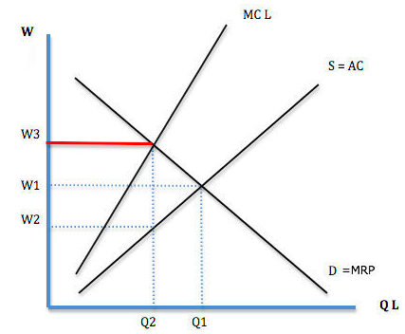
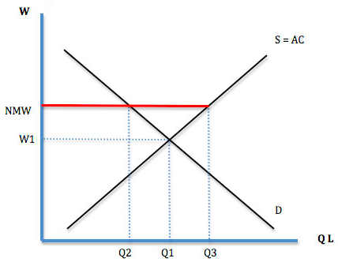
Minimum Wage is Positive
POINT 1: Reduces poverty and increases employment.
As: The minimum wage increases the wages of the lowest paid. These workers will have increased income and will reduce relative poverty. Increase the incentives to accept a job. With a minimum wage, there is a bigger difference between the level of benefits and the income from employment. A minimum wage could also increase the participation rate as the benefits of work become greater and more worthwhile.
Ae: Increased unemployment? (1) Scope for unemployment If labour markets are competitive, a minimum wage above the equilibrium could cause a fall in demand for workers, and excess supply. In figure 2, a wage above the equilibrium, the national minimum wage can cause unemployment of Q3-Q2. Certain industries vulnerable to a ‘living wage’ It is argued labour intensive industries, where labour costs are a high percentage of overall costs (and therefore have an inelastic demand curve) could be hit by a high National Minimum Wage harder In particular care workers for old people are often paid the Minimum Wage. (2) Regional variations in wages: A big problem with a national minimum wage is that wages vary enormously within the UK. In London, with higher costs of living, not many people get the minimum wage because wages are relatively higher. However, in some areas a minimum wage of £9 could cause significant unemployment, especially in labour intensive industries. It is estimated that in 10 hot spot low pay areas 30% of workers are on the Minimum Wage. (3) Certain areas of the country face much higher living costs (say London) than others and therefore a blanket national minimum wage may not help households in these expensive areas.
POINT 2: Improves the macroeconomic performance of the UK
As: (1) Increase productivity. The efficiency wage theory states that higher wages can increase the incentive for people to work harder and thus higher wages may increase labour productivity. If firms have to pay higher wages, they may put more focus on increasing labour productivity, which increases efficiency of the economy (2) Increased investment. Firms will have an increased incentive to invest and increase labour productivity because labour is more costly. Both points shift LRAS to the right, curb inflationary pressures, stimulate economic growth and reduce structural, frictional and real-wage unemployment. (3) Lower price levels help to stimulate exports and reduce the size of the current account deficit and leads to less reliance on a financial account surplus.
Ae: Inflationary pressures? Higher wages passed onto consumers. An increase in the minimum wage could cause firms to increase prices and pass the costs onto consumers. Will also make exports uncompetitive and greater incomes could suck in more imports, worsening the current account deficit. Lack of regional purchasing power also might mean that some areas, higher wages mean significant increases in AD fuelling inflation further.
POINT 3: Stops imperfections in the labour market
As: Counterbalance the effect of monopsony employers. If firms have Monopsony power they can drive wages down by employing fewer workers. However, minimum wages will make this more difficult. Therefore a minimum wage could have a positive effect on employment. In figure 1, a monopsony pays a wage of W2 and employs Q2. If a minimum wage was placed equal to W1, it would increase employment to Q1. Therefore, in some circumstances, it is feasible that a minimum wage could actually increase employment – or at least not cause any employment. Arguably many firms can afford to pay higher wages, a minimum wage helps redistribute income in society.
Ae: More and more workers are getting stuck on the minimum wage More than 1 million workers receive the minimum wage. The highest proportion are amongst women, ethnic minorities and young people. The fear is that a minimum wage encourages firms to keep more workers on the lowest band of wages.
FIGURE 1 – Monopsony Employer
FIGURE 2– Competitive Labour Market with a National Minimum Wage (NMW)

Slide 41
Maximum Wage Debate: Discuss the view that a maximum wage cap should be introduced into labour markets in the UK TASK: Create 3 essay points which you can evaluate to discuss whether the UK Government should use this and then write a conclusion
Point 1 - SHOULD: Reduces the problem of persistent Income inequality issue in the UK
As: (1) Inequitable top 1% earning disproportionately more than they should; leads to ‘inequality issues’ with persistent lack of opportunities for elements of the economy etc. In some labour markets, labour may have the ability to bargain for wages which include substantial economic rent especially if their labour is demand inelastic (i.e. harder to replace labour with capital) – example CEO’s. Cannot rely on shareholders at AGMs to prevent increase in top earnings due to loss of power.
Ae: (1) Inequality can be a good - ‘Trickle down effect’ and incentive effects. (2) If you want to reduce wages through Government intervention, why not increase income tax? A maximum wage limits the income of high earners, but, the government gets nothing in return -raised tax revenue can be used to redistribute income
Point 2 - SHOULDN’T: Creates distortions in the labour market through disincentivising workers to work
As: (1) Disincentives to work. A maximum wage may encourage workers to leave and work in another country. Firms may find a shortage of skilled workers or top executives, this could harm economic prospects. (2) Hard to enforce in a globalised world? Could lead to brain drain from UK?
Ae: (1) Lack of maximum wage actually creates distortions (and market failure!). Because it prevents the most skilled labour migrating to the highest paid jobs. For example, if lawyers received very high wages, the best graduates may train to become lawyers, but this means other job sectors, such as doctors, engineers would not attract the best workers. Doctors and engineers may have greater social value than lawyers (2) Also reduces costs for firms which will be good for the economy in the short run and long run.
Point 3 - SHOULD: A good idea – there has been precedent elsewhere and a pay ratio (20:1 scheme could work within a firm)? is a realistic proposition as opposed to a wage cap or 100% income tax.
As: There was a maximum wage for professional footballers in England up until 1960. The maximum wage for footballers was £14 per week (1951), £15 (1953), £17 (1957) and £20 (1958). With many clubs on the face of bankruptcy, some argue, the Football League should consider a return to a maximum wage – to prevent clubs spending more than they can afford on wages. However, this is really focused on the peculiarities of Football economics – where clubs have a tendency to push themselves towards the brink of bankruptcy. (2) The average pay of a FTSE 100 chief executive has rocketed from around £1m a year in the late 1990s - about 60 times the average UK worker - to closer to £5m today, more than 170 times in 2014. John Lewis operates a pay ratio to calculate its executives’ pay, and no one argues that John Lewis is anything other than an extremely successful and well run retailer.
Ae: (1) If firms are willing to pay high wages, then presumably the workers must have a value (Marginal Revenue Product) equal to their wage – it is the same for footballers. (2) Pay ratio’s wouldn’t work in a company like Goldman Sachs (investment bank) as the average pay is already very high. Also, issuing of share options etc. would allow companies to get around it.

Slide 42
90+90:

Slide 43
Paper 3 MOCK PAPER
You have 45 minutes today and 90 minutes tomorrow to complete the following in 3’s (or 4’s for middle table)
Complete in full written prose the 10 marker and the 15 marker (see plan to the right as to who is scribe)
Provide a detailed plan for the 25 marker.
ALL NEEDS TO BE FINISHED AND HANDED IN BY THE END OF THURSDAYS LESSON COMPLETED
Scribes
GROUP A: Chris Hegg
GROUP B: Jess Pow
GROUP C: Ethan Ricketts
GROUP D: Laura Deacon
GROUP E: Harry Dervan
GROUP F: Josh Williams

Slide 44
END

Slide 45
Assess the importance of the minimum wage in reducing poverty and inequality (25 marks)
INTRO
MAIN
POINT 1: Minimum wage reduces poverty and inequality (TODAY)
As
Ae
POINT 2: Redistributing Income and Wealth through taxation and benefits reduces poverty and inequality (THURSDAY)
As
Ae
POINT 3: Other forms of Government Intervention that might include setting poverty targets and job schemes to get the unemployed into work (WEEK TUESDAY)
As
Ae
CONC

Slide 46
Assess the importance of the minimum wage in reducing poverty and inequality (25 marks)
INTRO
MAIN
POINT 1: Increase in wages
As
Ae
POINT 2: Increase in employment
As
Ae
POINT 3: Wider positive effects on the economy
As
Ae
CONC
A3 Sheet
How do each of these link to the essay title?
- ‘Needs’
- ‘Disparities in income/wealth’

Slide 47
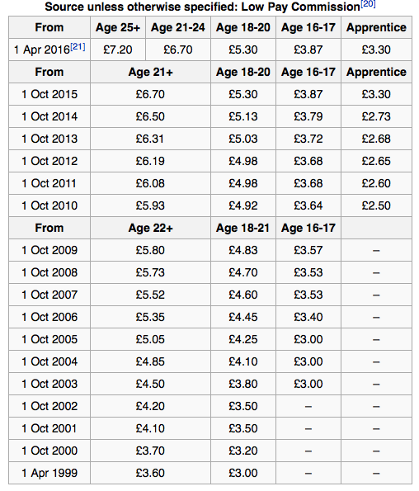
CASE STUDY #1 Legislation: The ‘Living Wage’
Worksheet with the following
1998 Minimum Wage Legislation introduced
1999 First worker gets paid minimum wage
2016 (April) Replaced with the ‘National Living Wage’
2020 – plans by Osborne to raise the wage to at least £9 an hour (not adjusted for inflation)
“An adult over the age of 22 working at the minimum wage for 7.5 hours a day, 5 days a week, will make £942.50/month and £11,310/year Gross Income. After PAYE this becomes £810.63/month or £9,727.55/year (2009/2010)”

Slide 48
CASE STUDY #1 Legislation: The ‘Living Wage’
Worksheet with the following
Background to minimum wage legislation in the UK
Arguments for and against the NMW reducing poverty and inequality (also how to link to the question)
Data to back up the arguments above
Reach a conclusion

Slide 49
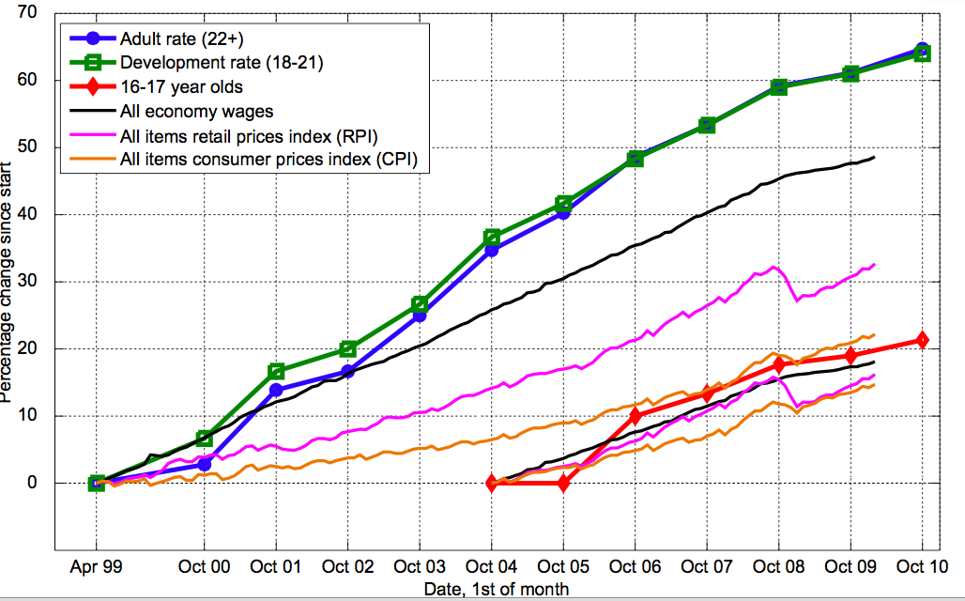

Slide 50
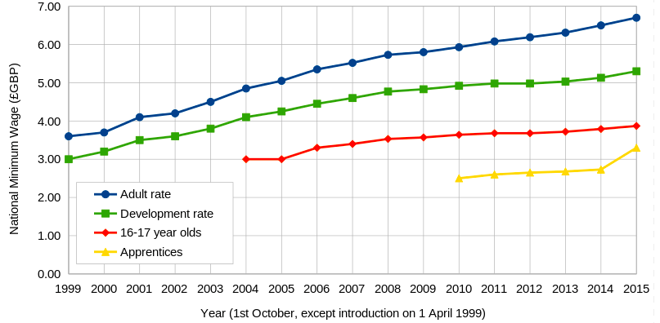

Slide 51
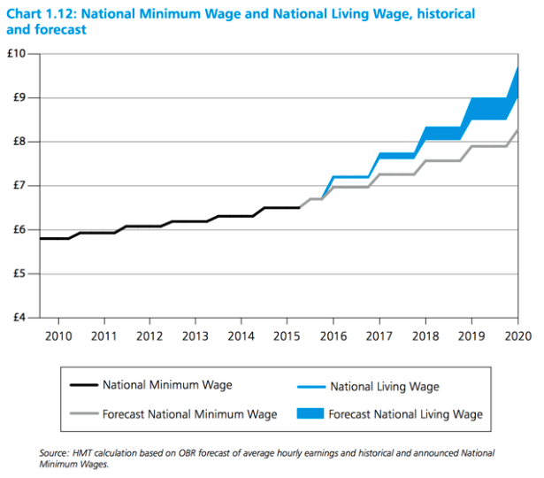

Slide 52
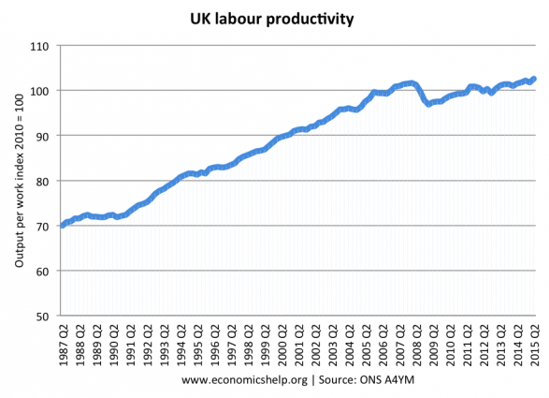

Slide 53
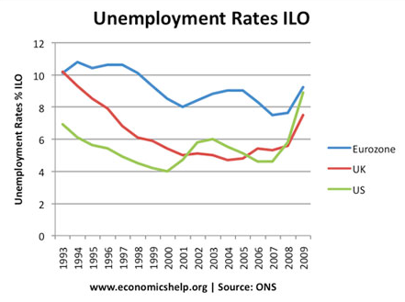

Slide 54
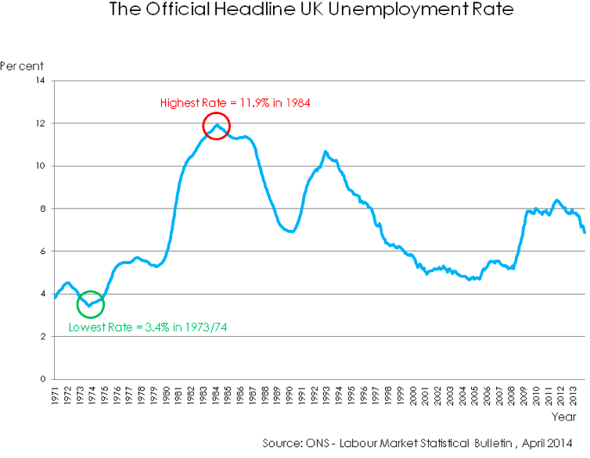

Slide 55
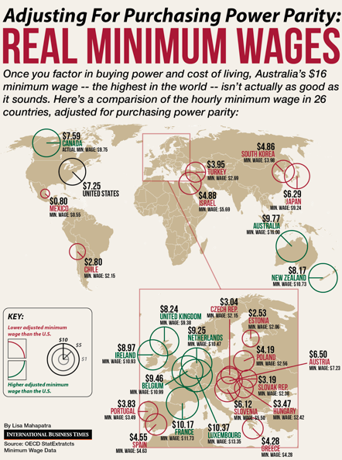

Slide 56
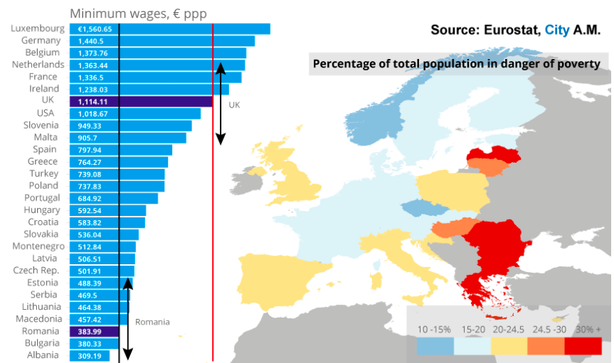

Slide 57
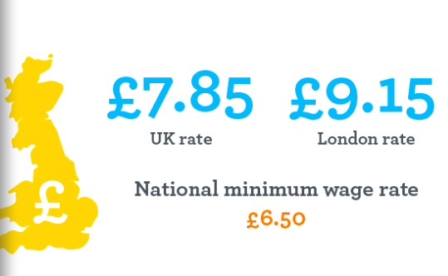
Living Wage Organisation Estimated Living Wage Autumn 2015

