Slide 1
Alison Lapper
By Mark Quinn

Slide 2
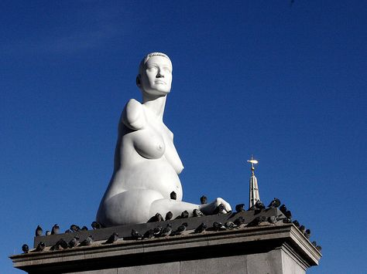

Slide 3
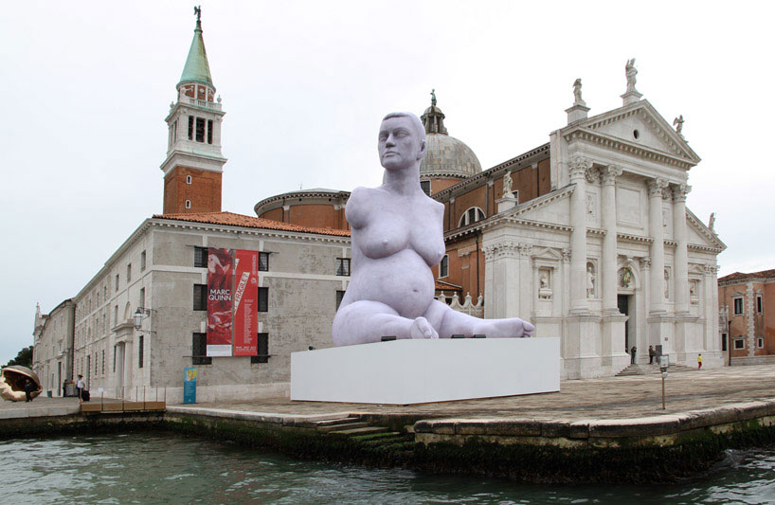
The 35ft artwork was placed in a pizza on the island of San Giorgio Maggiore however, it became controversial and later objected to by the Catholic Church as it looked ‘out of place’ and ‘removed from context’.

Slide 4
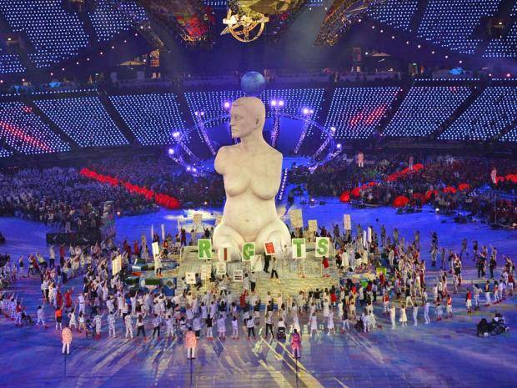
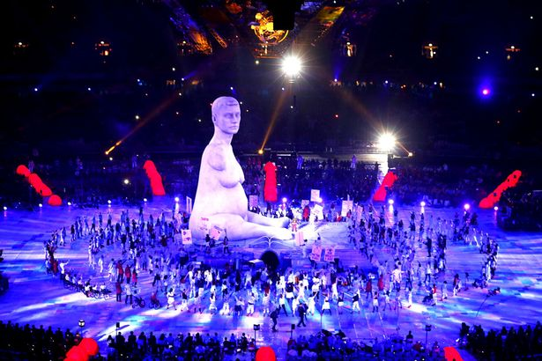
https://youtu.be/Kd4FgGSY5BY?t=3h32m44s
This piece was another variation on Alison Lapper (43ft tall) featured in the London 2012 Para Olympic Ceremony. As the Olympics originated in Greece, this sculpture was a way to challenge beauty harking back to Greek & Roman statuary.

Slide 5
