Slide 1
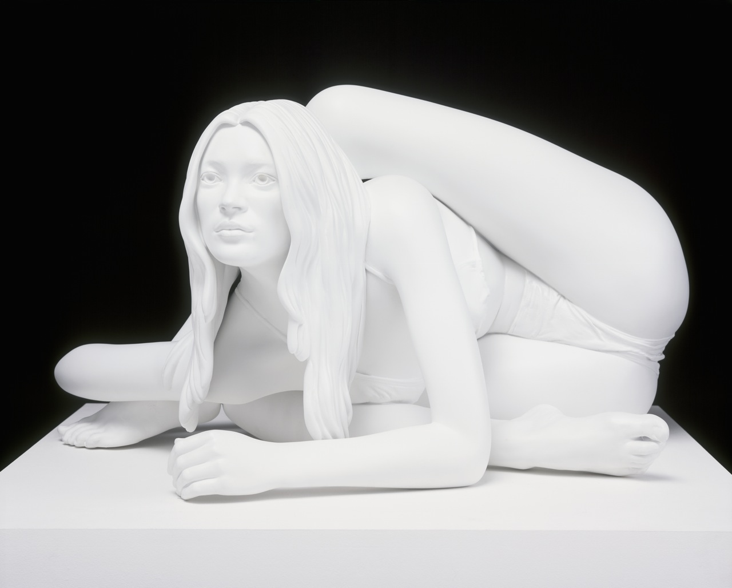
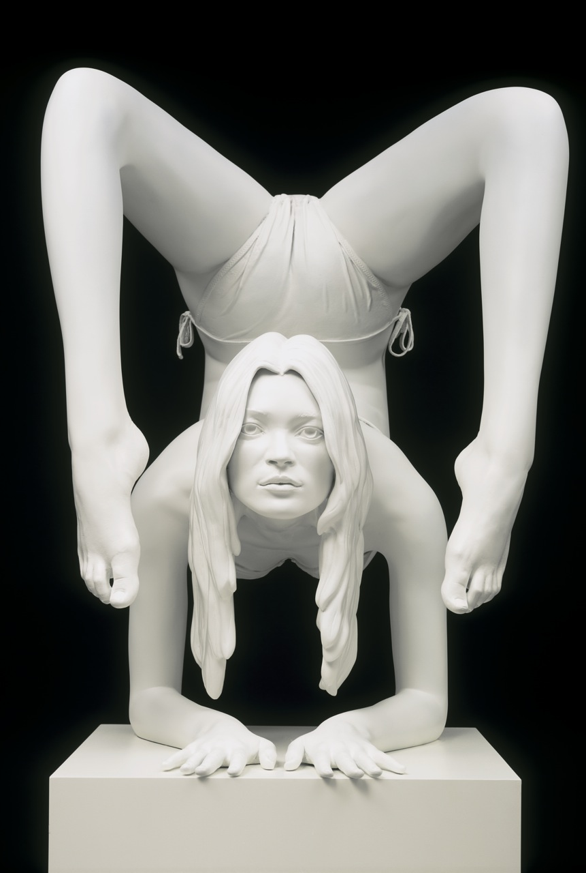
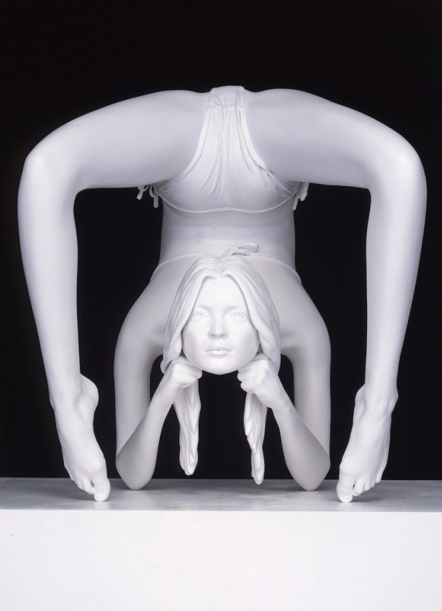
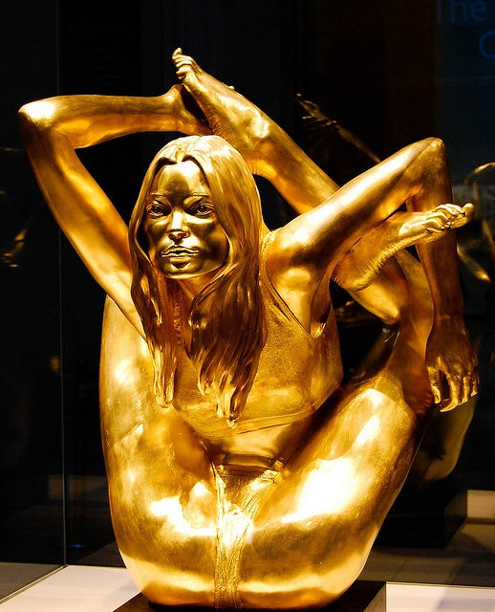
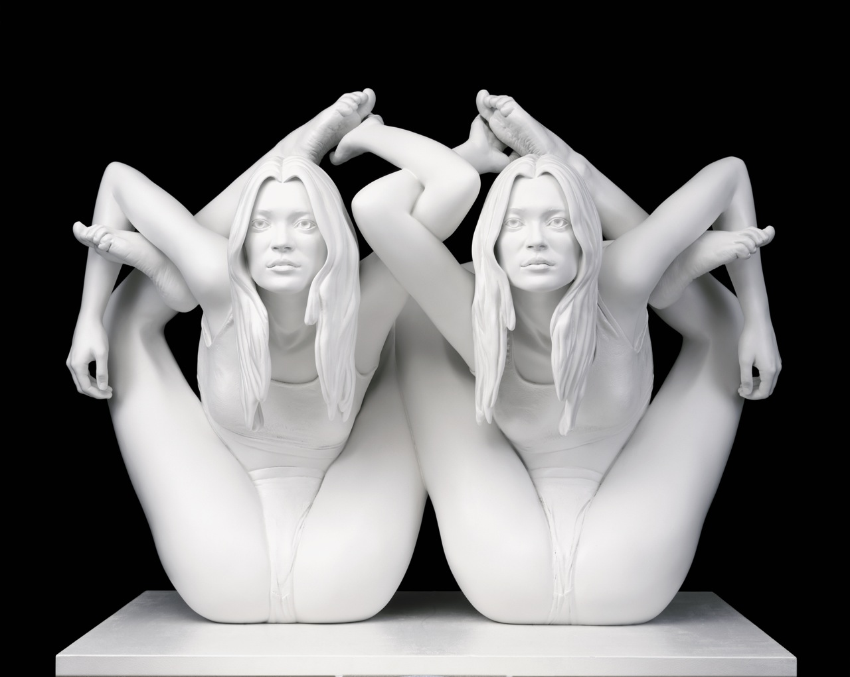
Siren and sphinx

Slide 2
Materials, Techniques and Processes
Marc Quinn used18 carat gold to sculpt the final Kate Moss Siren
Gold is seen as the most valuable material in the world,
However gold is just a belief system and inherently no more valuable than any other material. This shows that nowadays people are lured into the impossible dream to be ‘perfect’ but never succeed due to the invented image of perfection.
The gold shell sculpture is based on a 2,000 year old Buddhist sculpture which relates to a moment of enlightenment
But also makes reference to eating disorders which can arise from the pursuit of impossible perfection.

Slide 3
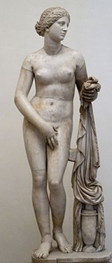
Media and meaning
Marble representative of Classical sculpture
Idealised beauty
The Yoga poses show the difficulty of beauty
The Final piece was in gold
Not only because its desired now as marble was then
But it is also shallow
It is also cast similar to a mask

