Slide 1
Marc quinn’s life
Gemma, Jacob and Frankie

Slide 2
Background
Born in 1964 in London
Studied History of Art at Cambridge
Showed Self at his first exhibition
Loosely affiliated with group YBA
Struggled with alcoholism and went into rehab in 1993

Slide 3
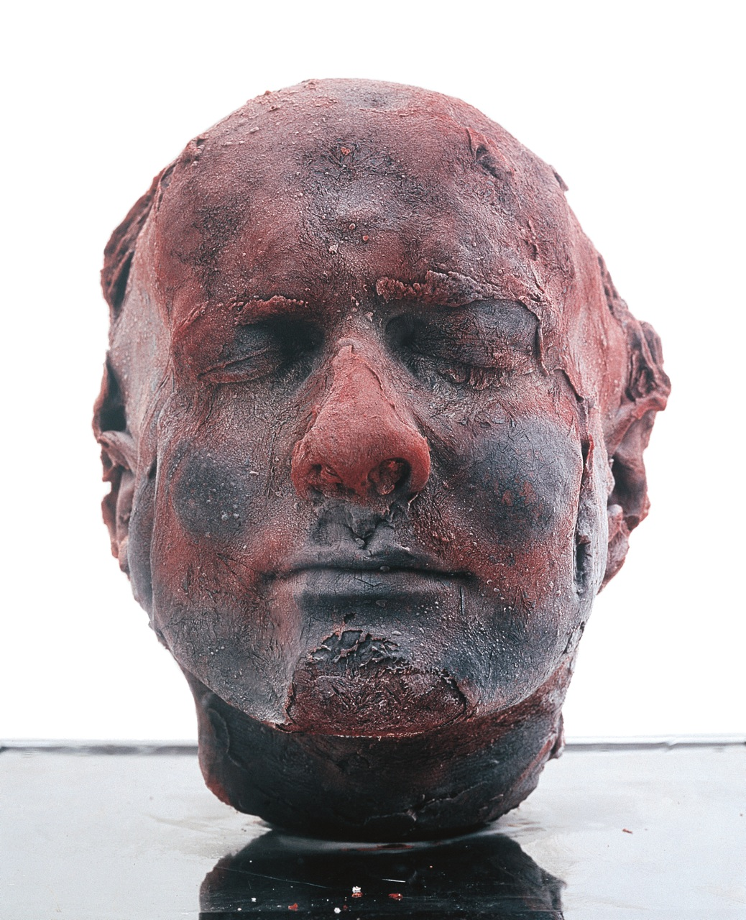
Self (Ongoing Project)
A self portrait made entirely of blood
At this time, Quinn was struggling with alcoholism, his dependency on alcohol is reflected by the artwork’s dependency on electricity.
As a new one is created every five years, it reflects his progression through life and his age.

