Slide 1
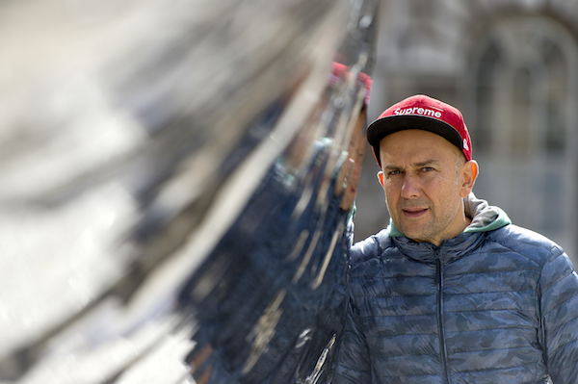
Marc Quinn

Slide 2
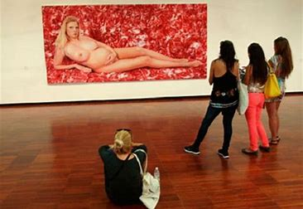

Slide 3
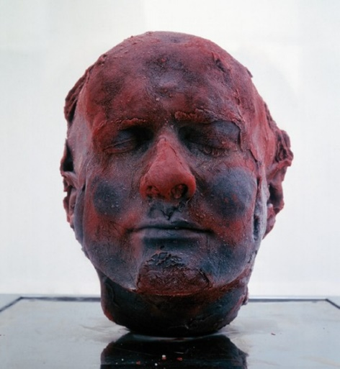
Self
1991

Slide 4
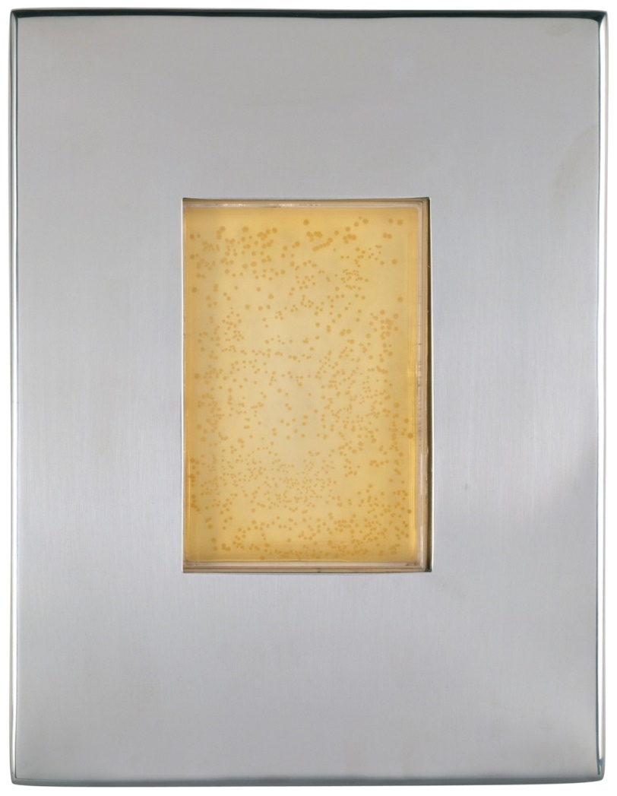
John Sulston A genomic portrait 2002

Slide 5
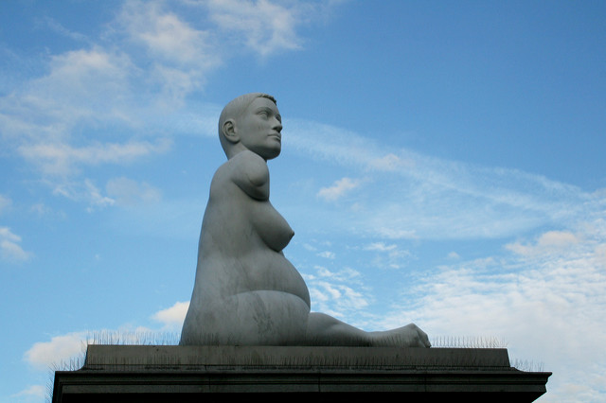
Alison Lapper Pregnant, 2004

Slide 6
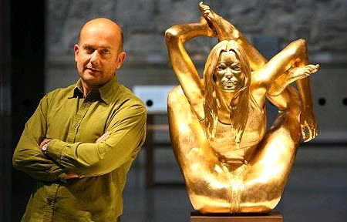

Slide 7
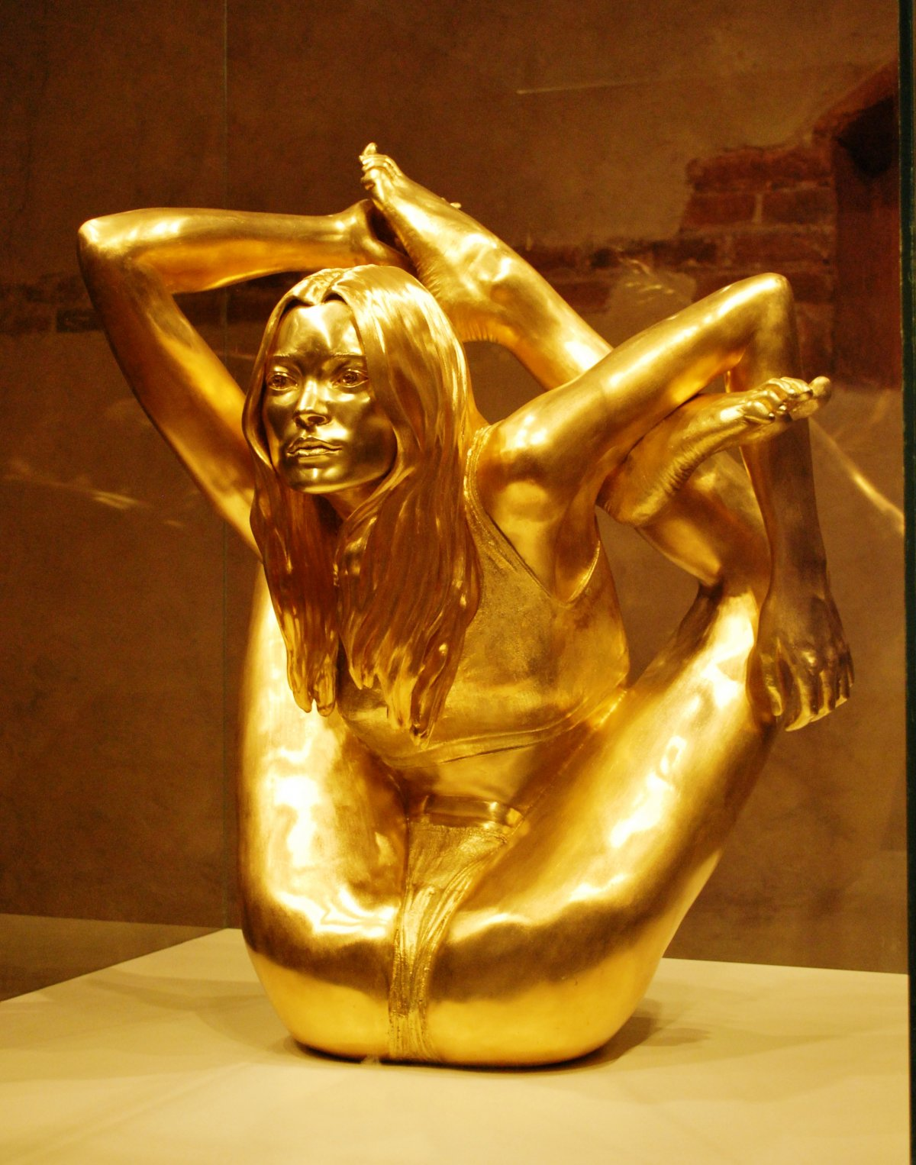
Siren, 2008

Slide 8
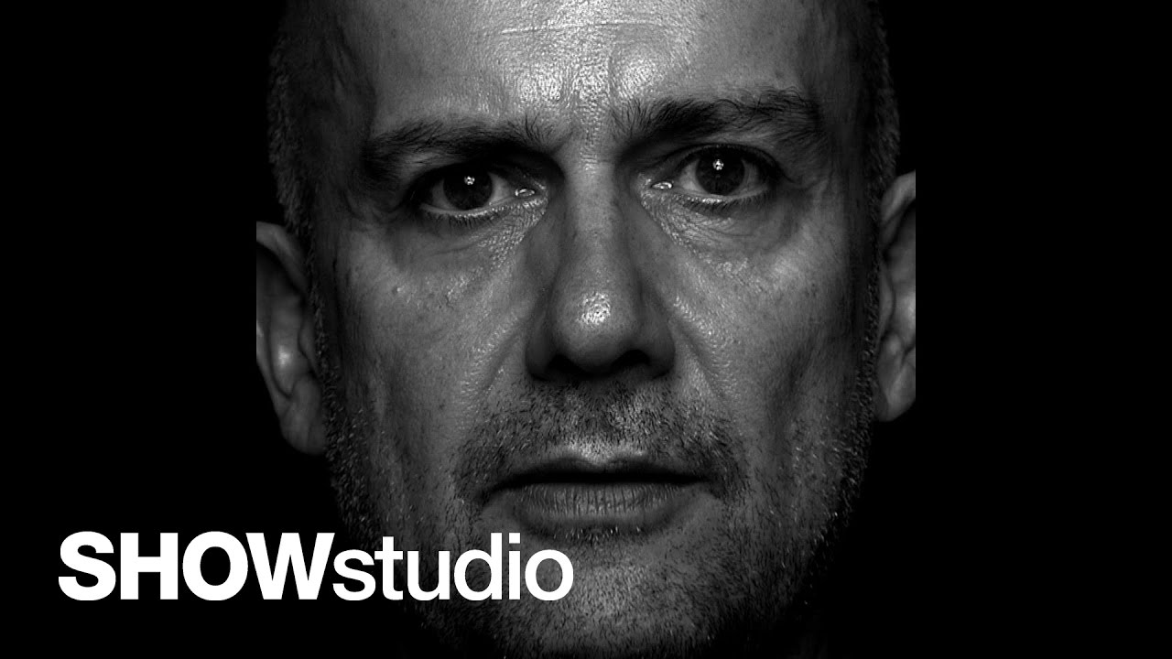
https://www.youtube.com/watch?v=Vq4HuuA2AMY

