Slide 1
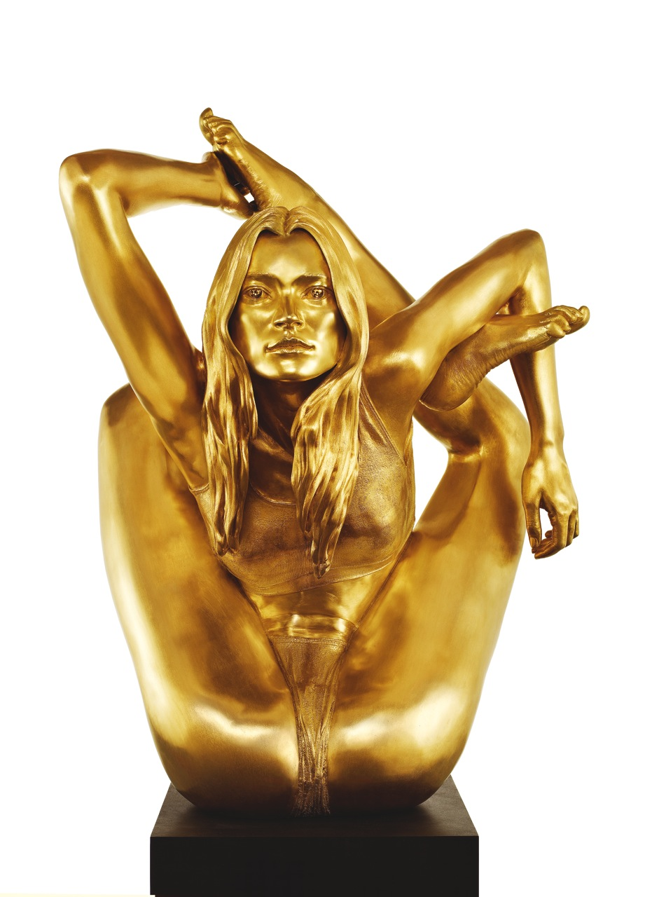
Siren
Marc Quinn

Slide 2
Art historical terms and concepts
It’s a 3D sculpture
Material: 18 carat gold
Subject matter: The sculpture depicts the body of Kate Moss contorted in an unrealistic way.
Concepts relevant to the theme: feminism and sexuality
Influences: Also this work is based on a Buddhist sculpture that is about 2000 years old, it related to the moment of enlightenment in Buddhist philosophy
The sculpture is one of a collection of sculptures

Slide 3
Cultural, social, technological and political factors
Influences: The works were influenced by
Social context: The piece depicts Kate Moss who became a media icon of the age.
Kate Moss is created as an idealised figure who is more of a cultural hallucination than an actual person of flesh and blood.
Perhaps it is the pressure from society that has made her physically contorted, this could allude to eating disorders

