Slide 1
Alison lapper
Mark Quinn

Slide 2
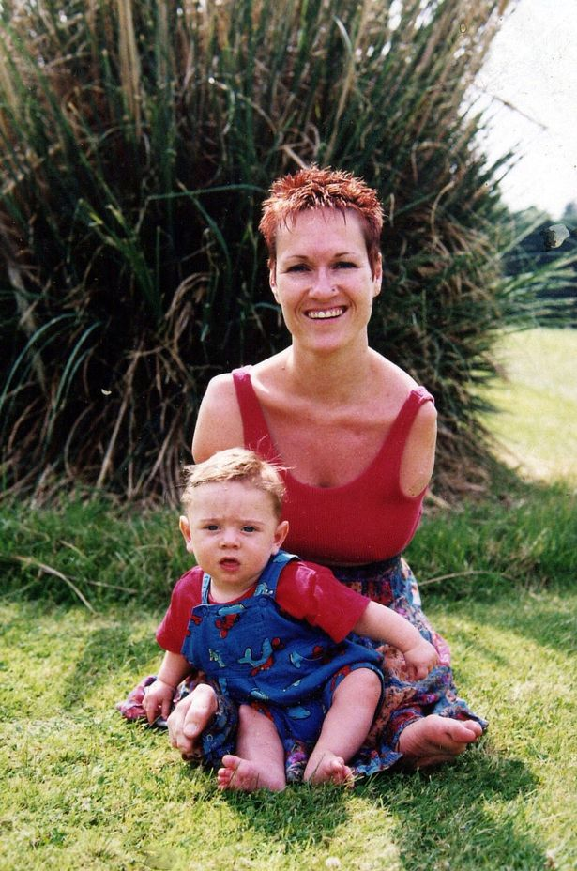
Background
Alison Lapper was born without arms and with shortened legs, a condition called phocomelia
Lapper is an artist and uses photography, digital imaging, and painting to, as she says, question physical normality and beauty, using herself as a subject
She was told she was unable to have children
She posed for Marc Quinn for the sculpture Alison Lapper Pregnant. Initially she refused to pose for Quinn.
Lapper's hesitation was regarding the way in which Quinn depicted disability. She wanted to be sure the depiction was not of pity. Quinn expressed how statues where their limbs had fallen off were highly regarded and cherished.

Slide 3
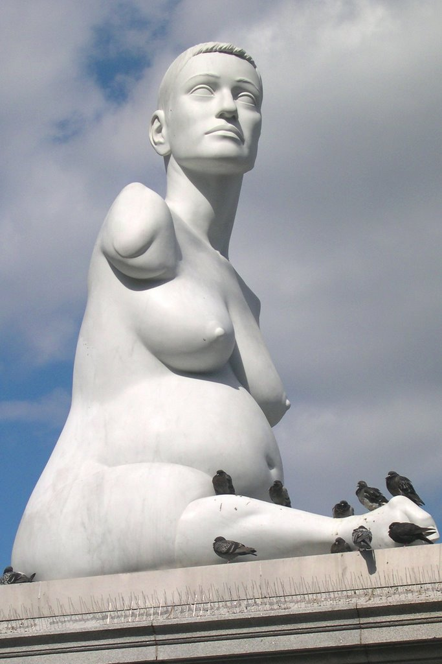
The Sculpture
The sculpture was carved from white marble, weighs 13 tonnes and stands 3.55 metres high
Alison Lapper is covered in plaster of Paris in Marc’s studio to make a mould of her body From this mould a life-size maquette is made in resin which is then used as a guide to carve the large marble sculpture in Italy The marble is carved at a studio in Pietrasanta, using marble sourced from a quarry in Carrera

Slide 4
Significance and message
The sculpture celebrates in a very public way the beauty of a different body, and makes us question the narrow binds of acceptability into which social norms tend to push us.
As well as being an artwork, the sculpture’s presence in Trafalgar Square has been hugely empowering in the progress of disabled rights in the UK

