Slide 1
Unit 36 – Lighting Techniques Learning Aim A (A1) The use of lighting techniques to create meaning in media products

Slide 2
A1 The use of lighting techniques to create meaning in media products
Complete the following PowerPoint, creating written content (annotations) and finding relevant images.
Each individual image requires as least ONE annotation, explaining how the lighting is being used.

Slide 3
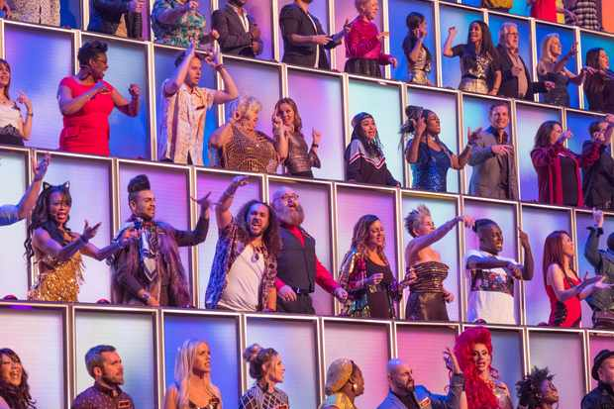
Functional purposes of lighting
The lighting is used in this games show
to provide the audience with information.
The aim of the game is to get each member
of the 100 crowd to stand up, which is
signified by a coloured light.
‘All Together Now’
Lighting to illustrate elements of a background to provide information to the audience
Practicals– onscreen sources of light from within the world of the product
Highlight products – in advertisements

Slide 4
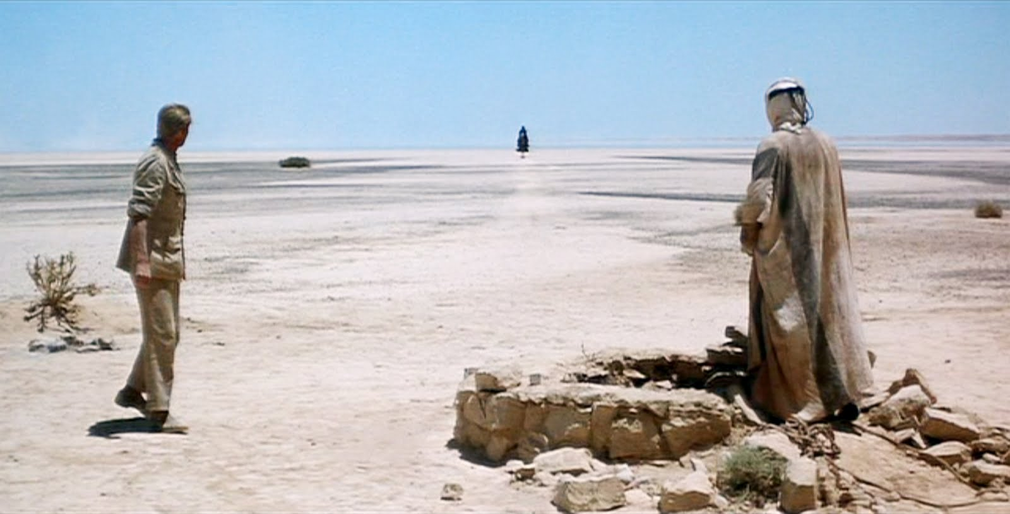
Artistic purposes
The lighting in this shot from Lawrence of
Arabia, successfully establishes the setting of a
hot, arid desert.
‘Lawrence of Arabia (1962)’
Lighting to establish a setting
Time of day (magic hour or blue hour)
The scene is naturally lit, with harsh pale
blue and white colour temperatures both
evident.

