Slide 1
Unit 20 LA-B: Explore Single Camera Techniques

Slide 2
Groups for Film M2
Toby
Skye
Josh
Leah
Gabriel
Ellena
Rachael
Lina
Brialeigh
Ben
Honor
Hayden
Zak
Grace
Sonya
Levi
Hugo

Slide 3
Groups for Film M1
Joe
Fin
Lola
Oli Tidy
Troy
Erin
Lily
Kacper
Freya
Olly Tarrant
Fynn
Molly
Max
Kiki
Jake
Sophie
Alice
Bo
Harry
Clara
Leo

Slide 4
Unit number and title | Unit 20: Single Camera Techniques Unit 21: Film Editing
Learning Aim | Unit 20 B: Explore Single Camera Techniques Unit 20 C: Produce a Single Camera Production Unit 21 B: Explore the use of editing tools, techniques and conventions Unit 21 C: Create a digitally edited sequence for a specific purpose
Assignment title | Exploring, producing and editing a Single Camera Production
Assessor | Matt Toogood/Mark Piper/Steve Grantham/Karina Free
Issue date | MONDAY 27TH FEBRUARY 2023
Hand in deadline | FRIDAY 5th MAY 2023

Slide 5
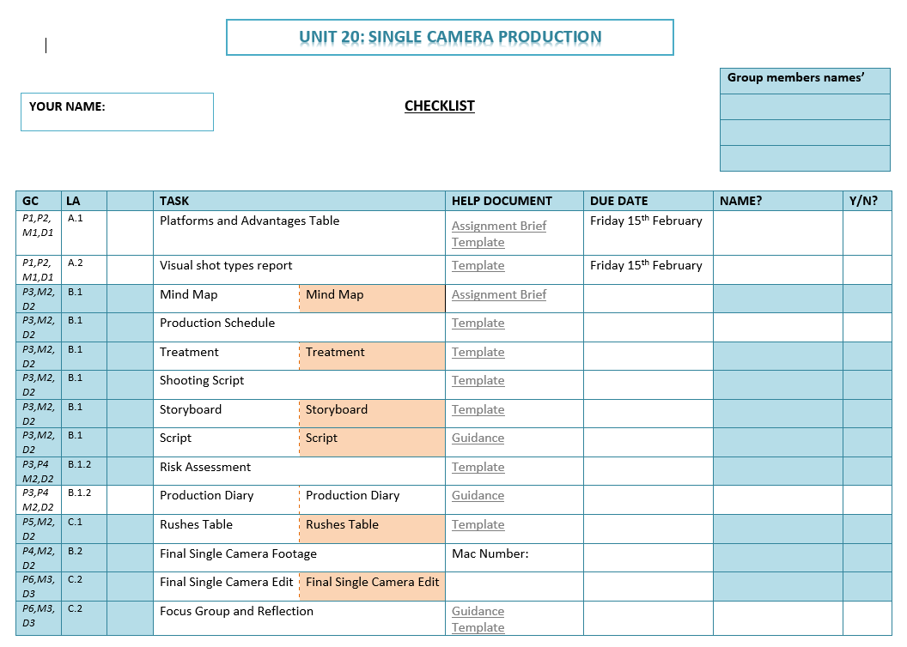

Slide 6
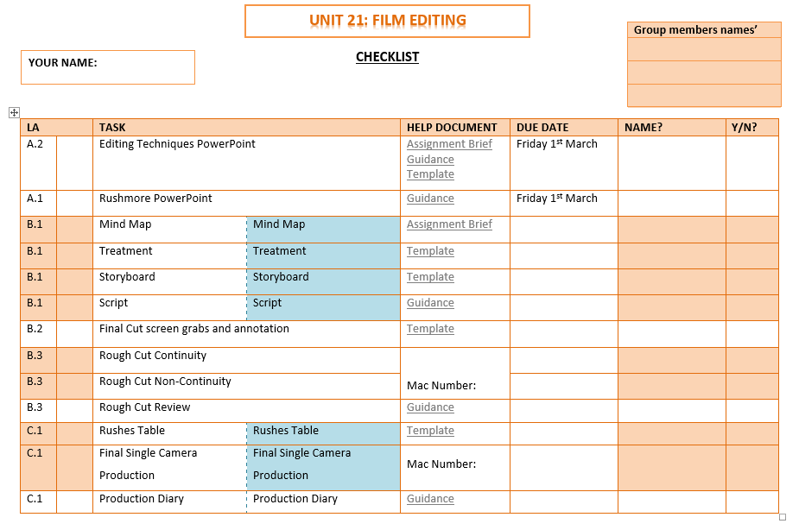

Slide 7
Unit 20 Schedule
Week | Week Beginning | Tasks
1 | 27th February | Mind map/planning
2 | 6th March | Pre-production Planning
3 | 13th March | Filming
4 | 20th March | Filming
5 | 27th March | Editing
 | Easter
6 | 17th April | Editing
7 | 24th April | Focus Groups
8 | 1st May | Final Edit
DUE FRIDAY 5th MAY

Slide 8
Unit 20 LA B: Grading Criteria
PASS 3 | MERIT 2 | DISTINCTION 2
Plan a single camera production | Demonstrate effective application of single camera planning and recording techniques to shoot footage for a single camera production. | Demonstrate accomplished planning skills and a high level of technical expertise to shoot footage for a single camera production, justifying creative and technical choices made.
PASS 4
Shoot footage for a single camera production
Assignment Sheet

Slide 9
Unit 20 LA c: Grading Criteria
PASS 5 | MERIT 3 | DISTINCTION 3
Review the footage and select appropriate shots for use in a single camera production. | Produce a high-quality single camera production using post-production techniques to effectively build narrative and maintain continuity, explaining the choices made. | Produce an accomplished and creative single camera production using post-production techniques to consistently build narrative and maintain continuity, justifying creative and technical choices made.
PASS 6
Carry out post-production to create a completed single camera production
Assignment Sheet

Slide 11
Mind map
You can photograph a paper mind map and upload that to your edublogs
You can create a free account at http://popplet.com
You can use ‘MindGenius’ on the computers, by searching
It should contain ideas on:
Type/platform
Genre
Narrative
Plot
Characters
Audience
Editing…

Slide 12
Production schedule

Slide 13
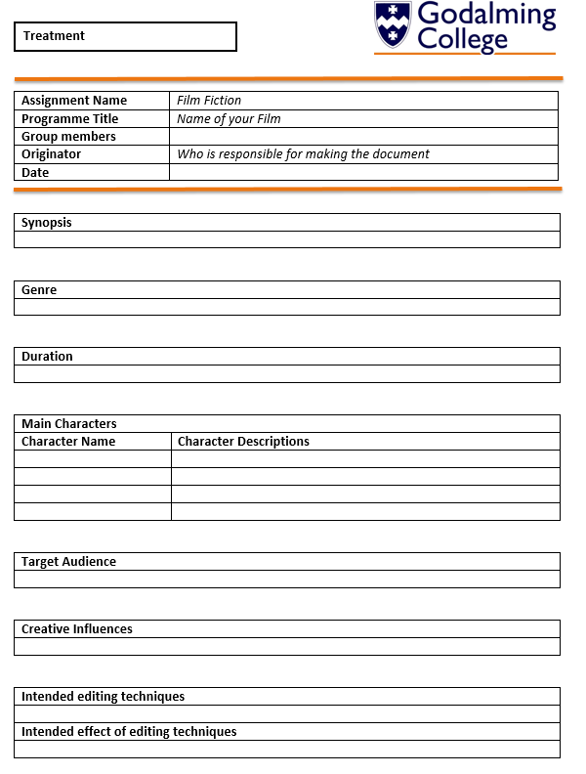
treatment

Slide 14
Shooting script

Slide 15
storyboard
Shot number: Action: Shot type: Sound: Shot duration: Editing notes:

Slide 16
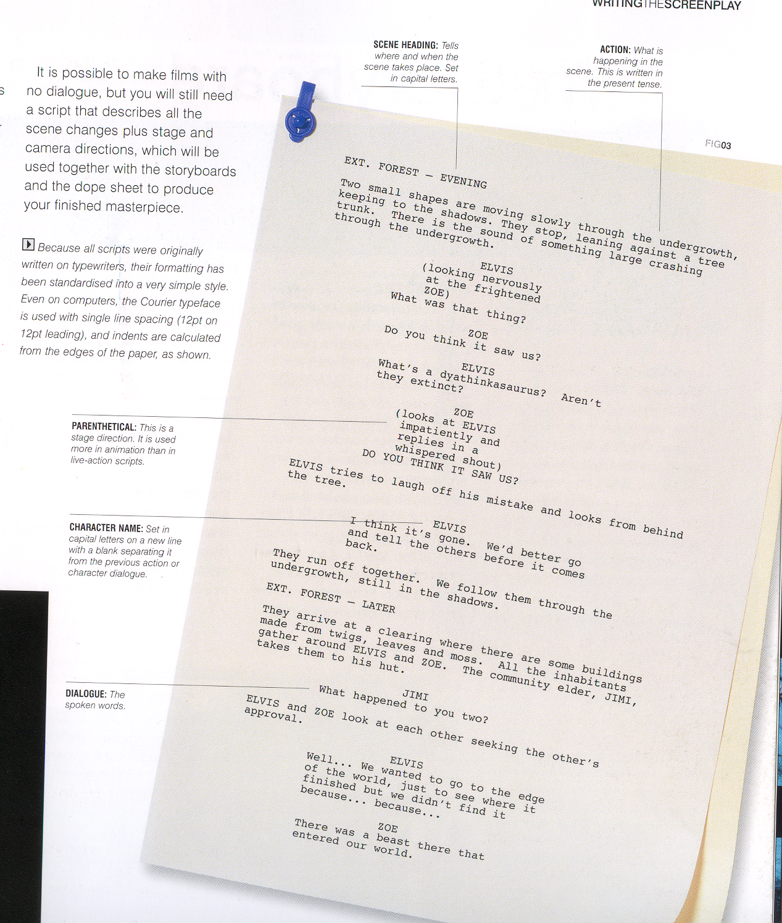
script

Slide 17
Slug Line
Day
Night or
Morning/Afternoon
etc.
Brief description of location
EXT. EDGE OF PLAYGROUND – DAY
We are at the edge of an empty school playing field, presumably after school.
INT. or EXT.

Slide 18
Dialogue
Characters name, centred alignment
NICK
(O.S.)
His name’s Rob Forrest. It’s nothing I can’t handle.
THERAPIST
(A little hurt)
I appreciate your honesty.
Dialogue,
align left –
tabbed x3
Parenthesis

Slide 19
Camera info
ECU of Nick.
Editing info
Cut to:

Slide 20
Production Diary

Slide 21
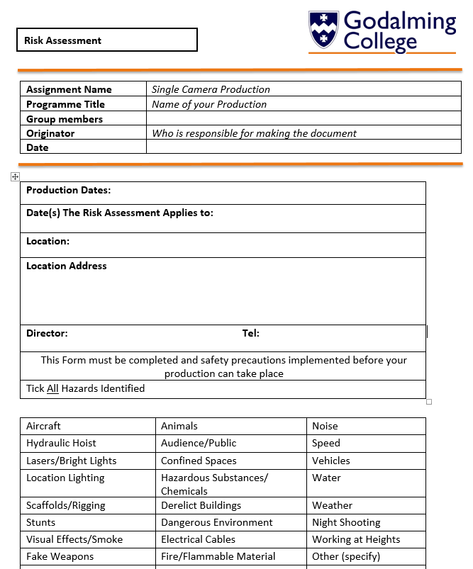
Risk assessment

Slide 22
Rushes table

Slide 23
Focus group and reflection
The Focus Group
Record in detail, the feedback given to you by the focus group. Make sure that you download the ‘Focus group feedback’ sheet from GoL to help.
Your Reflection: Download help sheet from GoL Reflect on the focus group feedback as well as your own views on the production
Respond in detail, to each point included in the focus group feedback - positive and negative points and justify the reasons for your choices if you disagree with some of the comments
Are there any changes are you need to make having received your feedback? Reshoots, editing, music etc.? Why? Explain the reasoning in making the changes
Justify the creative and technical choices you have made throughout your production that has bought you to the end piece. Analyse at least 1 from each element listed below:
Cinematography, Editing, Sound, Mise-en-scene, Lighting, Narrative

Slide 24
