Slide 1
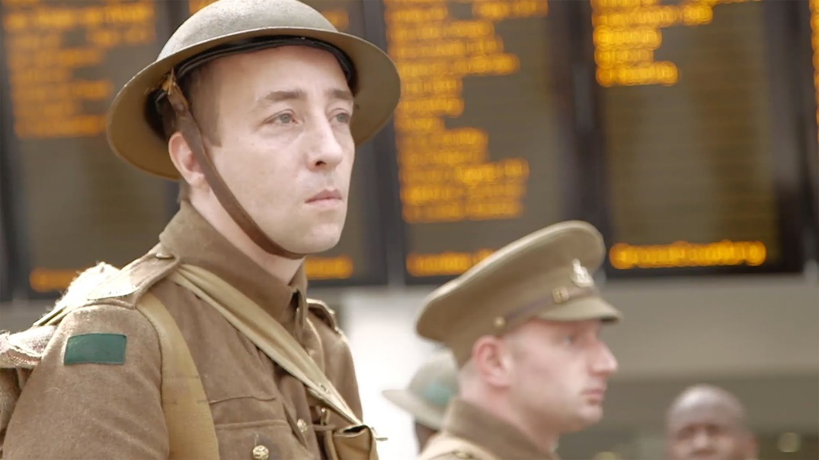
It is the morning of July 1st 2016 and Private Harry Dobson of the 13th Battalion / York and Lancaster Regiment waits with fellow soldiers at a train station. They are soon to depart for the Somme. More than three million soldiers would participate in this battle and an estimated one million would be killed or wounded on both sides. Among the fatalities would be Harry, aged 18. He is played here by an actor to mark the centenary of what is considered one of the bloodiest battles in human history.

Slide 2
‘We’re here because we’re here’, 2016, Jeremy Deller

Slide 3
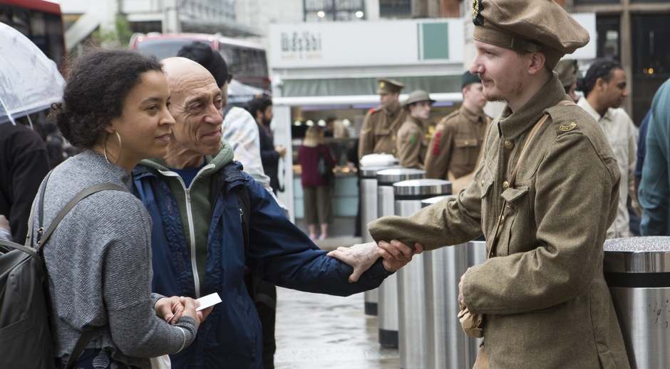
‘We’re here because we’re here’, 2016, Jeremy Deller

Slide 4
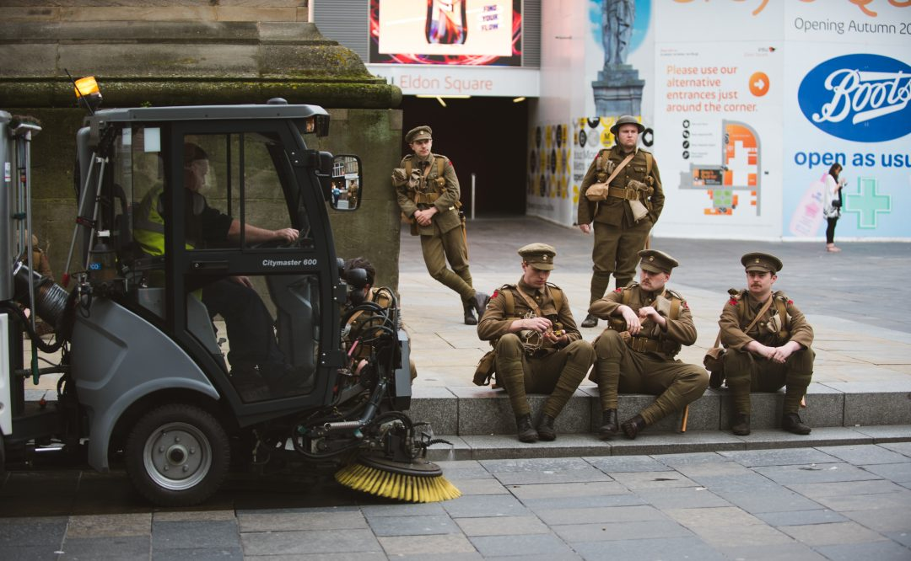
‘We’re here because we’re here’, 2016, Jeremy Deller
https://www.youtube.com/watch?v=1pd1XYx27_U

Slide 5
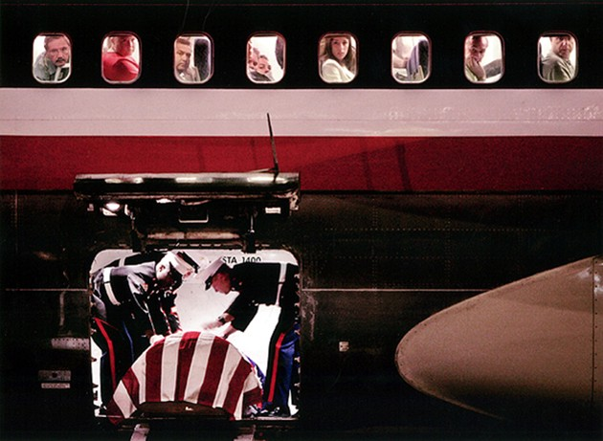
The Iraq War 2003-2011

Slide 6
The Iraq War 2003-2011
Why did the war begin?
https://www.youtube.com/watch?v=6daSrkgDX0k
https://www.youtube.com/watch?v=tAjqGnQpVks

Slide 7
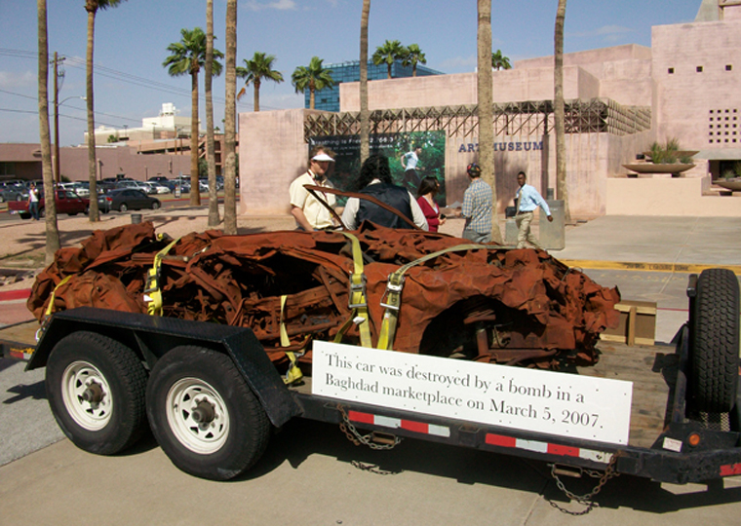
‘It Is What It Is’- Conversations About Iraq, 2009, Jeremy Deller
This project started as the idea to create a mobile museum of the war in
Iraq that would tour the US. Finding material for the museum proved difficult,
until we were offered a car that had been destroyed in Iraq, in the heart of the former
British empire. From this car, used as a centrepiece, we constructed a room in the New Museum,
New York, where the public could meet and talk to people involved in the conflict in some way.
The idea was then taken on the road; we towed the car from New York to LA, stopping off in 14 towns and cities on the way – a classic American road trip route – accompanied by an Iraqi citizen and an enlisted American soldier. It was presented in as neutral a way as possible, which puzzled a lot of people. But it meant that the public were more likely to talk to us, because they weren’t scared of being dragged into some sort of political arena. Sometimes these conversations went on for hours. The car was subsequently donated to the Imperial War Museums

Slide 8
‘It Is What It Is’- Conversations About Iraq, 2009, Jeremy Deller
https://www.youtube.com/watch?v=2GPSVwWWr_0
https://www.themoderninstitute.com/artists/jeremy-deller/works/it-is-what-it-is-2009/63/

Slide 9
‘It Is What It Is’- Conversations About Iraq, 2009, Jeremy Deller
Title. What significance if any, can we take from the title?
What associations can be made about a motor car?
The car was used to stimulate conversation. What were
These conversations about and why?
What do you know about Iraq other than recent political
issues?
How has the destruction of this car come about? What
involvement does the West have in its destruction?
Why might Deller have decided to tour the car across the US in particular?
An American veteran of the Iraqi war and an Iraqi citizen accompanied the car on its tour across
the US. What was the purpose of their participation?
As a sculptural object, the car fits the category of a readymade. What does this term mean?
Deller has not changed or altered this work in any. Why might that be?
The car is now on display at the Imperial War Museum London. Does this add to the meaning of
the work? Is the new placement of significance?

