Slide 1
WEEK 4

Slide 2
HOMEWORK DUE FOR Monday….
PREP: Trade or Aid
What was the debt crisis?
Aid can be ‘debt relief’

Slide 3
90:

Slide 4
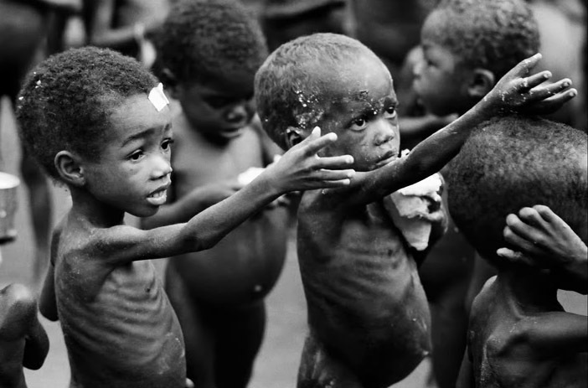
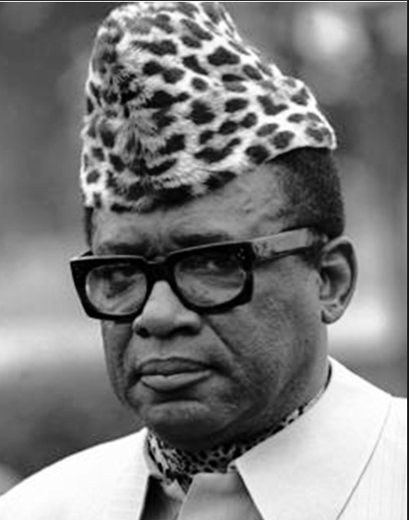
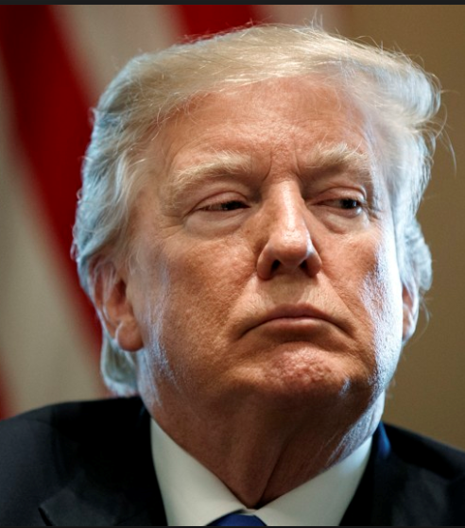
Revision Worksheet 20 Economic Development and Growth
DEVELOPMENT AND GROWTH
Why arguably does growth lead to development?
What is the difference between development and growth?
ECONOMIC GROWTH IN DEVELOPING COUNTRIES
What provide opportunities for growth in developing countries?
What barriers are there to growth in developing countries?
“POOREST COUNTRY” IN THE WORLD
Democratic Republic of Congo (DRC)
“RICHEST COUNTRY IN THE WORLD”
United States of America (USA)

Slide 5
Economic Development and Growth THEORY AND KEY TERMS
ESSAY: Evaluate the view that GDP is the best way to measure ‘standards of living’ and economic development in an economy. (25 Marks)
FIRST POINT OF THE ESSAY: GDP is a good measure
Economic growth means an increase in real national income / national output, measured by GDP. Economic development means an improvement in the quality of life and living standards, e.g. measures of literacy, life-expectancy and health care. We would expect economic growth to enable more economic development. Higher real GDP enables more to be spent on health care, education, infrastructure and technology through greater tax revenues earnt. It also leads to more job opportunities which provides households in the economy with income which can lead to greater spending and profits for firms. Greater incomes mean households can improve their living standards by affording basic and luxuries. So higher GDP can be associated with higher economic development
However, the link is not guaranteed. It is possible to have economic growth without development. i.e. an increase in GDP, but most people don’t see any actual improvements in living standards. The proceeds of economic growth could be wasted or retained by a small wealthy and/or corrupt elite or a specific sector of the economy? Perhaps the tax collection is inefficient in a country? Also environmental problems - producing toxic chemicals will lead to an increase in real GDP but without proper regulation, it can also lead to environmental and health problems. Military spending - a country may increase GDP by spending more on military goods. However, if this is at the expense of health care and education it can lead to lower living standards. So GDP might not be associated fully with the concept of ‘development’ and other measures exist such as the HDI (Human Development Index).
SECOND POINT OF THE ESSAY: HDI is a viable alternative…..

Slide 6
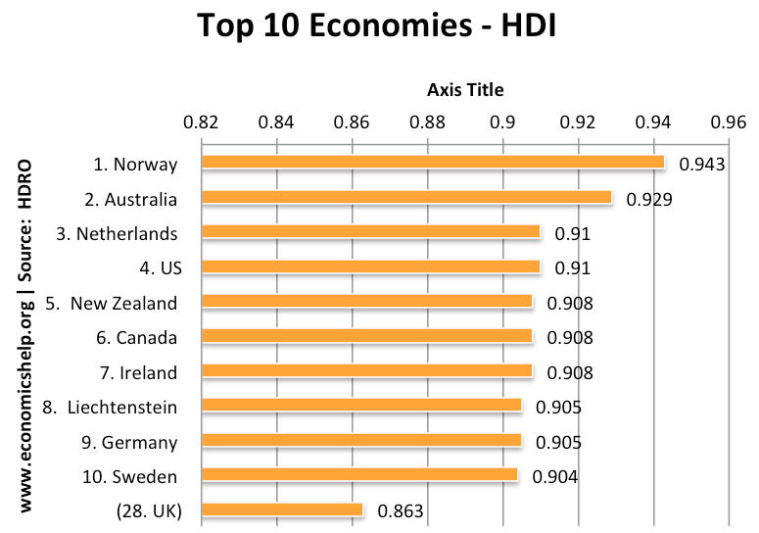

Slide 7
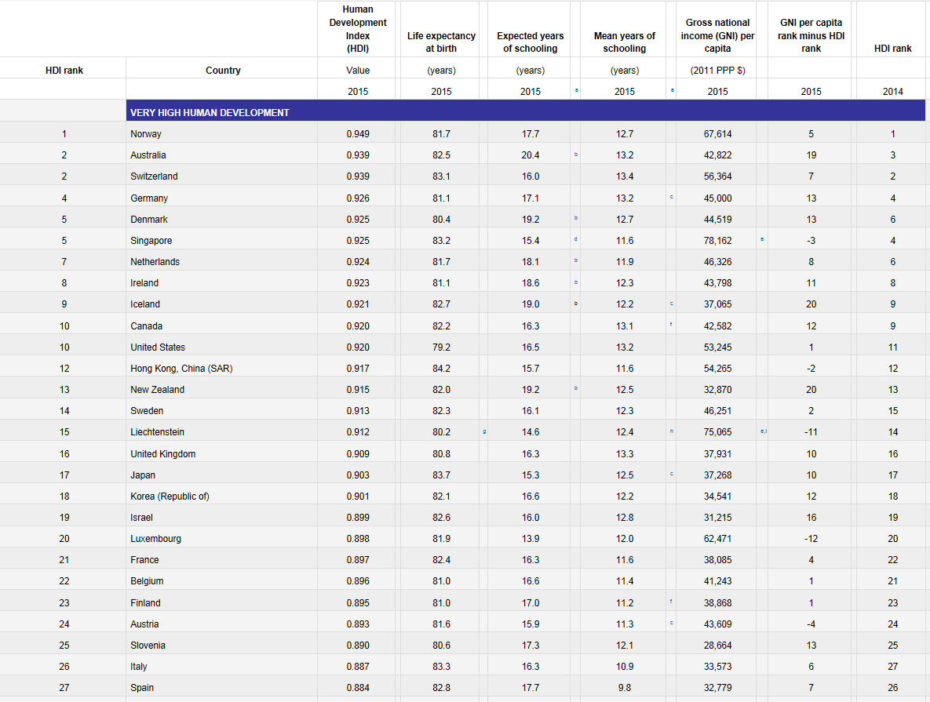

Slide 8
Economic Development and Growth STATISTICS – World Bank
Exchange rates at ‘market rate’ and ‘Purchasing Power Parity’ (PPP)
Less than $455 per year is absolute poverty line (less than $1.25 per day)

Slide 9
Economic Development and Growth STATISTICS – CIA Factfile
 | USA High Income Economy (>$12,236) | UK High Income Economy (>$12,236) | CHINA Upper Middle Income Country ($3,956 TO $12,235) | ZAMBIA Lower Middle Income Country ($1,006 TO $3,955) | DEMOCRACTIC REPUBLIC OF CONGO - DRC Low Income Country ($1,005 OR LESS)
HDI INCOME - GDP per capita HEALTH - Life Expectancy EDUCATION - Expected Years of Schooling and Mean years of Schooling | 16/188 (Very High Development) | 16/188 (Very High Development) | 90/188 (High Development) | 139/188 (Medium Development) | 176/188 (Low Development)
GDP (Total at PPP) | $19.36 trillion | 2.88 trillion | $23.12 trillion | $0.689 trillion | $0.067 trillion
GDP (Per Capita at PPP exchange | $59,500 | $43,600 | $16,600 | $4,000 | $800
GDP Growth Rates | 2.2% | 1.7% | 6.8% | 4% | 2.8%
Inflation | 2.1% | 2.6% | 1.8% | 6.8% | 41.7%
Unemployment | 4.4% | 4.4% | 4%* | 15% | 43%*
Balance of Payments (Current Account) | -2.38% of GDP (-$462 billion) | --3.17% of GDP (-$91.42 billion) | 0.7% of GDP ($162.5 billion) | 1.3% of GDP ($0.918 billion) | -27.5% of GDP ($-1.849 billion)
Budget Surplus/Deficit (% of GDP) | -3.4% | -3.6% | -4% | -8.4% | -0.3%
National Debt (% of GDP) | 77.4% | 90.4% | 18.6% | 62.8% | 14.6%
SOURCES:
Classification of Countries by Income - World Bank (Multilateral organisation based in New York)
HDI Statistics - United Nations Development Programme
Statistics (except HDI) - CIA Factfiles (Website of US Intelligence Service)
* Be careful of unemployment figures - very old estimates

Slide 10
GOVERNMENT POLICY
You are an economic advisor hired by the Government’s of the DRC or Zambia (you decide) as their Economic Advisor, what key Government policies would you recommend to them and why? (25 Marks)

Slide 11
90:

Slide 12
Economic Development and Growth INTERNAL STRATEGIES FOR GOVERNMENTS
TASK:
Listen to me (no notes)
Take notes on the two models below that explain how economic growth can lead to development
Evaluate these 2 models; why may they be in correct?
Rostow’s 5 Stages of Growth
Traditional (Tribal) Society
Tribal societies which depend on tradition and change very little year on year
Largely small scale agriculture with very little output or growth
Traditional Societies preparing for take-off
Commerce and trade appear
Some specialisation and small scale manufacturing
Perhaps basic financial institutions for the mobilisation of savings for investment?
Take off! (Industrial Revolution!?)
Shift from agriculture to large scale manufacturing
Output increases significantly but only a small fraction of society benefits (development of ‘elites’)
Shift from rural to urban areas
Growth more important than development as a whole!
Drive to maturity
Manufacturing shifts from ‘capital goods’ to ‘consumer goods’
Rapid development of transport infrastructure
Social welfare becomes important (schools, hospitals, universities etc.)
Age of high mass consumption
Primary sector declines (reliance on imports)
High consumption of consumer goods
High levels of disposable income
GOAL: Promote Economic Development through Economic Growth
‘Modernisation’ Model: Rostow’s 5 Stages of Growth
Harrod Damor Model: Greater savings lead to greater investment

Slide 13
Economic Development and Growth INTERNAL STRATEGIES FOR GOVERNMENTS
GOAL: Promote Economic Development through Economic Growth
‘Modernisation’ Model: Rostow’s 5 Stages of Growth
Harrod Damor Model: Greater savings lead to greater investment
Rostow’s 5 Stages of Growth
Traditional (Tribal) Society
Tribal societies which depend on tradition and change very little year on year
Largely small scale agriculture with very little output or growth
Traditional Societies preparing for take-off
Commerce and trade appear
Some specialisation and small scale manufacturing
Perhaps basic financial institutions for the mobilisation of savings for investment?
Take off! (Industrial Revolution!?)
Shift from agriculture to large scale manufacturing
Output increases significantly but only a small fraction of society benefits (development of ‘elites’)
Shift from rural to urban areas
Growth more important than development as a whole!
Drive to maturity
Manufacturing shifts from ‘capital goods’ to ‘consumer goods’
Rapid development of transport infrastructure
Social welfare becomes important (schools, hospitals, universities etc.)
Age of high mass consumption
Primary sector declines (reliance on imports)
High consumption of consumer goods
High levels of disposable income

Slide 14
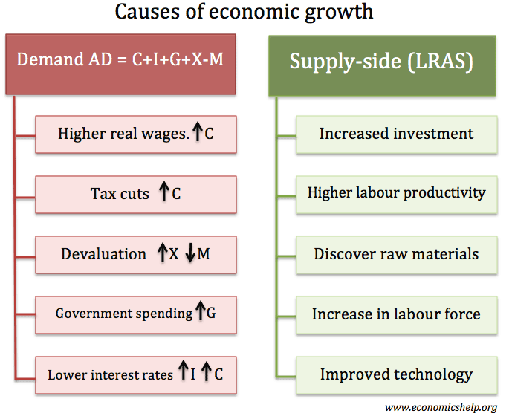
Causes of Economic Growth
ECONOMIC STABILITY (Price Level)
CONFIDENCE: Low and stable levels of inflation give a good climate for business investment and confidence
POLITICAL STABILITY
CORRUPTION AND WAR: Levels of corruption, e.g what percentage of tax rates are actually collected and spent on public services? Is the society stable?
INEQUALITY: Lack of property rights perhaps and a larger ‘wealthy elite’ might lead to gains for a small minority; leads to unrest.
INTERNAL ECONOMIC INFLUENCES (Economic Growth - LRAS)
PHYSICAL CAPITAL – Improved infrastructure –e.g. transport and communication. Encourage technological advances etc.
HUMAN CAPITAL - Educational standards and labour productivity. Basic levels of literacy and education can determine the productivity of the workforce.
LABOUR MOBILITY. Is labour able to move from relatively unproductive agriculture to more productive manufacturing?
SAVING POTENTIAL: Higher savings can fund more investment and allow easier credit, helping economic growth (or can it?).
EXTERNAL ECONOMIC INFLUENCES (Economic Growth - AD and LRAS)
TRADE: Scope for trade links with other countries? Not suffering from ‘forced specialisation’ and ‘resource curse’
FDI: Levels of inward investment. For example, China has invested in many African countries to help export raw materials, that its economy needs.
AID: The flow of foreign aid and investment. Targeted aid, can help improve infrastructure and living standards.

Slide 15
What is the Best Route for Economic Growth and Development Free Market or Interventionist?
KEY POINTS:
The IMF and the World Bank
Neoliberalism and ‘The Washington Consensus’
Criticisms of the IMF and their ‘SAP’s’: Zambia case study?
Questions to answer for your notes:
Provide a brief overview of IMF and World Bank
What is neo-liberalism and the Washington consensus?
What are SAP’s (Structural Adjustment Policies)
Why did the IMF come in for criticism?
Notes:
EXTERNAL INFLUENCES
NEO-LIBERALISM and the ‘Washington Consensus?
Role of IMF in Economic Development: The IMF can play a role in dealing with economic crisis. The IMF can give a country a loan to meet a temporary fiscal or balance of payments problem. This loan can be vital for helping the economy to deal with an unexpected crisis. Without the loan, the economy may have to experience a bigger fall in living standards to meet the creditors. However, the role of the IMF is often criticised. In return for a loan, the IMF has often insisted on certain free-market reforms in return for the loan. This has included: Privatisation, Tax reform, Cuts in government spending (often on welfare payments). These free market supply-side policies have arguably often harmed economic development, e.g. reducing access to basic necessities and lower government spending on the poor. However, the IMF often point out that they are usually asked to help only in crisis so there is often a difficult choice to make
World Bank and Economic Development: The World Bank is a financial body committed to the reduction of poverty in developing countries. It offers long-term loans for capital programs. The World Bank is committed to achieving its aims through the promotion of international trade, capital investment and foreign investment.
The World Bank has often been criticised for its promotion of structural adjustment policies. These free market-oriented policies have often caused, at least temporary, upheaval in the economy.
In particular structural adjustment policies implemented in sub-Saharan Africa arguably failed to alleviate poverty when introduced in the 1980s. (Criticism of S.A.)
In response to these criticisms, the World Bank has sought to change its policies of structural adjustment placing greater emphasis on maintaining social spending and improving education.

Slide 16
EXERCISE: Essay Marking Market based solutions to economic development
INDIVIDUALLY: Read through the essay and write out the plan for the essay
SHARE: Compare it with your partner
INDIVIDUALLY: Mark the essay
SHARE: Compare it with your partner
Class discussion
Write out a plan for this essay: “Evaluate whether it is best for a developing country to adopt market based or interventionist policies for their development.”

Slide 17
Economic Growth and Inequality/Poverty
Economic growth may or may not reduce relative poverty; it depends on the income distribution of the growth.
Absolute Poverty: This is an income below a certain level necessary to maintain a minimum standard of living. (e.g. enough money to buy the basic necessities of food, shelter and heat.
Therefore, economic growth should reduce absolute poverty, so long as the poorest can gain some increase in living standards from the nation’s growth.
Does Economic Growth reduce Relative Poverty?
Economic growth will reduce income inequality if:
Wages of the lowest paid rise faster than the average wage.
Government benefits, such as; unemployment benefits, sickness benefits and pensions are increased in line with average wages.
Economic growth creates job opportunities which reduce the level of unemployment. Unemployment and lack of employment are one of the biggest causes of relative poverty.
Minimum wages are increased in line with average earnings.
Progressive taxes redistribute income. Progressive taxes such as higher rates of income tax will take a higher percentage of income from the rich; this can be used to fund social spending, such as health care, education and welfare benefits which help to reduce income inequality.
Why economic growth may not reduce income inequality
Economic growth often creates the best opportunities for those who are highly skilled and educated. In recent years, in the UK, we have seen faster wage growth for highly paid jobs than unskilled jobs.
Modern economies are creating an increased number of part-time/flexible service sector jobs. In these sectors, wages have been lagging behind average earnings.
In the UK, government benefits have been indexed linked. This means increased in line with inflation. This means that benefit incomes have fallen behind average earnings.
Interest-bearing wealth. The wealthy gain interest and dividends from their assets. This rent, interest and dividends can be used to re-invest in increasing their wealth. For the wealthy, it is a wealth creating cycle – which increases their share of income. The economist Thomas Piketty argued that without government intervention the rate of return from wealth would lead to widening income and wealth inequality.
Economic growth will not necessarily solve unemployment. For example, growth cannot solve structural and frictional unemployment; this is unemployment caused by lack of skills and geographical immobilities.

Slide 18
90:

Slide 19
Economic Development and Growth INTERNAL STRATEGIES FOR GOVERNMENTS
Free market or Interventionist?

Slide 20
“Evaluate whether it is best for a developing country to adopt market based or interventionist policies for their development.”
INTERNAL SOLUTIONS?
SHORT RUN: Demand Side Policies to promote macro stability
Inflation targeting through monetary policy and stable exchange rate – central bank independence?
Stable fiscal policy – avoid large budget deficits
Some countries may be battling very high AD and external influences which push up inflation. Others may be facing a significant lack of demand which requires boosting AD.
LONG RUN: Supply Side Policies to promote economic growth
Free Market Supply Side Policies?(Privatisation, deregulation, lower taxes and stimulate private investment)? Encouraging business environment for FDI etc.
Interventionist Supply Side Policies? (spending on education, health, infrastructure etc.)? Correcting classic ‘merit good’ and ‘public good’ market failures.
LONG RUN: Industrialisation to promote economic growth
Export Orientated? Move towards manufacturing with a push to increase exports by specialising in the production of goods with a comparative advantage
Import Substitution? Move towards manufacturing by implementing import tariffs to protect key ‘infant industries’ against foreign competition

Slide 21
Economic Growth for Development
https://www.economicshelp.org/blog/1413/development/multinational-corporations-in-developing-countries/

Slide 22
WEEK 5

Slide 23
HOMEWORK DUE FOR Monday….
RWS 20

Slide 24
90:

Slide 25
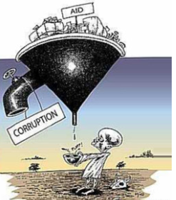
Economic Development and Growth EXTERNAL STRATEGIES FOR GOVERNMENTS: Trade, Aid and FDI
STARTER: Do you agree or disagree with international aid as an effective way to promote development in country? State a position and be able to verbalise an argument.
Read through the essay as a class. As we read, identify the INTRO and CONC, highlight the main points and arguments.
Grade the essay! What do you think of it? Good points and bad?
What other points could the essay have made which are not included?
Why might trade be the answer for a developing country?
Why might trade not be the answer for a developing country?
Trade or Aid for a developing country?

Slide 26
CHAINS OF ANALYSIS: An explanation flow diagram of how aid might reduce poverty / promote development
INCREASED MONEY FOR THE GOVERNMENT
The Government are receiving “free” money that they do not have to pay back. The Government can now afford to provide welfare programmes (such as benefits, healthcare and education) as well as infrastructure projects (dams, roads, rail, electricity etc.
Also if they are receiving more tax because people in the economy have more money, they can increase spending even more
AID
The giving of money to an economy (normally through the Government although some charities give money to communities etc). Governments do not need to pay back the money.
Aid can be bi-lateral (from one country to another), multi-lateral (from several countries/organisations to a country) or emergency aid (charities, Governments, multi-lateral agencies giving money in the wake of a natural disaster)
POVERTY IS REDUCED
Due to money from the Government (benefits, welfare, subsidies, infrastructure) and from firms (through wages to workers) people are able to meet their basic needs (or relative needs)
MONEY INTO THE ECONOMY
AID: Money from charities/NGO’s/multi-lateral agencies/Foreign Government to the domestic Government or smaller communities
INCREASE IN EXPENDITURE
Households will now have more money and will be able to afford more goods and services. This in turn will boost the profits of firms
ECONOMIC GROWTH: INCREASED OUTPUT (GDP)
The economy has grown because the Government might give subsidies to firms which then leads to greater output (measured by GDP). The economy is capable of producing more stuff!
EMPLOYMENT AND MORE WAGES (INCOMES)
Firms need more workers (from households) to increase output. Wages increase and more people are employed raising income
INCREASE IN SAVINGS AND THEREFORE INVESTMENT
Households have more money and can afford to save their money in financial institutions such as banks or stockmarkets. The financial institutions now have more money to loan to firms. This in turn means firms have more money for investment (building more factories, starting new businesses) and can increase output

Slide 27
International Aid?
FOR
Relieve absolute poverty.
In an emergency
Greater incomes mean greater saving and development.
Provides ‘kick start’ to development if targeted on infrastructure etc. and there is a ‘savings gap’ of funds for the private sector.
Better to have bottom up than top down unless your current account deficit and government budget are in dire straits!?
Debt relief
Attached reform agendas can help - SAP’s, HIPC
Prevent crowding out
Taken out by dictators who are now deposed
No viable alternatives?
Trade = resource curse through forced specialisation and dutch disease. Destruction of domestic industry?
FDI = sovereignty issues for countries (new form of colonialism?)
AGAINST
Corruption
Can mean aid is filtered away from those who need it (especially in rural areas)
Breed corruption (‘rent seeking’)
Crowding Out - bloats Government size
Aid agencies have misinformation - e.g. DFID. Hard to measure impact.
Dependency and moral hazard to occur?
Too interventionist - distorts running of free markets and can lead to mis-spending by Government - i.e. spend less on healthcare (because it is paid for by tied aid) and spend more on the military.
Better alternatives - Trade and FDI

Slide 28
FDI ARGUMENTS “Evaluate the effectiveness of FDI in promoting development?” TASK: Use ALL the arguments below to construct a three point essay addressing the question above.
ADVANTAGES
Capital inflows create higher output and jobs - LRAS shifts to the right.
Capital inflows can help finance a current account deficit rather than increasing debt burden on households and firms.
Recipient country can benefit from improved knowledge, technology and expertise of foreign multinational.
Investment from abroad could lead to higher wages and improved working conditions and infrastructure (roads, communications, healthcare and education). Especially if the MNCs are conscious of their public image of working conditions in developing economies.
Greater tax revenues for host Government can lead to better provision of merit and public goods.
Long-term capital inflows are more sustainable than short-term portfolio inflows. e.g. in a credit crunch, banks can easily withdraw portfolio investment, but capital investment is less prone to sudden withdrawals. Especially true for less economically developed countries.
DISADVANTAGES
Gives multinationals controlling rights within foreign countries. Critics argue powerful MNCs can use their financial clout to influence local politics to gain favourable laws and regulations.
FDI may be a convenient way to bypass local environmental laws. Developing countries may be tempted to compete on reducing environmental regulation to attract the necessary FDI.
FDI does not always benefit recipient countries as it enables foreign multinationals to gain from ownership of raw materials, with little evidence of wealth being distributed throughout society.
Multinationals have been criticised for poor working conditions in foreign factories (e.g. Apple’s factories in China)
MNC’s may avoid tax (e.g. Google, Apple and Starbucks in UK and Glencore in Zambia). Many LEDC’s may face a ‘race to the bottom’ to attract FDI

Slide 29
90:

Slide 30
Paper 3: Specimen 1

Slide 31
90:

Slide 32
Paper 3: Specimen 1

Slide 33
END

