Slide 1
Blogs
A blog is a means of communication used to examine a topic that often consists of written text, video, audio, or other ways to exchange information.

Slide 2
Examples

Slide 3
Key features
a blog has some form of navigation, usually menus
a blog’s layout contains a header, footer and content. Usually there is at least one sidebar running beside the content.
categories of posts
that readers can access the archives, previous posts
that a post can contain text and images, (and often video and other media)
that posts can contain links to other posts, both within blog and to the entire web
should contain a contact page and form
should contain an about page
You can add comments from readers at the end of the blog
Not formal but not overly colloquial
More of a relationship between writer and reader i.e. use of direct address

Slide 4
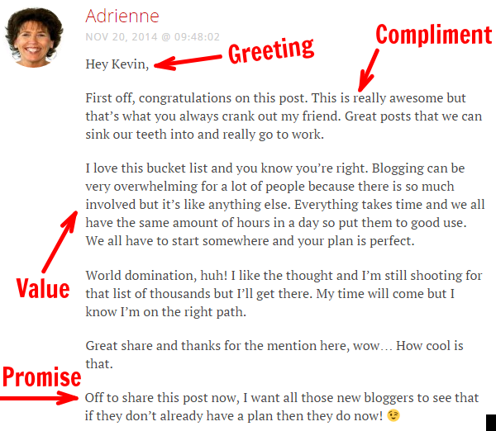
Comments

