Slide 2
Speech Form – Martin luther king (dream)
I have a dream that one day this nation will rise up and live out the true meaning of its creed: "We hold these truths to be self-evident, that all men are created equal."
I have a dream that one day on the red hills of Georgia, the sons of former slaves and the sons of former slave owners will be able to sit down together at the table of brotherhood.
I have a dream that one day even the state of Mississippi, a state sweltering with the heat of injustice, sweltering with the heat of oppression, will be transformed into an oasis of freedom and justice.
I have a dream that my four little children will one day live in a nation where they will not be judged by the colour of their skin but by the content of their character.
I have a dream today!

Slide 3
A good speech may include:
Repetition
Power of three
Emotive language
Direct address
Evidence (statistics, quotations, examples)
Rhetorical schemes/ tropes (e.g. rhetorical questions)
Personal pronouns

Slide 4
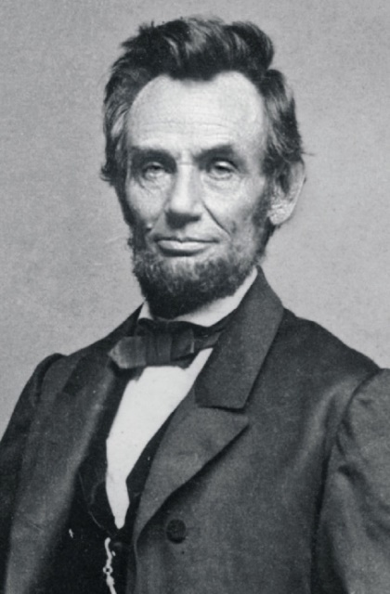
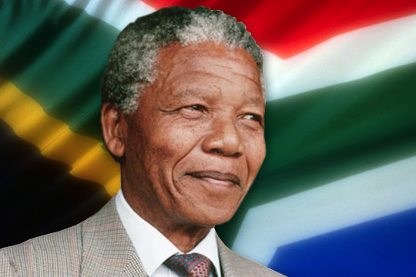
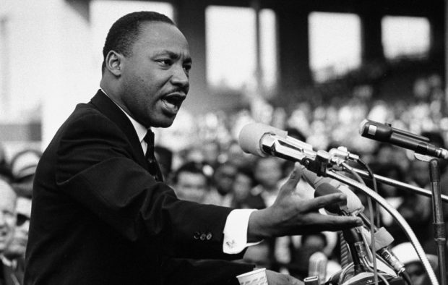
Three well known speeches:
Gettysburg Address – A. Lincoln
I have a dream – Martin L.K.
I am prepared to die – Nelson Mandela

Slide 5
Rhetorical Devices

