Slide 1
Talk Features

Slide 2
Talk Features
Personal Introduction
Anecdote
Facts and statistics
Audience participation
  closed questions only
Avoid ‘invisible’ punctuation
  Pre-modify statement
Direct address – ‘you’ and ‘your’ to directly relate to audience
Simple sentences
Varied verb mood
Informal register – use contractions, first person and simple sentences
Deictic References
  “I’m sure all of you here think..”
Case studies

Slide 3
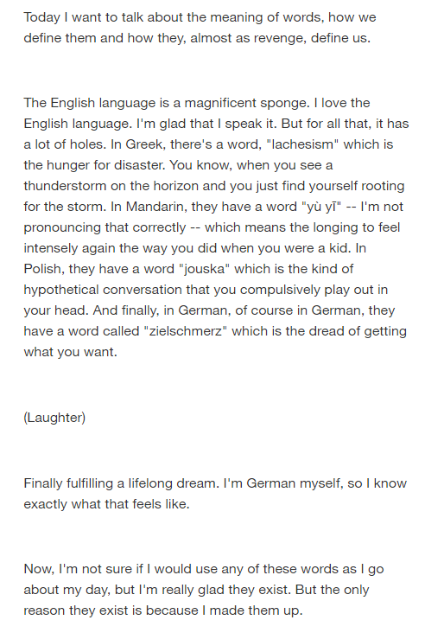
Examples

Slide 4
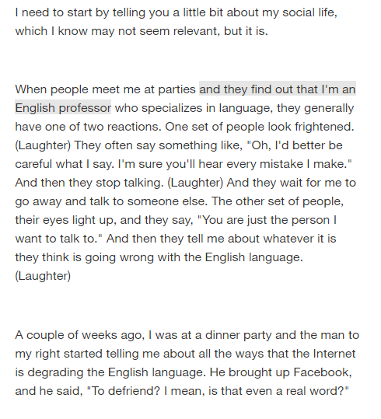
Direct address
Contraction
Anecdote
Avoid invisible punctuation

