Slide 1
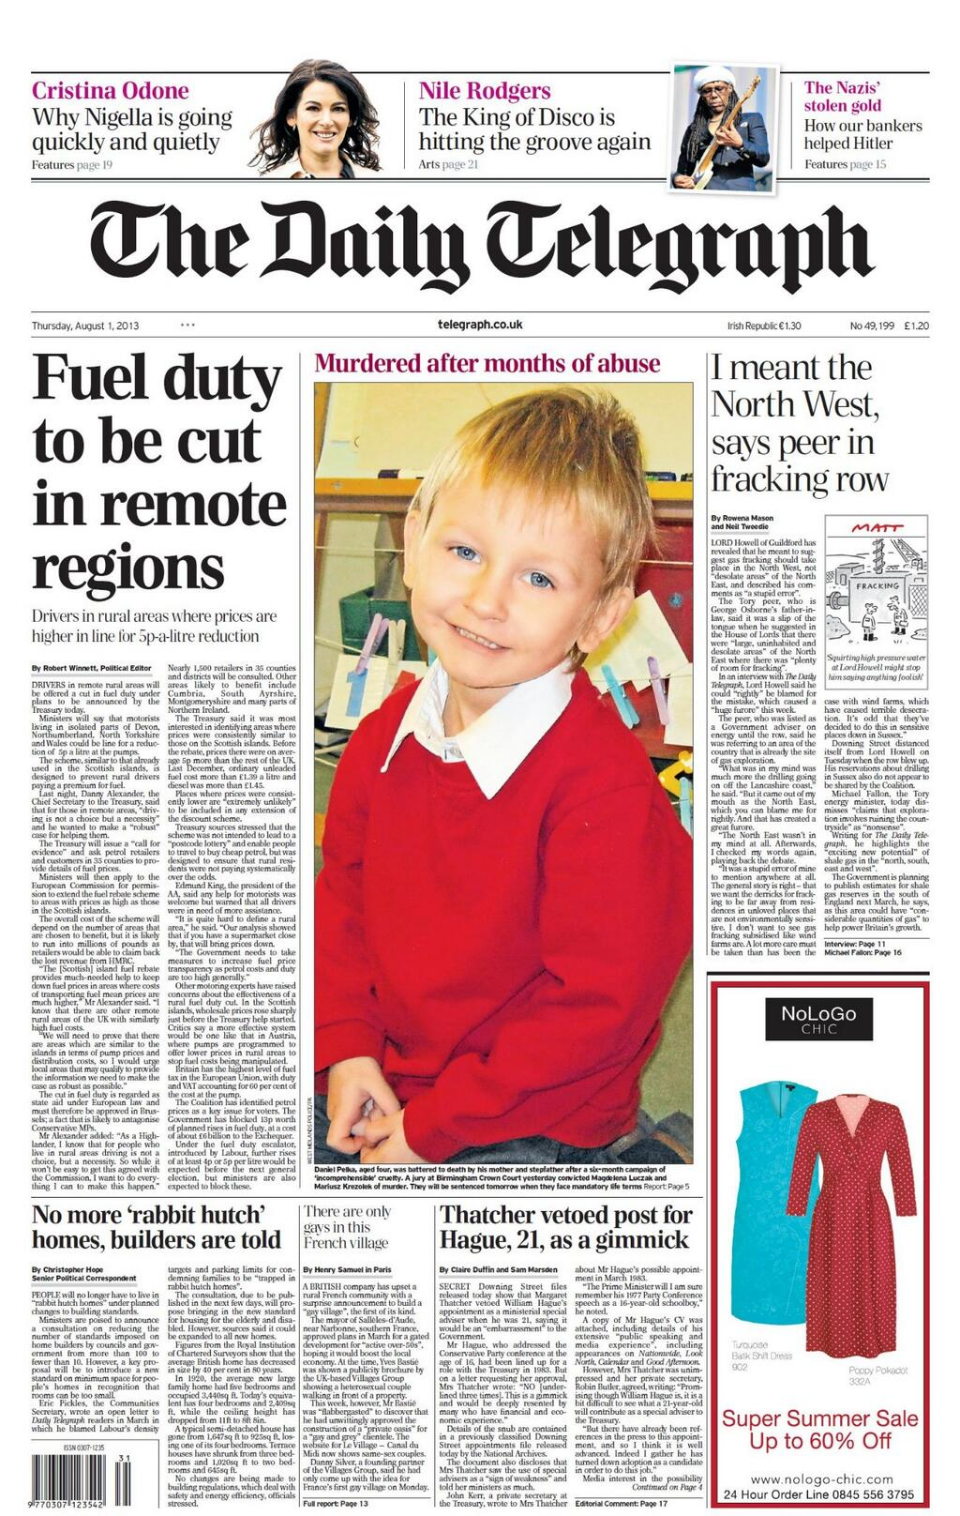
Title. Usually catchy, engages reader attention.
Multi-modal. You don’t need to draw the picture – just put a box.
Date
Subheading. Provides more info after the title.
Author of the article. Can add twitter username too.
Picture caption box – describes photo.
Columns
Advert – usually related to the article. In the box, put who the advert is by.
Page number

Slide 2
Linguistic features
Rhetorical schemes/ tropes
Metaphors, similes, personification
Use adjectives before/after a subject in order to convey a certain opinion of the subject
“the monster, who murdered the woman in her house…”
Quotes
Indications of other journalism features (e.g. “the police were not helpful in my enquiries”)
Low frequency lexis but not subject specific – for the average broadsheet reader.
Less colloquial features (were not instead of weren’t)
Varied syntax

