Slide 1
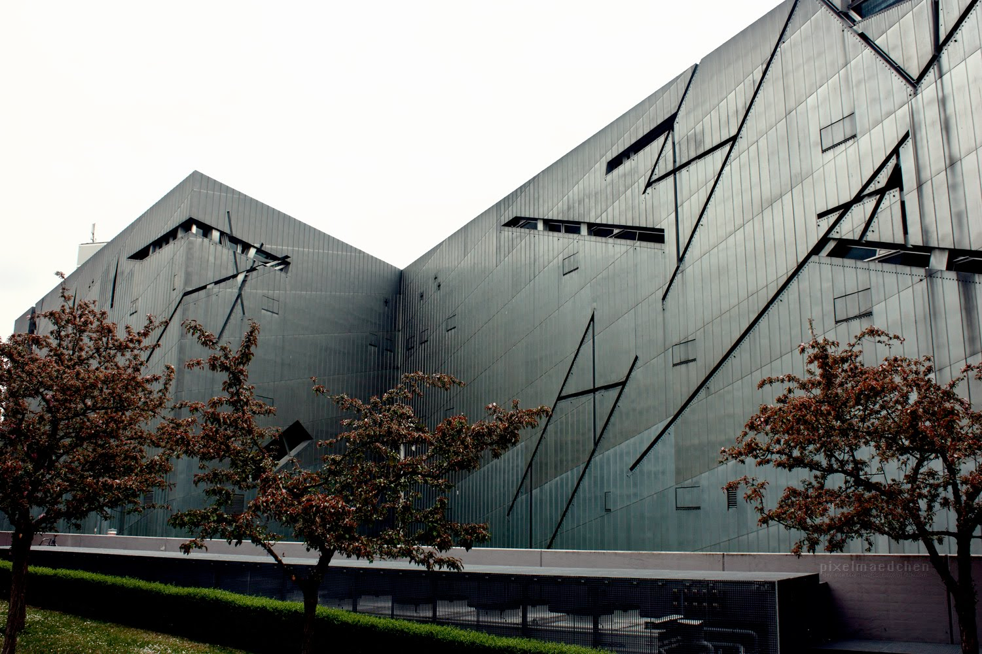
Daniel Libeskind, Jewish Museum, Berlin, 2001

Slide 2
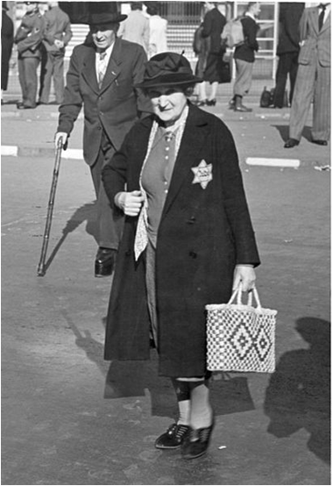
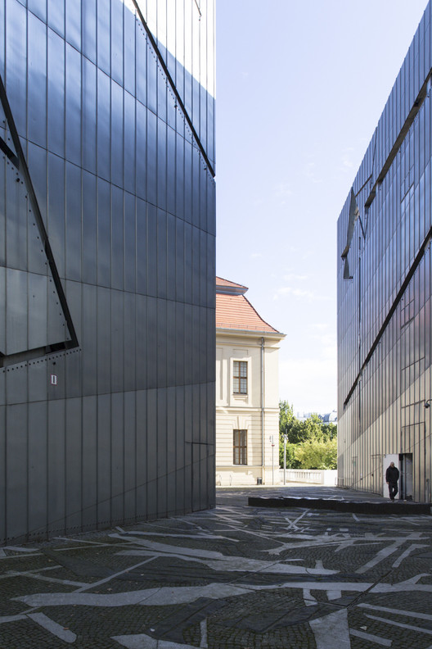
To understand this building we need to examine….
…who it represents
….the architect’s concept…
….the effect on visitors

Slide 3
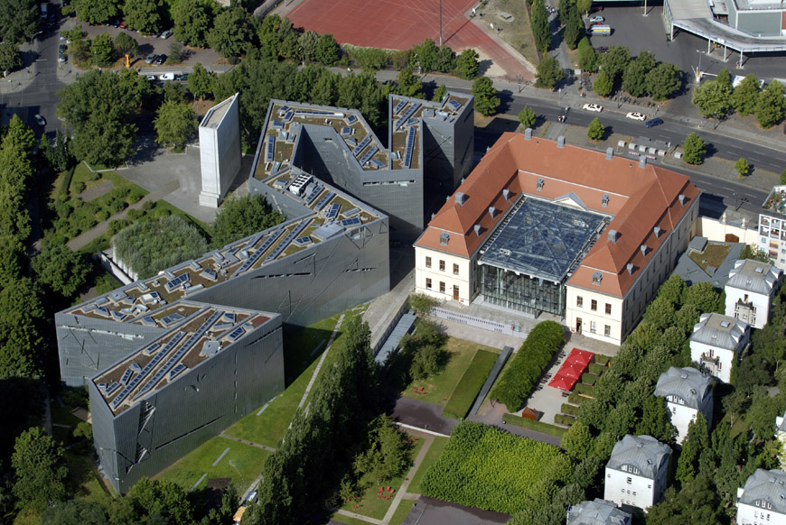
1: It is impossible to understand the history of Berlin without understanding the enormous
contributions made by its Jewish citizens.
2: The meaning of the Holocaust must be integrated into the consciousness and memory
of the city of Berlin; and, finally, for its future,
3: The City of Berlin and the country of Germany must acknowledge the erasure of Jewish
life in its history.

Slide 4
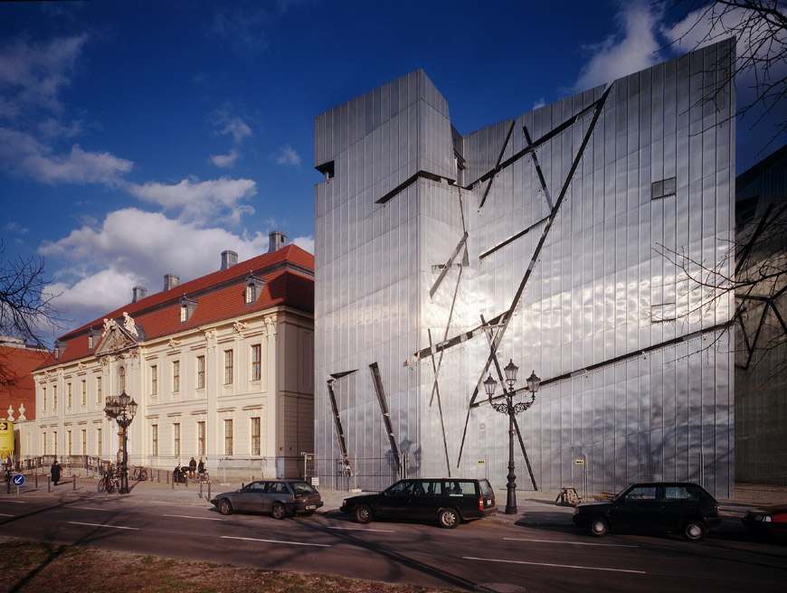
The visitor enters the Baroque Kollegienhaus and then descends by stairway through the dramatic
Entry Void, into the underground. The existing building is tied to the new extension, through
the underground, thus preserving the contradictory autonomy of both the old and new structures
on the surface.

Slide 5
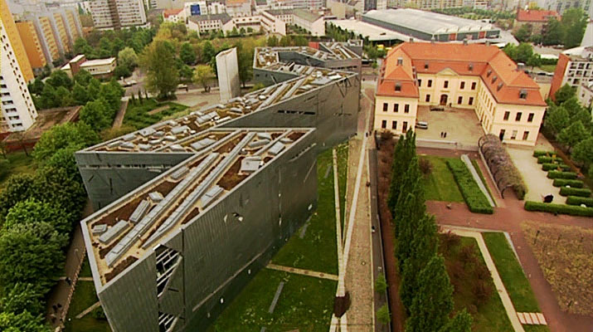
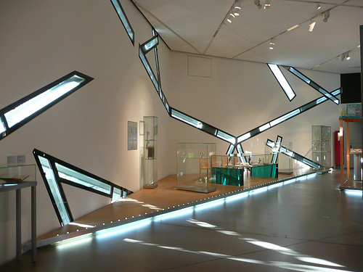
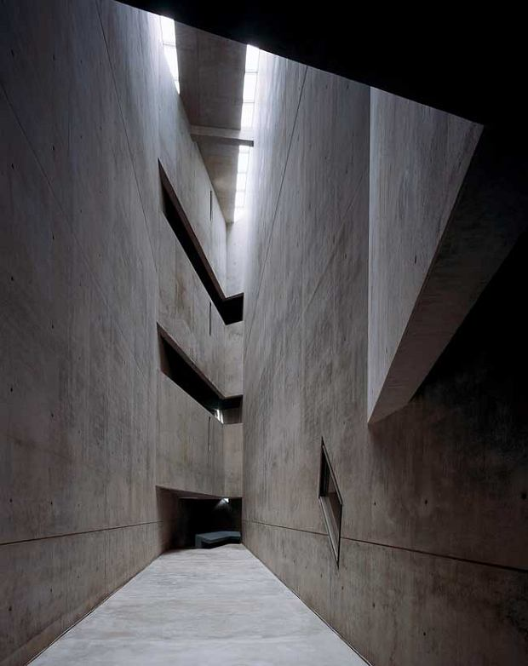
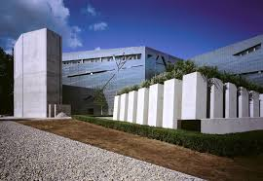
https://www.youtube.com/watch?v=dNJ5rgebyEE

Slide 6
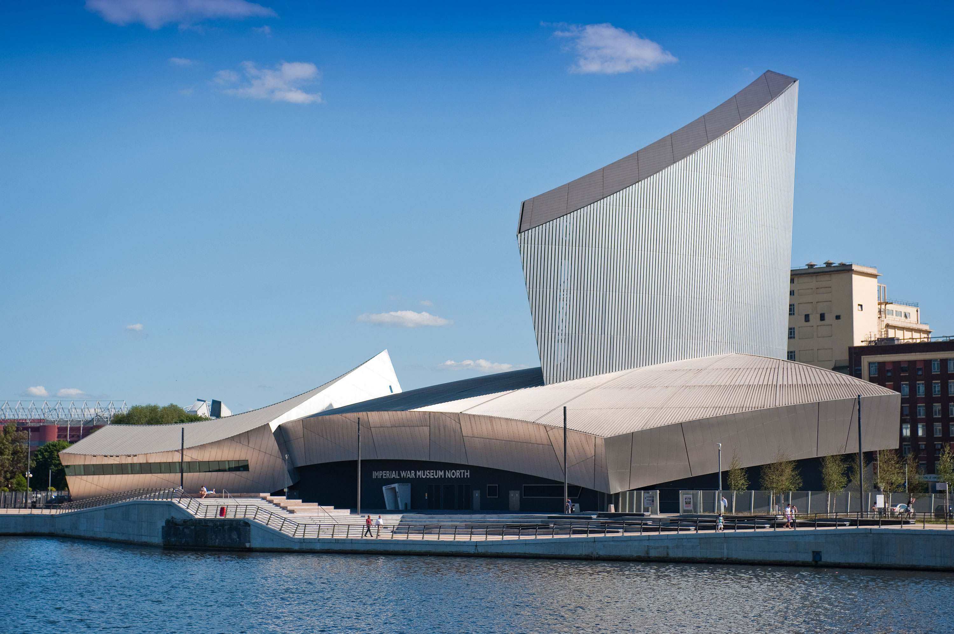
Daniel Libeskind, Imperial War Museum North, Manchester, 2001

Slide 7
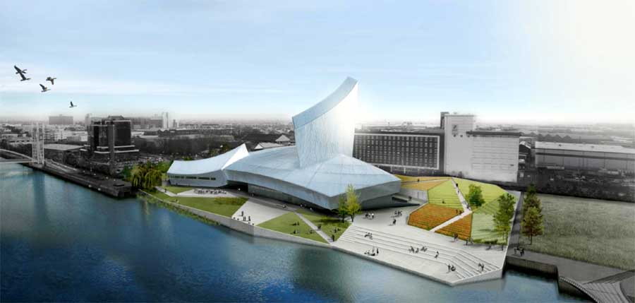
The Imperial War Museum North (IWMN) in Manchester, England, tells the story of how war has
affected the lives of British and the Commonwealth citizens since 1914.
The design concept is a globe shattered into fragments and then reassembled. The interlocking of
three of these fragments—representing earth, air, and water—comprise the building’s form.
The Earth Shard forms the museum space, signifying the open, earthly realm of conflict and war;
the Air Shard serves as a dramatic entry into the museum, with its projected images, observatories
and education spaces; and the Water Shard forms the platform for viewing the canal, complete with
a restaurant, cafe, deck and performance space.

Slide 8
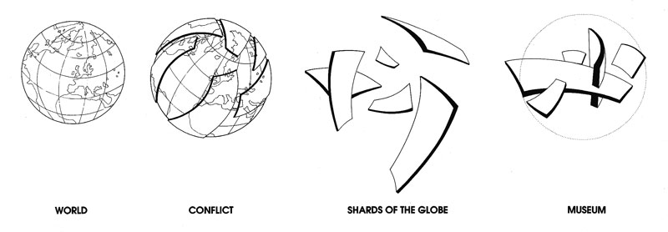
Libeskind wanted the building to be a symbol of the effects of war, so he came up with the concept
of a globe shattered into three pieces – and though it's been put back together, it will never be the
same again. That's why IWM North is made up of the EarthShard, WaterShard and the AirShard –
a piece of the building to represent conflict on land, sea and in the air.

Slide 9
Q: What is the significance of the location/site of the Imperial War Museum North?
Q: The design of the building is composed of three distinct parts. What does these represent?
Q: In what ways does the internal layout and design of this building link to Libeskind’s Jewish Museum in Berlin? Q: The main display area is ‘immersive’. Sound, video and photographic projections surround visitors to the gallery. What was Libeskind hoping to achieve with this effect?
Q; The contents of the museum’s display aim to illustrate ‘conflict and it’s effect’. Name some of the conflicts referenced in this museum.
Q: What is the theory behind Libeskind’s design for this building (think of a globe)?
Q: Libeskind uses sloping floors, narrow passageways and leaning walls in the design of this building. Why?
Q: Explain the significance of each of these aspects of the building; the Watershard, the AirShard and the EarthShard. Find an image for each and include below your description.
Q: This building is described as Deconstructivist in style. What does this phrase mean in relation to architecture?
Q: Explain Libeskind’s choice of materials. Why does he use sheet metals such as aluminium and zinc? What are the advantages of using such materials?

