Slide 1
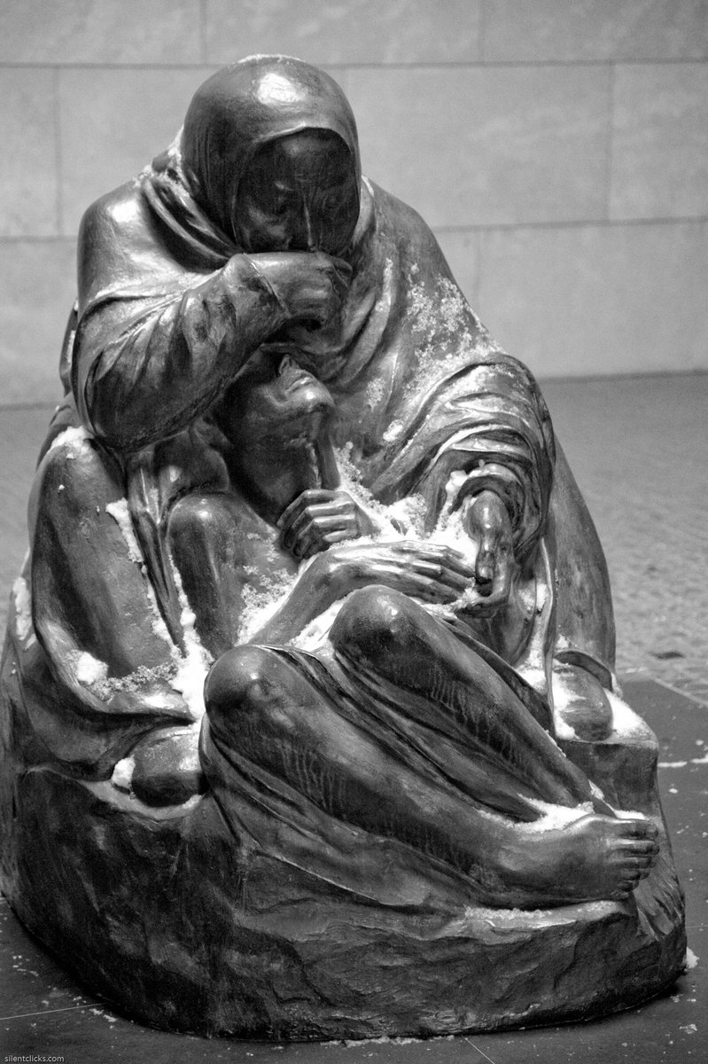
‘Pietà’ (Mother with Her Dead Son), Käthe Kollwitz, completed 1939

Slide 2
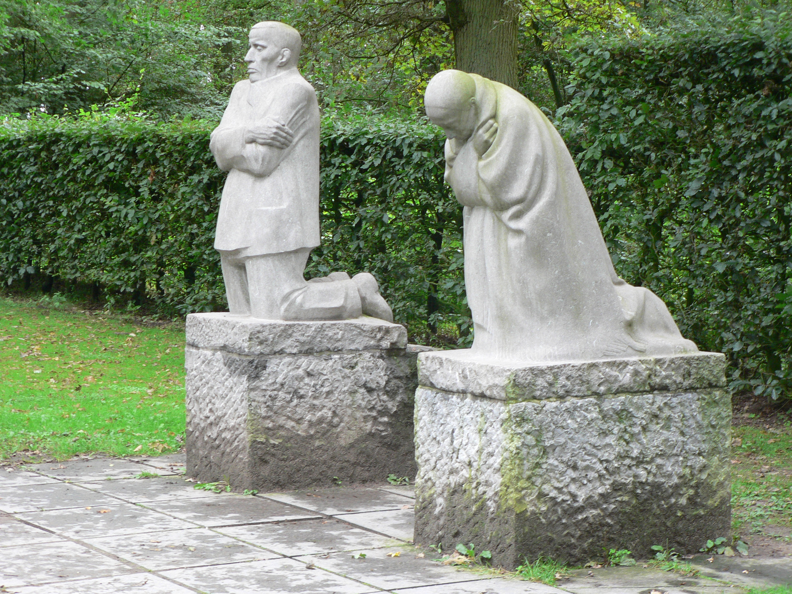
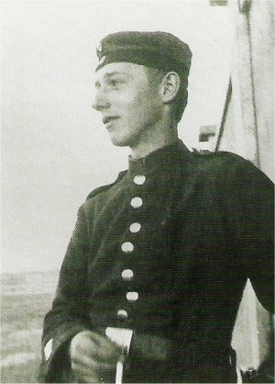
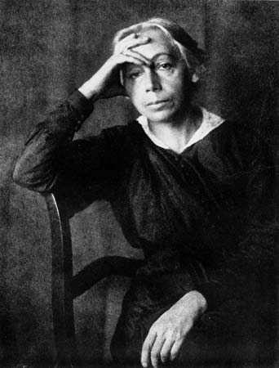
Käthe Kollwitz, 1867-1945
Kollwitz was a German artist whose work had a particular
focus on themes and subjects linked to social issues and
the struggles of everyday life.
Her husband was a doctor who tended the poor and
destitute of Berlin- and these people would become a key
topic in her work.
Kollwitz worked primarily in sculpture, drawing and
printmaking and received many prestigious awards
throughout her early career.
WW1 would have a devastating impact on Kollwitz. Her
youngest son Peter was killed, aged 18, fighting for Germany
Kollwitz would create works depicting mothers mourning the loss of a dead child or children.
She began work on memorial to Peter and other German soldiers killed in the First World War.
‘The Grieving Parents’ was eventually completed in 1932 and is situated in a war cemetery in
Germany.

Slide 3
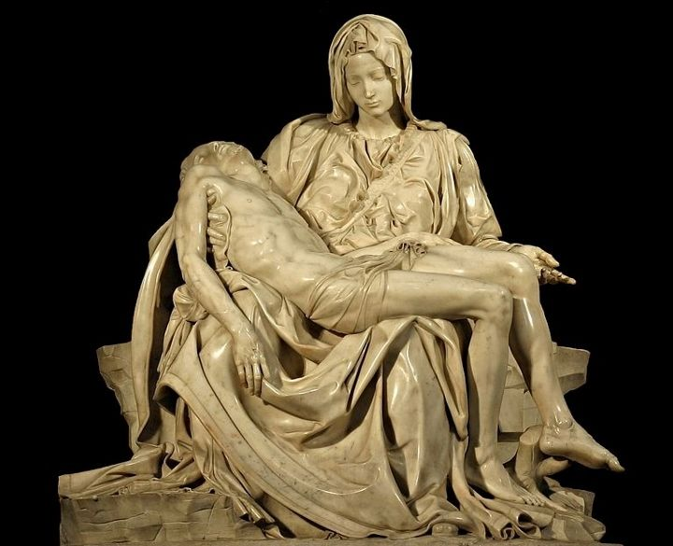
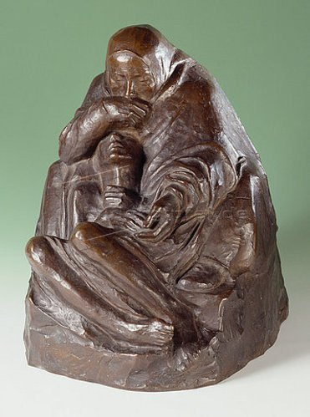
In October 1937 Kollwitz wrote in her diary on the anniversary of her son’s death, she was working on a sculpture to personally commemorate him. She described this work as a ‘Pietà’.
‘Pietà’, Michelangelo, 1498-99
‘Pietà’, Käthe Kollwitz, 1938-39

Slide 4
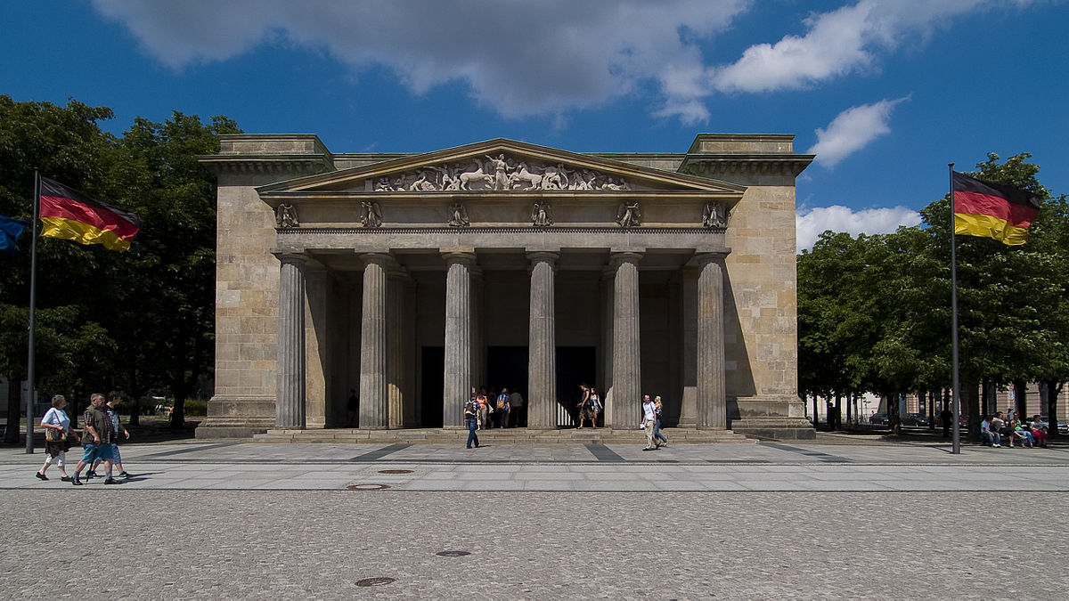
Kollwitz’s ‘Pietà’ is now located in the Neue Wache (New Guardhouse). This is a Neoclassical
building initially constructed for King William III of Prussia to accommodate his troops.
Since then the building’s function has undergone a number of changes. During the rule of
Hitler it was appropriated by the Nazis and today it is known as the ‘Central Memorial of the
Federal Republic of Germany for the Victims of War and Dictatorship’.

Slide 5
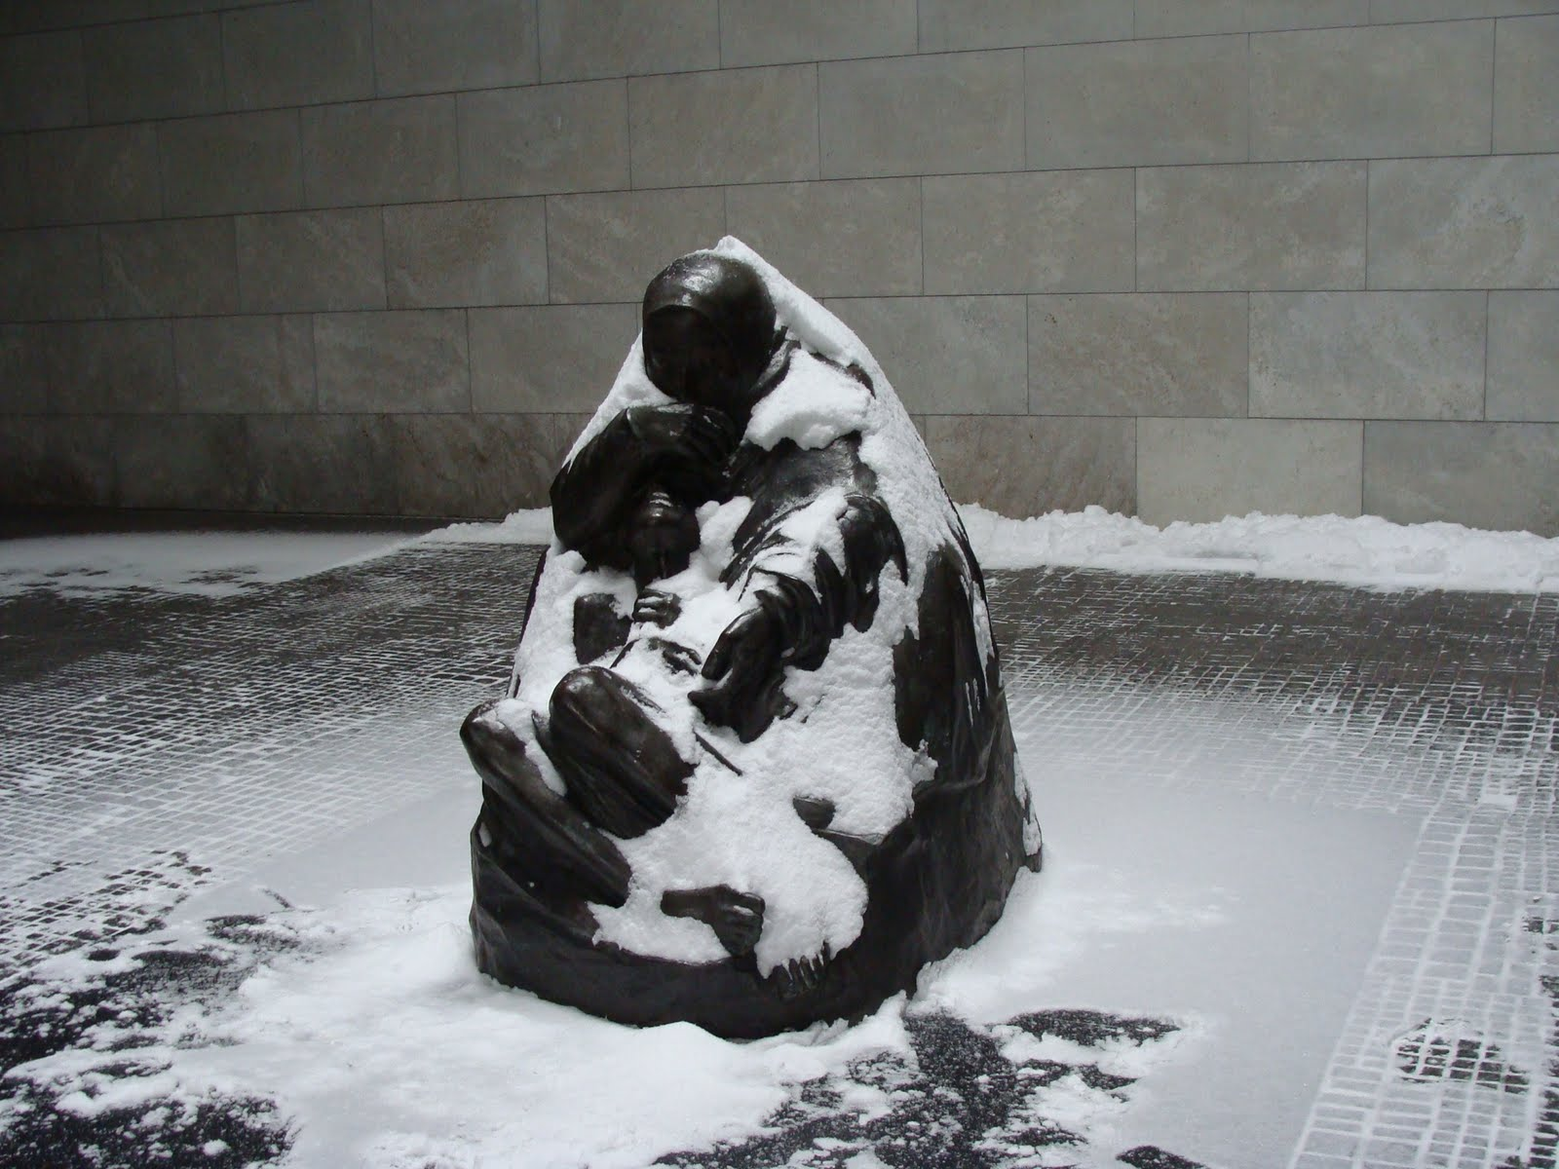
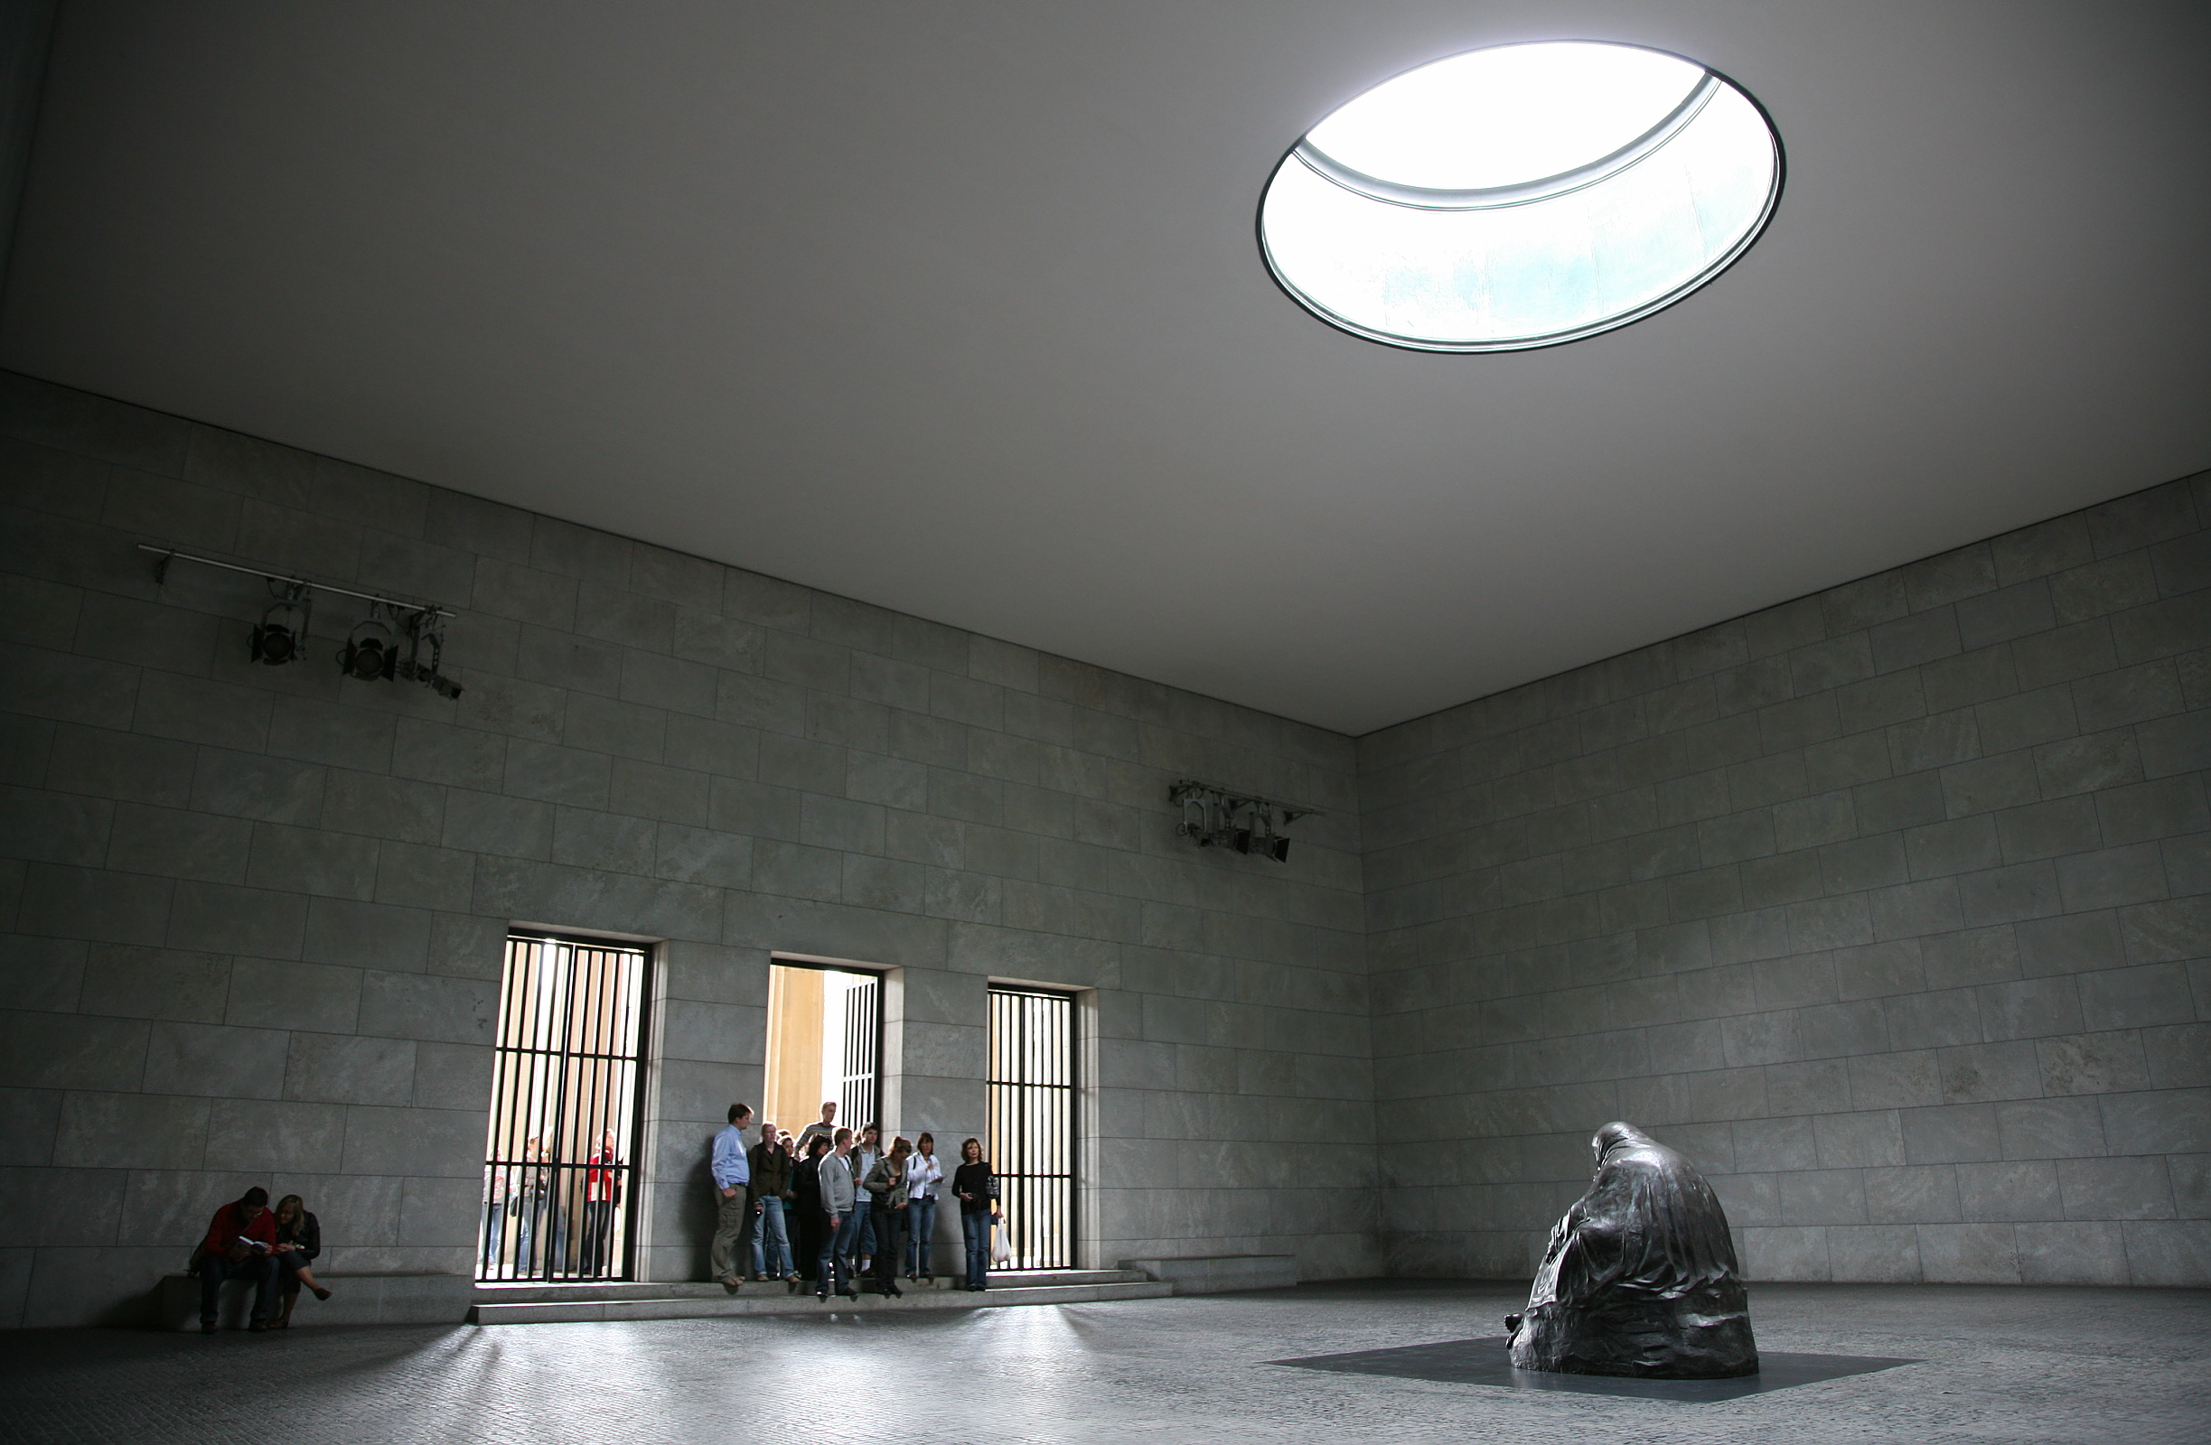
Kollwitz’s ‘Pietà’ is placed directly below an open oculus in the roof of the building.

Slide 6
