Slide 1
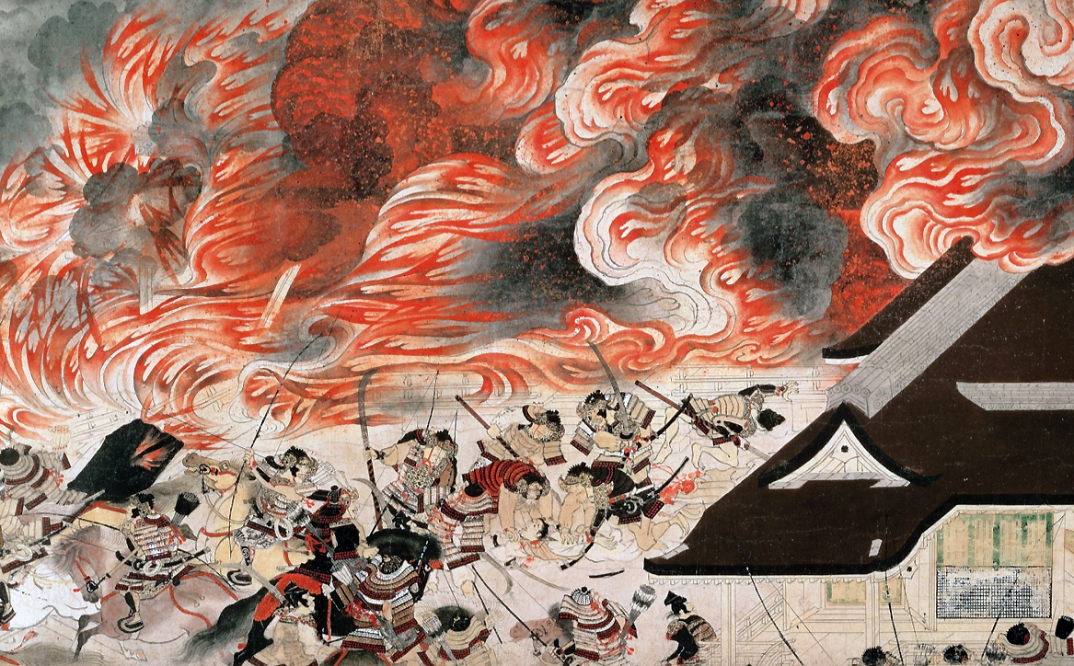
Night Attack on the Sanjô Palace, second half of the 13th century

Slide 2
Key words to remember:
Emaki
otoko‐e
Heiji Insurrection of 1159‐60 aka Heiji rebellion
Shōgun
Kyoto
http://learn.bowdoin.edu/heijiscroll/viewer.html

