Slide 1
Creating a Book Using Microsoft Publisher

Slide 2
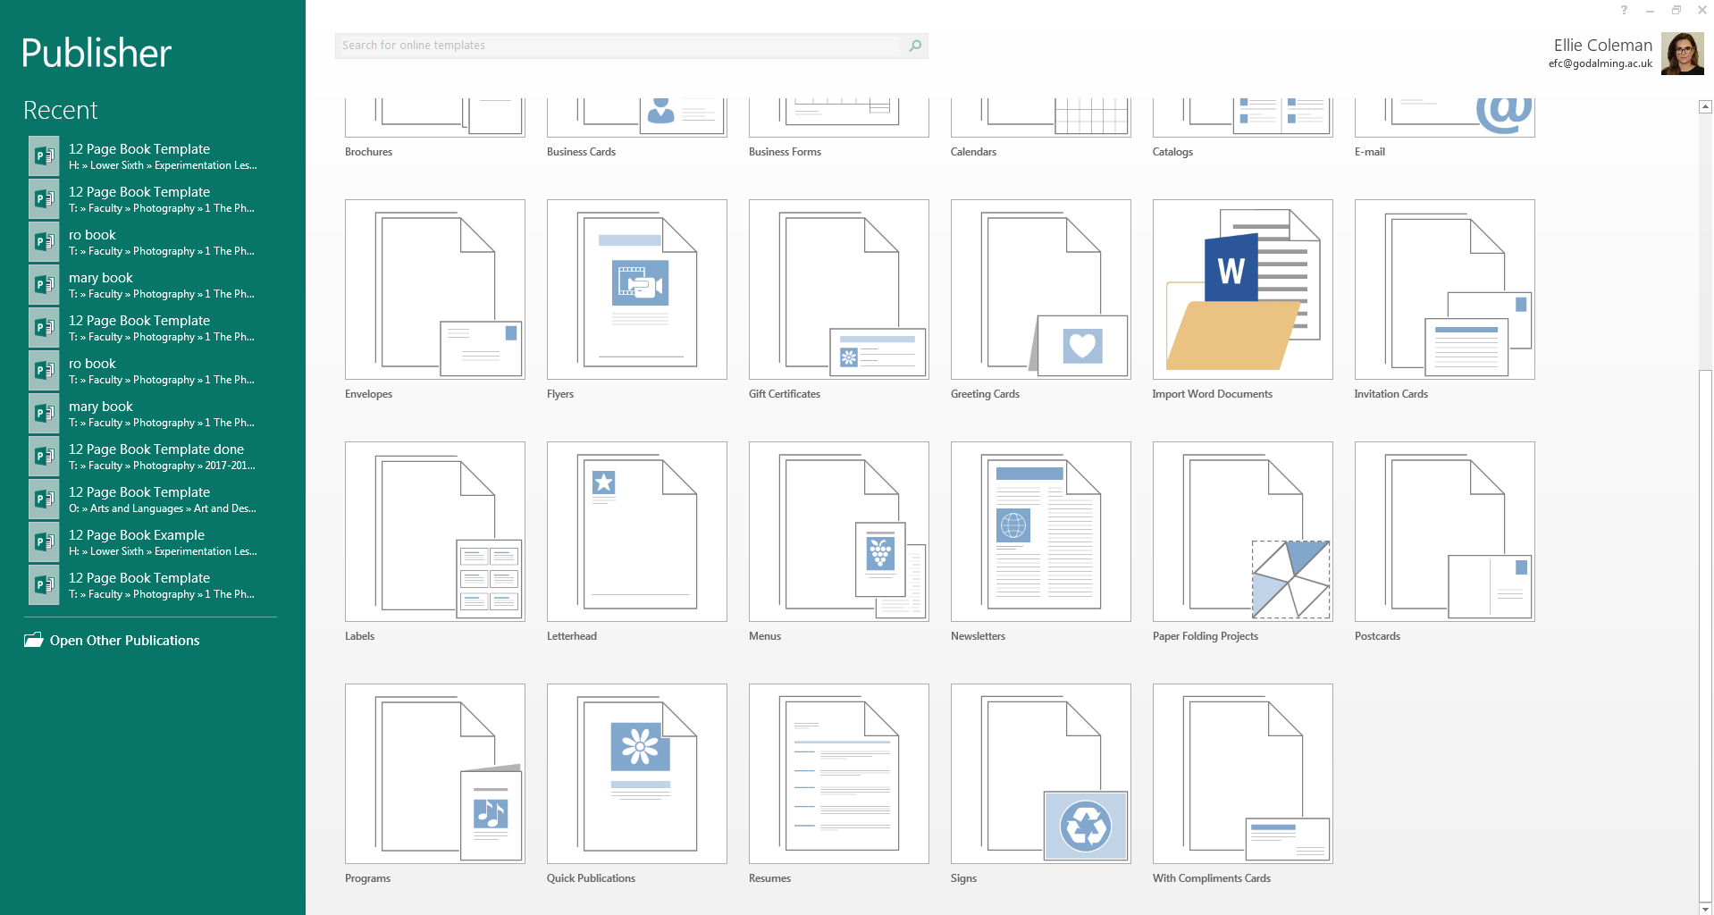
Open up Publisher and you will get a menu with lots of different options, scroll down until you see ‘Programs’

Slide 3
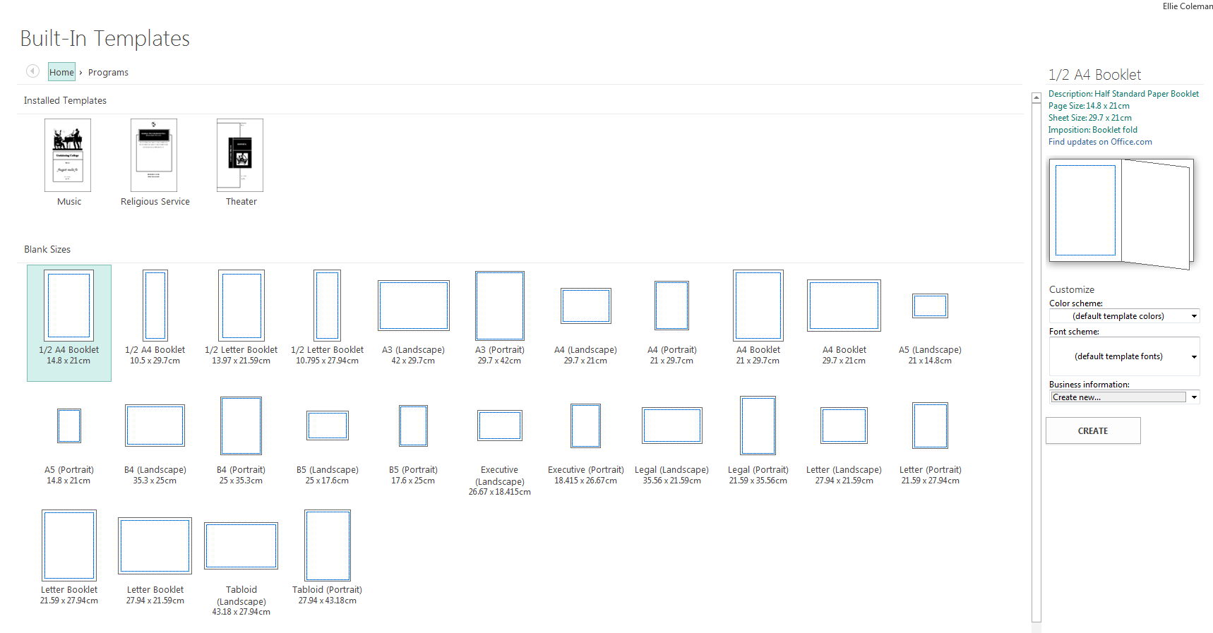
Select ‘½ A4 Booklet’
Leave all other settings on default and click ‘create’

Slide 4
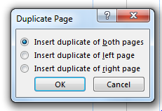
When you click create you will get an error message pop up on screen, click ‘Yes’
This will open up your publisher document, but you will only have 4 pages
To add more pages right click on the double page and select ‘Insert Duplicate Page’
NOTE: The number of pages MUST be a multiple of 4
You will get another pop up, make sure you select ‘Insert Duplicate of Both Pages’
Do this as many times as needed to get the correct amount of pages that you need

Slide 5
Once you have inserted the amount of pages that you want you can start placing your images on each page.
You may have to test print a few times to get the order correct.

Slide 6
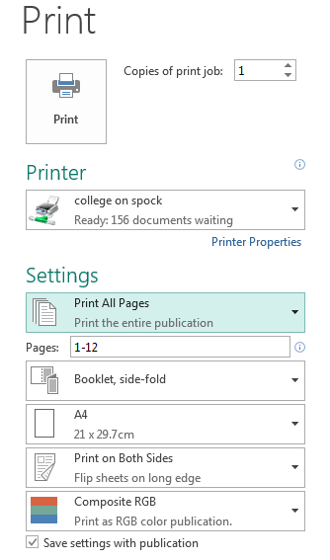
Printing Your Book…
Once you have placed all of your images you need to print to COLLEGE ON SPOCK
Make sure in the settings it says ‘Booklet, side-folded’
You should also have it set to ‘Print on Both Sides’

Slide 7
Binding Your Book…
Once you have printed your book you need to bind it together by sewing it.
To do this, you first need fold each page of your book in half, make sure you don’t mess up the order!
Then you need to make 3 holes in the centre fold of each page using a needle

Slide 8
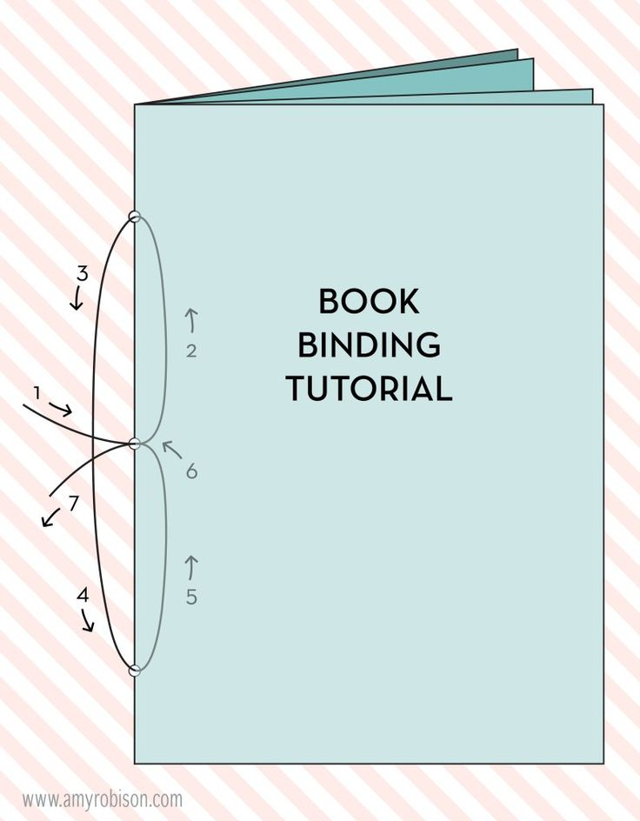
Once you have made your holes use a needle and tread to sew your book together.
Go in through the centre hole from the outside first
Then up to the top hole
All the way down to the bottom hole
And then out through the middle hole
Then you just need to tie together the two ends of string as neatly as possible.

