Slide 1
Potential Outcomes idea- a book.
To be printed out on A4 paper to give an A5 or A6 book.
]If you want A4, work with an A3 original page in your
Programme.
You need 300 dots per inch for image resolution to be right,
This is usually the default setting… but check.

Slide 2
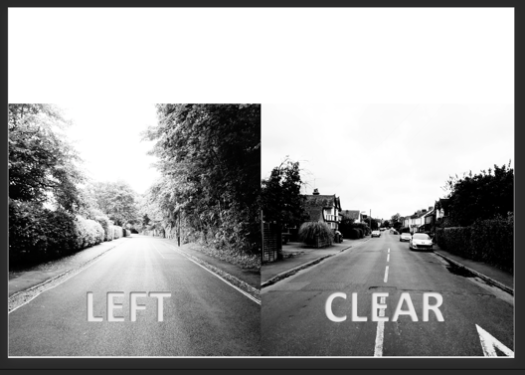
Create an A4 Powerpoint, or work in Photoshop and create an A4 page.
In Powerpoint
Have two images to be you pages
Side by side and add text if wanted.,
In Photoshop

Slide 3
Set of pages with two eventual ‘book pages’ per A4 page
Square format book
Rectangular format landscape orientation
Rectangular format portrait orientation

Slide 4
When printing set number of pages per sheet to achieved required size. Eg with two page originals ‘2’ for A6 pages.

Slide 5
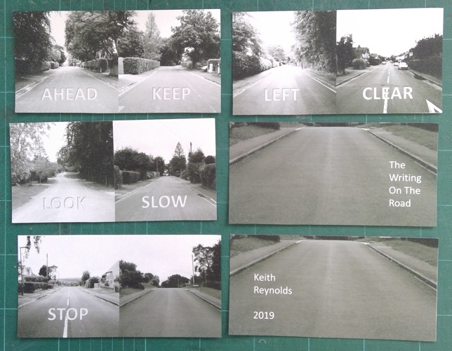
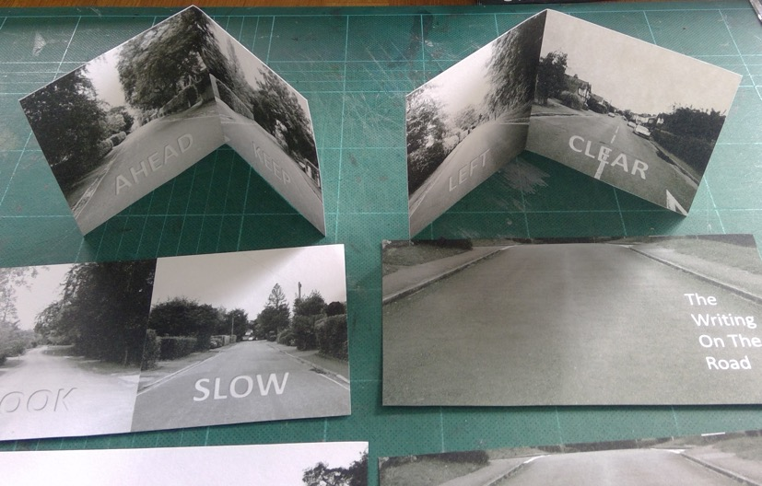
Cut out pages and fold in half.
Glue back to back, lining-up carefully at the spine.
Have and extra blank for folded piece for front and back if endpapers are required.

Slide 6
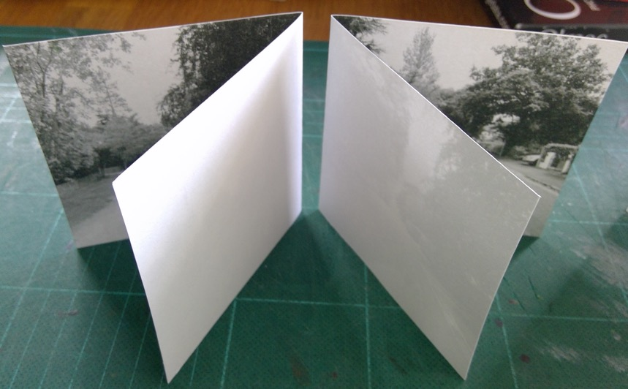
Glue back to back, lining-up carefully at the spine

Slide 7
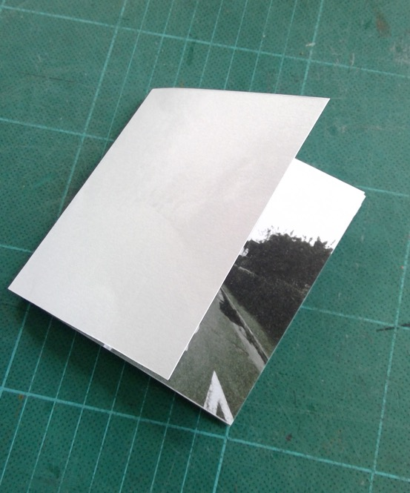
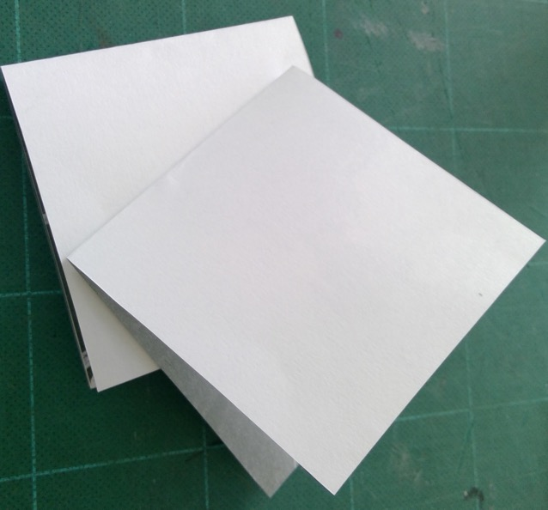
Glue back to back, lining-up carefully at the spine
Use waste paper to protect surfaces from unwanted glue

Slide 8
Cover needs to be bigger to include depth of spine.
Could have made two A4 pages to produce front and back.

Slide 9
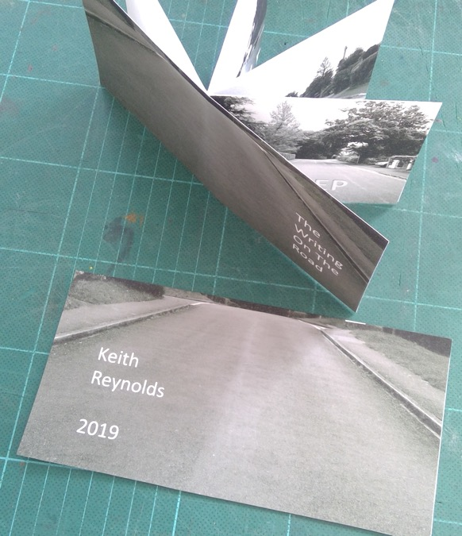
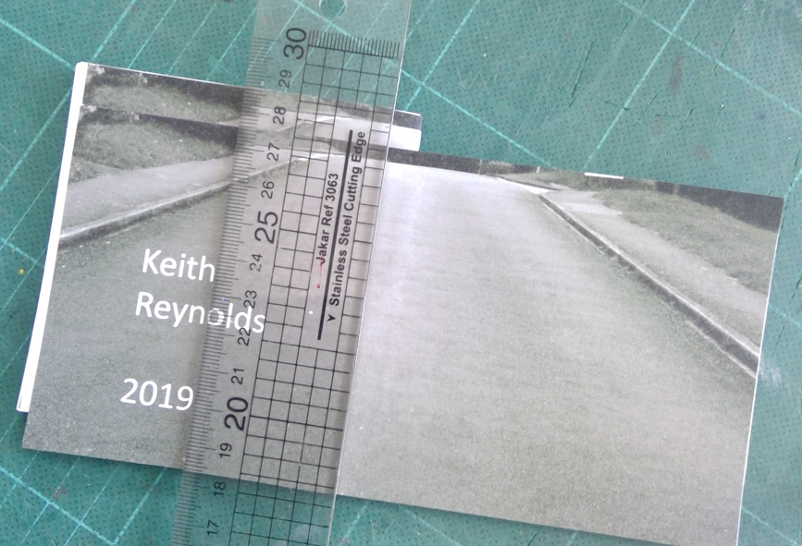
Cut front and back parts to fit.
Paste back part to front part.
Paste back part to back page of book

Slide 10
