Slide 1
Global Filmmaking
Exam Prep

Slide 2
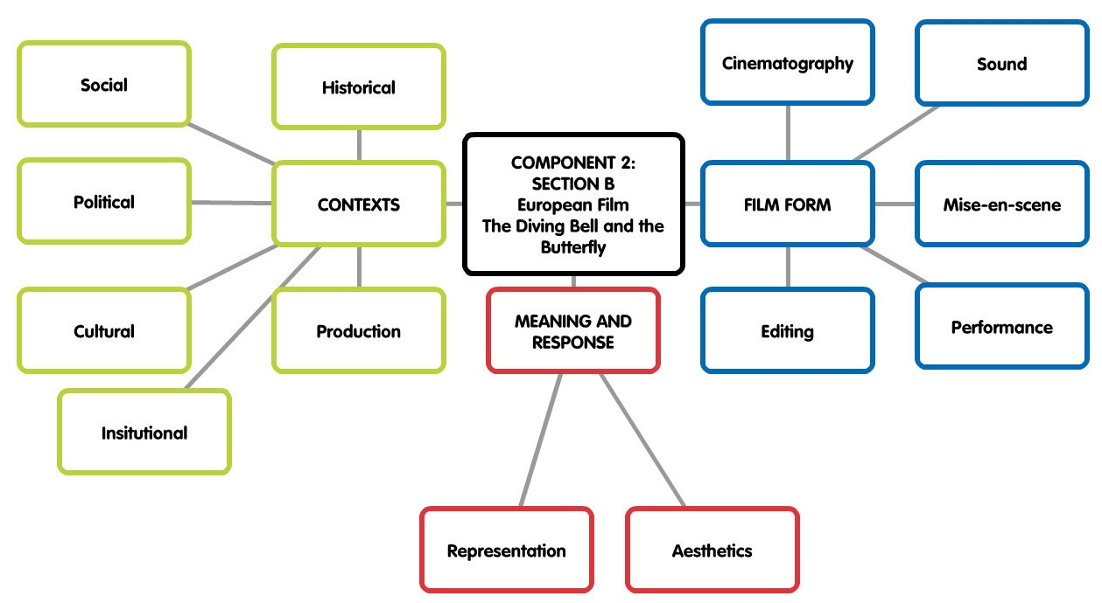
What will the Exam questions be on…

Slide 3
Task 1: Essay planning
Use the past questions and plan 1 essay from each area…
  Film Form
  Aesthetics
  Representation
  Context
Key points and key scenes

Slide 4
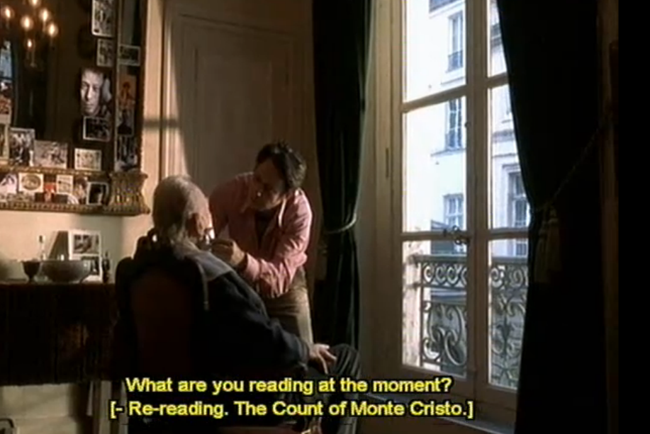
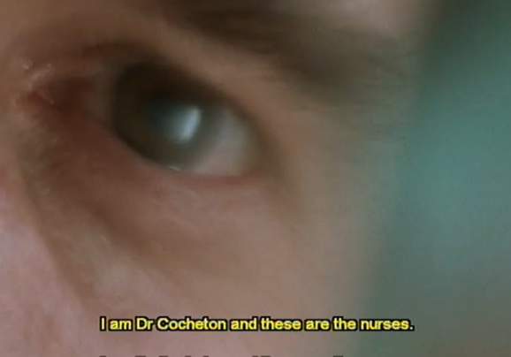
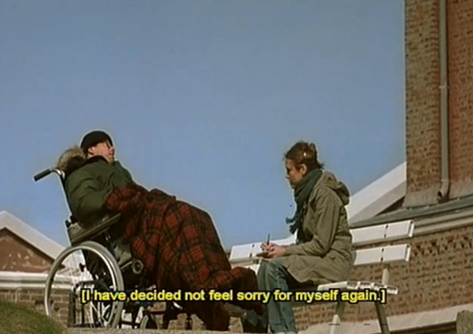
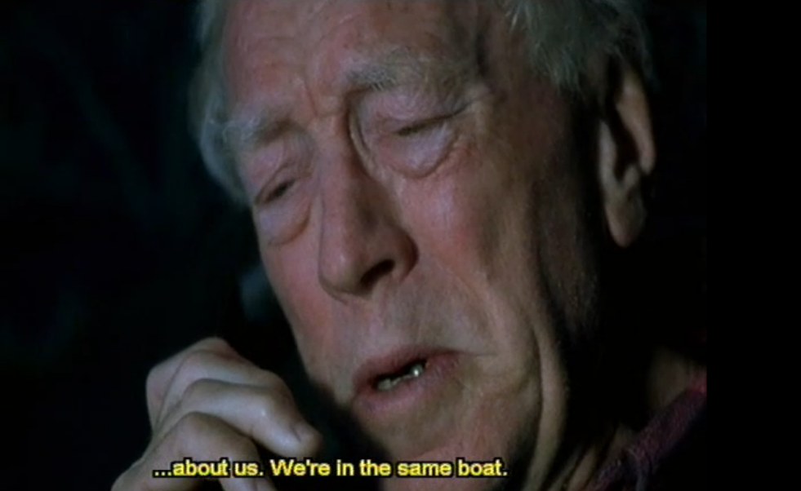
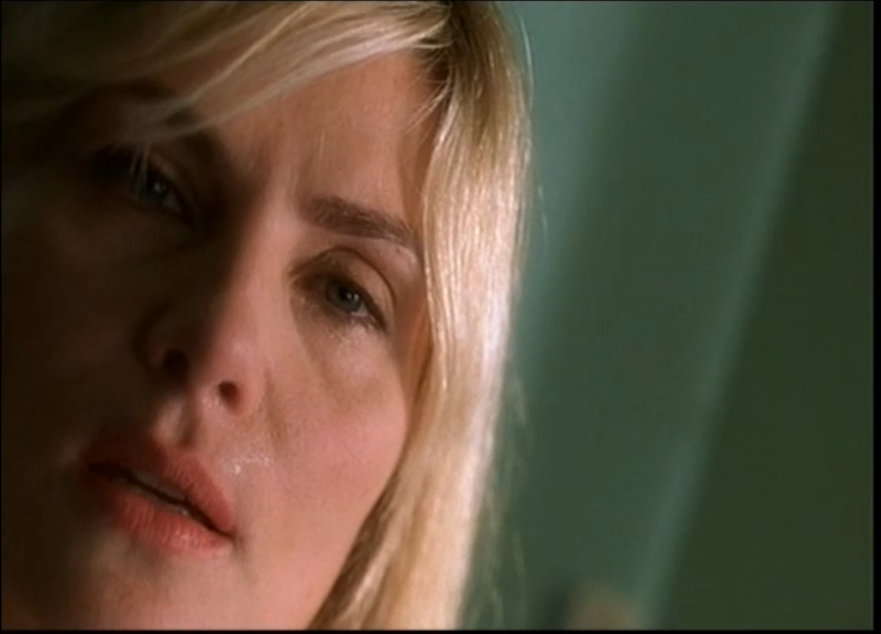
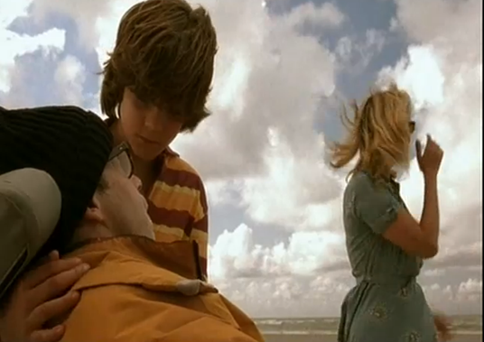
Scenes WE have covered
The Shave
Opening Sequence
The Fantasy
Father and Son
Celine and Innes
Father’s Day

Slide 5
Task 1: Essay planning
Use the past questions and plan 1 essay from each area…
  Film Form
  Aesthetics
  Representation
  Context
Key points and key scenes

Slide 6
Task 2: Essay writing
Choose a Film Form question and write a main paragraph from the essay
 | Excellent | Good | Satisfactory
 | A | B | C/D
Question answered throughout | Excellent, detailed and engaging response that applies to all aspects of the question. | Good, reasonably detailed and engaging response that applies to all aspects of the question. | Satisfactory and reasonably detailed response that applies to aspects of the question.
Knowledge of Film Form | Excellent demonstration and application of the core study areas of the chosen films. | Good demonstration and application of the core study areas of the chosen films. | Satisfactory demonstration and application of the core study areas of the chosen films.
Examples from The Diving Bell and The Butterfly | Uses excellent points that are well supported with sophisticated references to the chosen film. | Uses good points that are well supported with detailed references to the chosen film. | Uses satisfactory points that are supported with reasonable references to the chosen film.
Application and detail in film form terminology | Excellent demonstration of knowledge and understanding of subject-specific terminology. | Good demonstration of knowledge and understanding of subject-specific terminology. | Satisfactory demonstration of knowledge and understanding of subject-specific terminology.
How detailed and sophisticated the analysis and response is | Analysis is excellent, sophisticated and detailed. | Analysis is good, and reasonably detailed. | Analysis is satisfactory and reasonable.
Writing style; including essay structure and SPAG | Excellent structure with clear focus and flow. Consistent and accurate throughout. | Well-structured with focus and flow. Consistent and accurate. | Reasonable structure, with minor inaccuracies.

Slide 7
Task 2: Essay writing
Choose a Film Form question and write a main paragraph from the essay
 | Excellent | Good | Satisfactory
 | A | B | C/D
Question answered throughout | Excellent, detailed and engaging response that applies to all aspects of the question. | Good, reasonably detailed and engaging response that applies to all aspects of the question. | Satisfactory and reasonably detailed response that applies to aspects of the question.
Knowledge of Film Form | Excellent demonstration and application of the core study areas of the chosen films. | Good demonstration and application of the core study areas of the chosen films. | Satisfactory demonstration and application of the core study areas of the chosen films.
Examples from The Diving Bell and The Butterfly | Uses excellent points that are well supported with sophisticated references to the chosen film. | Uses good points that are well supported with detailed references to the chosen film. | Uses satisfactory points that are supported with reasonable references to the chosen film.
Application and detail in film form terminology | Excellent demonstration of knowledge and understanding of subject-specific terminology. | Good demonstration of knowledge and understanding of subject-specific terminology. | Satisfactory demonstration of knowledge and understanding of subject-specific terminology.
How detailed and sophisticated the analysis and response is | Analysis is excellent, sophisticated and detailed. | Analysis is good, and reasonably detailed. | Analysis is satisfactory and reasonable.
Writing style; including essay structure and SPAG | Excellent structure with clear focus and flow. Consistent and accurate throughout. | Well-structured with focus and flow. Consistent and accurate. | Reasonable structure, with minor inaccuracies.

Slide 8
With reference to key sequences, explore how filmmakers use mise-en-scène to enhance the themes in your chosen films. Make detailed references to particular sequences in your answer.
Question answered throughout
Knowledge of Film Form
Examples from The Diving Bell and The Butterfly
Application and detail in film form terminology
How detailed and sophisticated the analysis and response is
Writing style; including essay structure and SPAG

Slide 9
With reference to key sequences, explore how filmmakers use mise-en-scène to enhance the themes in your chosen films. Make detailed references to particular sequences in your answer.
Introduction
Question answered throughout
Knowledge of Film Form
Examples from The Diving Bell and The Butterfly
Application and detail in film form terminology
How detailed and sophisticated the analysis and response is
Writing style; including essay structure and SPAG

Slide 10
Task 3: Essay writing
  Write a paragraph for an Aesthetics, Representation and Context essay.
Task 4: REVISION
Retrieval practice for core areas: Context Film Form Representation Aesthetics
Retrieval practice on key scenes
Retrieval practice on Film Form Terminology, including quizzes

