Slide 1
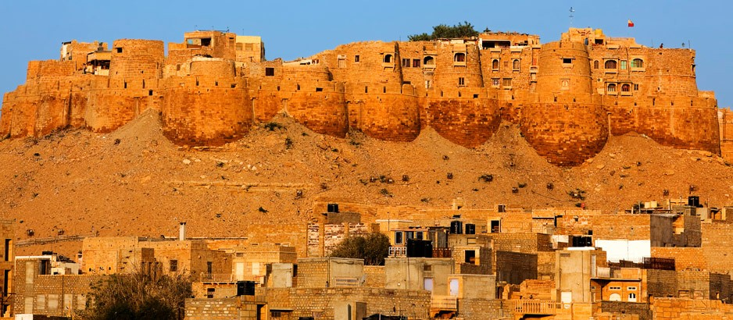
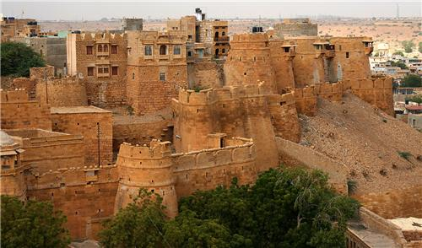
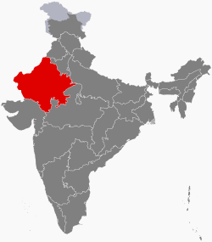
Golden Fort
Built 1156 AD

Slide 2
Golden Fort
Built 1156 AD
Built by King Rawal Jaisal in Rajasthan near the border between India and Pakistan
This is a fortified city and is also known the Golden Fort
For almost 800 years this fort was actually the city of Jaisalmer containing an entire
city of people within its walls
The fort is located on what was an important trade route and as such was a contested
area where caravans of traders and merchants ran the risk of being attacked for
their goods
Within the fortified walls of the city were also a palace and a temple

Slide 3
City wall with fortified houses
Outer wall of ramparts
(defensive walls around a
Castle, fort etc)
Escarpment (naturally occurring steep slope)
Bastion (a projecting part of a fortification built at an angle to the line of a wall)

Slide 4
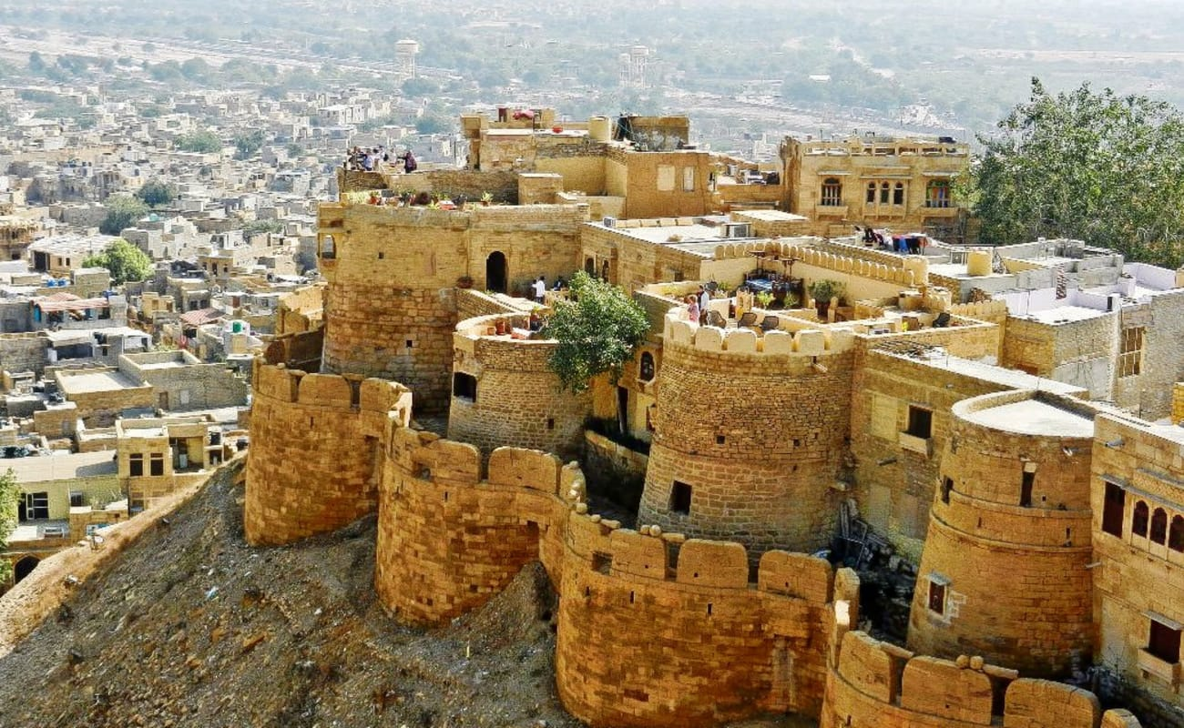
Golden Fort
Built 1156 AD
Wall-walk
Merlon
Crenel
Crenelated walls

Slide 5
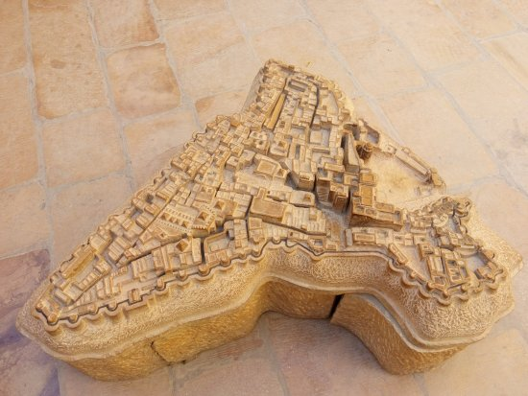
Golden Fort
Built 1156 AD

