Slide 1
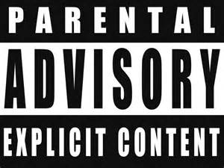
HOW LANGUAGE OFFENDS

Slide 2
Who do you think the following pejorative terms refer to?
1) crow
2) shirtlifter
3) yid –
4) harridan –
5) windowlicker –
6) hermaphrodite –
7) trollop –

Slide 3
1) crow - Black woman
2) shirtlifter – Homosexual man
3) yid – Jewish person
4) harridan – old woman
5) windowlicker – person with a disability (usually a learning difficulty)
6) hermaphrodite - intersex
7) trollop – sexually promiscuous woman

Slide 4
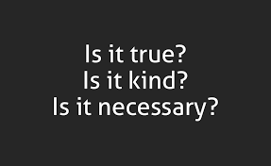
Power of language
Is a word inherently offensive, or does it depend on context?
The power of words to offend changes over time.
What does this tell us?
Some words have been reclaimed by those who they seek to offend.
2 key terms:
Linguistic determinism – language determines thought (Sapir-Whorf).
Can we have thoughts that we can’t put into words?
Linguistic relativity – language is dependent on the culture around you. e.g. Inuits have 50 words for snow. Do we think the function of swear words have changed? How do you know that you’re not being offensive?

Slide 5
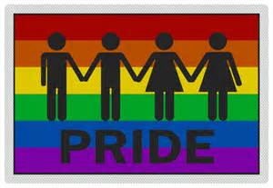
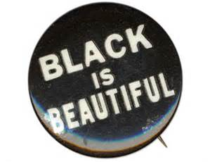
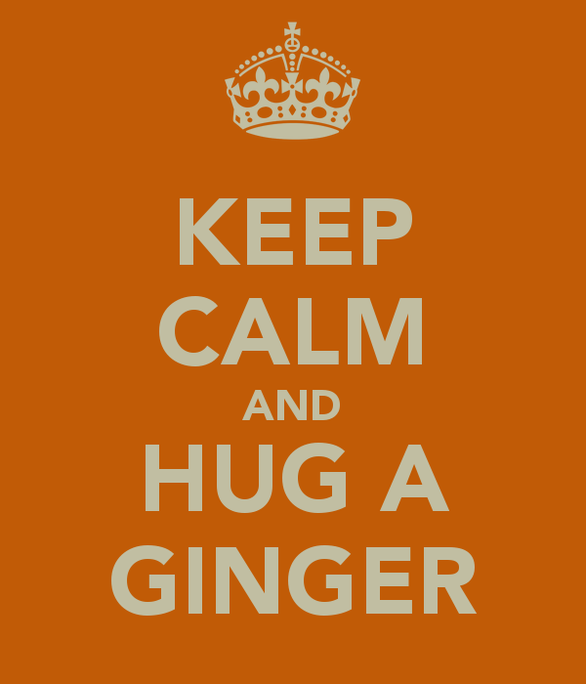

Slide 6
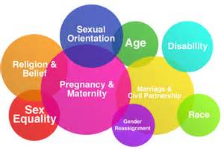
Protected characteristics: Equalities Act 2010
Do we agree with all these being protected characteristics?
Why do we need protected characteristics?
Would you want to add any more protected characteristics?

