Slide 1
Extra viewing
EDUQAS AS Level Film Studies - The Diving Bell and the Butterfly (Schnabel 2007)
Comp 2 – Section B

Slide 2
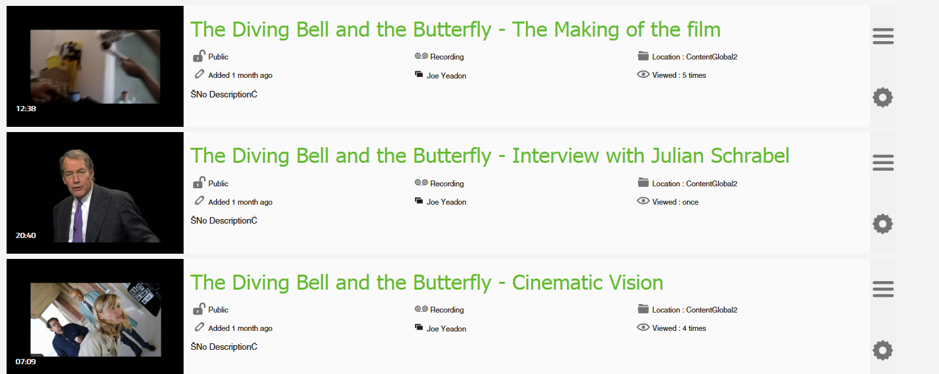
Please watch these three ‘extras’ from the DVD.

Slide 3
While watching the extras make notes on:

