Slide 1
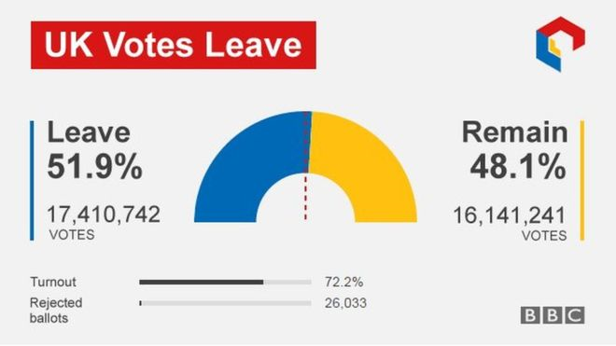
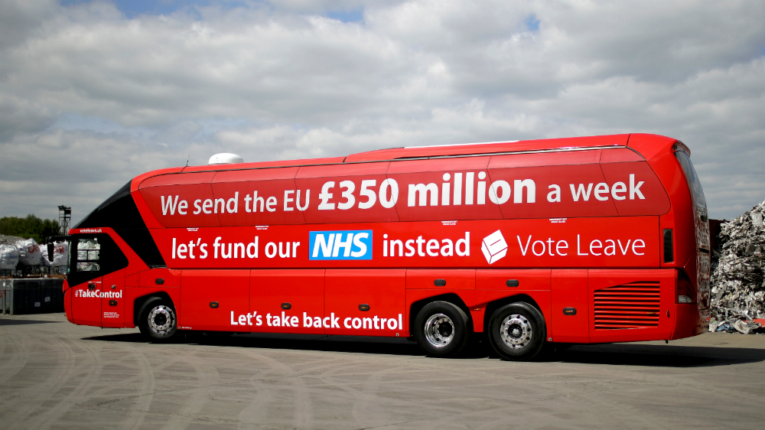
GUEST SPEAKER – 27th April
Next Friday Mark Stuart, an Assistant Professor of Politics at the University of Nottingham, is coming in to talk to the department.
He will be giving a talk from 1-2pm in the main hall on 'Explaining the Outcome of the 2016 Brexit Referendum‘.
The talk is open to all Lower and Upper Sixth students, with lower sixth students strongly advised to attend.
Mark has been researching and writing on UK politics for over 20 years and is an expert on the UK parliament. His particular interest is backbench rebellions (we used his research in Unit 2!)
There will be time devoted to Q&A, and he is happy to answer questions on UK politics as a whole, as well as studying Politics at University (which may be of interest to U6 students!)

Slide 2
Revision sessions – open to AS and A level students
Date W/B | Politics (New Specification)
 | Unit 1 | Unit 2
 | Monday 212 | Wednesday 212
16.04.18 Topic 1 | Democracy and participation | Constitution
23.04.18 Topic 2 | Political Parties | Parliament
30.05.18 Topic 3 | Electoral Systems | Executive
07.05.18 Topic 4 | (Bank Holiday) | Relationships between the branches
14.05.18 Topic 5 | Voter behaviour and the media | Exam technique (AS only)
21.05.17 Topic 6 | General Q & A | (Inset Day)

Slide 3
Using the source, evaluate the extent to which party leaders can secure victory in elections (30)

Slide 4
Describe the influence of social class on voting behaviour (10) Using the source, explain the significance of region on voting behaviour (10) Using the source, assess the extent to party leaders are the most important factor in securing victory in elections (10)

Slide 5
Recap – list all the different factors that can impact on voting behaviour
Then rank them in order of importance, in your view

Slide 6
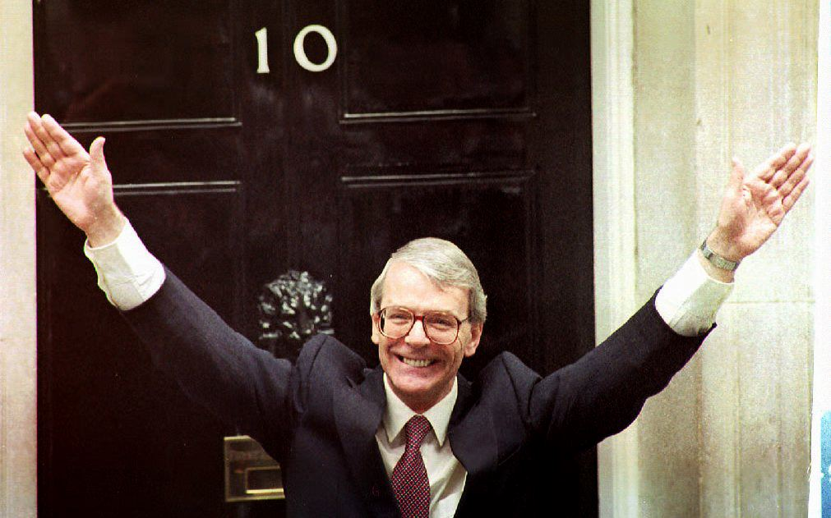
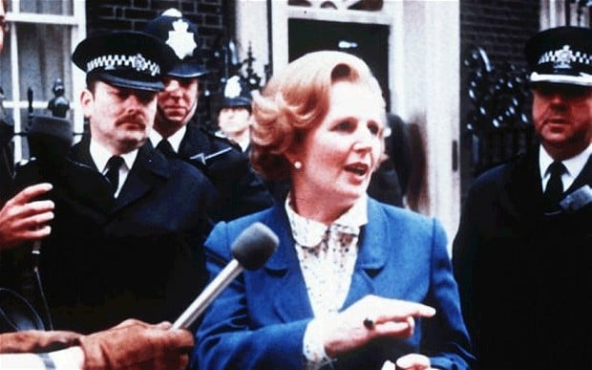
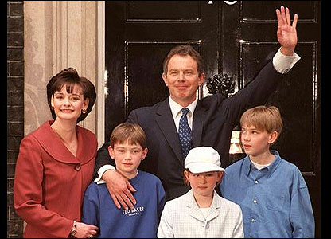
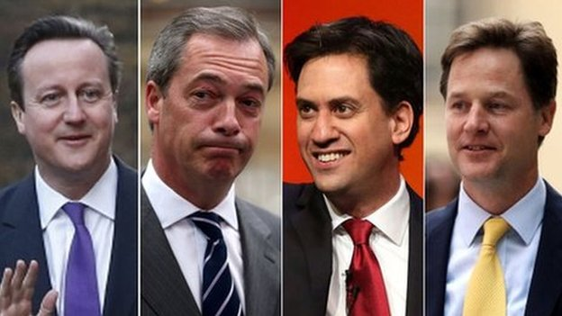
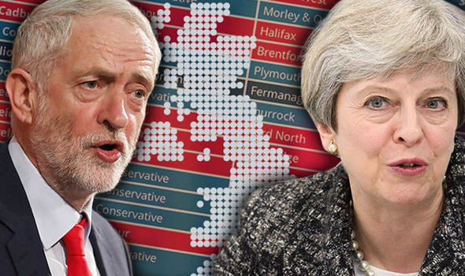
Election focus
We are going to be looking in detail at the following elections:
1979
1992
1997
2015
2017

Slide 7
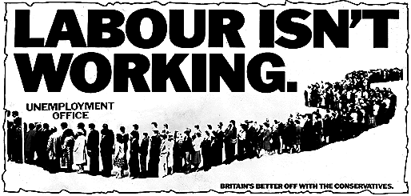
1979 election
Watch this Conservative Party Political broadcast from 1979, what do you think the main issues were in this election?

Slide 8
1979 election
Party | Seats won | Change since last election | % votes won | Change since last election
Con | 339 | +68 | 43.9 | +8.1
Lab | 269 | -50 | 36.9 | -2.3
Liberal | 11 | -2 | 13.8 | -4.5
Others | 16 | N/A | 5.4 | N/A

Slide 9
Watch

Slide 10
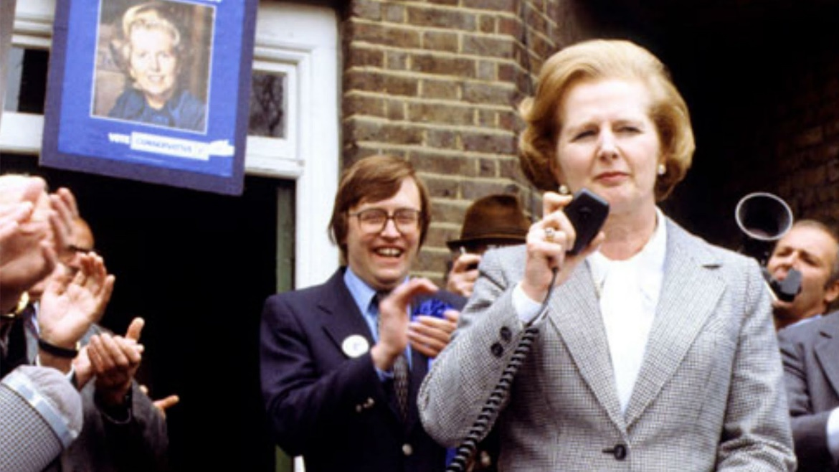
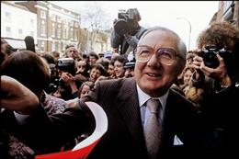
1979 election
Read the article and electoral data
Use the information within it, plus the textbook page 144, to add detail to the table on page 37

Slide 11
1979 election
Factor | Summary of how it impacted on the election
Demographic issues | Age not a factor – conservatives won support of all age groups, including 18-24 yr olds (42%) Class more important – C2 shift to Conservatives to become even in support (11% swing). DE support grew too, although still majority Labour (9% swing) However, there was an erosion of working class vote and the middle class had grown.
Valence and other issues (how competent the parties were perceived) | Economic Competence is key. Circumstances of 1970s and the Winter of Discontent. A cosy relationship had developed between Labour and Trade unions in the 1970s with union having access to no.10 (‘Beer and sandwiches’). Callaghan’s attitude – ‘Crisis, what crisis?’. Labour were perceived to be weak on union power. Conservative advert (created by Saatchi & Saatchi) ‘Labour isn’t working’ v effective at consolidating this view. Callaghan had also been against Wilson’s attempts to curb Trade Union power (‘In place of Strife’ policy). Unemployment was 1m. Conservatives were considered more economically competent with a radical solution to curb union power and introduce monetarism.
The role of party leaders | the Conservatives won in spite of, not because of, Margaret Thatcher. ‘Sunny Jim; Callaghan was more popular with the electorate, friendly and approachable. 20% ahead in polls. Thatcher was unpopular – posh and distant. Was considered shrill. Had been unpopular Minister of Education (Thatcher, the Milk Snatcher). Made efforts to improve image (lowered voice, used of Saatchi &Saatchi, good photo ops – with baby calf, in chocolate factory etc).
Turnout and its significance | 76 %. This was lower than Feb 1974 election of 78.8%. There was an absention of working class and union members
Political issues impacting on the election | Strikes by teachers and printers during campaign. Winter of discontent.
Other factors | Policies: conservatives emphasised union reform and cutting inflation. Labour emphasised commitment to full employment too. Economy not in good shape.

Slide 12
Which of the following was most important in 1979? Why?
Demographic issues
Valence and other issues (remember, this means how competent the parties were perceived)
The role of party leaders
Turnout and its significance
Political issues impacting on the election
Task: Write a brief sentence at the bottom explaining the most important factor in your view.

Slide 13
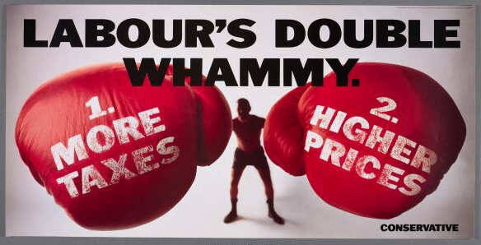
Extension/HW
Watch the short video clip of Thatcher’s 1979 campaign (link on slide 14) and take notes on how she campaigned.
Read the article and answer the questions on the 1992 election on page 38
Then complete the page in the booklet, using this information and your own research online

