Slide 1
Ancient History Greek Period Study Revision
Session 1:
The Challenge of Persia, 492-479 BC

Slide 2
Reminder of the exam essentials
The AS Paper
10 mark question (15 mins.)
20 mark ‘mini essay’ (30 mins.)
30 mark essay question (45 mins.)
1.5 hours in total
50% of the AS
The A Level Paper
20 mark interpretation question(30 mins.)
30 mark essay question (45 mins.)
1.25 hours in total
25% of the A-Level

Slide 3
Reminder of the exam essentials
The AS Paper
60 marks available in total
Overall:
15 are for your own knowledge of the period
15 are for the analysis and evaluation you include
30 are for your use and analysis of the ancient sources
The A Level Paper
50 marks available in total
Overall:
10 are for your own knowledge of the period
10 are for the analysis and evaluation you include
15 are for your use and analysis of the ancient sources
15 are for your analysis and evaluation of modern historians’ views

Slide 4
Overview of the Persian Wars
499-494 – The Ionian Revolt
492 – Mardonius’ campaign in the north of the Aegean
491 – Darius demanded ‘Earth and Water’ from the Greek states
490 – First Persian invasion under Darius
480 – Second Persian invasion under Xerxes and Mardonius
479 – Final defeat of the Persians

Slide 5
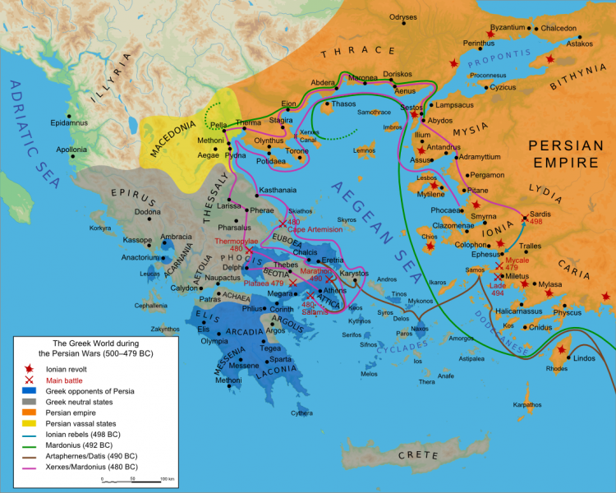

Slide 6
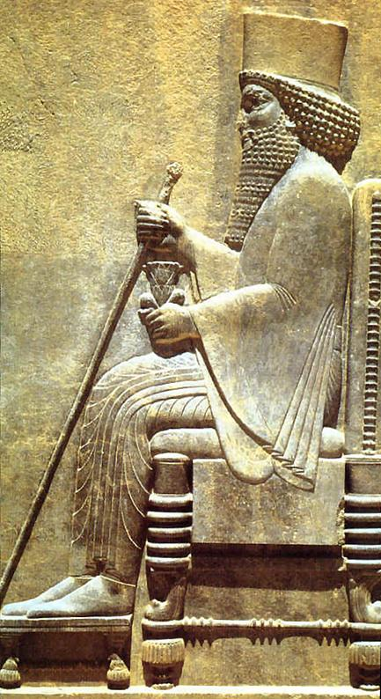
The First Persian Invasion, 490
King Darius was determined to get revenge against Athens and Eretria for the support hey had sent the Ionian rebels (this reached its worst point for the Persians with the capture of Sardis and burning of its temples)
A number of Greek states had medized by giving earth and water but Athens and Sparta had refused
Around 600 ships and 25,000 Persian troops took part in the invasion
The Persian commanders, Datis and Artaphernes captured the island of Naxos but diverted around the sacred island of Delos
The Persians attacked and captured the city of Eretria, supposedly because a number of Eretrians betrayed the city and opened the gates

Slide 7
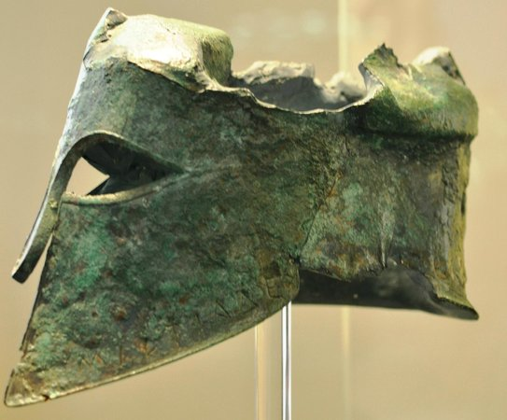
The First Persian Invasion, 490
The Persians’ next target was Athens and their strategy was to land at Marathon, defeat the Athenian army there and then sail round to take Athens unopposed
At the battle of Marathon the Athenians were outnumber 2 to 1 and took the unusual step of running to attack the enemy
The commander of Athenian forces was Miltiades
On the eve of the battle the Athenians were joined by their Plataean allies
Herodotus claims that 6,400 Persians were killed for the loss of only 192 Athenians
The victorious Athenians marched the 26.2 miles back to Athens to then defend the city against the Persian forces who had fled Marathon

Slide 8
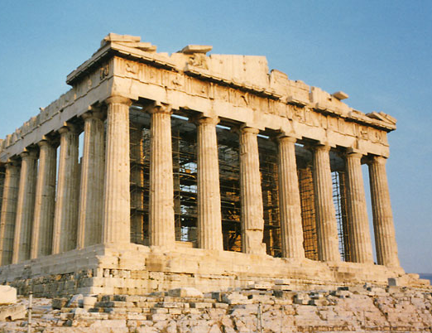
The First Persian Invasion, 490
The first Persian invasion was a humiliating defeat for Darius and Persia
Darius reacted by demanding a larger invasion but was then distracted by a rebellion in Egypt and died in 486
Marathon was an incredibly important victory for Athens – they had defeated the invading Persians on their own without Spartan help

Slide 9
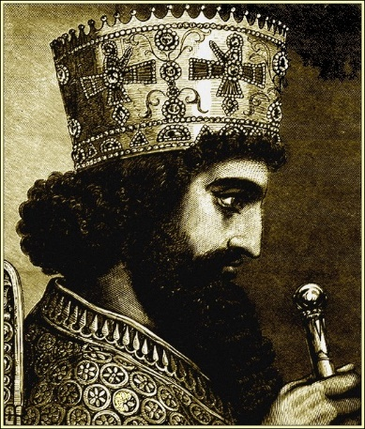
The Second Persian Invasion, 480
Darius was succeeded as king by his son Xerxes. According to Herodotus he received contrasting advice from Mardonius and his uncle Artabanus about whether to invade Greece again
To combat the much larger second invasion, a number of Greek states formed the Hellenic League in 481 to combine their resources. Sparta assumed leadership
The Persian invasion came from the north and over land. The Greeks were first pushed out of the region of Thessaly
The Hellenic League agreed to try to halt the Persian advance at Thermopylae

Slide 10
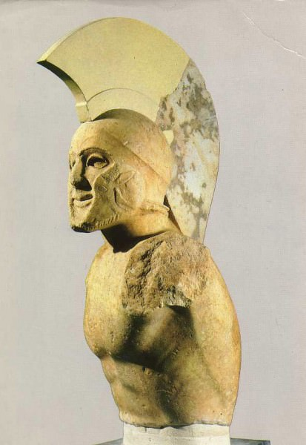
The Second Persian Invasion, 480 - Thermopylae
The Greeks were divided over where to fight the Persians. Peloponnesian cities wanted to withdraw behind the Isthmus while those in Attica and Boeotia did not
300 Spartans and between 6,000 and 7,000 Greeks fought over 3 days. A religious festival or in-fighting may have stopped Sparta sending a larger force. Xerxes may have had 80,000 soldiers
A Greek Ephialtes is meant to have told the Persians of a path to outflank the Greek forces leading to their complete defeat on the third day, including the death of Leonidas
The Spartans were joined in the final battle by the Thespians and Thebans
Following the defeat the Persians were now able to march into Boeotia and Attica

Slide 11
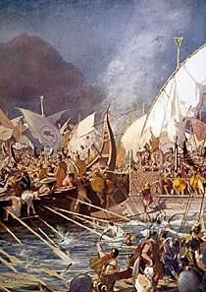
The Second Persian Invasion, 480 - Salamis
Before Salamis the Greeks and Persians had fought an indecisive battle at Artemisius
Athens was the dominant naval power (think conflict with Aegina and ‘wooden walls’ oracle). The overall commander was the Spartan Eurybiades. The Corinthian ships were led by Adeimantus
The Athenian commander Thermistocles persuaded the fleet to fight at Salamis (Athens itself had been captured by this point)
The larger Persian force was made to fight in the narrow strip of water around Salamis and was defeated
Some historians claim that this was the decisive victory of the invasion. Xerxes turned to the Greek queen Artemisia for advice
Xerxes withdrew to northern Greece and offered Athens generous terms which created panic in Sparta. Mardonius was left to lead a reduced Persian army

Slide 12
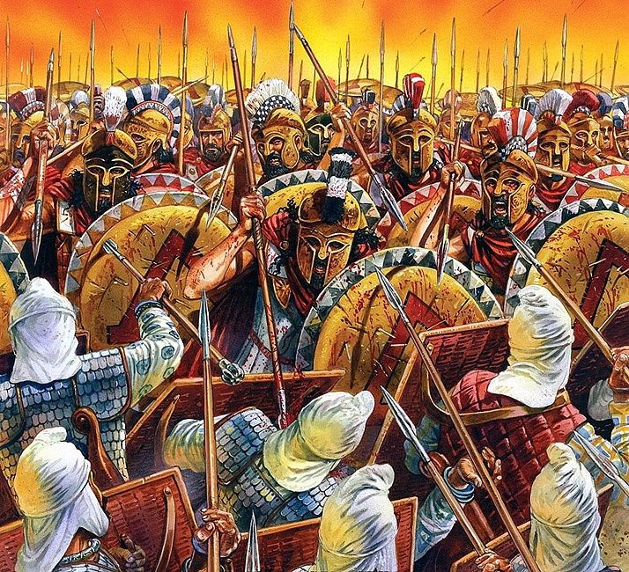
The Second Persian Invasion, 480 - Plataea
Mardonius marched back into Attica with around 30,000 men (remember that Thebes was a Persian ally)
The Hellenic League appeared divided – Athens accused Sparta of breaking a promise to send troops into Boeotia to fight the Persians and threatened to make a separate peace with Persia
Eventually Sparta did send an army under Pausanias. Lots of different Greek states were involved in the battle but even Herodotus gave credit to Sparta for the victory
Plataea was the decisive defeat of the Persian invasion on land

Slide 13
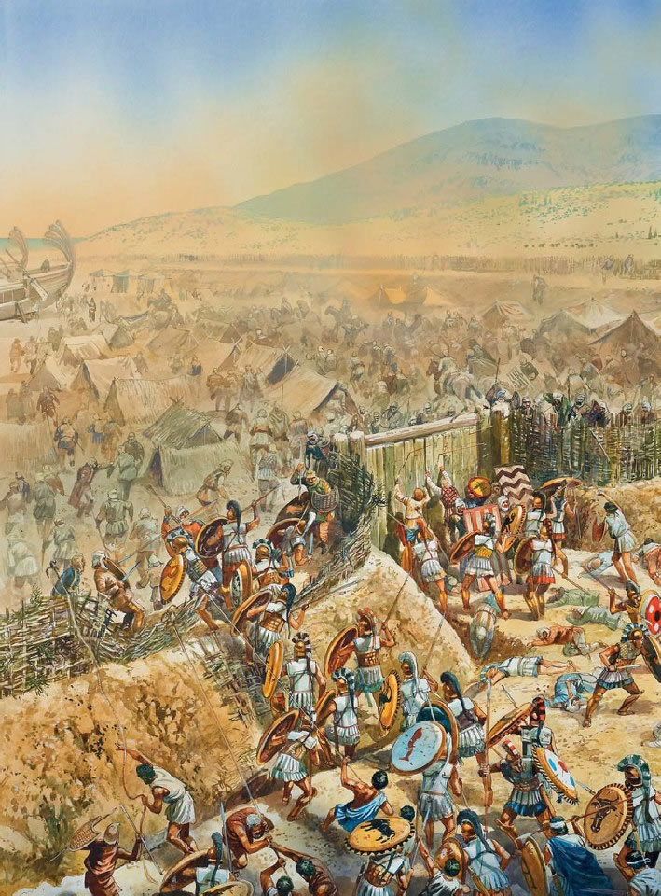
The Second Persian Invasion, 479 – Mycale
Mycale was the final battle of the Persian wars but took place in Asia Minor
The Persians had been based on the island of Samos and withdrew to Mycale, beaching their ships to build defences
The Greek forces were commanded by the Spartan King Leotychides
During the battle, the Ionian Greeks who had been fighting for the Persians switched sides leading to a comprehensive Greek victory
The most important aspect of the battle was the conference held by the Hellenic League after it. The Spartans wanted to relocate the Ionian Greeks to the mainland but the Athenians refused and said they should remain
This can be seen as the early signs of growth of an Athenian empire

Slide 14
Sources - Herodotus
Wrote an extremely detailed account of the Persian wars in his Histories written decades later (probably 440s/30s, published early 420s)
Lived in Athens in the 440s/30s
The strength of his work in terms of reliability is the detail and level of research that went into it – Herodotus used a variety of sources including oral accounts of survivors of the Persian wars
Herodotus also claimed that he was a critical historian and would not believe something just because he was told it:
“My business is to record what people say, but I am by no means bound to believe it.”
There is clear evidence of his applying this e.g. he says that he does not believe the rumour that a signal was given to the Persians at the battle of Marathon by members of the Alcmaeonidae family to sail fro Athens

Slide 15
Sources - Herodotus
There are though a number of features of Herodotus’ writing that you need to be aware of and be ready to analyse in an essay:
SPEECHES – Herodotus includes lengthy speeches that he had no way of hearing or getting an account of. These are made up by him often to portray someone in a particular way. E.g.:
Xerxes receiving advice from Artabanus and Mardonius - Herodotus uses this to portray the king as indecisive weak; Artabanus is shown as the wise uncle who is ignored
Xerxes receiving advice from Artemisa – she is portrayed as wise an decisive to again make the king look worse
MYTHS/GODS – Herodotus mixes factual accounts of events with myths and gods (this in sharp contrast to Thucydides who deliberately left this out)E.g.:
Mardonius fleet in 492 was lost near Thasos and the men eaten by sea monsters
The Athenian runner Pheidippides was confronted by the god Pan whilst running to Sparta to get help in 490

Slide 16
Sources - Herodotus
PRO-ATHENIAN – Herodotus was not Athenian but lived there for a period and was clearly sympathetic. Throughout his work he puts forward a pro-Athenian interpretation of events. E.g.:
He credits victory at Mycale exclusively to Athens despite the Greek forces being mixed and having Spartan leadership
Herodotus was also critical of other Greek states who at the time he was writing were hostile to Athens (Sparta and Corinth in particular). E.g.:
In the arguments for and against fighting at Salamis he portrays the Corinthian commander Adeimantus as a coward
Sparta are shown as reluctant to fight at Mycale and wanted instead to retreat behind the wall across the Isthmus
LEADERS – Herodotus glorifies the role of Athenian leaders E.g.
Miltiades in persuading the Athenians to fight at Marathon
Themistocles for persuading the Greeks to fight at Salamis

Slide 17
Sources - Others
Persian Inscriptions
Naqs-e Rustam – shows Darius’ desire to expand the Persian empire but also his concern for law and justice
Xerxes’ Inscriptions – found at the ‘Gate of All Lands’; challenges Herodotus’ portrayal by showing the king as humble to the highest god of the Persian religion and also a builder rather than just a fighter
Serpent Column
Built in 478 BC at Delphi to thank the god Apollo for Greek victory. The names of 31 Greek states are inscribed on the column giving a sense of the cooperation of the Hellenic League. However, Athens and Sparta are still at the top and 5 members of the League are not included showing disagreement and division

Slide 18
Final Points
Some key sources to make sure you have re-read and revised:
Herodotus:
6.94-117 (P.14-21 of the booklet) – The build up to the battle of Marathon and the battle itself
7.5010h (P.24-27) – Xerxes receiving advice from Artabanus and Mardonius
8.56-63 (p.43-45) – Themistocles persuading the Greeks to fight at Salamis
9.6-9.8 (p.49) – Tension between Athens and Sparta before the Battle of Plataea
Some overview questions to test yourself with:
Outline the ways in which relations between the Greek states shift and change during this period
Compare the view of the Persians put forward by the royal inscriptions to that of Herodotus
Why did some Greek states ‘Medise’ and why is our understanding of this limited?
Assess how reliable you find Herodotus’ account of this period

