Slide 1
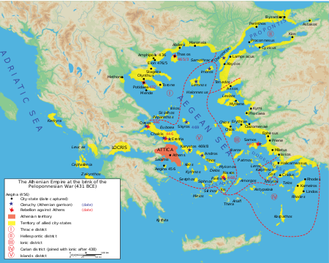
Ancient History Greek Period Study Revision
Session 2:
Greece in Conflict
479-446 BC

Slide 2
Overview of the Period
479 – Athens begins to build walls around the city
478 – Delian League formed
468 – Delian victory at the battle of Eurymedon
465 – Revolt of Thasos from the Delian League
464 – Helot Revolt in Sparta
460-446 – ‘First Peloponnesian War’
460 – Start of failed Athenian attempt to take control of Egypt
460 – Megara joins the Delian League
457 – Battle of Tanagra
454 – Delian treasury moved to Athens
449 – Supposed Peace of Callias
446 – Spartan invasion of Attica

Slide 3
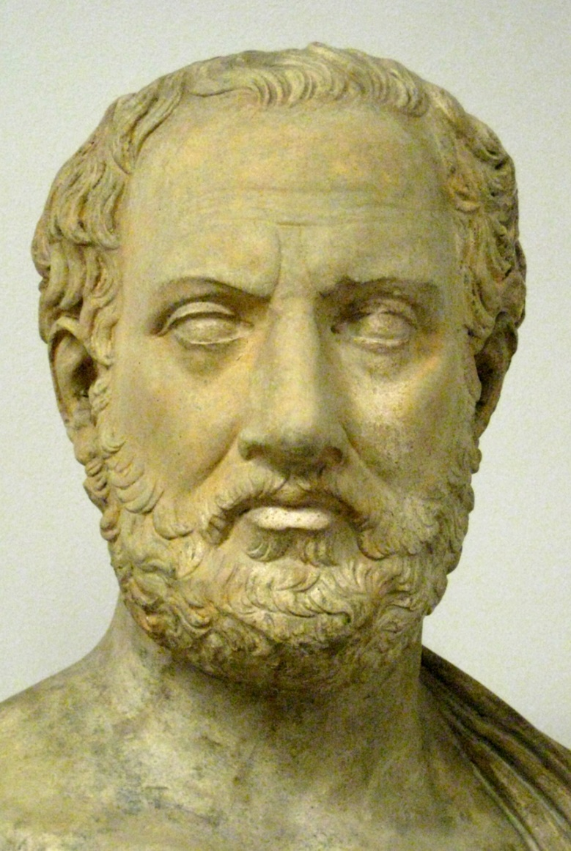
Sources - Thucydides
Wrote History of the Peloponnesian War
Focused on relations between Athens and Sparta in the build-up to conflict in 431 and then the conflict itself
Was a general during the Archidamian War – failed to stop Brasidas from capturing Amphipolis in 424
Claim to write a dispassionate account and certainly less pro-Athenian than Herodotus
Writing during a movement in Athens known as rationalism that sought ‘scientific’ explanations for things rather than myths and the gods
The Pentecontaetia covers the period 479-431 but lacks detail on in places on this wide period
Thucydides also neglected the importance of Persia in his work
Work ends in 411

Slide 4
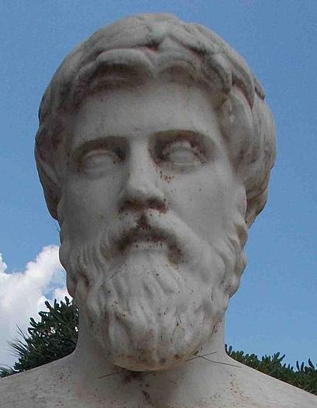
Sources – Plutarch
Wrote Parallel Lives which compared famous Greeks and Romans. This included the Lives of Aristeides, Cimon and Pericles
Born in Greece, writing during the Roman empire approx. AD 50-120
Style of his work was biographical – he states that it is not his aim to critically weigh up and analyse evidence
Very distant from the events he was describing but based his work a wide range of sources some of which were very early and have been lost
At times he compares earlier sources to reach judgements about which is most reliable. At others his is accepting of what they say

Slide 5
Plutarch – some key sources
Aristeides 23 (p.9):
Praises Aristeides and Cimon as ‘fair’ and ‘noble’, whilst criticising the Spartan commander Pausanias as ‘harsh’
Explains that Greek willingly sought Athenian leadership
Cimon 11-12.4 (p.12):
Praises Cimon’s leadership of the Delian League as he pushed back Persia: “No one did more to humble the great King and abase his pride than Kimon”
Pericles 23.1-2 (p.28):
Suggests that Pericles paid off the Spartans in 446 BC (invaded Attica under King Pleistoanax) by paying 10 talents year and “in this way deferred the war”
Shows that Greeks used other means than conflict to resolve differences but also suggests conflict was inevitable as Pericles was “not purchasing peace but time during which he could make preparations quietly and ensure that the Athenians fought better.”

Slide 6
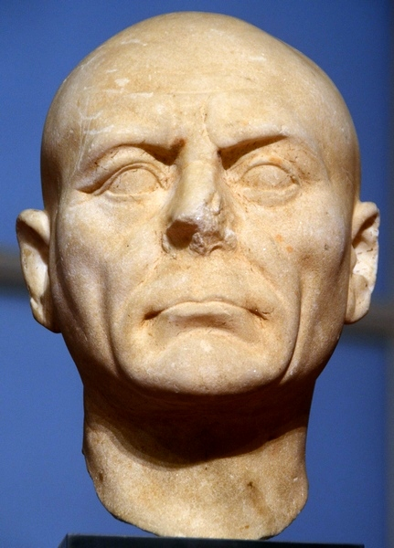
Sources – Diodorus
Wrote Universal History which was an attempt to write a history of the known world up to 60 BC
Writing in the first-century BC. From Sicily, known as the ‘Sicilian’
Based his work on the Greek writer Ephorus (405-330) who was much closer to the events of the Peloponnesian Wars but was trained in the school of rhetoric which tried to make events as dramatic and exciting as possible
Very few of his other sources survive meaning that historians debate the reliability of Diodorus’ account

Slide 7
Diodorus – some key sources
11.46-47 (p.11):
Praises Aristeides for setting the tribute fairly for members of the Delian League
Says that the Greek states in the Aegean “enthusiastically submitted” to Aristeides and Athens (important when assessing whether Athens built an empire or not)
12.2.1-2 (p.22):
Praises the growth of Athenian power after 479 saying that they had “so humbled the famous Persian hegemony as to compel them to make an agreement to free all the cities of Asia.”
This is evidence for the Peace of Callias in 449 (Diodorus gives the terms of the peace on p.22-3
12.2.1-2 (p.22):
Praises the growth of Athenian power after 479 saying that they had “so humbled the famous Persian hegemony as to compel them to make an agreement to free all the cities of Asia.”
This is evidence for the Peace of Callias in 449

Slide 8
Sources - Others
Harpokration, s.v. Attikois grammasin
Harpokration wrote about the work of an earlier historian Theopompus. Harpokration argued that the supposed Peace of Callias between the Delian League and Persia in 449 was a forgery from Theopompus, who was writing when Athenian power in the 4th century BC was considerable reduced and wanted to exaggerate the height of its power in the 5th century
Aristotle Politics
A 4th century philosopher in Athens. Commented that the Athens’ treatment of its allies was very harsh and in particular of Chios, Samos and Lesbos who by 450 were the only members of the league still providing ships - Very good evidence to show that by 446 Athens was running the Delian League as an empire
Chalkis Decree
446/5 – a decree passed by the Athenian assembly imposing terms on the city of Chalkis on the island of Euboea. The Chalkidians had to swear not revolt against Athens and important legal cases were transferred from Chalkis to Athens. Very good evidence to show that by 446 Athens was running the Delian League as an empire

Slide 9
‘Relations between Athens and Sparta were doomed from the moment that the Persians were defeated in 479’

Slide 10
Assess the level of threat the Persians presented to the Greeks between 478 and 449 BC

Slide 11
Final Points
Some overview questions to test yourself with:
Was conflict between Athens and Sparta inevitable after the Persian Wars?
How important was the role played by Greek States other than Athens and Sparta in the development of relations between 479 and 446 BC?
Assess the level of threat the Persians presented to the Greeks between 478 and 449 BC
Compare the strengths and weaknesses of the sources for this period
Example exam questions (AS & A-Level)
‘Relations between Athens and Sparta were doomed from the moment that the Persians were defeated in 479’
How far do you agree with this view? You must use and analyse the ancient sources you have studied as well as your own knowledge to support your answer. [30]

Slide 12
Final Points
Example exam questions (AS)
On the basis of these passages, and the other sources you have studied, to what extent did the Athenians intend to turn the Delian League into an empire from which they would benefit the most? [20]
After that Naxos left the League and the Athenians made war on the place. After a siege Naxos was forced back to allegiance. This was the first case when the original constitution of the League was broken and an allied city lost its independence, and the process was continued in the cases of the other allies as various circumstances arose. The chief reasons for these revolts were failures to produce the right amount of tribute or the right number of ships, and sometimes a refusal to produce any ships at all.
Thucydides 1.98-9
After that Naxos left the League and the Athenians made war on the place. After a siege Naxos was forced back to allegiance. This was the first case when the original constitution of the League was broken and an allied city lost its independence, and the process was continued in the cases of the other allies as various circumstances arose. The chief reasons for these revolts were failures to produce the right amount of tribute or the right number of ships, and sometimes a refusal to produce any ships at all.
Thucydides 1.98-9
The Chalcideans are to swear an oath on the following terms: ‘I will not revolt from the people of Athens by any means or device whatsoever, neither in word nor in deed, nor will I obey anyone who does revolt, and if anyone revolts I will denounce him to the Athenians, and I will pay to the Athenians whatever tribute I persuade them to agree, and I will be the best and fairest ally I am able to be and will help and defend the Athenian people, in the event of anyone wronging the Athenian people, and I will obey the Athenian people.’
The Chalkis Decree

