Slide 1
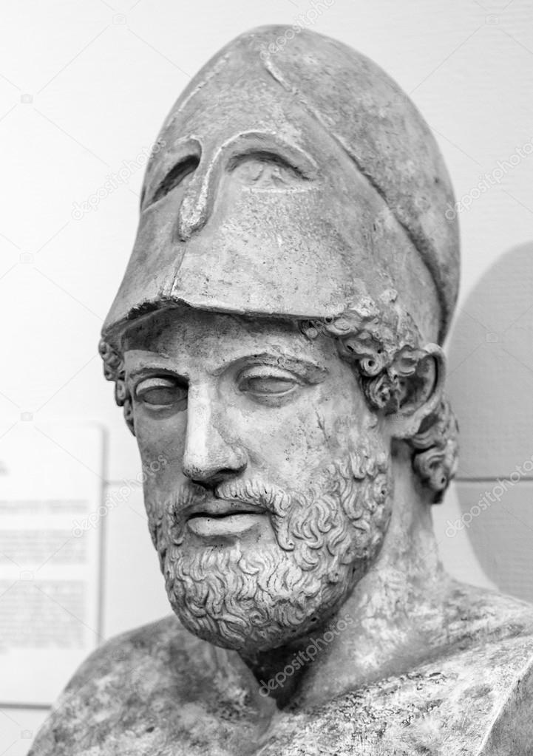
Ancient History Greek Period Study Revision
Session 3:
Peace and Conflict
446-431 BC

Slide 2
Overview of the Period
446 – Thirty Years Peace
440 – Conflict between Samos and Miletus
435 – conflict between Epidamnus and Corcyra
433 – Athens sends support to Corcyra resulting in conflict with Corinth
432 – Potidaea revolts against Athens
432 – Athens imposes economic sanctions on Megara
432 – Meeting of the Peloponnesian League to complain about Athens
431 – Outbreak of the Peloponnesian war

Slide 3
The Thirty Years Peace
All of the evidence we have for this comes from Thucydides – it is very easy to remember therefore but keep referring to him in your answers
The peace treaty was to last for 30 years (1.115)
Athens had to give up territory it had recently gained – Nisaea and Pegae (the harbours belonging to Megara), and Troezen and Achaea in the Peloponnese (1.115)
Each side was to keep the allies it had when the treaty was finished (1.140)
If any ally revolted and joined the other alliance then this would break the treaty (1.35)
The treaty included a set list of allies on each side (1.40)
Any neutral state could ally itself with either alliance (1.35 & 1.40)
Argos was excluded from the peace treaty but was allowed to be at peace with Athens (it had already agreed a peace with Sparta separately) (5.14)
If one side wanted to resolve an issue through arbitration then it could not be attacked by the other (1.40 & 5.14)
There may have been a term relating specifically to Aegina (1.67)

Slide 4
The Thirty Years Peace
All of the evidence we have for this comes from Thucydides – it is very easy to remember therefore but keep referring to him in your answers
The peace treaty was well thought out and covered a wide range of issues that were causing tension between Athens and the Peloponnesian League
The aim was to mark out clear Athenian and Spartan ‘spheres of interest’ to prevent the two stumbling into conflict
Athens gained recognition of its control of the Delian League whilst Sparta gained land that had previously been lost
However the peace was over-ambitious and was unlikely to last for 30 years
It did nothing to end resentment of smaller members within each league
It depended on the two sides agreeing to arbitration to settle differences.

Slide 5
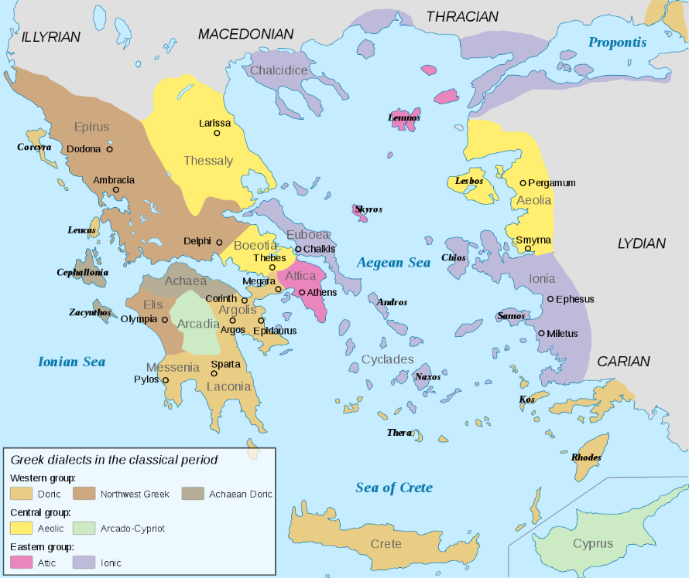
Samos and Miletus
This was not a complaint raised by the Peloponnesians but did increase tension between the two leagues and can be seen as a cause of war
Both were members of the Delian League but went to war with each other in 440 BC. Miletus appealed to Athens for help who did so by imposing democracy on Samos having overthrown its leaders
Samos appealed to the local Persian satrap for help and together they pushed back Athens
Athens responded with a nine-month campaign and defeated Samos – forcing them to hand over their navy and to pay tribute to Athens
The conflict showed the hostility to Athens in the Delian League and that Athens would use force to control it. Most significantly, Thucydides tells us that Sparta was ready to invade Attica during the conflict but was prevented from doing so by Corinth.

Slide 6
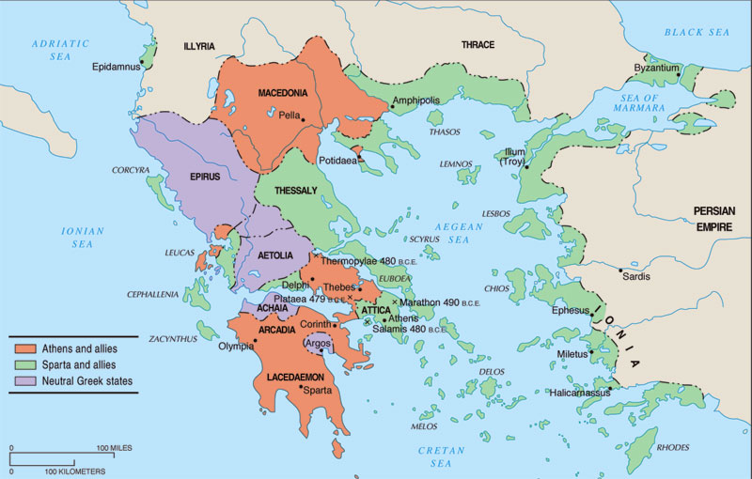
Complaint 1: Epidamnus and Corcyra
Epidamnus was a colony of Corcyra. Corcyra was a former colony of Corinth.
Conflict between Epidamnus and Corcyra in 435 led Corinth to intervene against Corcyra who they believed did not show them enough respect
In 433, after defeating Corinthians at the battle of leucimme, Corcyra appealed to Athens for help
Corcyra was an attractive ally for Athens as it had a powerful navy of 120 ships. After discussing whether to intervene Athens sent military forces to Corcyra
This complaint increased tension between Athens and Corinth enormously. Thucydides (p.12/13) tells us that Corinth argued Athens was breaking the terms of the Thirty Years Peace.
He also describes how Corinth claimed to have had done Athens two ‘good turns’ (Samos and Aegina) and therefore expected Athens not to interfere in its ‘sphere of interest’
Good evidence of conflict being caused by Athenian-Corinthian tension or by Athens expanding its power

Slide 7
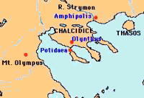
Complaint 2: Potidaea
Potidaea had an awkward status – it was a ‘subject state’ of Athens but was also a Corinthian colony. Corinth still sent magistrates to administer the city
The Athenians feared revolt in Potidaea and that this might spread to other friendly states in the north of the Aegean and Thrace
Athens made demands on Potidaea whilst the Spartans threatened to invade Attica if they attacked Potidaea but were too divided to act
In 432 Athens sent a force of 2,000 hoplites and began a three-year siege of Potidaea in 432 BC. Corinth also sent a force to defend Potidaea
Further evidence of tension between Athens and Corinth (not necessarily the two Leagues). Also shows that Sparta was again ready to invade Attica but was prevented by internal divisions. This suggests that Sparta had no intention of sticking to the peace of 446 BC
Thucydides (p.17) is relatively neutral and claims that “Both the Athenians and the Peloponnesians had already grounds of complaint against each other.”

Slide 8
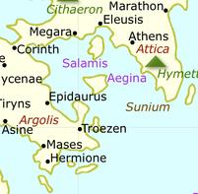
Complaint 3: Megara
Thucydides gives very little detail on how Megara was a complaint that contributed to the outbreak of war in 431 BC
The issue revolves around the Megarian Decree – a law that banned Megarians from trading in Athenian ports or those of members of the Delian League around 432 BC. It had a number of possible motives:
Megara had sent eight ships to support the Corinthians against the Athenians at the battle of Leucimme and decree may have been designed to deter other states from helping Athens’ enemies
A theory passed on by Plutarch was that the Megarians had profaned a religious land and then killed an envoy who was sent to complain about this. Killing an envoy was a serious religious offence
Pericles may have created the decree to distract Athenian attention away from the trial of his friend Pheidias for embezzlement
Some blamed Pericles’ mistress Aspasia for passing the decree
Thucydides (p.18) claims that the Spartans viewed the Megarian Decree as “the chief point” and that “war could be avoided if Athens would revoke the Megarian decree”.
Can be used as evidence that Athens wanted war and triggered it with the Megarian Decree, or that Sparta wanted war and exaggerated the impact of the decree to justify it

Slide 9
Complaint 5: The Ambracian Gulf
Complaint 4: Aegina
Thucydides portrays this as a minor cause of conflict
Aegina claimed that in a treaty with Athens they had been guaranteed more independence which Athens was now denying them
Corinth complained that Athens was interfering in their sphere of influence in the Ambracian Gulf
Claimed that Athens supported the Amphilochians and Acarnanians against Corinth’s ally the Ambracians

Slide 10
The Outbreak of War in 431
First the Peloponnesian League met (432) to discuss the complaints against Athens. This is when the ‘Corinthian Complaint’ was raised
Athens responded to this by defending its power and empire
Sparta debated going to war - the debate was between King Archidamus II and the ephor Sthenelaidas. Sparta voted in favour of war
The Peloponnesian League met again and after hearing more arguments from Corinth, voted to go to war
Sparta sent Athens an ultimatum asking them to give up their empire
Pericles advised the Athenian Assembly to reject the ultimatum which they did
WAR

Slide 11
Thucydides – some key sources
Corinthian Complaint (p.21-22):
Blamed Sparta for the growth of Athenian power claiming that they had neglected their leadership of the Peloponnesian League
Evidence that Sparta was being controlled by its enemies
Athenian Response to the Corinthian Complaint (p.23-24):
Defence of Athenian power and empire claiming that “we have done nothing extraordinary”
Said that they could not give up their empire due to “Security, honour and self-interest”
Potential evidence that growth of Athenian power was not the cause of war
King Archidamus vs. Sthenelaidas(26-27):
Evidence of internal divisions in Sparta about whether to go to war or not
Pericles advice to the Athenian Assembly ):
Argued against any concessions and claimed “Sparta was plotting against us”
Evidence of Pericles’ leadership and role in starting the war

Slide 12
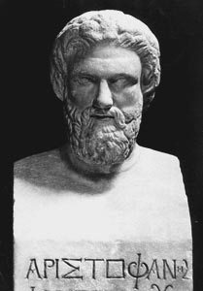
Sources – Aristophanes
An Athenian play-write from around 427 BC to the end of the Peloponnesian War
His style was satirical comedy but he also include slapstick and physical comedy
His purpose was to entertain so he naturally exaggerates for comic effect
However, his satire of contemporary politics and leaders was based on truth (otherwise it wouldn’t be funny)
He also gives us a sense of the mood in Athens during the war which none of the other sources do

Slide 13
Aristophanes – some key sources
Acharnians (p.18):
Suggests that the Megarian Decree was created to punish the city for the supposed abduction of two of Aspasia’s (Pericles’ mistress) prostitutes
This is designed to be ludicrous to be funny but does suggest that there were self-motivated reasons for the decree and that it may not have been designed to deliberately provoke war

Slide 14
Plutarch – some key sources
Pericles, 28.1-3 (p.11):
Gives details on the surrender of Samos to Pericles and the punishments he imposed.
Recounts the story that Pericles executed the captains of the Samian triremes but says that he does not believe it as the historian who told the story was from Samos and was therefore hostile to Athens
Very good example of how Plutarch weighs and assesses evidence
Pericles, 30-31 (separate handout, on GOL if you have lost it):
Explains the different possible motives for the Megarian decree
States that Pericles had a personal grudge against Megara that he wanted to settle
“It is not easy to discover what the original reason was for the proposal being accepted but everyone blames Pericles for the fact that it was not overturned”

Slide 15
How far was Spartan inaction and conservatism responsible for the outbreak of war in 431?

Slide 16
Assess how influential the Corinthians were in Spartan foreign affairs

Slide 17
Final Points
Some overview questions to test yourself with:
Analyse the extent to which any party had just cause for war
Consider whey the 30 Year Peace did not last
Assess how influential the Corinthians were in Spartan foreign affairs
Make an appraisal of Pericles’ responsibility for the outbreak of the Peloponnesian War

