Slide 1
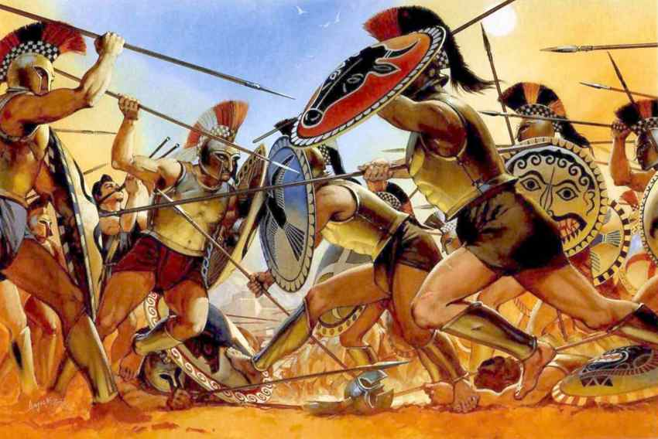
Ancient History Greek Period Study Revision
Session 4:
The Archidamian War
431-420 BC

Slide 2
Overview of the Period
431 – Thebes launched a surprise attack on Plataea
431 – First Spartan invasion of Attica (these continued in 430, 428, 427 and 425)
430 – Plague in Athens
429 – Death of Pericles
429 – Athenian naval victory at the Battle of Naupactus
428 – Revolt of Mytilene against Athens
427 – Spartans captured the city of Plataea
426 – Cleonymous Decree
425 – Thoudippos Decree
425 - Athenian victory at Pylos and Sphacteria
424 – Brasidas captured Athenian allies in region of Thrace e.g. Amphipolis
424 – Athens was defeated at the Battle of Delium by the Boeotian League
423 – Armistice signed between Athens and Sparta
422 – Athenian forces under Cleon defeated at the Battle of Amphipolis
421 – Peace of Nicias agreed

Slide 3
Spartan Strategy
Archidamus II led the first invasion of Attica in 431
He followed a traditional strategy which aimed to destroy Athenian agriculture, lure the Athenians out into open battle and defeat them
Invasions were short (longest was 40 days) and were repeated in 431, 430, 428, 427 and 425
Sparta was also hoping to exploit anti-Athenian feeling. Thucydides sais that: “People’s feeling were generally very much on the side of the Spartans”
Spartan strategy failed to appreciate, however, that Athenian naval power would allow the city to withstand these invasions. Spartan strategy and leadership at this point was too traditional.
Thucydides 5.14
“The Spartans on their side had found that the war had gone very differently from what they imagined when they believed that they could destroy the power of Athens in a few years simply by laying waste to her land.”

Slide 4
Athenian Strategy
Pericles designed Athens’ strategy going in to the war. It would be a defensive strategy that made use of Athens’ walls and the Long Walls (finished 457) that connected the city to Piraeus.
Athens would use their navy to launch raids on Sparta and her allies but would essentially outlast Sparta by withstanding their invasions.
Thucydides 2.65 (p.9)
Pericles had three rules to lead to victory: 1. Be patient and take care of the navy; 2. Avoid adding to the empire during the conflict; 3. Do nothing to risk the city of Athens itself
Very good evidence of Pericles’ importance to Athenian strategy and of Thucydides’ pro-Pericles views e.g. he says that Pericles could lead because of “his intelligence, and his known integrity”, and that “power was really in the hands of the first citizen”.
Thucydides 2.13 (p.10-11)
Records speech from Pericles outlining the reasons why Athens would win the war – Hoplites, triremes, fortifications, tribute from allies, wealth

Slide 5
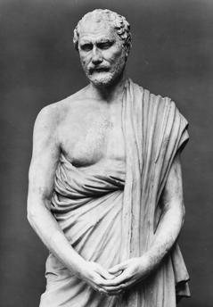
Athens during the War
The plague in 430-29 and again in 426 devastated the city with an estimated mortality rate of 30%
Thucydides says that “the plague which did more harm and destroyed more life than almost any other single factor”
The highest profile death was Pericles. With the loss of the ‘first citizen’ no clear leader emerged to replace him and a group figures competed for power
One of these was Demosthenes who wanted to follow a more aggressive policy in the war
The Athenians following the revolt of the city of Mytilene in 428 also took much tighter control of their empire, passing the Cleonomous and Thoudippos decrees

Slide 6
Pylos and Sphacteria
Tactic of epiteichismos
Spartan forces were cut off at which point Sparta offered Athens an immediate peace treaty “As for Sparta and Athens, if ever there was a good time for making peace it is now, before some irredeemable event overtakes us.”
Thucydides tells us that Cleon advised the Athenian assembly to demand more from the Spartans in return for peace which Sparta rejected. Cleon then boasted he could defeat the Spartan forces on Pylos and Sphacteria in 20 days
The Spartans surrendered – “The event caused much more surprise among the Hellenes than anything else that happened in the war”
Hugely significant as it showed their was division in Sparta over the war and now gave Athens a group of Spartiate prisoners in Athens halting further annual invasions of Attica.
Thucydides 2.65 (p.9)
Thucydides is naturally hostile to Cleon as he viewed all successors to Pericles as inferior and more specifically disliked Cleon’s humble origins. He accused Cleon of being a demagogue who whipped up popular support. Thucydides is also unfavourable to democracy in general so his portrayal of Cleon may not be reliable

Slide 7
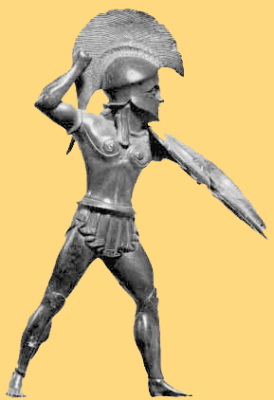
Brasidas and Thrace
Defeat in Pylos and Sphacteria forced Sparta to change the way they fought the war
Brasidas led a force of mercenaries and freed helots (known as neodamedeis) to attack Athenian territory in Thrace and cut off their timber supplies
Thucydides claims that Athens’ allies were eager to give their support to Brasidas – they “vied with each other in being the first to revolt”. (p.24)
In 424 Brasidas captured the important city of Amphipolis
When Cleon arrived in 422 to retake the city the Sprtans achieved a decisive victory but both Brasidas and Cleon were killed
Thucydides 4.80-4.81 (p.23
Thucydides is very favourable to Brasidas: “the chief factor in creating a pro-Spartan feeling among the allies of Athens was the gallantry of Brasidas and the wisdom he showed.” – Why?

Slide 8
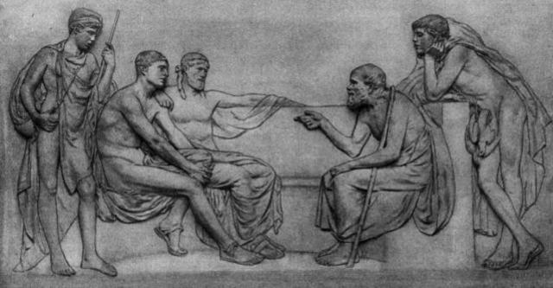
The Peace of Nicias, 421 BC
With the death of Cleon and Brasidas, the two main supporters of war, the way was open for peace.
Athens had suffered defeats at Delium and Amphipolis and the new aggressive strategy in the war did not appear to be working
Sparta still needed to get its prisoners back and the return of Pleistoanax to the throne brought a moderate view to Sparta’s leadership
Sparta’s truce with Argos was also due to expire meaning that Sparta could face fighting on two fronts
Thucydides 5.13-17 (p.26-27)
Argues that both sides were ready for peace in 422-1 and that this was due in part to the death of Brasidas and Cleon – “the two people who on each side had been most opposed to peace”

Slide 9
The Peace of Nicias, 421 BC
Everyone had the right to go to ‘pan-Hellenic’ temples
The treaty was to last for 50 years
Neither Athens and its allies nor Sparta and its allies were to attack each other
Sparta was to give back the cities it had taken in the north of Aegean (Thrace region)
Sparta would give up Panactum – a key fort on the border between Attica and Boeotia
Athens would give back Cytheria and other islands off the Peloponnese
Athens would return the prisoners taken on Sphacteria
The allies would swear to the agreement
Athens and Sparta could adjust the terms of the peace if they both agreed

Slide 10
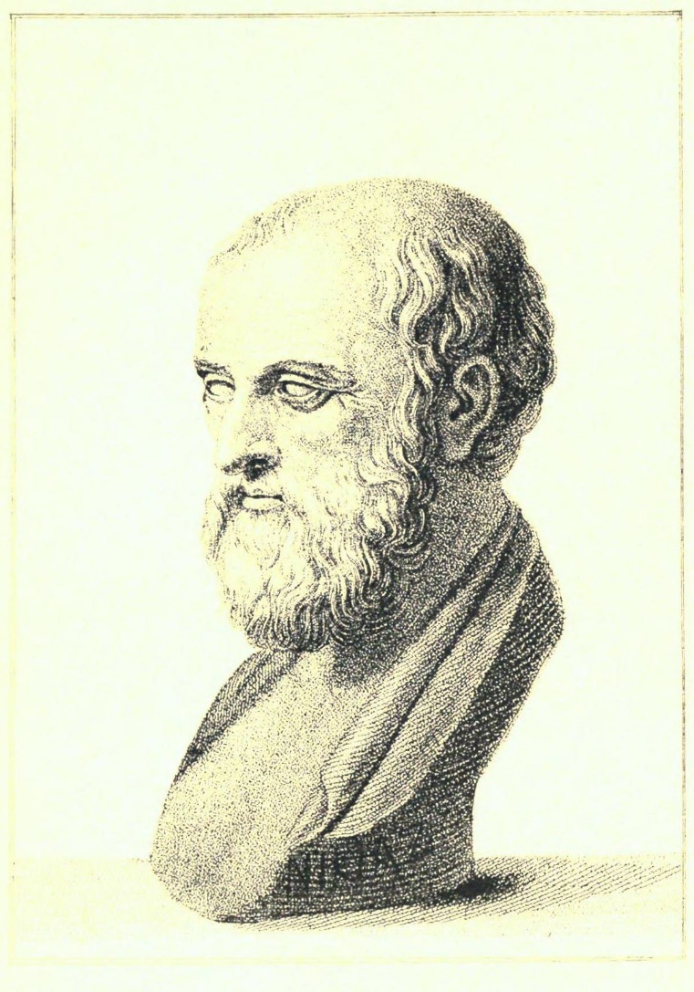
The Peace of Nicias, 421 BC
This was a very flawed peace treaty and is best seen as a ceasefire rather than a lasting peace treaty
The inhabitants of towns taken by Sparta did not want to return to Athenian control and the Spartan commanders would refuse to hand them over
Argos was not included and quickly ended its truce with Sparta
Sparta’s allies felt particularly disappointed as they had not been consulted or gained any solutions to the ‘complaints’ they had raised
These allies refused to agree to the treaty forcing Athens and Sparta to agree a separate treaty.
Thucydides 5.25 (p.30)
“The truce was never properly in force, and each side did the other a great deal of harm” – Suggests that the treaty had little chance of working

Slide 11
Aristophanes – some key sources
Peace (p.23):
Shows that many Greek states under Athenian control were ripe for revolt
The play was performed in 421 BC and demonstrates that many in Athens wanted peace – shows division at home over continuing the war
Peace (p.25):
Highlight critical of Cleon claiming that he attacked opponents by calling them “Brasidean sympathisers” whilst ignoring that “Greece was on its way to desolation”
Like Thucydides, Aristophanes disliked Cleon’s humble roots: “And the man who did all of this was the tanner.” His portrayal of Cleon will therefore potentially be exaggerated

Slide 12
‘Leadership was lacking at both Athens and Sparta during the Archidamian War’ How far do you agree with this view?

Slide 13
'Treaties stood no hope of succeeding in keeping the peace in the fifth century'. How far do you agree with this view? To what extent did the outcome of conflicts during this period depend on the strengths and weaknesses of the leaders of each side?

Slide 14
Final Points
Some overview questions to test yourself with:
Explain why the events at Pylos and Sphacteria were a turning point in the Archidamian War
Assess why the Archidamian war was inconclusive
Outline how Athens’ relations with its allies changed during the Archidamian War
Analyse the extent to which the Spartans did not deserve to win the Archidamian War.

