Slide 1
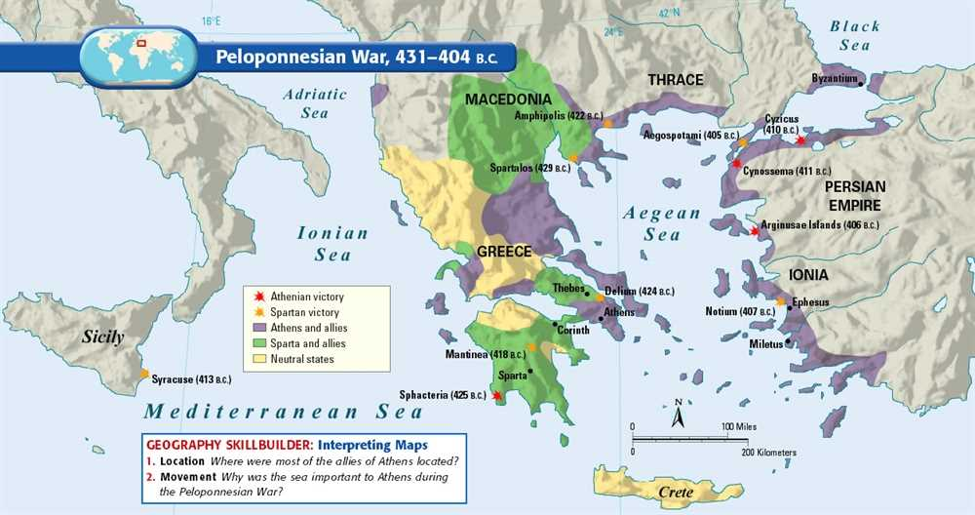
Ancient History Greek Period Study Revision
Session 5:
The Final Years of the Peloponnesian War and its aftermath
420-404 BC

Slide 2
Overview of the Period
419 – Four-way alliance between Athens, Argos, Mantiea and Elis
418 – Spartan victory at the Battle of Mantinea
415-413 – Sicilian Expedition
414 – Spartan occupation of Decelea
413-404 – The Ionian War
413 – Spartan alliance with the Persian Satrap Tissaphernes
411 – Oligarchic Coup in Athens
411 – Spartan alliance with the Persian Satrap Pharnabazus
410 – The ‘Council of 400’ in Athens was removed and replaced with the ‘Council of 5,000’
407 – Darius II announced that Persia would officially support Sparta
405 – Athenian defeat at Aegospotami
404 – Athens starved into final surrender

Slide 3
The breakdown of the Peace of Nicias
The Peace Treaty was opposed by several groups in Athens, Sparta and in their allies
Alcibiades looked to build a new offensive alliance to take the war to Sparta
in 419 he arranged a four-way alliance with Argos, Mantinea and Elis
This was extremely significant as it suggested that Sparta was losing control of its Peloponnesian allies – e.g. Corinth secretly turned to Argos to take leadership of the Peloponnesian League
Under their King Agis, Sparta defeated this alliance at the Battle of Mantiea in 418
Argos became an oligarchy and agreed a new truce with Sparta, Elis and Mantinea resumed their positions under Spartan leadership
Technically the Peace of Nicias was still in force but was already being openly challenged

Slide 4
The breakdown of the Peace of Nicias
Thucydides, 5.43
“The leader of this group was Alcibiades, the son of Clinias, a man who was still young in years (or would have been thought so in any other city in Hellas), but who had reached a position of importance owing to the respect in which his family was held. He was genuinely convinced that the best thing for Athens was an alliance with Argos – though it is true also that considerations of his own dignity affected his opposition to the peace with Sparta.”
Thucydides presents Alcibiades as a young and reckless figure but one who was very capable leader and general (important for any leadership question)

Slide 5
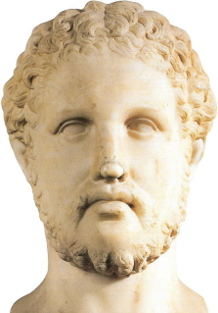
The Sicilian Expedition 415-413 BC
The city-state of Syracuse was a large and prosperous ally of Sparta and Athens feared that it might lend its support to Sparta in the Peloponnesian war
Victory in Sicily also offered huge wealth to Athens and the chance to expand their empire across the Mediterranean. For Alcibiades, it was chance to gain political power by leading the calls for an expedition
The official reason for the expedition was in response to a call for help from the Sicilian city and Athenian ally Egesta. The Egestans exaggerated the amount of money they could contribute to the expedition
Nicias argued against the expedition but the Assembly voted in favour. Alcibiades, however, was accused of sacrilege by his enemies and when ordered back to Athens to stand trial, he defected to Sparta

Slide 6
The Sicilian Expedition 415-413 BC
The loss of Alcibiades meant that the Athenian expedition was no without effective leadership - Nicias was against the whole thing and was indecisive. Despite this and due to the sheer size of the Athenian force, it won early victories against Syracuse
The Athenians, however, lost the initiative and found the Syracusans well led and resourced. Athens responded by sending further reinforcements under Demosthenes
In 414 the Spartan commander Gylippus arrived in Sicily and proved more effective than any Athenian leader
The Spartans and their allies in Sicily eventually trapped the Athenians in the harbour of Syracuse defeating them in a naval battle in 413 BC
The Athenian land forces tried to escape but were killed or captured to a man, Even Nicias was killed

Slide 7
The Sicilian Expedition 415-413 BC
Thucydides, 6.31 (p. 11)
“And what made this expedition so famous was not only its astonishing daring and the brilliant show it made, but also it great preponderance of strength over against whom it set out, and the fact that this voyage, the longest ever made by an expedition from Athens, was being undertaken with hopes for the future which, when compared with the present position, were of the most far-reaching kind.”
Thucydides describes the size of the Athenian expedition and how the hopes for it contrasted with the despair its defeat created
Thucydides, 6.82-83 (p.13)
“‘We therefore deserve the empire which we have, partly because we supplied to the cause of Hellas the largest fleet and a courage that never looked back, while these subjects of ours harmed us by being just as ready to act in the service of Persia, partly because we wanted to have the strength to hold our own in relation to the Peloponnesians.”
- Athens justified its empire to the Greek on Sicily

Slide 8
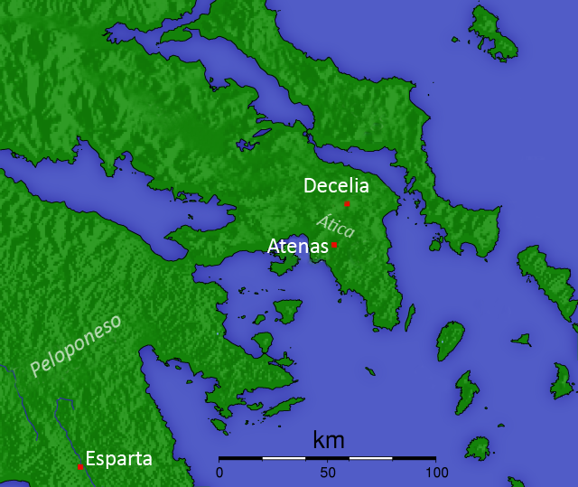
The Occupation of Decelea, 414 BC
A significant turning point in the war as Sparta renewed direct conflict with Athens with a new strategy
Spartans and Peloponnesians permanently occupied Decelea interrupting Athens’ food supplies from Euboea
Thucydides described the impact: Athens had to permanently guard the city and send cavalry out to attack the Spartans; slaves deserted; food had to be sailed round the coast to Piraeus
Thucydides, 7.27-28 (p.16)
Suggests that the Spartan occupation of Decelea was made worse by the Athenian decision to sustain the campaign in Sicily – this suggest poor Athenian leadership
Also explains how Athens became ‘embarrassed financially’ and had to raise taxes on their subjects increasing the risk of revolt even further

Slide 9
The Role of Persia in the Ionian War
Persia had never stopped monitoring the Peloponnesian war. They wanted to intervene at the right moment to support the winning side and rebuild their power around the Aegean – Sparta and Persia had discussed an alliance in 425 and there is also evidence of an alliance between Athens and Persia around 424-23 (Possibly the Peace of Epilycus)
Athens’ defeat in Sicily gave Persia the opportunity to act as “Next winter the whole of Hellas, after the great disaster in Sicily, turned immediately against Athens.” (Thucydides 8.2 p. 18)
Sparta began to cooperate with the local Persian Satrap Tissaphernes in 413 to win over the Athenian subject Chios – there is confusion over the specific terms of the treaty but Persia was allowed to tax the ‘Asiatic’ Greeks and would in return pay for a Peloponnesian fleet – However, Tisssaphernes delayed in sending the funds according to Thucydides because he wanted to keep “the two sides evenly balanced, by not committing himself to either side and so giving it the advantage.” (Thucydides 8.87, p. 24)
In 411/10 Sparta lost patience with Tissaphernes and agreed a treaty instead with another satrap Pharnabazus. In 407 King Darius II formally gave full Persian support to Sparta (Possible a new treaty called the Treaty of Boeotia)
Darius appointed his son Cyrus as Persian commander – he maintained a good relationship with the Spartan commander Lysander but not with his temporary successor Callicratidas.

Slide 10
The Role of Persia in the Ionian War
Persia’s involvement in the Ionian War was hugely significant:
The provided the funds to build a fleet for the Peloponnesians
This had been what Sparta lacked in the Archidamian War
It allowed Sparta to pick off Athens’ allies and cut off their supplies
Athens’ final defeat would be at sea in 405 BC
However
Persia only intervened when the tide had already turned against Athens meaning that the defeat in Sicily or the Spartan occupation of Decelea might have been more important
Thucydides also underplays Persia’s role making it difficult to know for sure how actively involved they had been before 413 BC.

Slide 12
Why did Athens lose the War?
Athens did not keep to Pericles’ strategy in the Archidamian War
Up to 30% of the population was lost during the plague
The defeat in Sicily
Poor Athenian Leadership
Rebellions from within the Athenian empire during the war
The Spartan decision to engage in naval warfare
Dynamic and effective leadership in Sparta
Persian financial support to the Peloponnesians
The Peloponnesian occupation of Decelea
When you are revising go back through your topic 4&5 booklets and find a source which would support each of these reasons

Slide 13
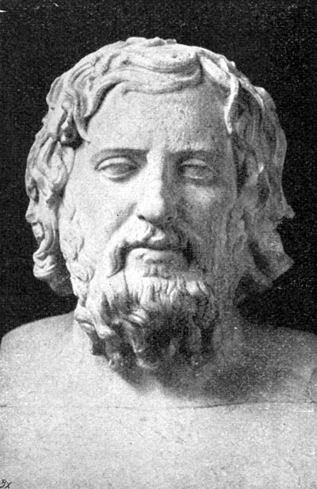
Xenophon – some key sources
Wrote ‘A History of My Times’ (also known as ‘Hellenica’)
Athenian citizen born 430 BC
Picked up the period 411 BC onwards as Thucydides’ account stops
Lacks the same depth as Thucydides
Covers the Spartan –Persian alliance from 411 onwards along with the final battels of the war
Xenophon (2.1. 20-32, p. 32)
“On the fifth day as the Athenians sailed up, Lysander gave special instructions to the ships that they were to follow them.”
Xenophon gives particular praise to Lysander for the Spartan victory at Aegospotami

Slide 14
How significant were the actions of individuals to the outcome of the conflicts between the Greeks and the Persians?

Slide 15
Discuss whether the sources play down the significance of Persian intervention in the Peloponnesian war

Slide 16
Final Points
Some overview questions to test yourself with:
Examine the reasons why the Peace of Nicias was not upheld
Analyse the extent to which naval power was more important than hoplite power in the Peloponnesian War
Assess the impact of Alcibiades upon Athens from 421
Discuss whether the sources play down the significance of Persian intervention in the Peloponnesian war

