Slide 1
The Constitution
Revision
The nature of our constitution
Sovereignty
The reforms

Slide 2
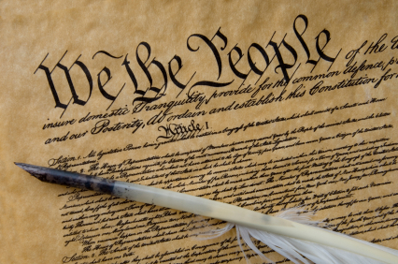
The role of a constitution
They establish the relationships between political institutions and individuals.
They define and establish the limits of government power.
They specify the rights of citizens and how they are protected.
They define who is a citizen
They establish and describe the arrangements for amending the constitution.

Slide 3
FUNCTIONS OF A CONSTITUTION
Constitutions vary greatly from country to country, however, there are several functions that are common to all constitutions:
▪ They provide legitimacy to those in power. It gives a legal status to the actions of government.
▪ They protect freedom. They restrain the behaviour of those in office and they set out the rights and responsibilities of government.
They encourage stability in government. They introduce order and predictability into the way government runs.
▪ They set out the basic goals and values of a state.
▪ They distinguish the spheres of influence of different parts of government. This is particularly the case in a Federal System where there can be multiple Constitutions within a single country.

Slide 4
There are two main types of constitution: Codified and uncodified constitutions
Codified Constitutions have the following features:
It is written on a single document.
Constitutional law is superior to ordinary law (entrenched)
Special arrangements exist to establish new constitutional laws, amend existing ones or repeal unwanted ones.
They normally come into existence after a national upheaval.
Uncodified constitutions have the following features:
It has a number of different sources.
Constitutional law is not superior to other law.
The laws are more flexible than codified constitutions.
The laws are not entrenched.

Slide 5
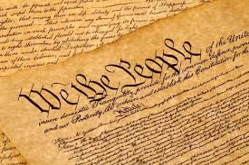
Examples of codified constitutions
United States of America – 1787
Australia – 1900
Germany – 1949
France – 1958
South Sudan – 2011 (The World’s newest independent country)
As of 2018, 158 countries in the world have codified Constitutions.

Slide 6
Examples of uncodified constitutions
Israel
New Zealand
United Kingdom
Saudi Arabia
As of 2018, only four countries in the world have uncodified constitutions.
Be Careful!
Sometimes uncodified constitutions are called unwritten constitutions whilst codified
constitutions are called written constitutions. This can sometimes be confusing because a large
amount of uncodified constitutions are, in fact, written down.

Slide 7
History of our constitution
Magna Carta 1215 | Magna Carta is considered so important is because it established the principle that even the king should respect the rule of law.
Henry VIII breaks with Rome and uses Parliament to do it 1533 | Henry VIII required Parliament to authorize the change to the Church thus enormously enhancing Parliamentary power.
1649 – Parliament wins Civil War and executes King Charles I | Charles tried to rule without Parliament but found that he could not do so when he provoked the Scots and the Irish into rebellion. It was impossible to raise enough money or sufficient troops without the authorisation of Parliament
1689 – Bill of Rights | This bill limited the power of English sovereigns by guaranteeing the king or queen could not: Interfere with the law.Establish a tax by him or herself and without an act of Parliament.
The Act of Settlement 1701 | The Act of Settlement is an Act of the Parliament of England that was passed in 1701 to settle the succession to the English and Irish crowns on Protestants only. The next Protestant in line to the throne was the Electress Sophia of Hanover, a granddaughter of James VI of Scotland and I of England.
The Act of Union 1707 | on May 1st, 1707, after each parliament in turn had passed the Act of Union, the new United Kingdom of Great Britain came into existence.

Slide 8
Later history
1832 – Great Reform Bill | Extended the vote to all males who owned property. The second bill in 1867 extended the vote to working class males.
1911 | House of Lords Act, meaning they could only delay bills not block them.
1919 | Women got the vote
1972 | UK joined the European Market
2016 | UK voted to leave the EU.

Slide 9
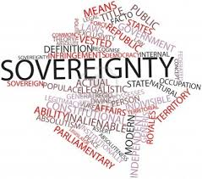
What is sovereignty?
It means ultimate power within a political system.
It can also mean the ultimate source of political power.
Legal sovereignty refers to the power to make laws. It is where power lies theoretically.
Political sovereignty refers to the location of power in general terms. It is where power lies in reality (therefore moves at election time).

Slide 10
Sources of the constitution - scratch
Statutes – Laws passed by the UK Parliament such as the Human Rights Act.
Conventions – Rules that are not legally enforceable but which are considered binding and so are virtually laws such as the Salisbury Convention which is a rule that the House of Lords cannot obstruct a proposal that was contained in the governing party’s last election manifesto.
Royal Prerogative – which are customs that allowed the monarch and now the PM to appoint people, declare war etc.
Authoritative writing- - Writings by constitutional experts which describe constitutional practise. The rule of law described by 19th century expert A V Dicey establishes the principle of equality under the law. Others = Walter Bagehot, Erskine May.
Treaties - transferring some power and sovereignty to the EU in agreements such as The Maastricht Treaty of 1992 and the Lisbon treaty of 2007
Common Law - Similar to conventions these are unwritten laws but unlike conventions they can be enforced by the courts. Public rights of way for instance, are typical rights established through common law.
Historical Precedent - How a rule got established.

Slide 11
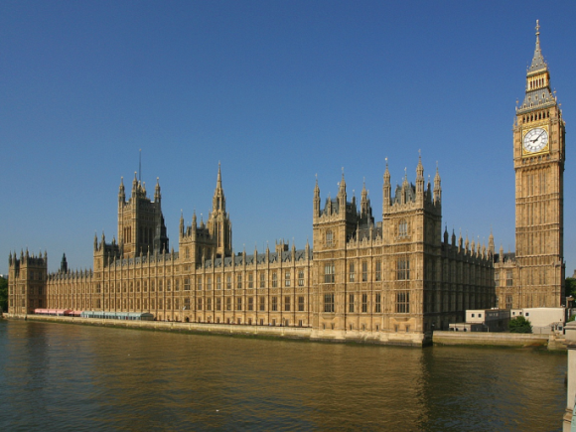
Where does sovereignty lie?
Parliament is legally sovereign: This means it is the ultimate source of law and the ultimate source of all political power.
UK government shares this sovereignty to some extent because it has the people’s mandate to implement its political programme. This means Parliament should not normally defy the will of the government when it is acting within the people’s mandate.
The people are sovereign at elections.
Referenda do NOT grant sovereignty to the people because they are not technically binding on Parliament. However, referendum results are sovereign in practice.
The European Union has legal sovereignty in those areas where it has jurisdiction. However, now that the UK has announced it will be leaving this is obviously coming to an end.
The devolved administrations do not have legal sovereignty, but they have quasi sovereignty. This means that the power granted to them is unlikely to be returned to Westminster.

Slide 12
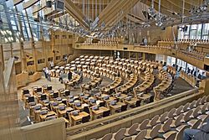
How has sovereignty changed in the uk since 1997?
A great deal of political sovereignty has been transferred to devolved administrations.
There has been an increasing use of referenda to resolve key issues.
Arguably the power of the executive in relation to Parliament has grown, giving it effectively more sovereignty though that might be debateable in the current minority government..
It has been argued that the incorporation of the European Convention on Human Rights into UK law is effectively a transfer of sovereignty over civil liberties.

Slide 13
To what extent is parliamentary sovereignty a myth?
Myth | Reality
The executive might be said to have more power than parliament as it is run by the winning party and usually tells parliament which way they should vote. | However, parliament has the authority to challenge the executive and ultimately to call a vote of no confidence and get rid of the government.
At election time the people are sovereign. | This is only a brief period while parliament waits to regain its sovereignty again.
The European Union has legal sovereignty in areas where it has jurisdiction. | The UK has not given up sovereignty finally to the EU because it can leave and regain all its authority.
The devolved administrations do not have legal sovereignty, but in reality the power granted to them is highly unlikely ever to return to Westminster. | There are still many areas where they are not in ultimate control, hence Scotland’s decision to go for total sovereignty.
Increasing use of referenda hands authority to the people to resolve key issues. | Technically Parliament is not bound by the result of a referendum, but in reality they would be virtually impossible to ignore.

Slide 14
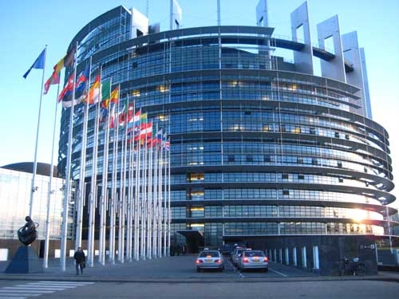
The EU impact on the constitution
EU laws are superior to UK laws.
In any conflict between EU law and UK law, EU law prevails.
UK courts must enforce EU law.
Appeals based on EU law are heard in senior British courts, but final appeals may go the European court of Justice.
Parliament has surrendered sovereignty to the EU in certain policy areas only: trade, consumer law, employment law, agricultural subsidies and fishing.
Now that the UK has chosen to leave they should technically get all these powers back.

Slide 15
Should the UK’s constitution be codified?
In favour | Against
Clarity. Citizens know how power is distributed and what the limits are to the power of political institutions. | Flexibility: An uncodified constitution can be easily changed and so evolve and adapt to changing circumstances.
Limiting Government: A codified constitution is likely to prevent a ‘drift’ of power towards over powerful government. | Strong government: A codified constitution might limit the power of government too much making government ineffective.
Safeguarding the constitution: If codified it would be difficult for a short-term government to amend the constitution for its own narrow benefit. | Accountability: Governments cannot hide behind an uncodified constitution to justify their inactivity, thus making them more accountable.
Rights: A codified constitution would clearly state the rights of citizens and help prevent government from abusing those rights. | Popular control. Though uncodified constitutions seem easy to change, in practice they can only be changed if the people desire change. So the constitution is more under popular control. Also it has stood the test of time.
Strong judicial influence. Such a constitution could be protected by the senior judges. | As it is not codified, such a constitution is less subject to control by unelected, unaccountable judges.

Slide 16
Royal Prerogative – now exercised by the PM
• Appoint and dismissing all government ministers.
• Dissolving parliament and calling general elections.
• Creating peerages.
• Granting honours such as knighthoods.
• Appointing ambassadors
• Final appointment of senior judges and bishops of the Church of England.
• Commanding the armed forces and declaring wars.
• Agreeing foreign treaties.
• Conducting relations with foreign powers.
• Declaring a state of emergency and thus suspending normal government.
• Granting pardons to convicted persons.
Represents a massive amount of power.

Slide 17
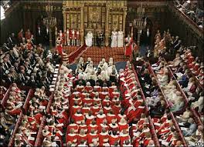
Why did New Labour reform the constitution?
Modernisation: The constitution looked out of date in relation to the rest of Europe.
Democratisation: New Labour was influenced by Liberalism and wished to make the constitution more democratic and liberal in nature.
Decentralisation: to spread power and stop the drift towards excessive executive power that Labour felt had been allowed under the long period of Conservative rule.
To protect civil liberties: It was felt that the uncodified nature of the British constitution left civil liberties open to abuse.
However, it has to be said that the reforms did not emerge with a grand plan or a coherent design but dealing with aspects of the constitution that were regarded as problematic and this has led to criticisms that they were piecemeal, cosmetic and not fully thought through.

Slide 18
The major reforms brought in by labour
House of Lords reform. Almost immediately reduced the number of hereditary peers to 92. Since then however, further House of Lords reform has stalled.
Freedom of Information – Citizens can see information that is held about them by public bodies – this has been relatively uncontroversial, but the right to see the workings of government has been watered down because government can claim it would imperil national security. However, it was FOI that uncovered MP expenses.
London government and local mayors: popular and high profile.
Devolved government - Scottish Parliament, Welsh Assembly and Northern Irish Assembly – now responsible for a lot of their own government. The West Lothian Question showed that people in the devolved areas now had more representation than those in England, and that their MPs could vote on issues that affected the English while those in England could not vote on questions affecting them. EVEL (English votes for English laws) 2015 was brought in and is supposed to have resolved this. Concerns that may encourage a break up of the union.
Human Rights Act – Has turned out to be controversial. Adds rights in British law for citizens to get protection for privacy, family
Constitutional Reform Act - introduced a separate Supreme Court, and a Judicial Appointments Committee to appoint judges, so these two measures have improved separation of powers.

Slide 19
What did the Coalition propose?
Electoral reform to the Westminster elections
Fixed term parliaments
House of Lords either partly or fully elected
A British bill of rights to replace the Human Rights Act
Equal constituency sizes
Recall of MPs
Equal powers to devolved states
Offer of referendum to Scotland to see if they wanted independence

Slide 20
How successful have the changes been?
Coalition reform | Detail
Electoral reform was desired by the Lib Dems who suffer under FPTP | A referendum was held in 2011 that voted no.
Fixed-term parliaments | These were agreed in 2010 to take away the PM’s power to call a date that suited the party in power.
House of Lords reform | No one can agree on exactly what they want.
A British Bill of Rights | Consideration was to be given to replacing the Human Rights Act, but this has not progressed.
Equal constituency sizes | In 2011 legislation began but the Lib Dems rescinded their support when Lords reform fell through
Recall of MPs | Constituents were to have the power to hold a vote on whether to recall MPs who abused their position. This collapsed in February 2014 – both sides blamed each other.
Devolution | Wales was given the chance to increase its powers. Now Scotland has been given a referendum on independence Sept. 2014

Slide 21
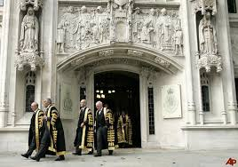
Key Changes - successes
Government has been decentralised through devolution and the introduction of elected mayors.
Rights are better protected through the Human Rights Act and the Freedom of Information Act.
The House of Lords has, arguably, become a more effective check on the power of government.
The electoral systems of Scotland, Wales and Northern Ireland have become more proportional.
The judiciary is more independent, and better able to protect rights and check abuses of governmental power.
The introduction of fixed terms means that governments cannot manipulate election dates for their own advantage.

Slide 22
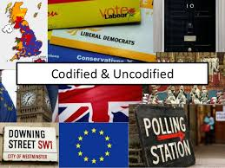
Key changes - criticisms
It can be argued that the UK has been weakened by devolution and the critics who said it might lead to the break up of the union might be proved right in September 2014.
The Human Rights Act and greater judicial independence have created conflict between senior judges and government and there are those who suggest that the HRA is a “criminals’ charter” enabling them to get rights to vote while in prison or avoid deportation.
Parliamentary sovereignty means that rights cannot properly be protected.
Electoral reform has failed.
The future of House of Lords reform is uncertain and the Lords remain undemocratic.
Many still argue that the UK needs a codified constitution to protect and clarify civil rights.
It is argued that the executive remains too strong and Parliament too weak.

Slide 23
To what extent is the UK constitution outdated
Aspects of the UK constitution that seem outdated | Assessment as to how far this is outdated
Uncodified | Important aspects are codified e.g. HRA
FPTP for general election | An opportunity was offered to amend this and it was rejected
London centred government | This has been much changed since devolution – possible endangering union
An unelected head of state and second house | The monarchy is constrained by the constitution. The House of Lords is proving difficult to reform. Some say it is doing a good job as it is.
Prime Minister has royal prerogative which gives him or her substantial powers of patronage | This has been somewhat reduced now the head of select committees are elected by MPs. The PM also no longer sets the date of elections with fixed term elections. However, there are still some significant areas where the PM retains substantial power.

Slide 24
How effective has constitutional reform been?
Effective at achieving aims | Not effective
Modernisation Creation of Supreme Court E petitions Better working hours in the Commons | House of commons still like an antiquated gentlemen’s club.
Democratisation The number of hereditary peers was reduced to 92. | House of Lords is still unelected. The voting system still favours two parties.
Decentralisation Devolution has made power less London based and increased control over local affairs | Though this could be said to have been unfair on the English and potentially lead to the break up of the union.
Improved human rights The Human Rights Act Freedom of Information | The HRA has been controversial with people saying it is a ‘charter for criminals’. FOI blamed for ‘lacking teeth’

